Slide 1
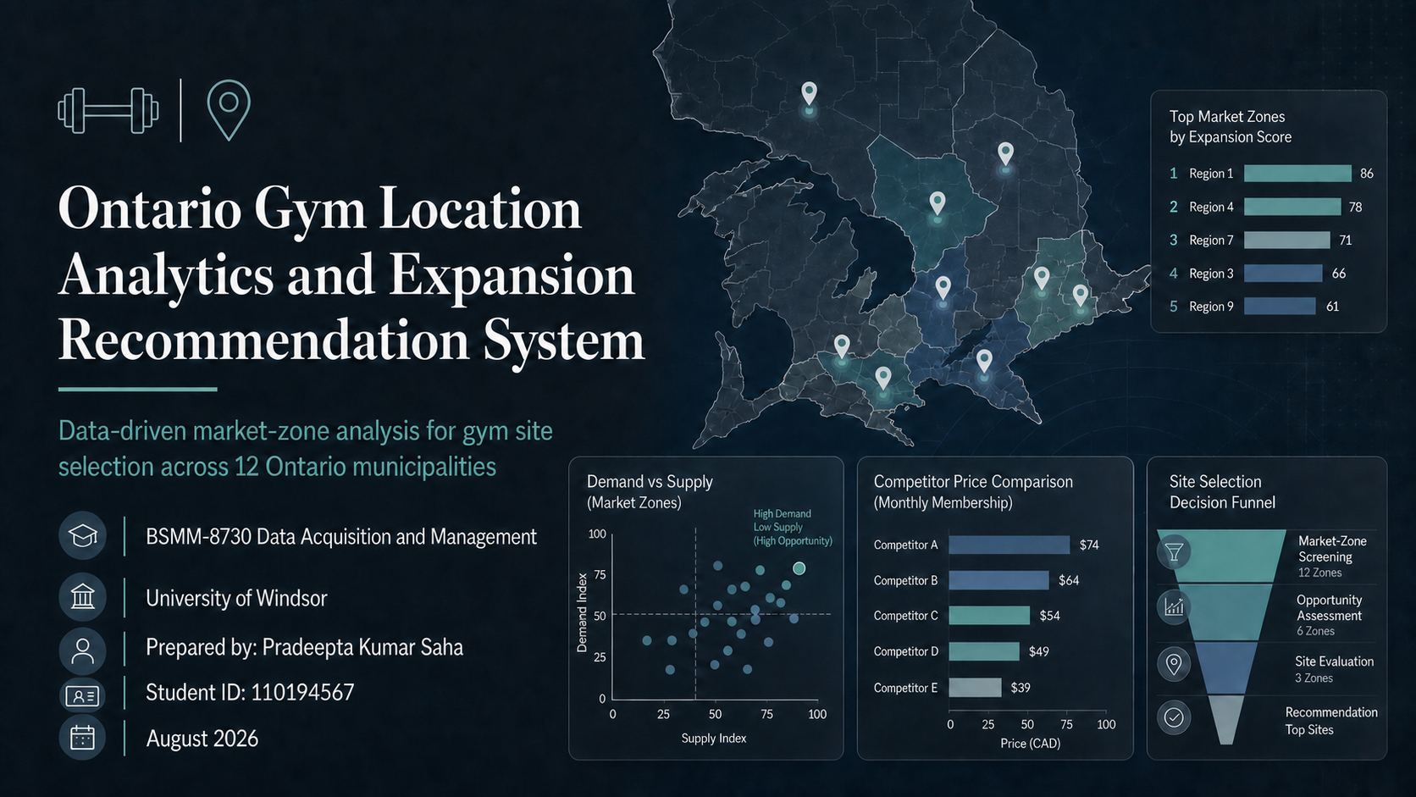

Slide 2
Why this research matters
A gym expansion decision should not rely only on intuition or city-level averages. The tool converts demographic, competition, review, pricing, and amenity data into a market-zone screening system.
City-level data is too broad
A manager needs area-level insight because a new club serves one trade area, not an entire municipality.
Competitors are unevenly distributed
A zone can have strong demand but limited budget/value gym coverage.
The tool makes comparison repeatable
Each area is judged using the same variables, making the recommendation easier to defend.
Gym Location Analytics and Expansion Recommendation System
01
Notes:
[Sources]
Dataset B: market-zone demographics derived from project census/DA variables.
Dataset C: competitor gym location records with ratings/reviews where populated.
Dataset D: market-zone competition and opportunity summary.
Manual workbook: top-10-gym-amenities-fees-manual-entry-template.xlsx.
Dashboard tool: https://ontario-gym-opportunity-dashboard.pradeepta07.chatgpt.site
Purpose slide: explains why the dashboard/tool was created before presenting analysis.

Slide 3
Project thesis: use 12 municipalities to find the best setup area
The project screens Ontario market zones to identify where a new gym has the strongest demand-and-gap signal.
Thesis
Input
Market-zone demographics + gym competitor data
By comparing demographic demand, local competition, budget-gym gaps, review evidence, and brand pricing/amenities across 12 municipalities, the tool can shortlist the most attractive market zones for the next gym location.
Method
Score demand, supply, competition, and positioning
Output
Top candidate zones for property-level site search
Gym Location Analytics and Expansion Recommendation System
02
Notes:
[Sources]
Dataset B: market-zone demographics derived from project census/DA variables.
Dataset C: competitor gym location records with ratings/reviews where populated.
Dataset D: market-zone competition and opportunity summary.
Manual workbook: top-10-gym-amenities-fees-manual-entry-template.xlsx.
Dashboard tool: https://ontario-gym-opportunity-dashboard.pradeepta07.chatgpt.site
Thesis states the scope: 12 Ontario municipalities and market-zone-level decision support.

Slide 4
The full dataset gives a wide but actionable screening base
The dataset is large enough for comparison, but still narrow enough to support area-level interpretation.
Municipalities
Market zones
Gym records
Population covered
12
58
190
2.6M
Potential gap zones
Rated gyms
Avg demand score
Avg opportunity
6
158
51.4
39.5
Highest preliminary opportunity signal: Central London, London (74.7).
Interpretation: the tool is designed for screening. Final decisions still require property-level verification of rent, traffic, visibility, parking, and exact trade area.
Gym Location Analytics and Expansion Recommendation System
03
Notes:
[Sources]
Dataset B: market-zone demographics derived from project census/DA variables.
Dataset C: competitor gym location records with ratings/reviews where populated.
Dataset D: market-zone competition and opportunity summary.
Manual workbook: top-10-gym-amenities-fees-manual-entry-template.xlsx.
Dashboard tool: https://ontario-gym-opportunity-dashboard.pradeepta07.chatgpt.site
Overall dataset insight uses Dataset B, C, and D summary fields.

Slide 5
DEMAND SCORE CALCULATION
Central London demand score calculation: 80.5
Raw values are converted into comparable 0-100 points, then multiplied by demand weights.
Percentile formula
Percentile score = zone rank / 58 market zones x 100
Example: Age 18-34 rank = 57 of 58, so 57 / 58 x 100 = 98.3
Step 1: raw values to points
Step 2: apply demand weights
Point contribution
Variable
Raw
Rank
Score
Category
Wt.
Score
Pts.
Young/student
28.2
Age 18-34
32.4%
57/58
98.3
Young/student
30%
94.0
28.2
Rental/apartment
19.1
Student proxy
8.8%
52/58
89.7
Rental/apartment
20%
95.7
19.1
Density
15.4
Density
20%
77.1
15.4
Population/growth
12.3
Renter share
60.0%
55/58
94.8
Population/growth
15%
81.9
12.3
Income/employment
5.5
Apartment share
59.7%
56/58
96.6
Income/employment
15%
36.4
5.5
Step 3: add weighted points
28.2 + 19.1 + 15.4 + 12.3 + 5.5 = 80.5
Meaning: strong young-adult, renter, apartment, density, and population signals offset a lower economic-context score.
Note: component scores are normalized/ranked against the 58 market zones and rounded for presentation.
Gym Location Analytics and Expansion Recommendation System

Slide 6
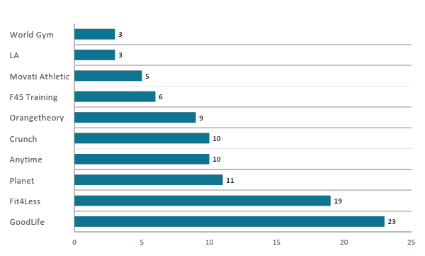
Top 10 gym brands define the competitive landscape
The major chains differ by footprint, price tier, and service model, so the tool compares both presence and positioning.
Largest footprint
GoodLife has the strongest location presence in the project dataset, followed by Fit4Less and Planet Fitness.
Budget-price benchmark
Fit4Less ($15.98) and Planet Fitness ($15.00) define the low-price comparison. If these are absent in a zone, a value-gym gap may exist.
Service model differences
Premium/boutique brands compete on training, classes, and amenities. Blank fee fields should be treated as manual follow-up, not as missing competition.
Insight: top-10 brand analysis explains whether a gap is about price, amenities, service model, or simply low competitor coverage.
Gym Location Analytics and Expansion Recommendation System
04
Notes:
[Sources]
Dataset B: market-zone demographics derived from project census/DA variables.
Dataset C: competitor gym location records with ratings/reviews where populated.
Dataset D: market-zone competition and opportunity summary.
Manual workbook: top-10-gym-amenities-fees-manual-entry-template.xlsx.
Dashboard tool: https://ontario-gym-opportunity-dashboard.pradeepta07.chatgpt.site
Top-10 gym analysis uses Dataset C brand counts plus the manual fee/amenity workbook for monthly price, training, and 24/7 fields.

Slide 7
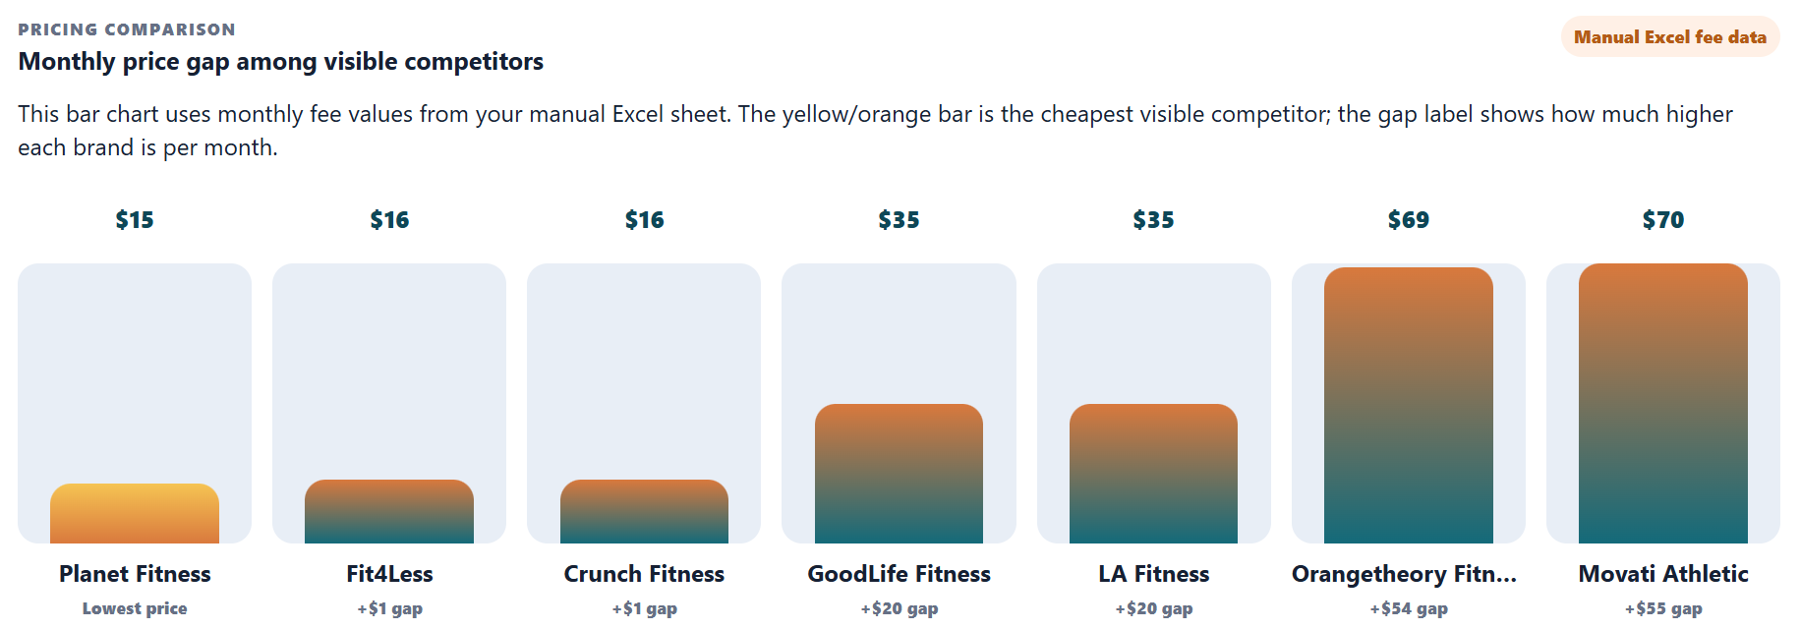

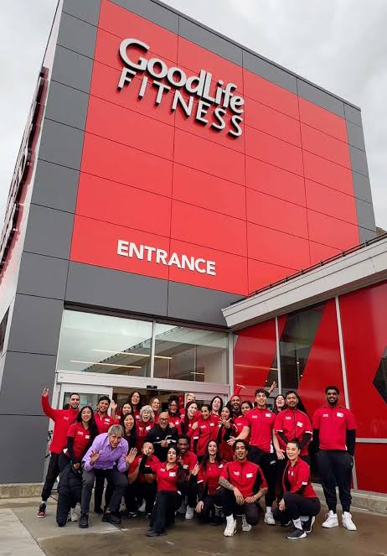

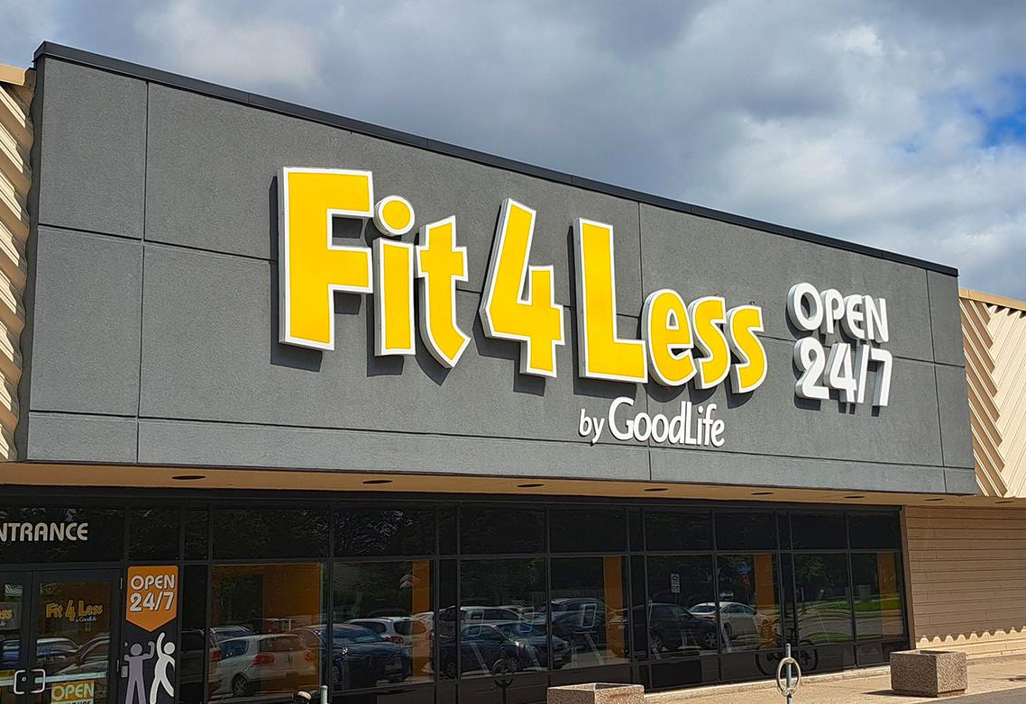



Top 10 gym brands define the competitive landscape
Budget gym
Premium
Super premium
Insight: top-10 brand analysis explains whether a gap is about price, amenities, service model, or simply low competitor coverage.
Gym Location Analytics and Expansion Recommendation System
04
Notes:
[Sources]
Dataset B: market-zone demographics derived from project census/DA variables.
Dataset C: competitor gym location records with ratings/reviews where populated.
Dataset D: market-zone competition and opportunity summary.
Manual workbook: top-10-gym-amenities-fees-manual-entry-template.xlsx.
Dashboard tool: https://ontario-gym-opportunity-dashboard.pradeepta07.chatgpt.site
Top-10 gym analysis uses Dataset C brand counts plus the manual fee/amenity workbook for monthly price, training, and 24/7 fields.

Slide 8
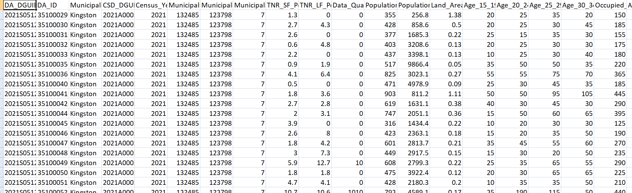
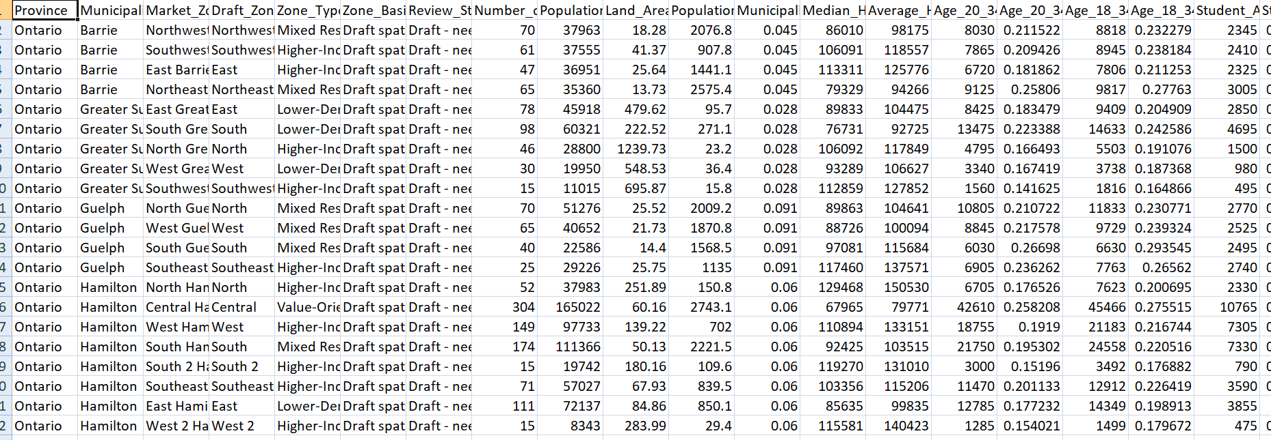
The full dataset gives a wide but actionable screening base
Scraped data by pincode
Scraped data as per Zone
Gym Location Analytics and Expansion Recommendation System
03
Notes:
[Sources]
Dataset B: market-zone demographics derived from project census/DA variables.
Dataset C: competitor gym location records with ratings/reviews where populated.
Dataset D: market-zone competition and opportunity summary.
Manual workbook: top-10-gym-amenities-fees-manual-entry-template.xlsx.
Dashboard tool: https://ontario-gym-opportunity-dashboard.pradeepta07.chatgpt.site
Overall dataset insight uses Dataset B, C, and D summary fields.

Slide 9
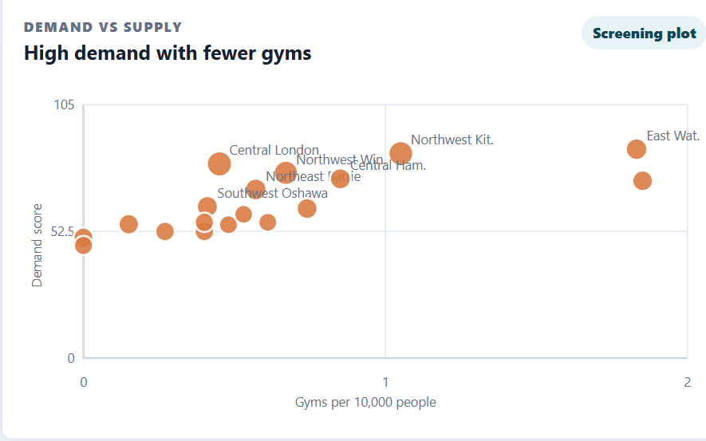

High demand becomes attractive only when supply is not already saturated
The best expansion candidate combines high demand with low gyms per 10,000 people and few direct budget competitors.
Preferred quadrant
High demand + low supply density. Central London and Northwest Windsor are strongest on this logic.
Waterloo and Kingston still matter, but they require sharper site selection because current gym density is higher.
Gym Location Analytics and Expansion Recommendation System
07
Notes:
[Sources]
Dataset B: market-zone demographics derived from project census/DA variables.
Dataset C: final fresh-crossmatched gym location records with ratings/reviews where populated.
Dataset D: final fresh-crossmatched market-zone summary.
Manual workbook: top-10-gym-amenities-fees-manual-entry-template.xlsx.
Dashboard tool: https://ontario-gym-opportunity-dashboard.pradeepta07.chatgpt.site
Scatter plot compares Dataset D Demand_Fit_Score_Preliminary to Gyms_per_10000_People.

Slide 10
Demand score turns raw census variables into one screening index
The demand score is a 0–100 preliminary fit score. It tells us where a gym concept should be investigated first.
30%
Young adult / student-age market
Age 18?34 share and student-age proxy signal fitness demand.
Formula
20%
Rental / apartment market
Renters and apartments indicate flexible local service demand.
Normalize each variable to 0–100, multiply by its weight, then sum the weighted values.
20%
Density and catchment intensity
Dense zones create easier access and stronger local catchments.
The result is used for screening only; it is not a final lease decision.
15%
Population scale and growth context
Larger/growing areas support more potential members.
15%
Income and employment context
Affordability and economic stability affect conversion potential.
Gym Location Analytics and Expansion Recommendation System
05
Notes:
[Sources]
Dataset B: market-zone demographics derived from project census/DA variables.
Dataset C: final fresh-crossmatched gym location records with ratings/reviews where populated.
Dataset D: final fresh-crossmatched market-zone summary.
Manual workbook: top-10-gym-amenities-fees-manual-entry-template.xlsx.
Dashboard tool: https://ontario-gym-opportunity-dashboard.pradeepta07.chatgpt.site
Demand score formula used in presentation: 30% young adult/student-age market, 20% rental/apartment market, 20% density/catchment intensity, 15% population scale/growth context, 15% income/employment context.

Slide 11
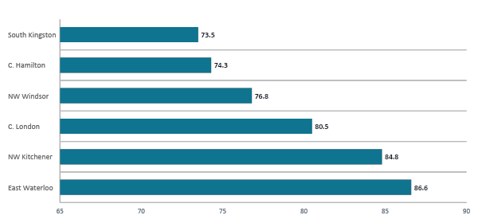
Six zones show the strongest demand signal across the dataset
This is the demand-first shortlist before checking whether the area is already crowded with competitors.
Key point
East Waterloo has the highest demand score, but demand is only the first filter. The next slides test competition pressure and budget-gym gaps.
Gym Location Analytics and Expansion Recommendation System
06
Notes:
[Sources]
Dataset B: market-zone demographics derived from project census/DA variables.
Dataset C: final fresh-crossmatched gym location records with ratings/reviews where populated.
Dataset D: final fresh-crossmatched market-zone summary.
Manual workbook: top-10-gym-amenities-fees-manual-entry-template.xlsx.
Dashboard tool: https://ontario-gym-opportunity-dashboard.pradeepta07.chatgpt.site
Top six are selected by Demand_Fit_Score_Preliminary from Dataset D.

Slide 12
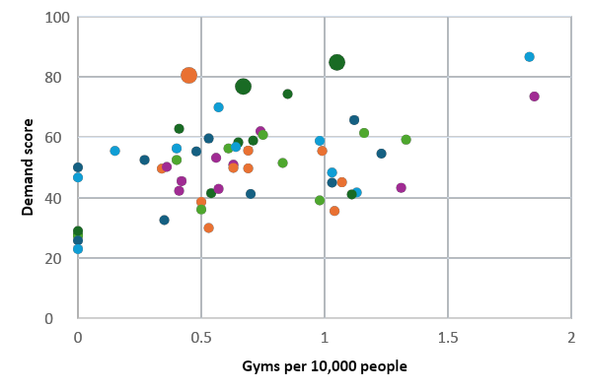
DASHBOARD INTERPRETATION
Dataset D
The analysis now narrows from all to top three setup zones
The next section uses the dashboard’s opportunity ranking and selected-zone views as the evidence base.
Central London
74.7
Northwest Kit.
73.1
Northwest Win.
70.2
Northeast Barrie
58.4
East Wat.
58.1
Southwest Oshawa
56
Central Ham.
55.5
West Guelph
54.7
Top 3 from the dashboard
Central London, Northwest Kitchener, and Northwest Windsor rank highest by opportunity score and move into detailed zone/competitor analysis.
Dashboard evidence deck | Ontario gym expansion recommendation
10
Notes:
[Sources]
Opening slides retained from the supplied deck: 1. gym-expansion-expanded-analysis-with-competitor-fees.pptx.
Dashboard outputs and underlying data: Dataset B market-zone demographics, Dataset C final fresh-crossmatched gym locations, and Dataset D market-zone summary.
Manual workbook: top-10-gym-amenities-fees-manual-entry-template.xlsx for monthly price and amenity/service fields.
Dashboard tool: https://ontario-gym-opportunity-dashboard.pradeepta07.chatgpt.site
Limitations: market zones are analytical approximations; competitor/fee data are screening-grade and require final verification before business use.
This slide intentionally mirrors the dashboard opportunity ranking and demand-vs-supply screening view.

Slide 13
DEMAND SCORE CALCULATION
Central London demand score calculation: 80.5
Raw values are converted into comparable 0-100 points, then multiplied by demand weights.
Percentile formula
Percentile score = zone rank / 58 market zones x 100
Example: Age 18-34 rank = 57 of 58, so 57 / 58 x 100 = 98.3
Step 1: raw values to points
Step 2: apply demand weights
Point contribution
Variable
Raw
Rank
Score
Category
Wt.
Score
Pts.
Young/student
28.2
Age 18-34
32.4%
57/58
98.3
Young/student
30%
94.0
28.2
Rental/apartment
19.1
Student proxy
8.8%
52/58
89.7
Rental/apartment
20%
95.7
19.1
Density
15.4
Density
20%
77.1
15.4
Population/growth
12.3
Renter share
60.0%
55/58
94.8
Population/growth
15%
81.9
12.3
Income/employment
5.5
Apartment share
59.7%
56/58
96.6
Income/employment
15%
36.4
5.5
Step 3: add weighted points
28.2 + 19.1 + 15.4 + 12.3 + 5.5 = 80.5
Meaning: strong young-adult, renter, apartment, density, and population signals offset a lower economic-context score.
Note: component scores are normalized/ranked against the 58 market zones and rounded for presentation.
Gym Location Analytics and Expansion Recommendation System

Slide 14
TOP 3 SELECTED ZONES
These are the three areas that deserve detailed site review
Each area has strong opportunity, zero direct budget competitors in the zone, and a clear reason to investigate property options.
#1
#2
#3
Central London
Northwest Kitchener
Northwest Windsor
London
Kitchener
Windsor
Opportunity score: 74.7
Demand score: 80.5
Population: 66,084
Gyms / budget: 3 / 0
Age 18–34: 0.3% | Renters: 1%
Opportunity score: 73.1
Demand score: 84.8
Population: 57,032
Gyms / budget: 6 / 0
Age 18–34: 0.3% | Renters: 1%
Opportunity score: 70.2
Demand score: 76.8
Population: 59,563
Gyms / budget: 4 / 0
Age 18–34: 0.3% | Renters: 1%
Best first search area
Very strong demand, needs site precision
Strong value gap, verify west-side trade nodes
Dashboard evidence deck | Ontario gym expansion recommendation
11
Notes:
[Sources]
Opening slides retained from the supplied deck: 1. gym-expansion-expanded-analysis-with-competitor-fees.pptx.
Dashboard outputs and underlying data: Dataset B market-zone demographics, Dataset C final fresh-crossmatched gym locations, and Dataset D market-zone summary.
Manual workbook: top-10-gym-amenities-fees-manual-entry-template.xlsx for monthly price and amenity/service fields.
Dashboard tool: https://ontario-gym-opportunity-dashboard.pradeepta07.chatgpt.site
Limitations: market zones are analytical approximations; competitor/fee data are screening-grade and require final verification before business use.
Selected-zone cards use the same variables shown in the dashboard selected-zone panel.

Slide 15
TOP 3 COMPETITIVE ANALYSIS
#1 Central London: priced chain leaves room below $35
London
Dashboard evidence: demand, supply, price position, and competitor type
Opportunity
Demand
Gyms / 10k
Budget gyms
Age 18-34
Renters
74.7
80.5
0.45
0
32.4%
60.0%
low supply
direct
Competitor mix
Price / value gap
Competitor evidence
Budget
$15
Competitor
Type
Rate
Reviews
Fit4Less
$16
GoodLife Fitness
Mid/Premium
4.1
493
3
2
Crunch
$16
Elite Personal Fit...
Unknown
5.0
5
1
Yoga Shack
Premium/Spec...
N/A
0
0
GoodLife
$35
Budget = gap signal
Visible priced competitor is about $19-$20 above budget-chain benchmarks.
All
Budget
Major
Local
Manager read
Best first review: high demand, low gym density, and no direct budget competitor. Test a value gym near student/downtown access nodes.
Gym Location Analytics and Expansion Recommendation System
14
15
Notes:
[Sources]
Opening slides retained from the supplied deck: 1. gym-expansion-expanded-analysis-with-competitor-fees.pptx.
Dashboard outputs and underlying data: Dataset B market-zone demographics, Dataset C final fresh-crossmatched gym locations, and Dataset D market-zone summary.
Manual workbook: top-10-gym-amenities-fees-manual-entry-template.xlsx for monthly price and amenity/service fields.
Dashboard tool: https://ontario-gym-opportunity-dashboard.pradeepta07.chatgpt.site
Limitations: market zones are analytical approximations; competitor/fee data are screening-grade and require final verification before business use.
Dashboard-style selected-zone and competitor analysis for Central London.

Slide 16
TOP 3 COMPETITIVE ANALYSIS
#2 Northwest Kitchener: boutique-heavy supply
Kitchener
Dashboard evidence: demand, supply, price position, and competitor type
Opportunity
Demand
Gyms / 10k
Budget gyms
Age 18-34
Renters
73.1
84.8
1.05
0
30.2%
61.8%
low supply
direct
Competitor mix
Price / value gap
Competitor evidence
6
Competitor
Type
Rate
Reviews
5
Budget
$15
Midtown Yoga KW
Premium/Spec...
4.9
289
Value
$20
F45 Training
Premium
4.8
97
1
ZM Cycle and Fitness
Unknown
4.2
90
0
Known fees
N/A
Budget = gap signal
Fee gap needs manual verification; category gap is still visible.
Volpe Martial Arts
Premium/Spec...
5.0
53
All
Budget
Major
Local
Manager read
Strong second review: demand is highest among the top three, but existing supply is mainly local/specialty. Budget positioning can still differentiate.
Gym Location Analytics and Expansion Recommendation System
15
16
Notes:
[Sources]
Opening slides retained from the supplied deck: 1. gym-expansion-expanded-analysis-with-competitor-fees.pptx.
Dashboard outputs and underlying data: Dataset B market-zone demographics, Dataset C final fresh-crossmatched gym locations, and Dataset D market-zone summary.
Manual workbook: top-10-gym-amenities-fees-manual-entry-template.xlsx for monthly price and amenity/service fields.
Dashboard tool: https://ontario-gym-opportunity-dashboard.pradeepta07.chatgpt.site
Limitations: market zones are analytical approximations; competitor/fee data are screening-grade and require final verification before business use.
Dashboard-style selected-zone and competitor analysis for Northwest Kitchener.

Slide 17
TOP 3 COMPETITIVE ANALYSIS
#3 Northwest Windsor: no budget chain in value market
Windsor
Dashboard evidence: demand, supply, price position, and competitor type
Opportunity
Demand
Gyms / 10k
Budget gyms
Age 18-34
Renters
70.2
76.8
0.67
0
29.0%
58.1%
low supply
direct
Competitor mix
Price / value gap
Competitor evidence
Competitor
Type
Rate
Reviews
4
4
Budget
$15
Windsor Rock Gym
Unknown
4.8
257
Value
$20
True Fitness Windsor
Unknown
4.6
221
0
0
Known fees
N/A
Refine Fitness Stu...
Unknown
4.8
88
Budget = gap signal
Fee gap needs manual verification; category gap is still visible.
Jackson Park Medic...
Unknown
4.5
88
All
Budget
Major
Local
Manager read
Third priority: renter/value profile is strong and competitors are local. Validate exact west-side trade nodes, parking, visibility, and lease options.
Gym Location Analytics and Expansion Recommendation System
16
17
Notes:
[Sources]
Opening slides retained from the supplied deck: 1. gym-expansion-expanded-analysis-with-competitor-fees.pptx.
Dashboard outputs and underlying data: Dataset B market-zone demographics, Dataset C final fresh-crossmatched gym locations, and Dataset D market-zone summary.
Manual workbook: top-10-gym-amenities-fees-manual-entry-template.xlsx for monthly price and amenity/service fields.
Dashboard tool: https://ontario-gym-opportunity-dashboard.pradeepta07.chatgpt.site
Limitations: market zones are analytical approximations; competitor/fee data are screening-grade and require final verification before business use.
Dashboard-style selected-zone and competitor analysis for Northwest Windsor.

Slide 18
SHORTLIST COMPARISON
The top 3 zones win for different reasons
Use this slide to explain how the dashboard moved from ranking to business interpretation.
1
Central London
2
Northwest Kitchener
3
Northwest Windsor
London
Kitchener
Windsor
Opp.
Demand
Gyms/10k
Opp.
Demand
Gyms/10k
Opp.
Demand
Gyms/10k
74.7
80.5
0.45
73.1
84.8
1.05
70.2
76.8
0.67
Best first search area
Highest demand, careful site precision
Value-market gap to verify
Opportunity and demand score
Supply pressure
Final read
Central London
74.7
Central London
3 gyms
0.45/10k
Central London is the cleanest first pick. Northwest Kitchener has the strongest demand, but needs precise site selection. Northwest Windsor is the value-market bet with local competitors and no direct budget chain.
NW Kitchener
73.1
NW Kitchener
6 gyms
1.05/10k
NW Windsor
70.2
NW Windsor
4 gyms
0.67/10k
Opportunity score combines demand and supply gap.
Lower gyms/10k makes the gap easier to defend.
Recommendation: take all three to property-level validation.
Gym Location Analytics and Expansion Recommendation System
14

Slide 19
LIMITATIONS AND FUTURE WORK
The tool screens zones; field validation makes the final decision
These limitations make the recommendation more defensible and show where the next version should improve.
Geographic limitations
Competitor data limitations
Business decision limitations
Market zones are analytical, not official boundaries.
Some local gym records are open-source screening records.
Model does not include lease costs, traffic counts, or parking.
Final trade areas should use drive-time or walk-time catchments.
Monthly fees and amenities need official/manual verification.
Visibility, zoning, and site condition must be checked.
Local roads, transit, and anchors need field review.
Ratings and reviews are point-in-time Google/SerpApi checks.
The output is a shortlist, not a final lease decision.
Future work
Add commercial real-estate data, drive-time catchments, traffic counts, parking availability, and a sensitivity test for demand/opportunity score weights.
Gym Location Analytics and Expansion Recommendation System
19

Slide 20
REFERENCES AND AI USE
Sources used to build and validate the project
AI was used as a support tool, not as a factual source.
References
AI-use acknowledgement
Statistics Canada. 2021 Census Profile and boundary files. SerpApi. Google Maps API documentation/results used for location, ratings, and review-count checks. OpenStreetMap/Nominatim. Geocoding and place-search records. Official gym websites/location pages for major-chain location, fee, and amenity checks. Project datasets B, C, D, and manual fee/amenity workbook.
Generative AI assisted with project planning, dataset structure, dashboard/report wording, slide design, and presentation refinement. AI was not treated as an authoritative factual source. Dataset values and factual claims should be verified through the cited datasets and official/source records.
Submission note
If asked during Q&A, explain that demand and opportunity scores are preliminary screening indices designed to rank zones for deeper site validation.
Gym Location Analytics and Expansion Recommendation System
20

Slide 21
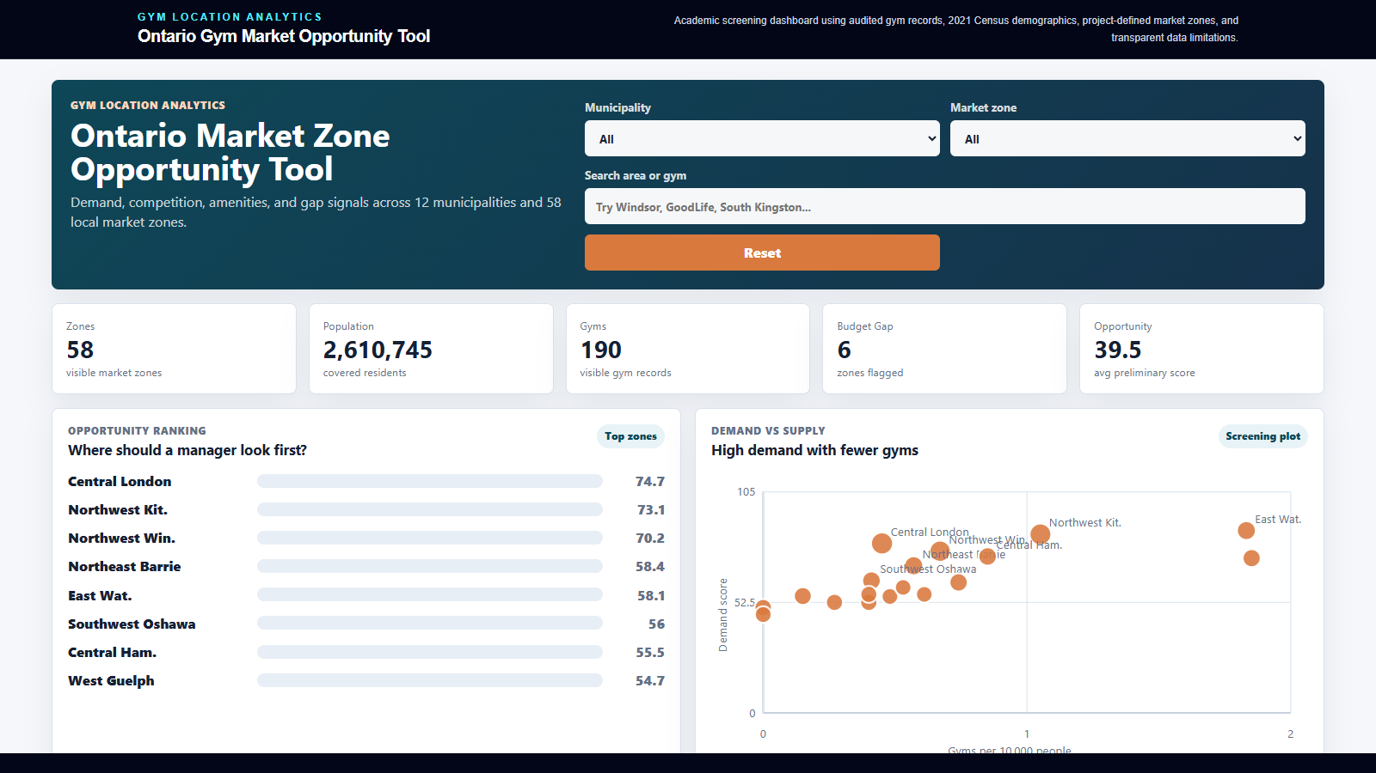
LIVE DASHBOARD ACCESS
Hosted dashboard for exploring Ontario gym market opportunities
Filter by municipality or zone, compare demand vs. supply, review competitors, and support the final short-list decision.
https://ontario-gym-opportunity-dashboard.pradeepta07.chatgpt.site/
Link:
Academic screening dashboard | verify final real-estate and operating assumptions before business action

Slide 22
APPENDIX
Data dictionary: what each dataset contributes
The dashboard joins demographic demand signals with competitor supply, service mix, pricing, and verification fields.
Dataset | Row level | Key variables | Purpose
A: Market zones | One project-defined zone | Municipality, market zone, zone type, approximate coverage | Makes large municipalities actionable
B: Demographics | One zone | Population, density, income, age 18?34, renter share, student proxy, employment | Estimates local demand
C/D: Competitors | One gym location / zone summary | Brand, address, gym type, budget/premium/boutique, rating/reviews, verification | Measures supply and competition
E: Amenities & fees | One gym brand | Monthly fee, personal training, classes, 24/7, tanning, hydro massage, sauna/steam | Identifies price and service gaps
Note: Market zones are analytical groupings, not official municipal boundaries; competitor and fee fields should be re-verified before real investment decisions.

