Slide 1

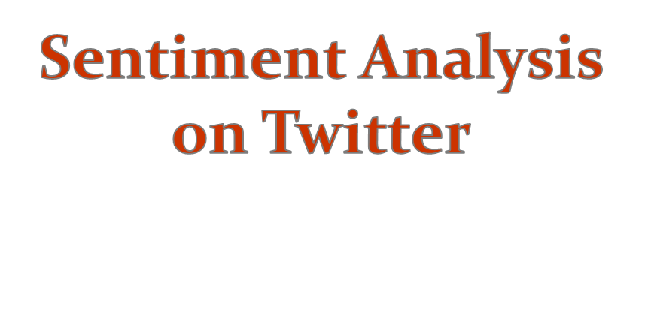
Under the guidance of
Prof. Vasudeva Varma
Submitted by:
Abhishek Jain(201201137)
Pradeep Anumala(201350843)
Pragya Musal(201405545)
Shashank S(201405599)

Slide 2

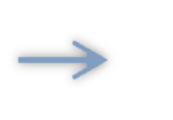
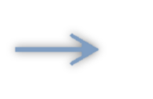



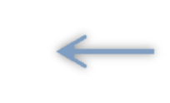
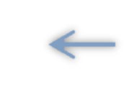

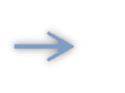

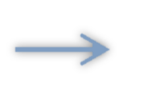
download
Parser
Tokenizer
Add Additional Features
Feature Vector Builder
PreProcessor
Construct feed File
SVM Classifier
Training.model
Test data
SVM Classifier
Polarity of tweet
(positive/negative/neutral)
Notes:
The above diagram depicts the high level design of the model.

Slide 3

A total of 9684 train tweets and 8987 test tweets are downloaded from twitter and are fed to Parser.
The parser
Removes the unavailable tweets
Segregates the tweet and polarity
The total no. of train tweets were 7875 and test tweets were 8011 after removing the unavailable tweets
Notes:
For each input file, the Parser creates two output files. One file contains the polarity and the other file contains the tweet text

Slide 4

We used the ‘ARK tokenizer’ to tokenize the tweets
The tokenizer divides each tweets into a sequence of space separated tokens and puts them into a file, which is used at a later stage for processing.

Slide 5

The tokenized tweets are fed to the pre processor which :
Replaces the urls with | | U | |
Replaces @references with | | T | |
Replaces +ve emoticons with the word ‘epositive’ and –ve emoticons with the word ‘enegative’
Replaces the words that signify negative context with the word “not”

Slide 6

The preprocessed file is fed to the feature vector builder which creates the list of sorted unique words.
The basic(baseline) feature that was considered was of unigrams.
A list of all unique unigrams across the training set was constructed and it formed the basic vector for each tweet.

Slide 7

The Feature Vector was enhanced by introducing more features like:
POS-Tagging
Count of emoticons, hashtags and exclamations.
Scores from standard Lexicons
Negated contexts

Slide 8

The formed feature vector was written into a file in a format expected by the libsvm classifier.
A linear SVM Classifier was used and trained with the training file as an input and creates training.model file
This model file was used on the testing file to predict the results.

Slide 9

The model is tested on the set of 8011 test tweets.
The following results were obtained:
Accuracy : 64%
F-measure : 0.6163

Slide 10
Thank You

