Slide 1
Entity-Relationship Modeling for a University Database
DATABASE MANAGEMENT SYSTEMS
Pradeep AV · Reg. No. 1921260084
SIMATS Engineering · Computer Science and Engineering
Notes:
Introduce yourself and the topic. Say that ER modeling is how we plan a database on paper before creating any tables, and that you will use a university as the running example.

Slide 2
What is ER modeling?
A conceptual way to describe the data of an organization as things, facts about those things, and the links between them, before choosing any database software.
Entity
Attribute
Relationship
A real-world thing we store data about, such as a Student or a Course.
A fact about an entity, such as a name, a registration number or credits.
A link between entities, such as a Student enrolls in a Course.
ER Modeling · University Database · 2
Notes:
Define ER modeling in your own words. Then explain the three core ideas using the university example. Mention that the ER diagram is understood by both designers and non-technical users.

Slide 3
Building blocks of an ER diagram
Element | Drawn as | University example
Entity | Rectangle | Student, Course
Weak entity | Double rectangle | Dependent of an Instructor
Attribute | Oval | Name, Email
Key attribute | Underlined oval | RegNo, CourseID
Multivalued attribute | Double oval | Phone numbers
Relationship | Diamond | Enrolls, Teaches
ER Modeling · University Database · 3
Notes:
Walk through the table row by row. Stress the key attribute because it uniquely identifies each entity and later becomes the primary key.

Slide 4
Entities in our university database
Student
Course
Instructor
Department
RegNo (key), Name, DOB, Email
CourseID (key), Title, Credits
EmpID (key), Name, Phone
DeptID (key), DeptName, Office
Four entities are enough to show every major kind of relationship.
ER Modeling · University Database · 4
Notes:
Introduce the four entities and their key attributes. Explain why these were chosen: a university needs students who take courses, taught by instructors who belong to departments.

Slide 5
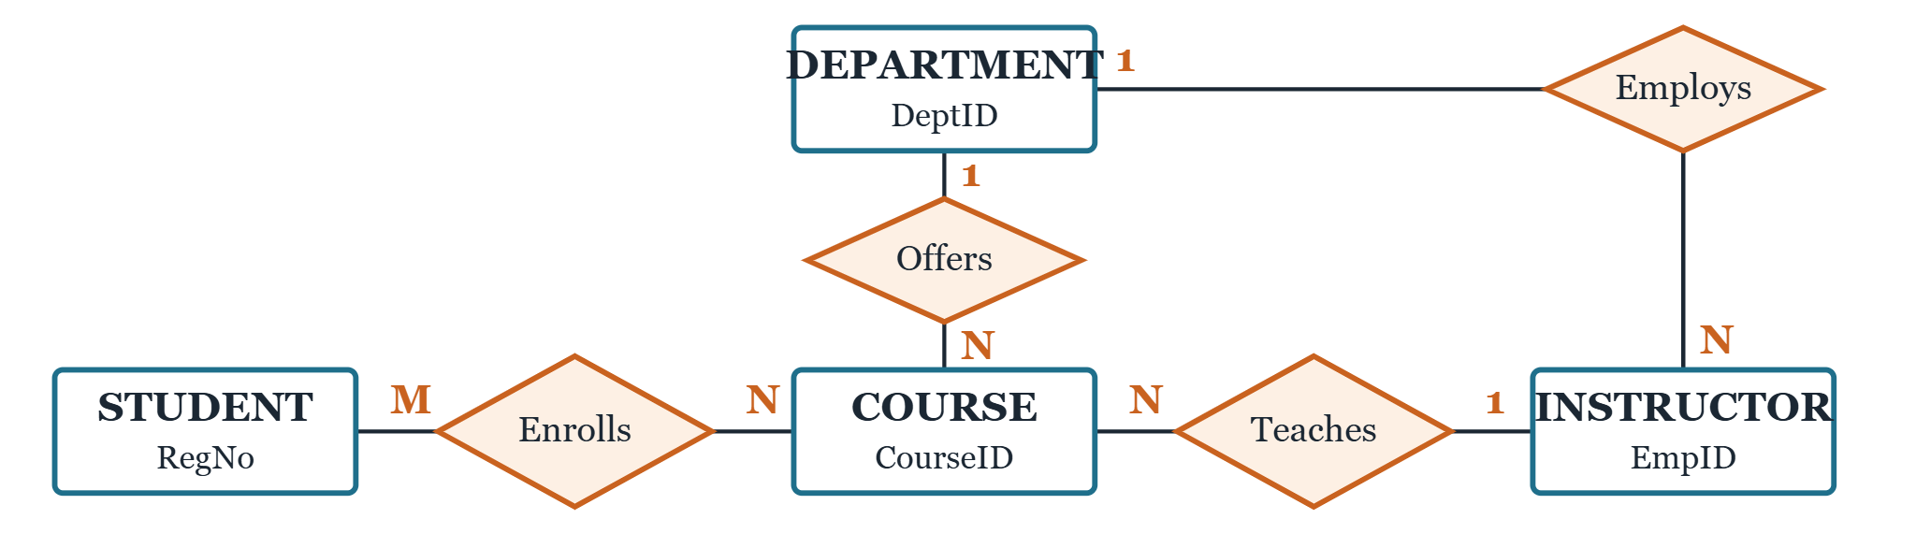
The university ER diagram
Rectangles are entities, diamonds are relationships, and the letters show cardinality.
ER Modeling · University Database · 5
Notes:
Trace one relationship at a time. A student can enroll in many courses and a course has many students (M:N). A department offers many courses, but each course belongs to one department (1:N). Say that this diagram is the centrepiece of the project.

Slide 6
Cardinality and participation
Constraint | Meaning | In our diagram
One-to-many (1:N) | One entity links to many others | One Department offers many Courses
Many-to-many (M:N) | Both sides link to many | Students enroll in many Courses
Total participation | Every entity must take part | Every Course is offered by a Department
Partial participation | Some entities may not take part | A new Student may have no Enrollment yet
ER Modeling · University Database · 6
Notes:
Cardinality answers how many; participation answers must it take part. Give the Course and Department example for total participation, which is drawn as a double line.

Slide 7
From diagram to real tables
Mapping rules
Real-world relevance
Each entity becomes a table and each key becomes its primary key. A 1:N link becomes a foreign key on the N side. An M:N link becomes its own table, such as Enrollment(RegNo, CourseID, Grade).
Student information systems, course registration portals and timetable tools all start from a model like this, which keeps data consistent and avoids duplication.
ER Modeling · University Database · 7
Notes:
Show that the diagram is not just a drawing: it converts directly into tables. Point out the Enrollment junction table as the answer to M:N relationships.

Slide 8
Summary and references
ER modeling plans data using entities, attributes and relationships.
Cardinality and participation capture the real rules of the university.
A good ER diagram converts cleanly into relational tables.
Elmasri and Navathe, Fundamentals of Database Systems, Pearson.
Silberschatz, Korth and Sudarshan, Database System Concepts, McGraw-Hill.
Connolly and Begg, Database Systems, Pearson.
ER Modeling · University Database · 8
Notes:
Recap the three takeaways in about 30 seconds, then invite questions. Likely questions: difference between 1:N and M:N, and what a weak entity is.

