Slide 1
Data mining with Cubist
Makhthum Syed
25-Oct-2016

Slide 2
Contents
Introduction
Cubist features
Rule based models
Committee models
Instance based corrections
Variable importance
Other features

Slide 3
Introduction
Data mining: Data mining is all about extracting patterns from an organization's stored or warehoused data.
These patterns can be used to
gain insight into aspects of the organization's operations
predict outcomes for future situations as an aid to decision-making
Cubist builds rule-based predictive models that output values, complementing C5.0 that predicts categories.
For instance, See5/C5.0 might classify the percentage yield from some process as "high", "medium", or "low", whereas Cubist would output a number such as "7.3".
Cubist is a powerful tool for generating rule-based models that balance the need for accurate prediction against the requirements of intelligibility. Cubist models generally give better results than those produced by simple techniques such as multivariate linear regression, while also being easier to understand than neural networks.

Slide 4
Cubist features
Designed to analyze substantial databases containing hundreds to millions of records and tens to thousands of numeric or nominal fields.
Relatively speed compared to other complex algorithms! Cubist also takes advantage of processors with up to eight cores in one or more CPUs (including Intel Hyper-Threading) to speed up model-building.
To maximize interpretability, Cubist models are expressed as collections of rules, where each rule has an associated multivariate linear model. Whenever a situation matches a rule's conditions, the associated model is used to calculate the predicted value.
Cubist is available for Windows and Linux.
Cubist is easy to use and does not presume advanced knowledge of Statistics or Machine Learning (although these don't hurt, either!).
RuleQuest provides C source code so that models constructed by Cubist can be embedded in your organization's own systems.

Slide 5
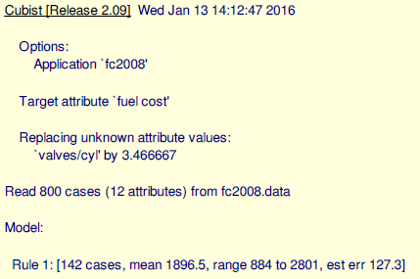
Rule Based Models
The first part identifies the version of Cubist, the run date, and the attribute that contains the target value.
Some attribute values might be missing; if so, Cubist replaces them by the most probable values. Missing values of continuous attributes are replaced by the mean of the known values for that attribute, while the replacement for missing discrete values is the most frequent attribute value.
Any such replacements are noted on the output. The same values are also used to replace missing values in any test cases, although the messages are not repeated.

Slide 6
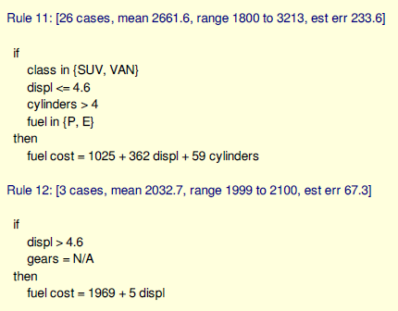
Rule Based Models
A rule indicates that, whenever a case satisfies all the conditions, the linear formula is appropriate for predicting the value of the target attribute. (If two or more rules apply to a case, then the values are averaged to arrive at a final prediction.)
Although the order of the rules does not affect the value predicted by a model, Cubist presents them in decreasing order of importance. The first rule makes the greatest contribution to the model's accuracy on the training data; the last rule has the least impact.
Each rule also carries some descriptive information: the number of training cases that satisfy the rule's conditions, their target values' mean and range, and a rough estimate of the expected error magnitude of predictions made by the rule. Within the linear formula, the attributes are ordered in decreasing relevance to the result.

Slide 7
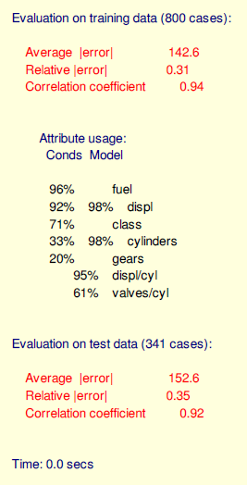
Rule Based Models
Models constructed by Cubist are evaluated on the training data from which they were generated, and also on a separate file of unseen test cases if this is present.
The average error magnitude is straightforward enough.
The relative error magnitude is the ratio of the average error magnitude to the error magnitude that would result from always predicting the mean value; for useful models, this should be less than 1 !
The correlation coefficient measures the agreement between the cases actual values of the target attribute and those values predicted by the model.

Slide 8
Committee models
The Cubist model can also use a boosting like scheme called committees where iterative model trees are created in sequence.
Unlike traditional boosting, stage weights for each committee are not used to average the predictions from each model tree. Each member of the committee predicts the target value for a case and the members predictions are averaged to give a final prediction.
The first member of a committee model is always exactly the same as the model generated without the committee option. The second member is a rule-based model designed to correct the predictions of the first member; if the first member's prediction is too low for a case, the second member will attempt to compensate by predicting a higher value. The third member tries to correct the predictions of the second member, and so on.
The recommended number of members is five, a value that balances the benefits of the committee approach against the cost of generating extra models.

Slide 9
Instance - Based Corrections
Another innovation in Cubist using nearest neighbors to adjust the predictions from the rule based model. First, a model tree (with or without committees) is created. Once a sample is predicted by this model, Cubist can find it's nearest neighbors and determine the average of these training set points.
The development of rules and committees is independent of the choice of using instances. The original C code allowed the program to choose whether to use instances, not use them or let the program decide. Our approach is to build a model with the cubist function that is ignorant to the decision about instances. When samples are predicted, the argument neighbors can be used to adjust the rule based model predictions (or not).
To tune the model over different values of neighbors and committees, the train function in the caret package can be used to optimize these parameters.

Slide 10
Variable Importance
The model Tree method for Cubist shows the usage of each variable in either the rule conditions or the (terminal) linear model.
In actuality, many more linear models are used in prediction that are shown in the output. Because of this, the variable usage statistics shown at the end of the output of the summary function will probably be inconsistent with the rules also shown in the output.
At each split of the tree, Cubist saves a linear model (after feature selection) that is allowed to have terms for each variable used in the current split or any split above it.

Slide 11
Variable Importance
As such, the final prediction is a function of all the linear models from the initial node to the terminal node. The percentages shown in the Cubist output reflects all the models involved in prediction (as opposed to the terminal models shown in the output).
The raw usage statistics are contained in a data frame called usage in the cubist object.
The caret package has a general variable importance method varImp. When using this function on a cubist argument, the variable importance is a linear combination of the usage in the rule conditions and the model.

Slide 12
Other Features
Unbiased rules
In its default mode, Cubist tries to minimize the average absolute error of the values predicted for new cases. As a consequence, the rules that Cubist generates may be biased -- the mean predicted value for the training cases covered by a rule may differ from their mean value.
Ex: Suppose, for instance, that we have to summarize the values 1, 2, and 12 by a single number. If we choose the mean value 5, the average absolute error over these values would be 14/3. Choosing the median value 2, however, the average absolute error becomes 11/3. Even though it gives lower absolute error, the choice of 2 is biased since the prediction (2) is lower than the mean of the values (5).
The model construction contains an option that instructs Cubist to make each rule approximately unbiased, with the downside that average absolute error is usually slightly higher. This option is recommended for applications where the training cases have a preponderance of a single target value (such as zero) because unbiased rules tend to give a finer gradation of predicted values.
Finally, because cases can be covered by different numbers of rules, the use of unbiased rules does not guarantee that the entire model is unbiased.

Slide 13
Other Features
Extrapolation
The extrapolation parameter controls the extent to which predictions made by Cubist's models can fall outside the range of values seen in the training data. Extrapolation is inherently more risky than interpolation, where predictions must lie between the lowest and highest observed value.
The extrapolation factor is to be set in the form of a percentage. Each rule records the highest and lowest target value of the training cases satisfying that rule's conditions. When the target value of a new case is predicted using the rule, the value computed from the linear formula may fall outside this range.
The extrapolation parameter limits the degree to which new values can lie above or below the values seen in the training data, expressed as a percentage of the range (the default being 5%).
Extrapolation may be constrained even further in two situations. When all the training cases covered by a rule have target values greater than or equal to zero, the rule will never predict a value less than zero. This restriction prevents Cubist from making silly predictions such as negative fuel costs.

Slide 14
Other Features
Weighting individual cases
By default, all training cases are treated equally when a model is constructed. In some applications, however, it may be desirable to assign different importance to the cases. Cubist achieves this by recognizing an optional attribute that gives the weight of each case. The attribute name must be case weight and it must have numeric values. The relative weight assigned to each case is its value of this attribute divided by the average value; if the value is undefined ("?"), not applicable ("N/A"), or is less than or equal to zero, the case's relative weight is set to 1. The case weight attribute itself is not used in the model.
The use of case weighting does not guarantee that the model will be more accurate for unseen cases with higher weights. Predictive accuracy on more important cases is likely to be improved only when cases with similar values of the predictor attributes also have similar values of the case weight attribute, i.e. when relatively important cases "clump together." Without this property, case weighting can introduce an unhelpful element of randomness into the model generation process. model!

Slide 15
Other Features
Sampling from Data sets:
Even though Cubist is relatively fast, building models from a large number of cases can take an inconveniently long time. Cubist incorporates a facility to extract a random sample from a dataset, construct a model from the sample, and then test the model on a disjoint collection of cases. By using a smaller set of training cases in this way, the process of generating a model is expedited, but at the cost of a possible reduction in the model's predictive performance.
The Sample option with x% has two consequences. Firstly, a random sample containing x% of the cases in the application's data file is used to construct the model. Secondly, the model is evaluated on a non-overlapping set of test cases consisting of another (disjoint) sample of the same size as the training set (if x is less than 50%), or all cases that were not used in the training set (if x is greater than or equal to 50%).
By default, the random sample changes every time that a model is constructed, so that successive runs of Cubist with sampling will usually produce different results. This re-sampling can be avoided by selecting the Lock sample option that uses the current sample for constructing subsequent models. If this option is selected, the sample will change only when another application is loaded, the sample percentage is altered, the option is unselected, or Cubist is restarted.

Slide 16
Thank you……. ☺ ☺

