Slide 1
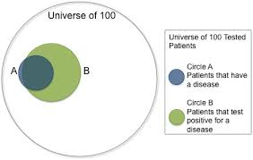
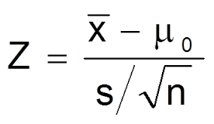

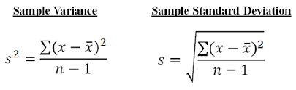
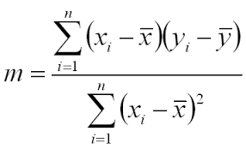

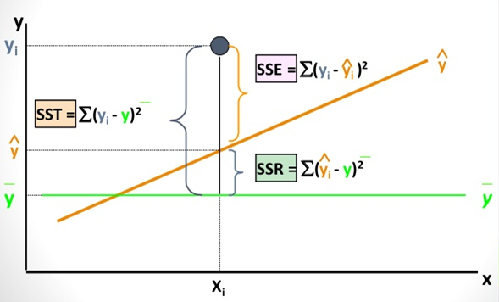

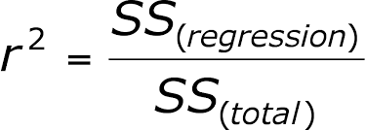
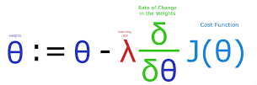
S is sample std dev
The relationship between X and Y is linear,
Y is distributed normally at each value of X,
The variance of Y at every value of X is the same (homogeneity of variances),
Independent variable X are linearly independent, OR in short X and Y are Independent and identically distributed (iid)

Slide 2
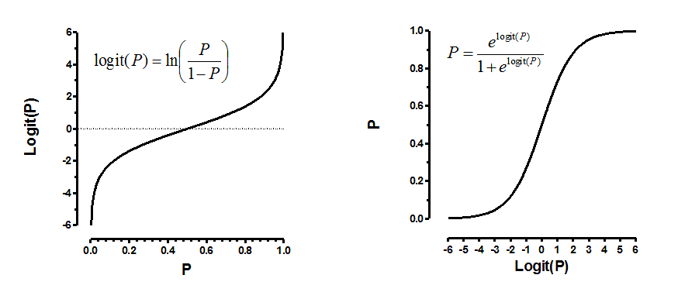
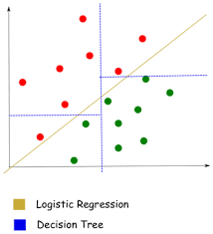

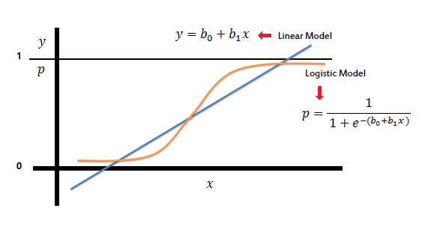
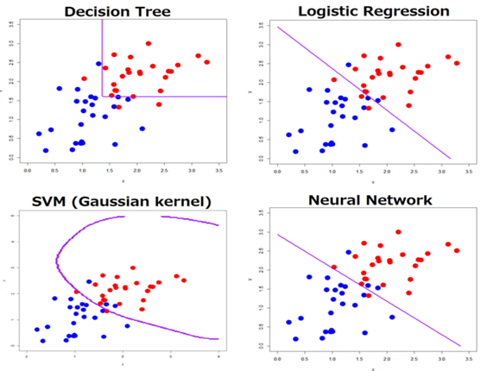
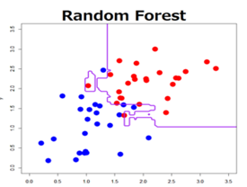
LR: Probabilistic, regularization
SVM: high Dim Data, text classifier, memory intensive, hard to interpret.
Imbalanced Classes: Fraud detection, Disease. Churn, ..
Collect more data ?
Generate Synthetic samples
Over sampling
Under sampling
Think it as Anamoly detection problem or outlier detection problem.

Slide 3
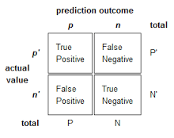
Decision trees implicitly perform variable screening or feature selection
Require relatively little effort from users for data preparation
Nonlinear relationships between parameters do not affect tree performance
Easy to interpret and explain to executives!
Instability - The decision tree changes when I perturb the dataset a bit.
Decision Boundaries are parallel to the axis -
Decision Trees do not work well if you have smooth boundaries. i.e they work best when you have discontinuous piece wise constant model. If you truly have a linear target function decision trees are not the best.
Decision Tree's do not work best if you have a lot of un-correlated variables.
Data fragmentation : Each split in a tree leads to a reduced dataset under consideration. And, hence the model created at the split will potentially introduce bias.
High variance and unstable : As a result of the greedy strategy applied by decision tree's variance in finding the right starting point of the tree can greatly impact the final result. i.e small changes early on can have big impacts later.

Slide 4
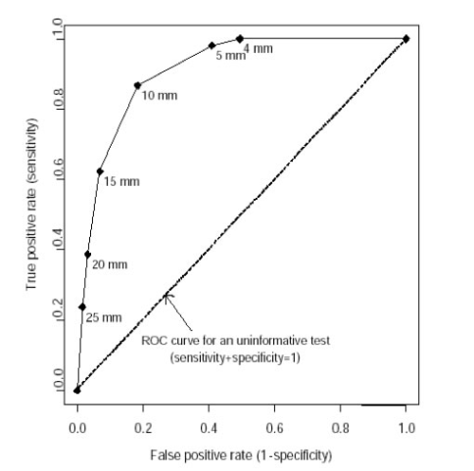
Bagging :
Before understand Bagging lets understand the concept of Bootstrap which is nothing but choosing a Random sample with replacement.
As everyone pointed Bagging is nothing but Bootstrap AGGregatING
Generate n different bootstrap training sample
Train Algorithm on each bootstrapped sample separately
Average the predictions at the end
One of the Key differences is the way how use sample each training set. Bagging allows replacement in bootstrapped sample but Boosting doesn’t.
Boosting Steps :
Draw a random subset of training samples d1 without replacement from the training set D to train a weak learner C1
Draw second random training subset d2 without replacement from the training set and add 50 percent of the samples that were previously falsely classified/misclassified to train a weak learner C2
Find the training samples d3 in the training set D on which C1 and C2 disagree to train a third weak learner C3
Combine all the weak learners via majority voting.

Slide 5
Ridge Regression : L2 Regularization
min(Least Square Objectfun)+ α(Sum of square Coeff)
Coefficient never reach ZERO for higher values of α
Includes all features in Model , Used to prevent OVERFITTING
Lasso Regression : L1 Regularization
min(Least Square Objectfun)+ α(absolute value of magnitude of Coeff)
Coefficient can be ZERO for higher values of α
Feature selection as some feature coefficient could be zero
STEPWISE regression is cumbersome for high Dimensional data
Elastic net combines both Ridge and Lasso

Slide 6
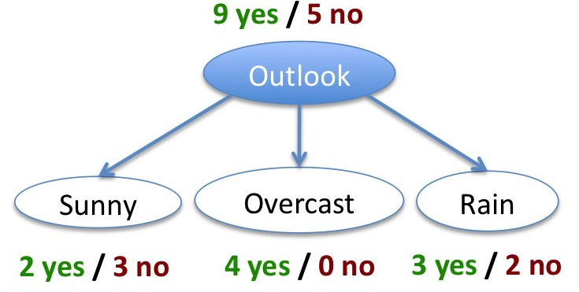
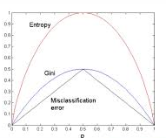
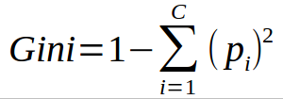

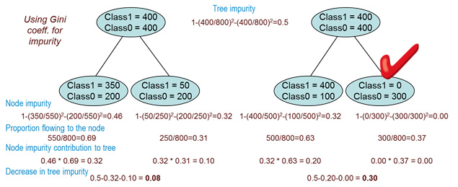
Variable importance in RF : The general idea is to permute the values of each feature and measure how much the permutation decreases the accuracy of the model. Clearly, for unimportant variables, the permutation should have little to no effect on model accuracy, while permuting important variables should significantly decrease it.

Slide 7
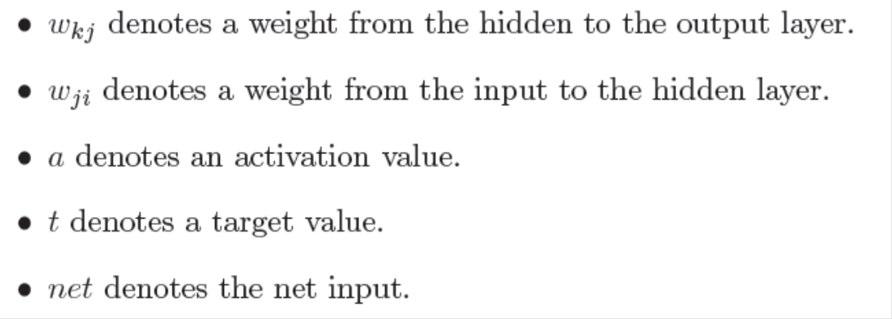
Gradient Descent Error
Total Error
Lets begin at the output layer with a particular weight.
However error is not directly a function of a weight. We expand this as follows.
Let’s consider each of these partial derivatives in turn. Note that only one term of the E summation will have a non-zero derivative: the one associated with the particular weight we are considering.

Slide 8
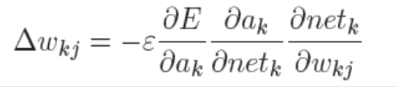

Derivative of the error with respect to the activation
Derivative of the net input with respect to a weight
Note that only one term of the net summation will have a non-zero derivative: again the one associated with the particular weight we are considering.
Derivative of the activation with respect to the net input
Weight change rule for a hidden to output weight
Now as
we can rewrite the result of the partial derivative as:
Change in weight is proportional to error at K multiplied by activation j. ie
Change in weight is proportional to error at (L+1)th layer multiplied by activation at Lth Layer.
Where a_{k} =

Slide 9

Now to determine the appropriate weight change for an input to hidden weight. This is more complicated because it depends on the error at all of the nodes this weighted connection can lead to.
Change in weight is proportional to error at (L+1)th layer multiplied by activation at Lth Layer.
For Change in weight form j to i
Error Propagated from K to J multiplied by rate of change of activation at j w r t net and weight
Error propagated from layer k to j is
The rate of change of activation at j wrt net and weight

Slide 10
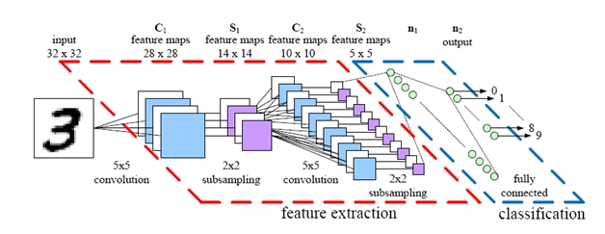
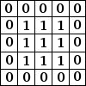
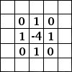
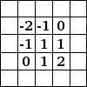
Blur
Blur
Edge Detect
Emboss

