Slide 1
Self Organizing Map

Slide 2
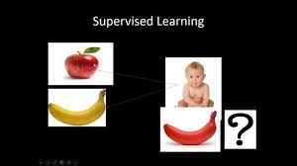
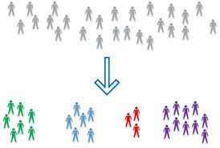
Supervised vs. Unsupervised Learning
A desired output result for each input vector is required when the network is trained. An ANN of the supervised learning type, such as the multi-layer perceptron, uses the target result to guide the formation of the neural parameters. It is thus possible to make the neural network learn the behavior of the process under study.
The training of the network is entirely data-driven and no target results for the input data vectors are provided. An ANN of the unsupervised learning type, such as the self-organizing map, can be used for clustering the input data and find features inherent to the problem.

Slide 3
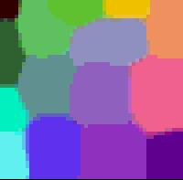
Self-Organizing Map (SOM)
Self-organizing maps (SOMs) are a data visualization technique invented by Professor Kohonen which reduce the dimensions of data through the use of self-organizing neural networks.
The way SOMs go about reducing dimensions is by producing a map of usually 1 or 2 dimensions which plot the similarities of the data by grouping similar data items together.
So SOMs accomplish two things
they reduce dimensions and
display similarities.
Like colors are grouped together such as the greens are all in the upper left hand corner and the purples are all grouped around the lower right and right hand side.

Slide 4

Unsupervised Learning
Training data: vectors, X
– Vectors of length n
p distinct training vectors
– Vector components are real numbers
Outputs
– A vector, Y, of length m: (y₁, y₂, ..., y_{i},…, y_{m})
• Sometimes m < n, sometimes m > n, sometimes m = n
-- Each of the p vectors in the training data is classified as falling in one of m clusters or categories
– That is: Which category does the training vector fall into?
Generalization
– For a new vector: (x_{j,1}, x_{j,2}, ..., x_{j,i},…, x_{j,n})
– Which of the m categories (clusters) does it fall into?

Slide 5
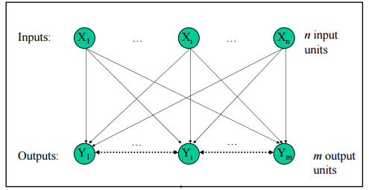
Network Architecture
Two layers of units
Input: n units (length of training vectors)
Output: m units (number of categories)
Input units fully connected with weights to output units
Intra-layer (“lateral”) connections
Within output layer
Defined according to some topology
No weight between these connections, but used in algorithm for updating weights
Note: There is one weight vector of length n associated with each output unit

Slide 6
Overall SOM Algorithm
Training
Select output layer topology
Train weights connecting inputs to outputs
Topology is used, in conjunction with current mapping of inputs to outputs, to define which weights will be updated
Distance measure using the topology is reduced over time; reduces the number of weights that get updated per iteration
Learning rate is reduced over time
Testing
Use weights from training

Slide 7

Output Layer Topology
Often view output in spatial manner
– E.g., a 1D or 2D arrangement
1D arrangement
– Topology defines which output layer units are neighbors with which others
– Have a function, D(t), which gives output unit neighborhood as a function of time (iterations) of the training algorithm
E.g., 3 output units
D(t) = 1 means update weight B & A if input maps onto B

Slide 8
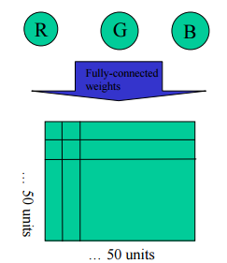
Example: 2D Output Layer Topology
Fully Connected Weights
Function, D(t), can give output unit radius as a function of time (iterations) when training the weights
Usually, initially wide radius, changing to gradually narrower
Often SOM’s are used with 2D topographies connecting the output units
In this way, the final output can be interpreted spatially, i.e., as a map

Slide 9
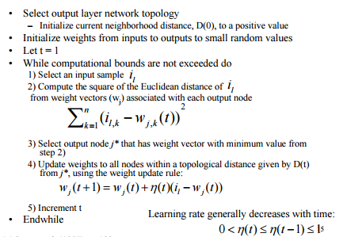
SOM Algorithm

Slide 10
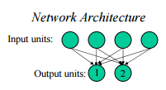
Example Self-Organizing Map
n = 4, m = 2
Training samples
i1: (1, 1, 0, 0)
i2: (0, 0, 0, 1)
i3: (1, 0, 0, 0)
i4: (0, 0, 1, 1)
What should we expect as outputs?

Slide 11
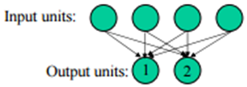
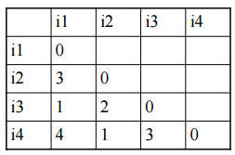
Example Self-Organizing Map cont..
What are the Euclidean Distances Between the Data Samples?
Training samples
i1: (1, 1, 0, 0)
i2: (0, 0, 0, 1)
i3: (1, 0, 0, 0)
i4: (0, 0, 1, 1)

Slide 12



Example Self-Organizing Map cont..
Example Details
Training samples
i1: (1, 1, 0, 0)
i2: (0, 0, 0, 1)
i3: (1, 0, 0, 0)
i4: (0, 0, 1, 1)
Let neighborhood = 0
– Only update weights associated with winning output unit (cluster) at each iteration
Learning rate
η(t) = 0.6; 1 <= t <= 4
η(t) = 0.5 η(1); 5 <= t <= 8
η(t) = 0.5 η(5); 9 <= t <= 12 etc.
Initial weight matrix
(random values between 0 and 1)

Slide 13


Example Self-Organizing Map cont..
First Weight Update
Training samples
i1: (1, 1, 0, 0)
i2: (0, 0, 0, 1)
i3: (1, 0, 0, 0)
i4: (0, 0, 1, 1)
Training sample: i1
– Unit 1 weights
• d² = (.2-1)² + (.6-1)² + (.5-0)² + (.9-0)² = 1.86
– Unit 2 weights
• d² = (.8-1)² + (.4-1)² + (.7-0)² + (.3-0)² = .98
– Unit 2 wins as 0.98 < 1.86
– Weights on winning unit are updated
– Giving an updated weight matrix:
new−unit2−weights = [.8 .4 .7 .3]+ 0.6( [1 1 0 0] - [.8 .4 .7 .3] )
= [.92 .76 .28 .12]

Slide 14

Example Self-Organizing Map cont..
Second Weight Update
Training samples
i1: (1, 1, 0, 0)
i2: (0, 0, 0, 1)
i3: (1, 0, 0, 0)
i4: (0, 0, 1, 1)
Training sample: i1
– Unit 1 weights
• d² = (.2-0)² + (.6-0)² + (.5-0)² + (.9-1)² = 0.66
– Unit 2 weights
• d² = (.92-0)² + (.76-0)² + (.28-0)² + (.12-1)² = 2.28
– Unit 1 wins as 0.66 < 2.28
– Weights on winning unit are updated
– Giving an updated weight matrix:
new−unit1−weights = [.2 .6 .5 .9]+ 0.6( [0 0 0 1 - [.2 .6 .5 .9] )
= [.08 .24 .20 .96]

Slide 15

Example Self-Organizing Map cont..
Third Weight Update
Training samples
i1: (1, 1, 0, 0)
i2: (0, 0, 0, 1)
i3: (1, 0, 0, 0)
i4: (0, 0, 1, 1)
Training sample: i1
– Unit 1 weights
• d² = (.08-1)² + (.24-0)² + (.2-0)² + (.96-0)² = 1.87
– Unit 2 weights
• d² = (.92-1)² + (.76-0)² + (.28-0)² + (.12-1)² = 0.68
– Unit 2 wins as 0.68 < 1.87
– Weights on winning unit are updated
– Giving an updated weight matrix:
new−unit2−weights = [.92 .76 .28 .12]+ 0.6( [1 0 0 0 - [.92 .76 .28 .12] )
= [.97 .30 .11 .05]

Slide 16

Example Self-Organizing Map cont..
Fourth Weight Update
Training samples
i1: (1, 1, 0, 0)
i2: (0, 0, 0, 1)
i3: (1, 0, 0, 0)
i4: (0, 0, 1, 1)
Training sample: i1
– Unit 1 weights
• d² = (.08-0)² + (.24-0)² + (.2-1)² + (.96-1)² = .71
– Unit 2 weights
• d² = (.97-1)² + (.30-0)² + (.11-1)² + (.05-1)² = 2.74
– Unit 1 wins as 0.71 < 2.74
– Weights on winning unit are updated
– Giving an updated weight matrix:
new−unit2−weights = [.08 .24 .20 .96]+ 0.6( [0 0 1 0 - [.08 .24 .20 .96] )
= [.03 .10 .68 .98]

Slide 17
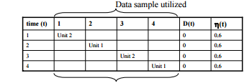

Example Self-Organizing Map cont..
Applying the SOM Algorithm
Training samples
i1: (1, 1, 0, 0)
i2: (0, 0, 0, 1)
i3: (1, 0, 0, 0)
i4: (0, 0, 1, 1)
After many iterations (epochs) through the data set:
Did we get the clustering that we expected ?
What clusters do the data samples fall into?

Slide 18
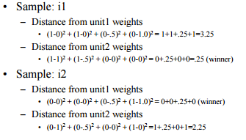
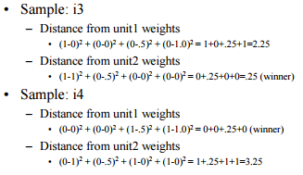

Example Self-Organizing Map cont..
Training samples
i1: (1, 1, 0, 0)
i2: (0, 0, 0, 1)
i3: (1, 0, 0, 0)
i4: (0, 0, 1, 1)
Conclusion
• Samples i1, i3 cluster with unit 2
• Samples i2, i4 cluster with unit 1

Slide 19
Example Self-Organizing Map cont..
What about generalization?
• New data sample
i5: (1, 1, 1, 0)
Training samples
i1: (1, 1, 0, 0)
i2: (0, 0, 0, 1)
i3: (1, 0, 0, 0)
i4: (0, 0, 1, 1)
What unit should this cluster with?
What unit does this cluster with?

Slide 20
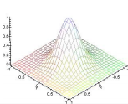
Self-Organizing Colors
More typically, SOM’s are used with 2D topographies connecting the output units
In this way, the final output can be interpreted spatially, i.e., as a map
Inputs
3 input units: R, G, B
Randomly selected RGB colors
Outputs
2500 units
Connected in a 2D matrix
Amount neighbor weights changed specified by a 2D Gaussian
Width of Gaussian decreases with iterations of training

Slide 21

Self-Organizing Colors cont..
Algorithm modifications
Random selection of winning output if multiple winning outputs
Weight update modified to include a contribution factor
Fully Connected Weights

Slide 22
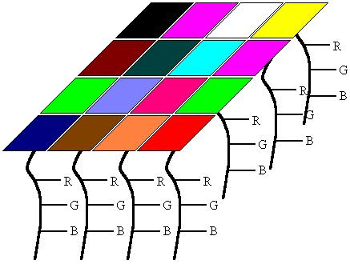
Self-Organizing Colors cont..
Sample Data
Here the colors are represented in three dimensions (red, blue, and green.)
The idea of the self-organizing maps is to project the n-dimensional data (here it would be colors and would be 3 dimensions) into something that be better understood visually (in this case it would be a 2 dimensional image map).
In this case one would expect the dark blue and the greys to end up near each other on a good map and yellow close to both the red and the green.
Weights are sometimes referred to as neurons since SOMs are actually neural networks.

Slide 23
Self-Organizing Colors cont..
The first step in constructing a SOM is to initialize the weight vectors. From there you select a sample vector randomly and search the map of weight vectors to find which weight best represents that sample.
Algorithm
Initialize Map
For t from 0 to 1
Randomly select a sample Get best matching unit Scale neighbors Increase t a small amount
End for
Since each weight vector also has neighboring weights that are close to it. The weight that is chosen is rewarded by being able to become more like that randomly selected sample vector. Also, the neighbors of that weight are also rewarded by being able to become more like the chosen sample vector.
From this step we increase t some small amount because the number of neighbors and how much each weight can learn decreases over time. This whole process is then repeated a large number of times, usually more than 1000 times.
In the case of colors, the program would first select a color from the array of samples such as green, then search the weights for the location containing the greenest color. From there, the colors surrounding that weight are then made more green. Then another color is chosen, such as red, and the process continues.

Slide 24

Self-Organizing Colors cont..
Get Best Matching Unit
This is a very simple step, just go through all the weight vectors and calculate the distance from each weight to the chosen sample vector. The weight with the shortest distance is the winner. If there are more than one with the same distance, then the winning weight is chosen randomly among the weights with the shortest distance. There are a number of different ways for determining what distance actually means mathematically. The most common method is to use the Euclidean distance:
In the case of colors, if we can think of them as 3D points, each component being an axis. If we have chosen green which is of the value (0,6,0), the color light green (3,6,3) will be closer to green than red at (6,0,0).
Light green = Sqrt((3-0)^2+(6-6)^2+(3-0)^2) = 4.24
Red = Sqrt((6-0)^2+(0-6)^2+(0-0)^2) = 8.49
So light green is now the best matching unit, but this operation of calculating distances and comparing them is done over the entire map and the weight with the shortest distance to the sample vector is the winner and the BMU

Slide 25
Self-Organizing Colors cont..
Scale Neighbors
There are actually two parts to scaling the neighboring weights:
determining which weights are considered as neighbors and
how much each weight can become more like the sample vector.
Determining Neighbors
The neighbors of a winning weight can be determined using a number of different methods. The Gaussian function where every point with a value above zero is considered a neighbor.
The amount of neighbors decreases over time. This is done so samples can first move to an area where they will probably be, then they jockey for position.

Slide 26
Self-Organizing Colors cont..
2. Learning
The second part to scaling the neighbors is the learning function. The winning weight is rewarded with becoming more like the sample vector. The neighbors also become more like the sample vector. An attribute of this learning process is that the farther away the neighbor is from the winning vector, the less it learns. The rate at which the amount a weight can learn decreases and can also be set to whatever you want. This Gausssian function will return a value ranging between 0 and 1, where each neighbor is then changed using the parametric equation. The new color is:
Current color*(1.-t) + sample vector*t
So in the first iteration, the best matching unit will get a t of 1 for its learning function, so the weight will then come out of this process with the same exact values as the randomly selected sample.

Slide 27
Self-Organizing Colors cont..
Determining the Quality of SOMs
There is a very simple method for displaying where similarities lie and where they do not. In order to compute this we go through all the weights and determine how similar the neighbors are.
This is done by calculating the distance that the weight vectors make between the each weight and each of its neighbors. With an average of these distances a color is then assigned to that location.
If the average distance were high, then the surrounding weights are very different and a dark color is assigned to the location of the weight. If the average distance is low, a lighter color is assigned. So in areas of the center of the blobs the colors are the same, so it should be white since all the neighbors are the same color. In areas between blobs where there are similarities it should be not white, but a light grey. Areas where the blobs are physically close to each other, but are not similar at all there should be black.

Slide 28
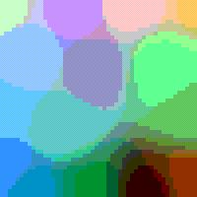
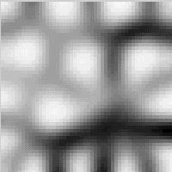
Self-Organizing Colors cont..
Areas where there is a light grey between the blobs represent a true similarity.
In the pictures above, in the bottom right there is black surrounded by colors which are not very similar to it. When looking at the black and white similarity SOM, it shows that black is not similar to the other colors because there are lines of black representing no similarity between those two colors.
Also in the top corner there is pink and nearby is a light green which are not very near each other in reality, but near each other on the colored SOM. Looking at the black and white SOM, it clearly shows that the two not very similar by having black in between the two colors.
With these average distances used to make the black and white map, we can actually assign each SOM a value that determines how good the image represents the similarities of the samples by simply adding these averages.

Slide 29
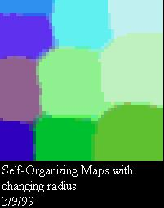
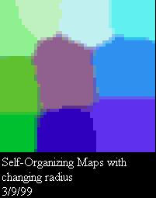
Self-Organizing Map
Advantages
They are very easy to understand. It’s very simple, if they are close together and there is grey connecting them, then they are similar. If there is a black ravine between them, then they are different
They classify data well and then are easily evaluate for their own quality so you can actually calculated how good a map is and how strong the similarities between objects are.
Disadvantages
Can not handle missing data.
Every SOM is different and finds different similarites among the sample vectors.
They are very computationally expensive which is a major drawback since as the dimensions of the data increases.

Slide 30
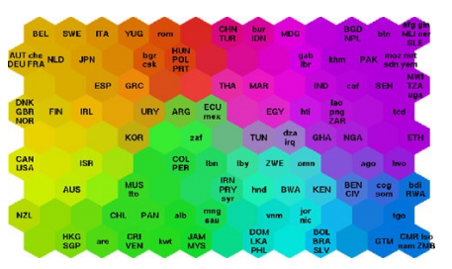
Self-Organizing Maps
This is a map of the world quality-of-life. Yellows and oranges represent wealthy nations, while purples and blues are the poorer nations.
From this view, it can be difficult to visualize the relationships between countries. However, represented by a SOM, it is much easier to see what is going on.
Here we can see the United States, Canada, and Western European countries, on the left side of the network, being the wealthiest countries. The poorest countries, then, can be found on the opposite side of the map (at the point farthest away from the richest countries), represented by the purples and blues.
Each hexagon represents a node in the neural network. This is typically called a unified distance matrix, or a u-matrix and is probably the most popular method of displaying SOMs

Slide 31
Introduction to Data Management
Introduction to Data Analytics
Understand what is data analytics & its applications across industries
Introduction to Data Sets and Data Models
Learn how to solve problems & understand the relevant data set structures for solving them
Business and Data Understanding
Equip yourself with the skills to understand business problem and data intuitively
Data Warehousing and OLAP
Equip yourself with the knowledge to extract and pre-process data before analysis
Data Visualization
Make your data alive with visuals using R, Excel and tools like Tableau
Case Study - Investments
Implement your learnings to find sectors in which different companies ought to invest

Slide 32
Statistics and EDA
Descriptive Statistics
Summarize and describe data sets using a measures such as Central tendency and variability
Inferential Statistics
Learn probability, Central Limit Theorem and much more to draw inferences
Exploratory Data Analysis
Derive initial insights from the data using R and other visualization tools
Hypothesis Testing
Understand how to formulate & test hypotheses to solve various business problems
Design of Experiment
Use Design of Experiment methodology for data collection
Case Study- Uber Supply Demand Gap
Apply Statistics and understand how you can solve the supply demand gap of cabs for Uber

Slide 33
Introduction to Predictive Analytics I
Data Preparation for Modelling
Equip yourself with the techniques and tools to prepare data for modelling
Introduction to Machine Learning
Learn all about Tasks, Features, Models and design of ML study
Linear Regression
Learn to implement linear regression and predict continuous data values
Supervised Classification
Understand and implements algorithms like K-NN, Naïve Bayes, Logistic Regression and Support Vector Machines
Clustering
Learn how to create segments based on similarities using K-Means and Hierarchical clustering
Case Study- Telecom Churn
Help a telecom giant predict if a customer will churn or not. Apply multiple algorithms simultaneously to see which one works the best

Slide 34
Introduction to Predictive Analysis II
Model Selection
Equip yourself with the knowledge to select the best algorithms for your data
Generalized Regression
What if the data doesn’t follow a straight line? Learn Ridge regression, regularized regression and LASSO
Time Series
Learn how to predict on time dependent/variant data
Decision Trees
Tree based model that is simple and easy to use. Learn the fundamentals on how to implement them
Neural Networks
Master Feed-forward, Recurrent and Gaussian Neural Networks. This is your way into AI!
Ensembles
Learn how algorithms can be combined for better results
Association Rule Mining
Ever wonder why beer is kept next to diapers in superstores? Find out in this module

Slide 35
BigData Analytics
Introduction to Big Data And Hadoop
Understand the basic concepts of Big Data and used Hadoop as processing platform for Big Data
Managing Big Data
Learn and Use Hadoop Ecosystem tools for data ingestion, extraction and management. Hadoop ecosystem tools namely Sqoop, Hive will be covered in this Module
Introduction to Spark
Understand and use Spark, a fast Big Data processing platform. Also learn the basics of Scala
Big Data Analysis
Learn how to analyze Big Data using SparkR, SparkSQL. Learn the basics of MLib

