Slide 1
Skill Analysis
April-10-2015

Slide 3
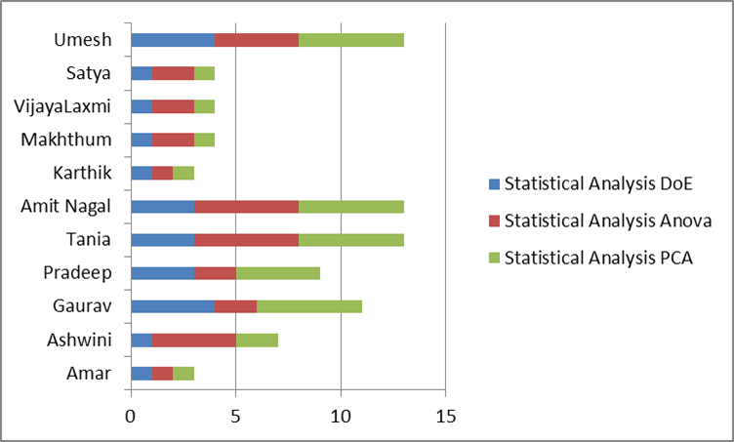
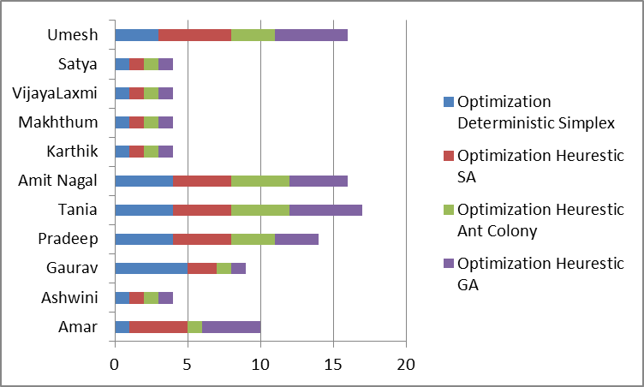
Statistical Analysis and Optimization

Slide 4
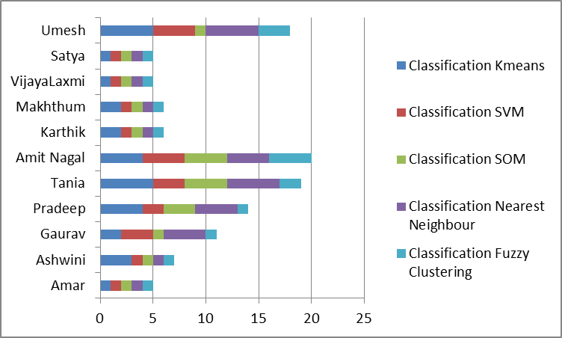
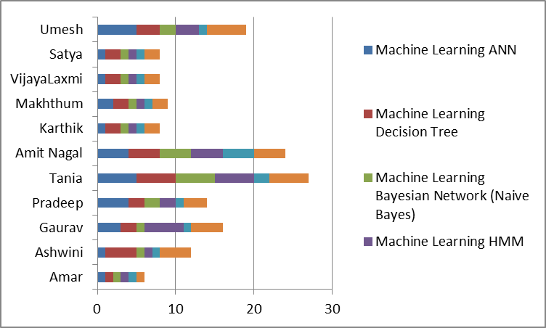
Classification and Machine Learning

Slide 5
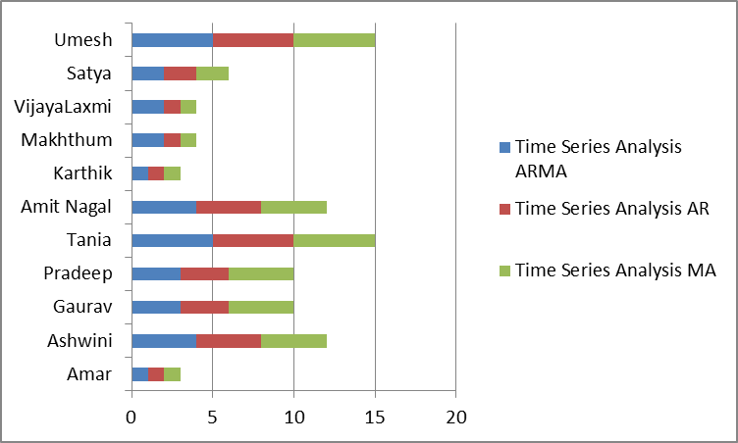
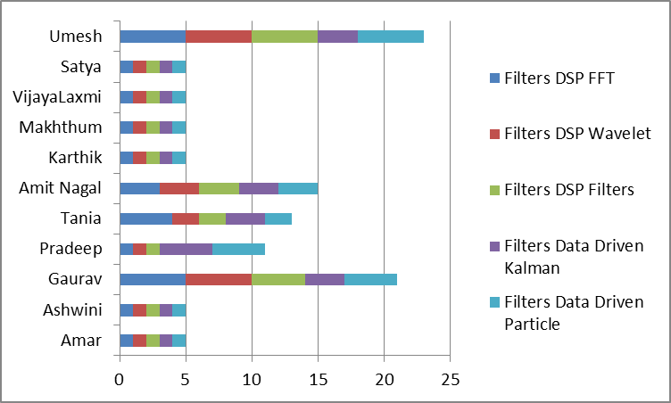
Time Series and Filters

Slide 6
Training Plan

Slide 7

THANK YOU!

