Slide 1
Descriptive Statistics
Dr. Pradeep Bilurkar
Notes:
This template can be used as a starter file for presenting training materials in a group setting.
Sections
Right-click on a slide to add sections. Sections can help to organize your slides or facilitate collaboration between multiple authors.
Notes
Use the Notes section for delivery notes or to provide additional details for the audience. View these notes in Presentation View during your presentation.
Keep in mind the font size (important for accessibility, visibility, videotaping, and online production)
Coordinated colors
Pay particular attention to the graphs, charts, and text boxes.
Consider that attendees will print in black and white or grayscale. Run a test print to make sure your colors work when printed in pure black and white and grayscale.
Graphics, tables, and graphs
Keep it simple: If possible, use consistent, non-distracting styles and colors.
Label all graphs and tables.

Slide 2

Statistics is the 'Science of Uncertainty",' Noel Cressie and Christopher K. Wikle,
Statistics for Spatio-Temporal Data, Wiley, 2011, p. 4

Slide 3
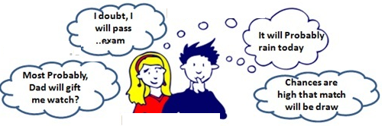
Statistics
Statistics, in a nutshell, is a discipline that studies the best ways of dealing with randomness, or more precisely and broadly, variation. As human beings, we tend to love information, but we hate uncertainty -- especially when we need to make decisions. Information and uncertainty, however, are actually two sides of the same coin. Statistician Xiao-Li Meng
Statistical techniques can't eliminate uncertainty, but can help us gain some knowledge despite it. They can help us see patterns through it, and help us quantify the certainty/uncertainty that the patterns are real and not just chance artifacts of our data or of our perception .

Slide 4
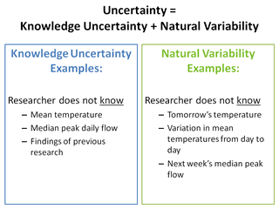
Terminology: Variation, Variability, Uncertainty
variability refers to natural variation in some quantity
whereas uncertainty refers to the degree of precision with which a quantity is measured
Example: The amount of a certain pollutant in the air is variable: it varies from place to place and from time to time. However, the uncertainty in the amount of that pollutant present in a particular place at a particular time depends on the quality (and presence or absence) of the instruments used to measure it.
uncertainty reflects lack of knowledge
variability reflects lack control

Slide 5

Probability-perspective
Classical : This is the perspective on probability that most people first encounter in formal education (although they may encounter the subjective perspective in informal education). For example, suppose we consider tossing a fair die. There are six possible numbers that could come up ("outcomes"), and, since the die is fair, each one is equally likely to occur. So we say each of these outcomes has probability 1/6. Since the event "an odd number comes up" consists of exactly three of these basic outcomes, we say the probability of "odd" is 3/6, i.e. 1/2.
More generally, if we have a situation (a "random process") in which there are n equally likely outcomes, and the event A consists of exactly m of these outcomes, we say that the probability of A is m/n. We may write this as "P(A) = m/n" for short.

Slide 6
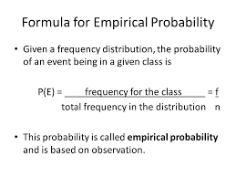
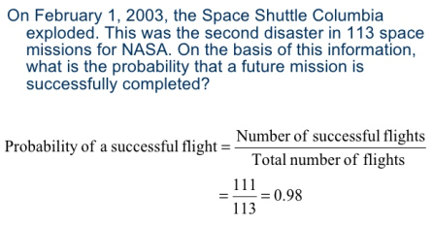
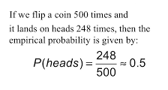
Probability-perspective
Empirical Probability

Slide 7
Probability-perspective
Common misunderstanding:
If there are only two possible outcomes, and you don't know which is true, the probability of each of these outcomes is 1/2.
In fact, probabilities in such "binary outcome" situations could be anything from 0 to 1. For example, if the outcomes of interest are "has cancer" and "does not have cancer," the probabilities of having cancer are (in most cases) much less than 1/2. The empirical (frequentist) perspective allows us to estimate such probabilities.

Slide 8


Confusing correlation and causation

Slide 9
Misconceptions
What is a Random Sample?
a sample is not random because it has a pattern. !!
The adjective "random" refers to the method by which the sample is chosen. Thus the phrase "random sample" really means "randomly chosen sample."
Random Variables and Probability Distributions
Randomly pick (in a way that gives each student an equal chance of being chosen) a University student and measure their height.
Picking the student is the random process; their height is the random variable.
Toss a coin and see whether it comes up heads or tails. Tossing the coin is the random process; the variable is heads or tails.
Toss two dice and take the product of the numbers that land up. Tossing the dice is the random process; the product is the random variable.

Slide 10
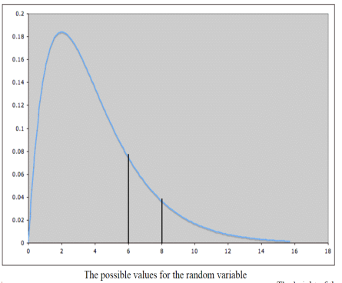
Random Variable- probability distribution
Usually, some values of a random variable occur more frequently than others. For example, if we are talking about heights of university students, heights of around 5' 7" are much more common that heights of around 4' or heights around 7'. In other words, some values of the random variable occur with higher probability than others. This can be represented graphically by the probability distribution of the random variable. For example, a random variable might have a probability distribution that looks like this:
The area under the curve between two values a and b is the probability that the random variable will take on values between a and b.
In this example, we can see that the value of the random variable is much more likely to lie between 2 and 4 (where the curve is high) than between 12 and 14 (where the curve is low).

Slide 11
Overview of Frequentist Confidence Intervals
The General Situation:
We are considering a random variable Y.
We are interested in a certain parameter (e.g., a proportion, or mean, or regression coefficient, or variance) associated with the random variable Y.
We do not know the value of the parameter.
Goal 1: We would like to estimate the unknown parameter, using data from a sample.
Goal 2: We would also like to get some sense of how good our estimate is.
The first goal is usually easier than the second. Example: If the parameter we are interested in estimating is the mean of the random variable, then we can estimate it using a sample mean.

Slide 12
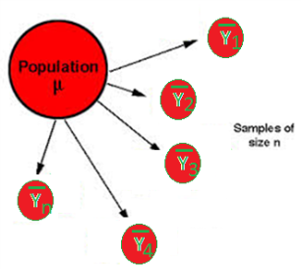
Overview of Frequentist Confidence Intervals
The mean of the random variable Y is also called the expected value or the expectation of Y. It is denoted E(Y). It is also called the population mean, often denoted µ. It is what we do not know in this example.
A sample mean is typically denoted ȳ (read "y-bar"). It is calculated from a sample y1, y2, ... , yn of values of Y by the familiar formula ȳ = (y1+ y2+ ... + yn)/n.
The population mean µ and a sample mean ȳ are usually not the same. Confusing them is a common mistake.
Note that I have written "the population mean" but "a sample mean". A sample mean depends on the sample chosen. Since there are many possible samples, there are many possible sample means.

Slide 13

Overview of Frequentist Confidence Intervals
The idea for the second goal: Although we typically have just one sample at hand when we do statistics, the reasoning used in frequentist (classical) inference depends on thinking about all possible suitable samples of the same size n.
Example: The parameter we are interested in estimating is the population mean µ = E(Y) of the random variable Y.
So we collect a simple random sample, say of size n, consisting of observations y1, y2, ... , yn. (For example, if Y is "height of an adult American male", we take a sample random sample of n adult American males; y1, y2, ... , yn are their heights.)
We use the sample mean ȳ = (y1+ y2+ ... + yn)/n as our estimate of µ. (This is an example of a point estimate -- a numerical estimate with no indication of how good the estimate is.)
But to get an idea of how good our estimate is, we look at all possible simple random samples of size n from Y
Ȳn : "sample mean of a simple random sample of size n from Y",
This is an estimate of the population mean µ.

Slide 14
Overview of Frequentist Confidence Intervals
This new random variable Ȳ_{n} has a distribution. This is called a sampling distribution, since it arises from considering varying samples. The distribution of Ȳ_{n} gives us information about the variability (as samples vary) of our method of estimating the population mean µ.
We don't know the sampling distribution (distribution of Ȳ_{n} ) exactly (in particular, it will depend on µ, which we don't know), but the model assumptions²will tell us enough so that it is possible to do the following:
If we specify a probability (we'll use .95 to illustrate), we can find a number a so that
The probability that Ȳ_{n} lies between µ - a and µ + a is 0.95
In other words we can say ,
The probability that µ lies between Ȳ_{n} - a and Ȳ_{n} + a is 0.95
Pl Note : the probability refers to Ȳ_{n}, not to µ. Thinking that the probability refers to µ is a common mistake in interpreting confidence intervals.
Aslo putting in different words
The probability that the interval from Ȳ_{n} - a to Ȳ_{n} + a contains µ is .95.

Slide 15
Overview of Frequentist Confidence Intervals
We are now faced with two possibilities (assuming the model assumptions are indeed all true):
The sample we have taken is one of the 95% for which the interval from Ȳ_{n} - a to Ȳ_{n} + a contains µ.
Our sample is one of the 5% for which the interval from Ȳ_{n} - a to Ȳ_{n} + a does not contain µ.
Unfortunately, we can't know which of these two possibilities is true.
Nonetheless, we calculate the values of Ȳn - a and Ȳn + a for the sample we have, and call the resulting interval a 95% confidence interval for µ.
We can say that we have obtained the confidence interval by using a procedure which, for 95% of all simple random samples from Y, of the given size, produces an interval containing the parameter we are estimating.
Unfortunately, we can't know whether or not the sample we have used is one of the 95% of "good" samples that yield a confidence interval containing the true mean µ , or whether the sample we have is one of the 5% of "bad" samples that yield a confidence interval that does not contain the true mean µ.
We can just say that we have used a procedure that "works" 95% of the time.

Slide 16
Frequentist Hypothesis Tests and p-values
We are considering a random variable Y which is normally distributed. (This is one of the model assumptions.)
Our null hypothesis is: The population mean µ of the random variable Y is a certain value µ0.
For simplicity, we will discuss a one-sided alternative hypothesis: The population mean µ of the random variable Y is greater than µ0. (i.e., µ > µ0)
Another model assumption says that samples are simple random samples. We have data in the form of a simple random sample of size n.
To understand the idea behind the hypothesis test, we need to put our sample of data on hold for a while and consider all possible simple random samples of the same size n from the random variable Y.
For any such sample, we could calculate its sample mean ȳ and its sample standard deviation s.
We could then use ȳ and s to calculate the t-statistic t = (ȳ - µ0)/(s/√n)
Doing this for all possible simple random samples of size n from Y gives us a new random variable, Tn. Its distribution is called a sampling distribution.
The mathematical theorem associated with this inference procedure (one-sided t-test for population mean) tells us that if the null hypothesis is true, then the sampling distribution has what is called the t-distribution with n degrees of freedom. (For large values of n, the t-distribution looks very much like the standard normal distribution; but as n gets smaller, the peak gets slightly smaller and the tails go further out.)

Slide 17
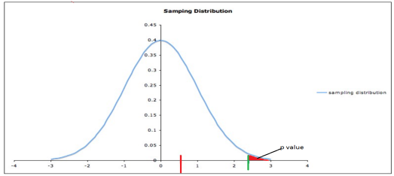
Frequentist Hypothesis Tests and p-values
Now consider where the t-statistic for the data at hand lies on the sampling distribution. Two possible values are shown in red and green, respectively, in the diagram below. Remember that this picture depends on the validity of the model assumptions and on the assumption that the null hypothesis is true.
The probability of a random variable lying in a certain region is the area under the probability distribution curve over that region, so the p-value is the area under the distribution curve to the right of the test statistic calculated from the data.
If the t-statistic lies at the red bar (around 0.5) in the picture, nothing is surprising; our data are consistent with the null hypothesis.
But if the t-statistic lies at the green bar (around 2.5), then the data would be fairly unusual -- assuming the null hypothesis is true.
So a t-statistic at the green bar would cast some reasonable doubt on the null hypothesis. A t-statistic even further to the right would cast even more doubt on the null hypothesis.

Slide 18
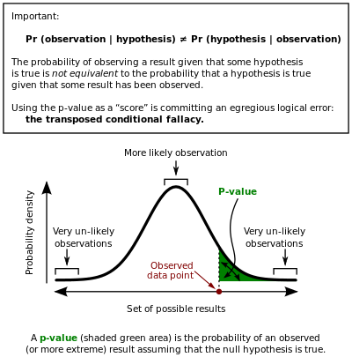

Slide 19
p-values
We can quantify the idea of how unusual a test statistic is by the p-value. The general definition is:
p-value = the probability of obtaining a test statistic at least as extreme as the one from the data at hand, assuming:
the model assumptions for the inference procedure used are all true, and
the null hypothesis is true, and
the random variable is the same (including the same population), and
the sample size is the same.
Notice that this is a conditional probability: The probability that something happens, given that various other conditions hold. One common misunderstanding is to neglect some or all of the conditions
The probability of a random variable lying in a certain region is the area under the probability distribution curve over that region, so the p-value is the area under the distribution curve to the right of the test statistic calculated from the data.

Slide 20
A statistical hypothesis
A statistical hypothesis is an assumption about a population parameter. This assumption may or may not be true. Hypothesis testing refers to the formal procedures used by statisticians to accept or reject statistical hypotheses.
The best way to determine whether a statistical hypothesis is true would be to examine the entire population. Since that is often impractical, researchers typically examine a random sample from the population. If sample data are not consistent with the statistical hypothesis, the hypothesis is rejected.
There are two types of statistical hypotheses.
Null hypothesis. The null hypothesis, denoted by H₀, is usually the hypothesis that sample observations result purely from chance.
Alternative hypothesis. The alternative hypothesis, denoted by H₁ or H_{a}, is the hypothesis that sample observations are influenced by some non-random cause.

Slide 21
P Value
Example: Researcher 1 conducts a clinical trial to test a drug for a certain medical condition on 30 patients all having that condition. The patients are randomly assigned to either the drug or a look-alike placebo (15 each). Neither patients nor medical personnel know which patient takes which drug. Treatment is exactly the same for both groups, except for whether the drug or placebo is used. The hypothesis test has null hypothesis "proportion improving on the drug is the same as proportion improving on the placebo" and alternate hypothesis "proportion improving on the drug is greater than proportion improving on the placebo." The resulting p-value is p = 0.15. Researcher 2 does another clinical trial on the same drug, with the same placebo, and everything else the same except that 200 patients are randomized to the treatments, with 100 in each group. The same hypothesis test is conducted with the new data, and the resulting p-value is p = 0.03. Are these results contradictory? No -- since the sample sizes are different, the p-values are not comparable, even though everything else is the same. (In fact, a larger sample size typically results in a smaller p-value).
Another common misunderstanding of p-values is the belief that the p-value is "the probability that the null hypothesis is true". The basic assumption of frequentist hypothesis testing is that the null hypothesis is either true (in which case the probability that it is true is 1) or false (in which case the probability that it is true is 0).

Slide 22

A Statistical Hypothesis
For example, suppose we wanted to determine whether a coin was fair and balanced.
A null hypothesis might be that half the flips would result in Heads and half, in Tails.
The alternative hypothesis might be that the number of Heads and Tails would be very different. Symbolically, these hypotheses would be expressed as
H0: P = 0.5
Ha: P ≠ 0.5.
Suppose we flipped the coin 50 times, resulting in 40 Heads and 10 Tails. Given this result, we would be inclined to reject the null hypothesis. We would conclude, based on the evidence, that the coin was probably not fair and balanced

Slide 23
A Statistical Hypothesis
Can We Accept the Null Hypothesis?
Some researchers say that a hypothesis test can have one of two outcomes: you accept the null hypothesis or you reject the null hypothesis. Many statisticians, however, take issue with the notion of "accepting the null hypothesis." Instead, they say: you reject the null hypothesis or you fail to reject the null hypothesis.
Why the distinction between "acceptance" and "failure to reject?" Acceptance implies that the null hypothesis is true. Failure to reject implies that the data are not sufficiently persuasive for us to prefer the alternative hypothesis over the null hypothesis.

Slide 24
Hypothesis Tests
This process, called hypothesis testing, consists of four steps.
State the hypotheses. This involves stating the null and alternative hypotheses. The hypotheses are stated in such a way that they are mutually exclusive. That is, if one is true, the other must be false.
Formulate an analysis plan. The analysis plan describes how to use sample data to evaluate the null hypothesis. The evaluation often focuses around a single test statistic.
Analyze sample data. Find the value of the test statistic (mean score, proportion, t statistic, z-score, etc.) described in the analysis plan.
Interpret results. Apply the decision rule described in the analysis plan. If the value of the test statistic is unlikely, based on the null hypothesis, reject the null hypothesis.

Slide 25
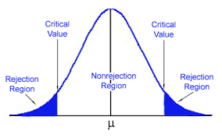
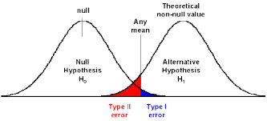
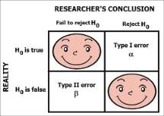
Decision Errors
Two types of errors can result from a hypothesis test.
Type I error. A Type I error occurs when the researcher rejects a null hypothesis when it is true. The probability of committing a Type I error is called the significance level. This probability is also called alpha, and is often denoted by α.
Type II error. A Type II error occurs when the researcher fails to reject a null hypothesis that is false. The probability of committing a Type II error is called Beta, and is often denoted by β. The probability of not committing a Type II error is called the Power of the test.

Slide 26
Decision Rules
The analysis plan includes decision rules for rejecting the null hypothesis. In practice, statisticians describe these decision rules in two ways - with reference to a P-value or with reference to a region of acceptance.
P-value. The strength of evidence in support of a null hypothesis is measured by the P-value. Suppose the test statistic is equal to S.
The P-value is the probability of observing a test statistic as extreme as S, assuming the null hypotheis is true.
If the P-value is less than the significance level, we reject the null hypothesis.
Region of acceptance. The region of acceptance is a range of values. If the test statistic falls within the region of acceptance, the null hypothesis is not rejected. The region of acceptance is defined so that the chance of making a Type I error is equal to the significance level.
The set of values outside the region of acceptance is called the region of rejection. If the test statistic falls within the region of rejection, the null hypothesis is rejected. In such cases, we say that the hypothesis has been rejected at the α level of significance.

Slide 27
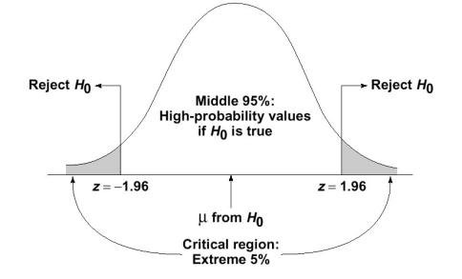
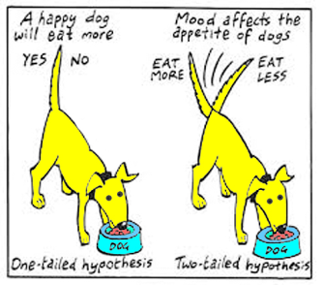
One-Tailed and Two-Tailed Tests
A test of a statistical hypothesis, where the region of rejection is on only one side of the sampling distribution, is called a one-tailed test.
A test of a statistical hypothesis, where the region of rejection is on both sides of the sampling distribution, is called a two-tailed test.

Slide 28
Power of a Hypothesis Test
The probability of not committing a Type II error is called the power of a hypothesis test.
Effect Size
To compute the power of the test, one offers an alternative view about the "true" value of the population parameter, assuming that the null hypothesis is false. The effect size is the difference between the true value and the value specified in the null hypothesis.
Effect size = True value - Hypothesized value
For example, suppose the null hypothesis states that a population mean is equal to 100. A researcher might ask: What is the probability of rejecting the null hypothesis if the true population mean is equal to 90?
In this example, the effect size would be 90 - 100, which equals -10.

Slide 29
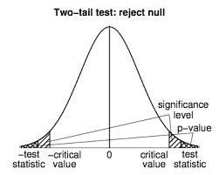
Factors That Affect Power
The power of a hypothesis test is affected by three factors.
Sample size (n). Other things being equal, the greater the sample size, the greater the power of the test.
Significance level (α). The higher the significance level, the higher the power of the test. If you increase the significance level, you reduce the region of acceptance. As a result, you are more likely to reject the null hypothesis. This means you are less likely to accept the null hypothesis when it is false; i.e., less likely to make a Type II error. Hence, the power of the test is increased.
The "true" value of the parameter being tested. The greater the difference between the "true" value of a parameter and the value specified in the null hypothesis, the greater the power of the test. That is, the greater the effect size, the greater the power of the test.

Slide 30
Problem
Suppose a researcher conducts an experiment to test a hypothesis. If she doubles her sample size, which of the following will increase?
I. The power of the hypothesis test. II. The effect size of the hypothesis test. III. The probability of making a Type II error.
(A) I only (B) II only (C) III only (D) All of the above (E) None of the above
Solution
The correct answer is (A). Increasing sample size makes the hypothesis test more sensitive - more likely to reject the null hypothesis when it is, in fact, false. Thus, it increases the power of the test.
The effect size is not affected by sample size. And the probability of making a Type II error gets smaller, not bigger, as sample size increases.

Slide 31

One Sample t -test
A supplier of a part to a large organization claims that the mean weight of this part is 90 grams. The organization took a small sample of 20 parts and found that the mean score is 84 grams and standard deviation is 11. Could this sample originate from a population of mean = 90 grams?
The organization wants to test this at significance level of 0.05, i.e., it is willing to take only a 5 percent risk of being wrong when it says the sample is not from the population. Therefore:
Null Hypothesis (H0): “True Population Mean Score is 90” Alternative Hypothesis (Ha): “True Population Mean Score is not 90” Alpha is 0.05
Farther away the observed or measured sample mean is from the hypothesized mean, the lower the probability (i.e., the p-value) that the null hypothesis is true. However, what is far enough?

Slide 32
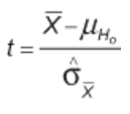


In this example, the difference between the sample mean and the hypothesized population mean is 6. Is that difference big enough to reject H0? In order to answer the question, the sample mean needs to be standardized and the so-called t-statistics or t-value need to be calculated.
In this formula, is the standard error of the mean (SE mean). Because the population standard deviation is not known, we have to estimate the SE mean. It can be estimated by the following equation:

Slide 33
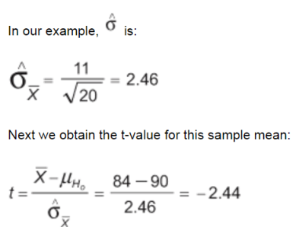
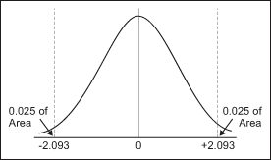
Finally, this t-value must be compared with the critical value of t. The critical t-value marks the threshold that – if it is exceeded – leads to the conclusion that the difference between the observed sample mean and the hypothesized population mean is large enough to reject H0. The critical t-value equals the value whose probability of occurrence is less or equal to 5 percent. From the t-distribution tables, one can find that the critical value of t is +/- 2.093.
Since the retrieved t-value of -2.44 is smaller than the critical value of -2.093, the null hypothesis must be rejected (i.e., the sample mean is not from the hypothesized population) and the supplier’s claims must be questioned.

Slide 34
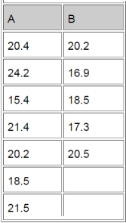
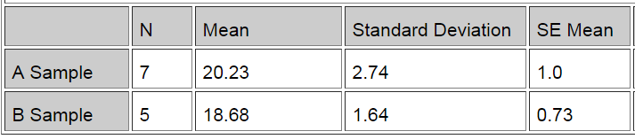
The Two-Sample T-Test
The question being answered is whether there is a significant (or only random) difference in the average cycle time to deliver a pizza from Pizza Company A vs. Pizza Company B. This is the data collected from a sample of deliveries of Company A and Company B.

Slide 35
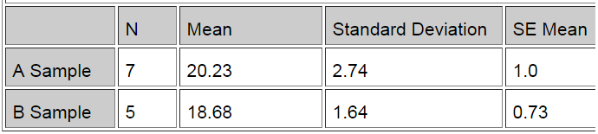
Difference = mu (A Sample) – mu (B Sample) Estimate for difference: 1.54857 95% CI for difference: (-1.53393, 4.63107) T-test of difference = 0 (vs not =): T-value = 1.12, P-value = 0.289, DF = 10 Both use pooled StDev = 2.3627
Since the p-value is 0.289, i.e. greater than 0.05 (or 5 percent), it can be concluded that there is no difference between the means. To say that there is a difference is taking a 28.9 percent risk of being wrong.

Slide 36

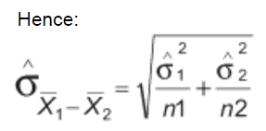
The Two-Sample T-Test
In the two-sample t-test, two sample means are compared to discover whether they come from the same population (meaning there is no difference between the two population means).
Now, because the question is whether two populations are actually one and the same, the first step is to obtain the SE mean from the sampling distribution of the difference between two sample means.
Again, since the population standard deviations of both of the two populations are unknown, the standard error of the two sample means must be estimated.
In the one-sample t-test, the SE mean was computed as such:

Slide 37
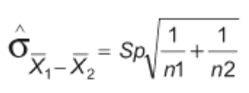
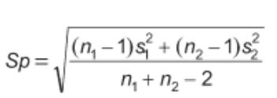
However, this is only appropriate when samples are large (both greater than 30). Where samples are smaller, use the following method:
Sp is a pooled estimate of the common population standard deviation. Hence, in this method it can be assumed that variances are equal for both populations. If it cannot be assumed, it cannot be used.

Slide 38
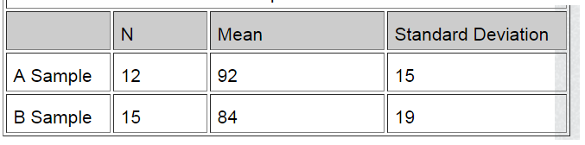
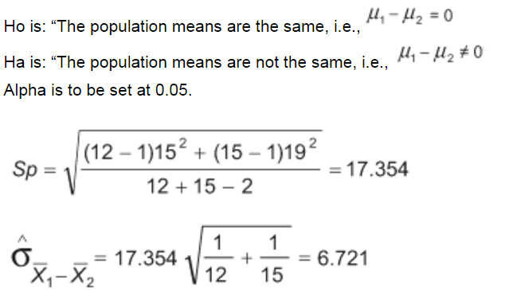
The Two-Sample T-Test

Slide 39

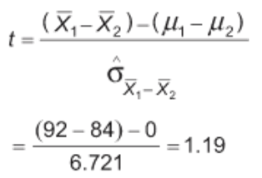
The Two-Sample T-Test
In the two-sample t-test, the t-statistics are retrieved by subtracting the difference between the two sample means from the null hypothesis, which is zero.
Looking up t-tables (using spreadsheet software, such as Excel’s TINV function, is easiest), one finds that the critical value of t is 2.06. Again, this means that if the standardized difference between the two sample means (and that is exactly what the t value indicates) is larger than 2.06, it can be concluded that there is a significant difference between population means.
Here, 1.19 is less than 2.06; thus, it is the null hypothesis that = 0.

Slide 40
Hypothesis Test for a Proportion
Problem 1: Two-Tailed Test
The CEO of a large electric utility claims that 80 percent of his 1,000,000 customers are very satisfied with the service they receive. To test this claim, the local newspaper surveyed 100 customers, using simple random sampling. Among the sampled customers, 73 percent say they are very satisified. Based on these findings, can we reject the CEO's hypothesis that 80% of the customers are very satisfied? Use a 0.05 level of significance.
Solution: The solution to this problem takes four steps: (1) state the hypotheses, (2) formulate an analysis plan, (3) analyze sample data, and (4) interpret results. We work through those steps below:
State the hypotheses. The first step is to state the null hypothesis and an alternative hypothesis.
Null hypothesis: P = 0.80 Alternative hypothesis: P ≠ 0.80
Note that these hypotheses constitute a two-tailed test. The null hypothesis will be rejected if the sample proportion is too big or if it is too small.

Slide 41
Hypothesis Test for a Proportion cont..
Formulate an analysis plan. For this analysis, the significance level is 0.05. The test method, shown in the next section, is a one-sample z-test.
Analyze sample data. Using sample data, we calculate the standard deviation (σ) and compute the z-score test statistic (z).
σ = sqrt[ P * ( 1 - P ) / n ] = sqrt [(0.8 * 0.2) / 100] = sqrt(0.0016) = 0.04 z = (p - P) / σ = (.73 - .80)/0.04 = -1.75
where P is the hypothesized value of population proportion in the null hypothesis, p is the sample proportion, and n is the sample size.
Since we have a two-tailed test, the P-value is the probability that the z-score is less than -1.75 or greater than 1.75.
We use the Normal Distribution Calculator to find P(z < -1.75) = 0.04, and P(z > 1.75) = 0.04. Thus, the P-value = 0.04 + 0.04 = 0.08.
Interpret results. Since the P-value (0.08) is greater than the significance level (0.05), we cannot reject the null hypothesis.

Slide 42
Hypothesis Test for a Proportion cont..
Problem 2: One-Tailed Test
Suppose the previous example is stated a little bit differently.
Suppose the CEO claims that at least 80 percent of the company's 1,000,000 customers are very satisfied. Again, 100 customers are surveyed using simple random sampling. The result: 73 percent are very satisfied. Based on these results, should we accept or reject the CEO's hypothesis? Assume a significance level of 0.05.
State the hypotheses. The first step is to state the null hypothesis and an alternative hypothesis.
Null hypothesis: P >= 0.80 Alternative hypothesis: P < 0.80
Note that these hypotheses constitute a one-tailed test. The null hypothesis will be rejected only if the sample proportion is too small.

Slide 43
Hypothesis Test for a Proportion cont..
Formulate an analysis plan. For this analysis, the significance level is 0.05. The test method, shown in the next section, is a one-sample z-test.
Analyze sample data. Using sample data, we calculate the standard deviation (σ) and compute the z-score test statistic (z).
σ = sqrt[ P * ( 1 - P ) / n ] = sqrt [(0.8 * 0.2) / 100] = sqrt(0.0016) = 0.04 z = (p - P) / σ = (.73 - .80)/0.04 = -1.75
where P is the hypothesized value of population proportion in the null hypothesis, p is the sample proportion, and n is the sample size.
Since we have a one-tailed test, the P-value is the probability that the z-score is less than -1.75. We use the Normal Distribution Calculator to find P(z < -1.75) = 0.04. Thus, the P-value = 0.04.
Interpret results. Since the P-value (0.04) is less than the significance level (0.05), we cannot accept the null hypothesis.

Slide 44
Hypothesis Test: Difference Between Proportions
Problem 1: Two-Tailed Test
Suppose the Acme Drug Company develops a new drug, designed to prevent colds. The company states that the drug is equally effective for men and women. To test this claim, they choose a a simple random sample of 100 women and 200 men from a population of 100,000 volunteers.
At the end of the study, 38% of the women caught a cold; and 51% of the men caught a cold. Based on these findings, can we reject the company's claim that the drug is equally effective for men and women? Use a 0.05 level of significance.
Solution: The solution to this problem takes four steps: (1) state the hypotheses, (2) formulate an analysis plan, (3) analyze sample data, and (4) interpret results. We work through those steps below:
State the hypotheses. The first step is to state the null hypothesis and an alternative hypothesis.
Null hypothesis: P₁ = P₂ Alternative hypothesis: P₁ ≠ P₂
Note that these hypotheses constitute a two-tailed test. The null hypothesis will be rejected if the proportion from population 1 is too big or if it is too small.

Slide 45
Hypothesis Test: Difference Between Proportions cont..
Formulate an analysis plan. For this analysis, the significance level is 0.05. The test method is a two-proportion z-test.
Analyze sample data. Using sample data, we calculate the pooled sample proportion (p) and the standard error (SE). Using those measures, we compute the z-score test statistic (z).
p = (p₁ * n₁ + p₂ * n₂) / (n₁ + n₂) = [(0.38 * 100) + (0.51 * 200)] / (100 + 200) = 140/300 = 0.467 SE = sqrt{ p * ( 1 - p ) * [ (1/n₁) + (1/n₂) ] } SE = sqrt [ 0.467 * 0.533 * ( 1/100 + 1/200 ) ] = sqrt [0.003733] = 0.061 z = (p₁ - p₂) / SE = (0.38 - 0.51)/0.061 = -2.13
where p₁ is the sample proportion in sample 1, where p₂ is the sample proportion in sample 2, n₁ is the size of sample 1, and n₂ is the size of sample 2.
Since we have a two-tailed test, the P-value is the probability that the z-score is less than -2.13 or greater than 2.13.
We use the Normal Distribution Calculator to find P(z < -2.13) = 0.017, and P(z > 2.13) = 0.017. Thus, the P-value = 0.017 + 0.017 = 0.034.
Interpret results. Since the P-value (0.034) is less than the significance level (0.05), we cannot accept the null hypothesis.

Slide 46
Hypothesis Test for a Mean
Problem 1: Two-Tailed Test
An inventor has developed a new, energy-efficient lawn mower engine. He claims that the engine will run continuously for 5 hours (300 minutes) on a single gallon of regular gasoline. From his stock of 2000 engines, the inventor selects a simple random sample of 50 engines for testing. The engines run for an average of 295 minutes, with a standard deviation of 20 minutes. Test the null hypothesis that the mean run time is 300 minutes against the alternative hypothesis that the mean run time is not 300 minutes. Use a 0.05 level of significance. (Assume that run times for the population of engines are normally distributed.)
State the hypotheses. The first step is to state the null hypothesis and an alternative hypothesis.
Null hypothesis: μ = 300 Alternative hypothesis: μ ≠ 300
Note that these hypotheses constitute a two-tailed test. The null hypothesis will be rejected if the sample mean is too big or if it is too small.
Formulate an analysis plan. For this analysis, the significance level is 0.05. The test method is a one-sample t-test.

Slide 47
Hypothesis Test for a Mean
Analyze sample data. Using sample data, we compute the standard error (SE), degrees of freedom (DF), and the t statistic test statistic (t).
SE = s / sqrt(n) = 20 / sqrt(50) = 20/7.07 = 2.83 DF = n - 1 = 50 - 1 = 49 t = (x - μ) / SE = (295 - 300)/2.83 = -1.77
where s is the standard deviation of the sample, x is the sample mean, μ is the hypothesized population mean, and n is the sample size.
Since we have a two-tailed test, the P-value is the probability that the t statistic having 49 degrees of freedom is less than -1.77 or greater than 1.77.
We use the t Distribution Calculator to find P(t < -1.77) = 0.04, and P(t > 1.77) = 0.04.
Thus, the P-value = 0.04 + 0.04 = 0.08.
Interpret results. Since the P-value (0.08) is greater than the significance level (0.05), we cannot reject the null hypothesis.
Note: If you use this approach on an exam, you may also want to mention why this approach is appropriate. Specifically, the approach is appropriate because the sampling method was simple random sampling, the population was normally distributed, and the sample size was small relative to the population size (less than 5%).

Slide 48
Hypothesis Test for a Mean
Problem 2: One-Tailed Test Bon Air Elementary School has 1000 students. The principal of the school thinks that the average IQ of students at Bon Air is at least 110. To prove her point, she administers an IQ test to 20 randomly selected students. Among the sampled students, the average IQ is 108 with a standard deviation of 10. Based on these results, should the principal accept or reject her original hypothesis? Assume a significance level of 0.01. (Assume that test scores in the population of engines are normally distributed.)
Null hypothesis: μ >= 110 Alternative hypothesis: μ < 110
Formulate an analysis plan. For this analysis, the significance level is 0.01. The test method is a one-sample t-test.

Slide 49
Hypothesis Test for a Mean
Analyze sample data. Using sample data, we compute the standard error (SE), degrees of freedom (DF), and the t statistic test statistic (t).
SE = s / sqrt(n) = 10 / sqrt(20) = 10/4.472 = 2.236 DF = n - 1 = 20 - 1 = 19 t = (x - μ) / SE = (108 - 110)/2.236 = -0.894
where s is the standard deviation of the sample, x is the sample mean, μ is the hypothesized population mean, and n is the sample size.
Here is the logic of the analysis: Given the alternative hypothesis (μ < 110), we want to know whether the observed sample mean is small enough to cause us to reject the null hypothesis.
The observed sample mean produced a t statistic test statistic of -0.894. We use the t Distribution Calculator to find P(t < -0.894) = 0.19. This means we would expect to find a sample mean of 108 or smaller in 19 percent of our samples, if the true population IQ were 110. Thus the P-value in this analysis is 0.19.
Interpret results. Since the P-value (0.19) is greater than the significance level (0.01), we cannot reject the null hypothesis.

Slide 50
Hypothesis Test: Difference Between Means
Problem 1: Two-Tailed Test
Within a school district, students were randomly assigned to one of two Math teachers - Mrs. Smith and Mrs. Jones. After the assignment, Mrs. Smith had 30 students, and Mrs. Jones had 25 students.
At the end of the year, each class took the same standardized test. Mrs. Smith's students had an average test score of 78, with a standard deviation of 10; and Mrs. Jones' students had an average test score of 85, with a standard deviation of 15.
Test the hypothesis that Mrs. Smith and Mrs. Jones are equally effective teachers. Use a 0.10 level of significance. (Assume that student performance is approximately normal.)
State the hypotheses. The first step is to state the null hypothesis and an alternative hypothesis.
Null hypothesis: μ₁ - μ₂ = 0 Alternative hypothesis: μ₁ - μ₂ ≠ 0
Note that these hypotheses constitute a two-tailed test. The null hypothesis will be rejected if the difference between sample means is too big or if it is too small.

Slide 51
Hypothesis Test: Difference Between Means
Formulate an analysis plan. For this analysis, the significance level is 0.10. Using sample data, we will conduct a two-sample t-test of the null hypothesis.
Analyze sample data. Using sample data, we compute the standard error (SE), degrees of freedom (DF), and the t statistic test statistic (t).
SE = sqrt[(s₁²/n₁) + (s₂²/n₂)] SE = sqrt[(10²/30) + (15²/25] = sqrt(3.33 + 9) = sqrt(12.33) = 3.51 DF = (s₁²/n₁ + s₂²/n₂)² / { [ (s₁² / n₁)² / (n₁ - 1) ] + [ (s₂² / n₂)² / (n₂ - 1) ] } DF = (10²/30 + 15²/25)² / { [ (10² / 30)² / (29) ] + [ (15² / 25)² / (24) ] } DF = (3.33 + 9)² / { [ (3.33)² / (29) ] + [ (9)² / (24) ] } = 152.03 / (0.382 + 3.375) = 152.03/3.757 = 40.47 t = [ (x₁ - x₂) - d ] / SE = [ (78 - 85) - 0 ] / 3.51 = -7/3.51 = -1.99
where s₁ is the standard deviation of sample 1, s₂ is the standard deviation of sample 2, n₁ is the size of sample 1, n₂ is the size of sample 2, x₁ is the mean of sample 1, x₂ is the mean of sample 2, d is the hypothesized difference between the population means, and SE is the standard error.
Since we have a two-tailed test, the P-value is the probability that a t statistic having 40 degrees of freedom is more extreme than -1.99; that is, less than -1.99 or greater than 1.99.
We use the t Distribution Calculator to find P(t < -1.99) = 0.027, and P(t > 1.99) = 0.027. Thus, the P-value = 0.027 + 0.027 = 0.054.
Interpret results. Since the P-value (0.054) is less than the significance level (0.10), we cannot accept the null hypothesis.

Slide 52
Hypothesis Test: Difference Between Means
Problem 2: One-Tailed Test
The Acme Company has developed a new battery. The engineer in charge claims that the new battery will operate continuously for at least 7 minutes longer than the old battery.
To test the claim, the company selects a simple random sample of 100 new batteries and 100 old batteries. The old batteries run continuously for 190 minutes with a standard deviation of 20 minutes; the new batteries, 200 minutes with a standard deviation of 40 minutes.
Test the engineer's claim that the new batteries run at least 7 minutes longer than the old. Use a 0.05 level of significance. (Assume that there are no outliers in either sample.)
State the hypotheses. The first step is to state the null hypothesis and an alternative hypothesis.
Null hypothesis: μ₁ - μ₂ >= 7 Alternative hypothesis: μ₁ - μ₂ < 7
Note that these hypotheses constitute a one-tailed test. The null hypothesis will be rejected if the mean difference between sample means is too small.

Slide 53
Hypothesis Test: Difference Between Means
Formulate an analysis plan. For this analysis, the significance level is 0.05.
Analyze sample data. Using sample data, we compute the standard error (SE), degrees of freedom (DF), and the t statistic test statistic (t).
SE = sqrt[(s₁²/n₁) + (s₂²/n₂)]
SE = sqrt[(40²/100) + (20²/100] = sqrt(16 + 4) = 4.472 DF = (s₁²/n₁ + s₂²/n₂)² / { [ (s₁² / n₁)² / (n₁ - 1) ] + [ (s₂² / n₂)² / (n₂ - 1) ] } DF = (40²/100 + 20²/100)² / { [ (40² / 100)² / (99) ] + [ (20² / 100)² / (99) ] } DF = (20)² / { [ (16)² / (99) ] + [ (2)² / (99) ] } = 400 / (2.586 + 0.162) = 145.56 t = [ (x₁ - x₂) - d ] / SE = [(200 - 190) - 7] / 4.472 = 3/4.472 = 0.67
where s₁ is the standard deviation of sample 1, s₂ is the standard deviation of sample 2, n₁ is the size of sample 1, n₂ is the size of sample 2, x₁ is the mean of sample 1, x₂ is the mean of sample 2, d is the hypothesized difference between population means, and SE is the standard error.

Slide 54
Hypothesis Test: Difference Between Means
Here is the logic of the analysis: Given the alternative hypothesis (μ₁ - μ₂ < 7), we want to know whether the observed difference in sample means is small enough (i.e., sufficiently less than 7) to cause us to reject the null hypothesis.
The observed difference in sample means (10) produced a t statistic of 0.67. We use the t Distribution Calculator to find P(t < 0.67) = 0.75.
This means we would expect to find an observed difference in sample means of 10 or less in 75% of our samples, if the true difference were actually 7. Therefore, the P-value in this analysis is 0.75.
Interpret results. Since the P-value (0.75) is greater than the significance level (0.05), we cannot reject the null hypothesis.

Slide 55
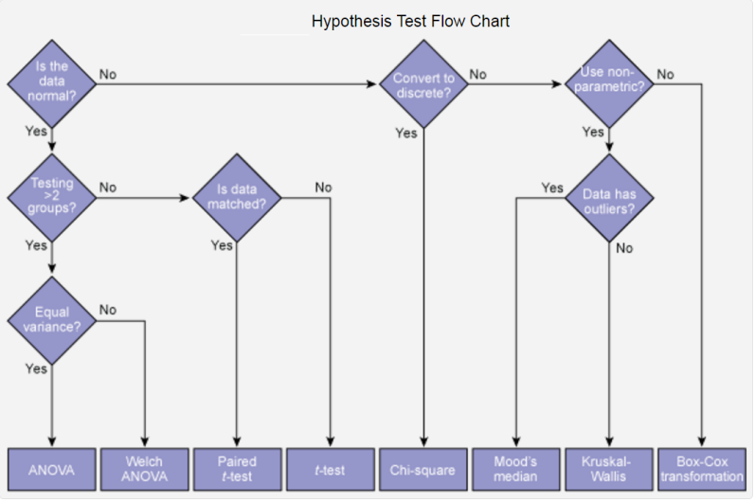
Hypothesis Test Flow Chart

Slide 56
What is a Z-test?
Learn more about Minitab 17
A Z-test is a hypothesis test based on the Z-statistic, which follows the standard normal distribution under the null hypothesis.
The simplest Z-test is the 1-sample Z-test, which tests the mean of a normally distributed population with known variance. For example, the manager of a candy manufacturer wants to know whether the mean weight of a batch of candy boxes is equal to the target value of 10 ounces. From historical data, they know that the filling machine has a standard deviation of 0.5 ounces, so they use this value as the population standard deviation in a 1-sample Z-test.
You can also use Z-tests to determine whether predictor variables in probit analysis and logistic regression have a significant effect on the response. The null hypothesis states that the predictor is not significant.
You also have the option to use a Z-test to do a normal approximation for tests of Poisson rate and tests of proportions. These normal approximations are valid when the sample size and the number of events are adequately large.

