Slide 1
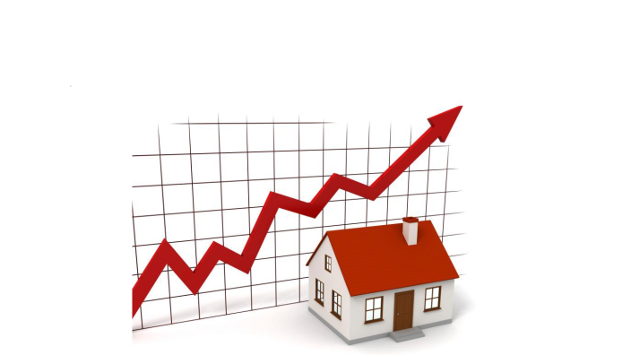
House Price prediction using KNN
By
Pradeep Mandapati

Slide 2
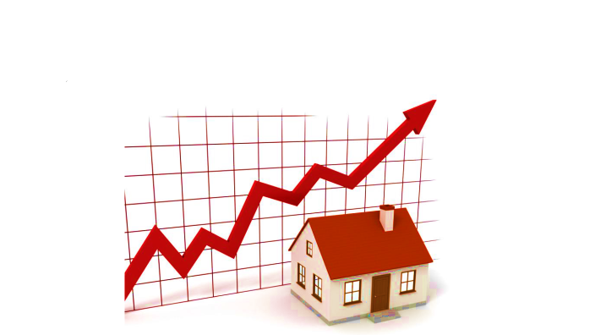
Agenda
Objective
Data Cleaning
Pre Processing for KNN
KNN Classification
KNN Regression
Conclusion
Questions

Slide 3
Objective
Classification Objective:
The objective is to estimate the appropriate house price quartile through KNN-based classification.
Regression Objective:
The objective is to estimate the appropriate house price through KNN-based Regression.

Slide 4


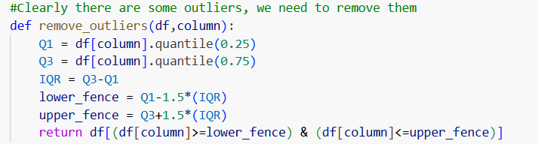
Data Cleaning
Remove the duplicates if any( We don’t have any duplicate data)
Replace any nan, NaN, None with np.nan
Convert the data types into relevant data types
Remove any outliers

Slide 5
Pre Processing for KNN
Normalize features
Since KNN is highly sensitive to feature scales, data normalization is essential.
Create a new feature: price_per_sqft
Compute the ratio of price ÷ lot_area.
Normalize price_per_sqft
Divide the new feature by 50 to bring its values to a comparable scale.
Create a new categorical feature: region
Segment the normalized price_per_sqft values into 16 quantile-based groups.

Slide 6
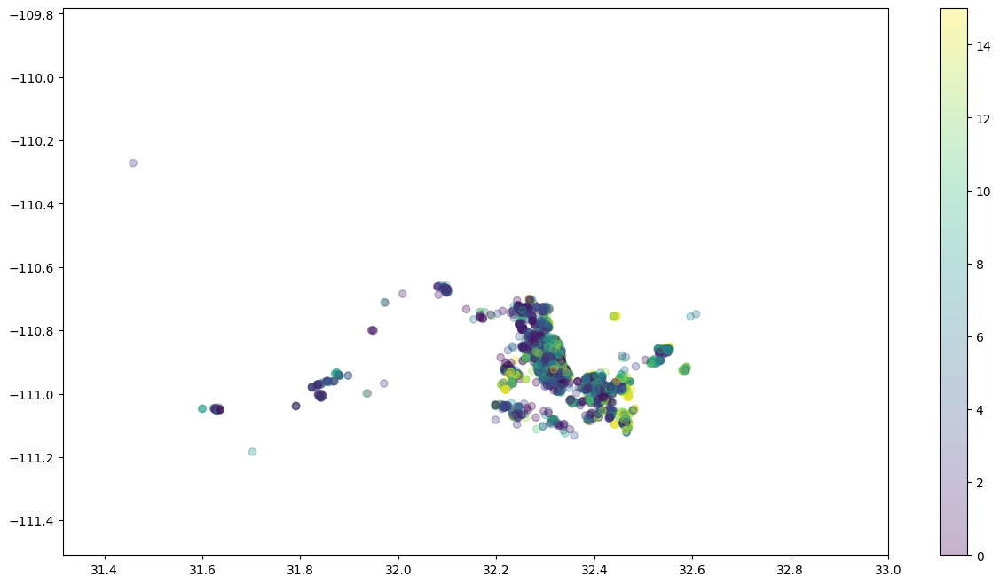
KNN Classification
The ‘region’ feature serves as the classification label, with KNN applied using geographic coordinates (latitude and longitude)
The below figure speaks about the spread of the regions wrt to geographic coordinates
KNN Accuracy:63.03%

Slide 7
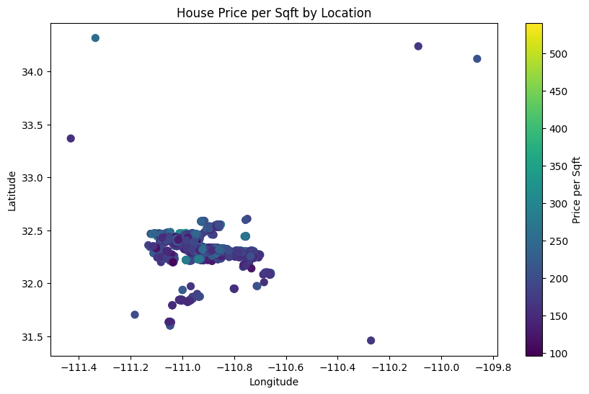
KNN Regression
The ‘sold_price’ serves as the label, with KNN applied 'latitude', 'longitude', 'bedrooms', 'bathrooms’ feature
The below figure speaks about the price per square feet wrt to geographic coordinates

Slide 8
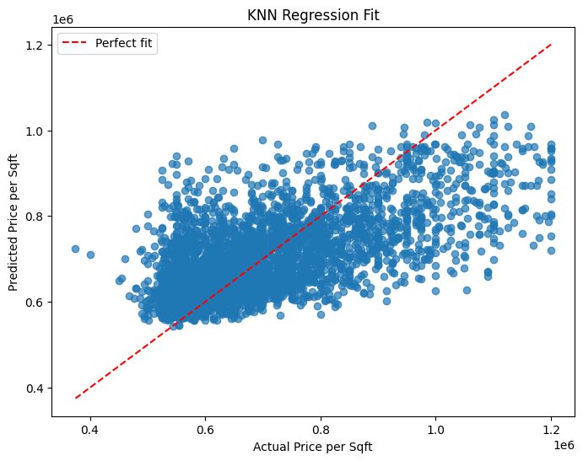
Cont.
The below figure speaks about the Ture sold value Vs Predicted sold of a property Value using KNN

Slide 9
Conclusion
Pre Procession of the data is done so that the KNN model can predict the required feature.
KNN Classification has an accuracy of 63.03%
KNN Regression has a good prediction rate

Slide 10
Questions

Slide 11
Thank You

