Slide 1

DMA COURSE PROJECT
G2NET: Gravitational Wave Detection
Team No:05
Team Members:
Pradeep Chegur – 01fe19bcs294
Praveen Thakkannavar – 01fe19bcs298
Swagat Ingalagaon – 01fe19bcs299
Naveen Doddamani – 01FE19BCS305
Under the Guidance of
-Prof. Shankar G

Slide 2
Problem Statement:
Detecting of Gravitational Waves from binary black holes collisions.
Challenge:
To build a model that analyze and detect Gravitational Wave time-series data from a network of Earth-based detectors.
Challenge Deadline:
September 30, 2021.

Slide 3
Understanding of Dataset:
Given a set of time series data containing simulated gravitational wave measurements from a network of 3 gravitational wave interferometers (LIGO Hanford, LIGO Livingston, and Virgo).
Train DATA:
Test DATA:
Number of rows : 560000
Number of Columns : 2
Attributes : ID, Target.
Number of rows : 226000
Number of Columns : 2
Attributes : ID, Target.
Attributes | Description
ID | Unique value for every wave
Target | The value for detecting when Gravitational Wave signal is present in data

Slide 4
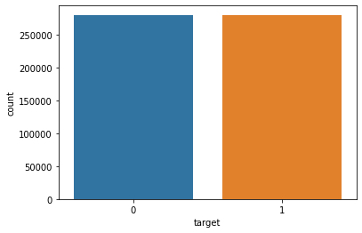
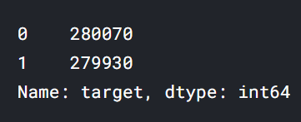
Data Visualization:
Target(0 or 1) VS count :
X-axis : value of ‘target’
Y axis : 1 unit = 50,000 records
Inference :
Out of the total 5,60,000 observations :
In 2,80,070 records no GW signals were detected.
In 2,79,930 records GW signals were detected.

Slide 5
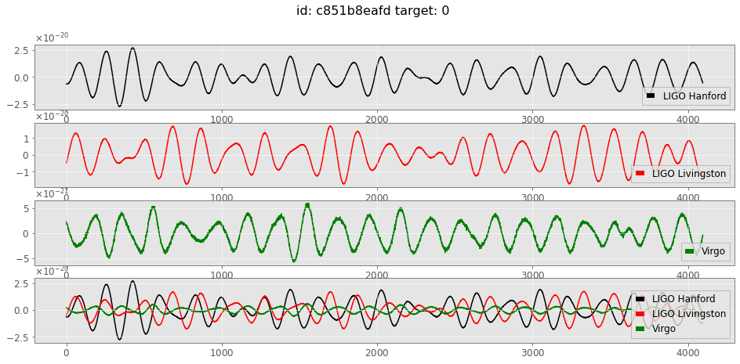
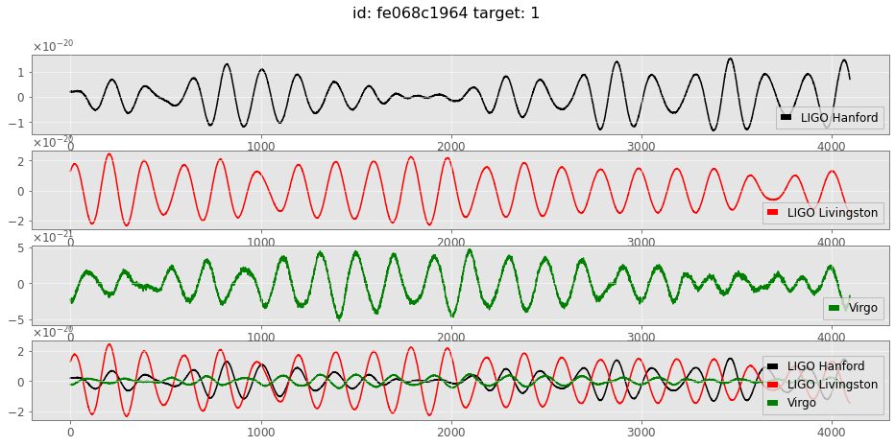
Data Visualization:

Slide 6
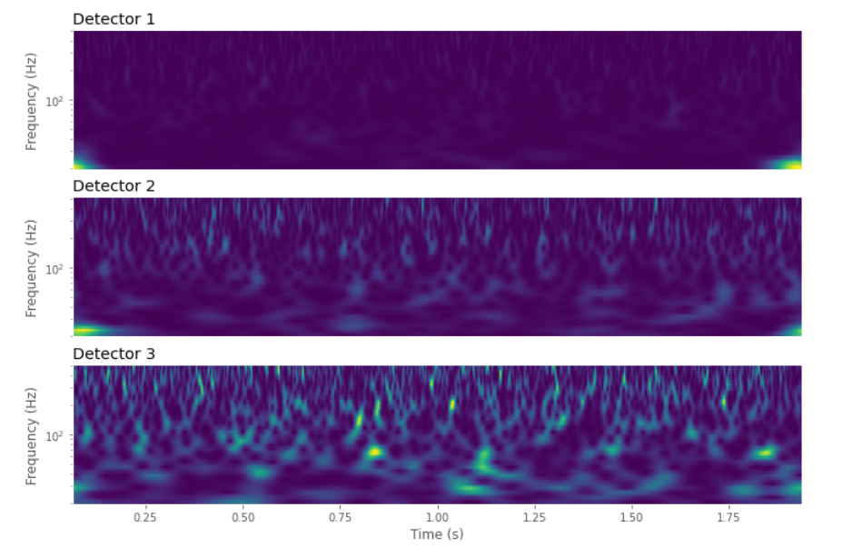
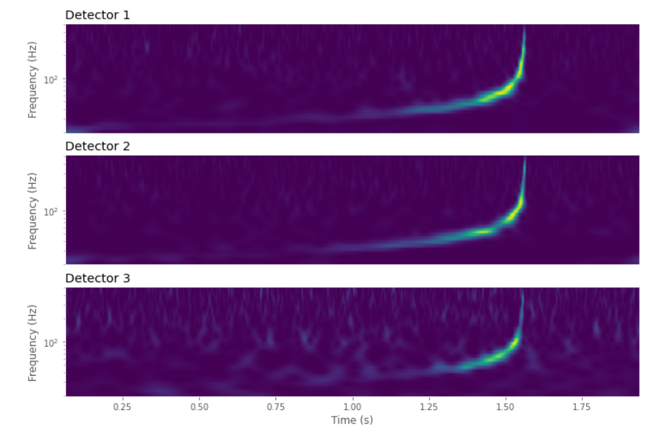
Constant Q-Transform:
Another way to visualize a GW signal is to perform a constant Q-transform (or CQT).
This is a time-frequency representation widely used in processing musical data.
Id: 3a14e1e694 Target: 0
Id: 7945e449f3 Target: 1

Slide 7
Pre-processing of Data:
Training set of time series data contains simulated gravitational wave measurements from a network of 3 gravitational wave interferometers (LIGO Hanford, LIGO Livingston, and Virgo).
Each time series contains either detector noise or detector noise plus a simulated gravitational wave signal.
Data cleaning here is about cleaning of digital signals - applying standard steps specific to “Digital Signal Processing” to avoid noise.
The 3 steps of data pre-processing are:
Applying a Window function.
Whitening the spectrum.
Bandpass.
Above steps referred from research paper named “A guide to LIGO–Virgo detector noise and extraction of transient gravitational-wave signals”.

Slide 8
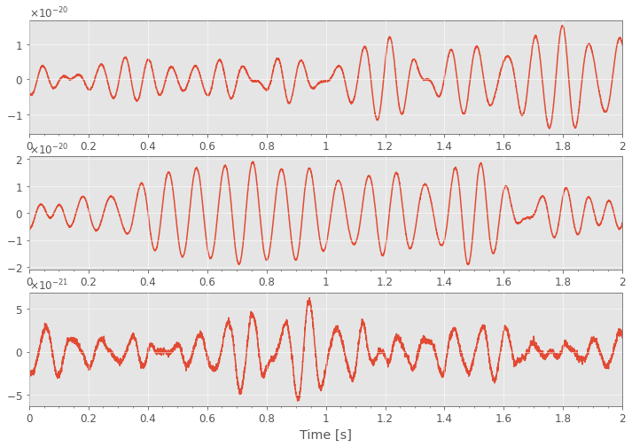
Before Pre-processing of a Single Data:
Selecting 000a5b6e5c.npy signal.
As signal is largely expandable across the ends, there is a need of window function to suppress spectral damage.

Slide 9
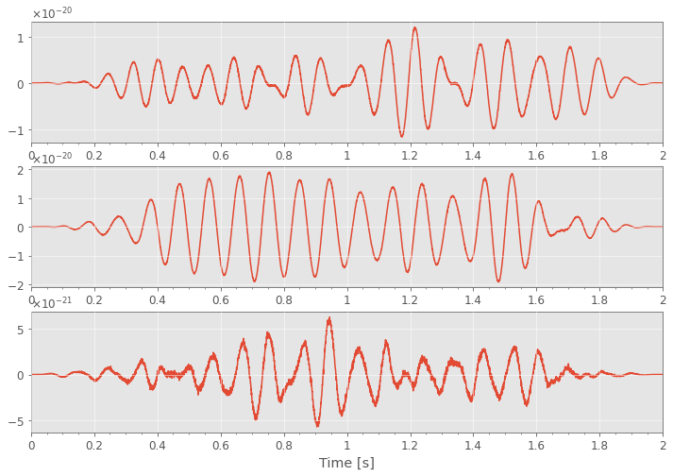
Applying Pre-processing steps:
Applying a window function: window = signal.tukey();
Advantage is signals will suffer less modification.
Before applying window function
After applying window function
Successfully suppressed spectral leakage.

Slide 10
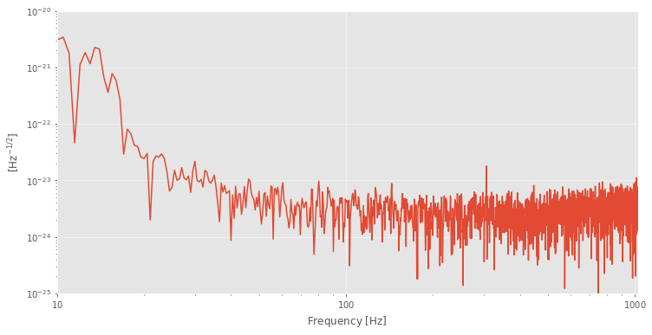
Before Applying further Pre-processing steps:
Signal Spectrum before applying Whitening and Bandpass.
From above spectrum we can conclude that there is a lot of low frequency noise. Hence moving on to next steps.

Slide 11
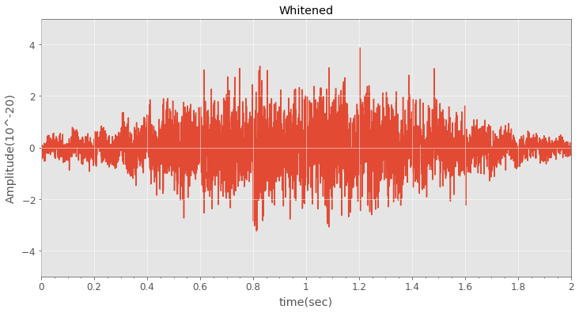
Applying Further Pre-processing steps:
Applying a whitening function: whiten_data= signal.whiten();
Advantage is it ensures the data in each frequency bin equal significance by down weighting where the noise is loud.

Slide 12
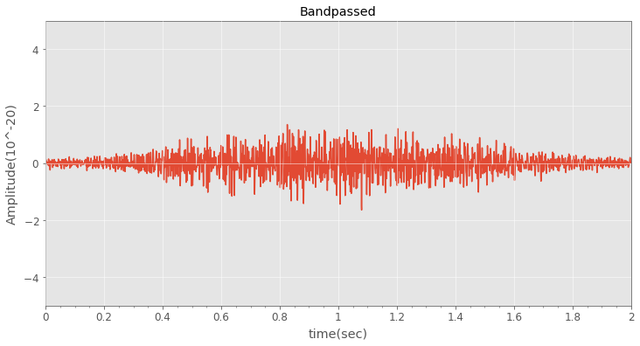
Applying Further Pre-processing steps:
Applying a bandpass function: bandpass_data= signal. bandpass();
Advantage is to remove noise outside of the specific range.
Referred range is (35,350) mentioned in research paper.

Slide 13
Learning Models Built:
1. Keras Model:
Keras is a powerful and easy-to-use free open source Python library for developing and evaluating deep learning models.
Keras can be used to build a neural network to solve a classification problem.
There are two ways to build Keras models:
Sequential API
Functional API
Sequential API allows to create models layer-by-layer for large data.
Sequential API is easy to create multiple layers.
In Sequential API, each layer has exactly one input and one output.
Functional API is for multiple inputs and multiple outputs.
Our model built by using Sequential API.

Slide 14
Data Generator Class for Keras Sequential Model building:
Data Generator class is to handle large data with batching, so the RAM does not need to handle the full data at once.
Functions used in this class are:
1. Initialization : To pass parameters.
2. Length : Returns the number of steps in an epoch.
3. Getitem : To obtain a given batch of data.
4. Data Generation : To produce batches of data.
In this model, we used
Used 1 Convoluted2D layer, 1 Flatten layer and 2 Dense layers.
Epoch used: 01

Slide 15
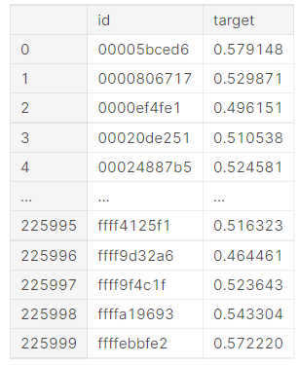
Result:
We got Sample Submission like this:
Validation Accuracy : 0.4983

Slide 16
2. Simple CNN Model:
The convolutional neural network models are used everywhere in the image data space.
They work phenomenally well on computer vision tasks like image classification, object detection, image recognition, etc.
In this model, we used
Epoch used: 03
Added 3 pairs of Convoluted2D layer and MaxPooling2D layer, 1 Flatten layer and 2 Dense layers.

Slide 17
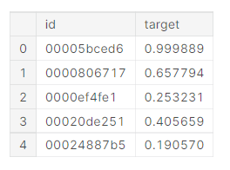
Result:
We got Sample Submission like this:
New Validation Accuracy : 0.8351
Accuracy Improved : 0.3368

Slide 18
3. Efficient net CNN Model:
In general, the EfficientNet models achieve both higher accuracy and better efficiency over existing CNNs, reducing parameter size and FLOPS by an order of magnitude.
The conventional practice for model scaling is to arbitrarily increase the CNN depth or width, or to use larger input image resolution for training and evaluation.
In this model, we used
Epoch used: 04
Added 6 Convoluted2D layer, 3 Flatten layer.

Slide 19
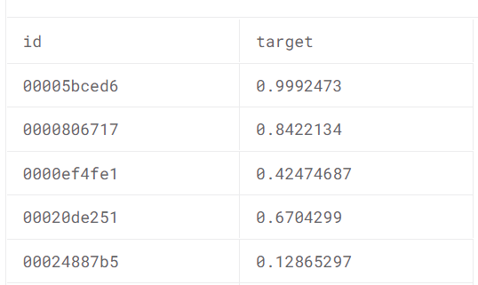
Result:
We got Sample Submission like this:
New Validation Accuracy : 0.8624
Accuracy Improved : 0.0273

Slide 20
Summary:
Model Name | Keras Model | Simple CNN Model | Efficient-Net CNN Model
Epoch Used | 01 | 03 | 04
Convoluted 2D Layer | 01 | 03 | 06
Maxpooling 2D Layer | 00 | 03 | 00
Flatten Layer | 01 | 01 | 03
Dense Layer | 02 | 03 | 00
Accuracy | 0.4983 | 0.8351 | 0.8624
Justification | A first basic model. Epoch used only one. Layers used are less. No Combination of Convoluted with Maxpooling layer. Hence accuracy is less. | Next to Keras Model. Epoch used three. At most 3 layers are used. Combination of Convoluted with Maxpooling layer. Hence accuracy is more. | Next to Simple CNN model. Epoch Used are four. At most 6 layers are used. No Combination of Convoluted with Maxpooling layer. Accuracy is maximum among three.
Leader Board Ranking | 1165 | 1019 | 578

Slide 21
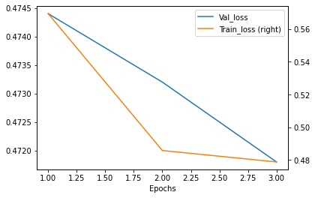
Model Visualization:
Plotting epoch vs train loss and test loss
Inference:
CNN Model:
As we can clearly see that the validation loss and Train loss is decreasing as we increase the number of epochs this means that to attain high accuracy the number of epochs should be more.

Slide 22
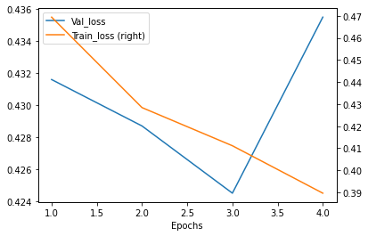
Model Visualization:
Plotting epoch vs train loss and test loss
Inference:
Efficient Net Model:
As we can clearly see that the validation loss and Train loss is decreasing as we increase the number of epochs up till epoch value is three.
This means that to attain high accuracy and to avoid the data loss the number of epochs should not exceed three so that the accuracy is maximum and loss is minimized.

Slide 23
Conclusions :
We understood complete KDD process.
We explored different Pre-processing steps that required for our problem statement.
We improved accuracy by adding more epochs and layers.
We started from basic model that is Keras model to higher model that is Efficient net model.

Slide 24
References:
https://www.kaggle.com/c/g2net-gravitational-wave-detection/overview – Challenge Link.
https://www.frontiersin.org/articles/10.3389/fspas.2020.00028/full – Information about Binary black hole.
https://spaceplace.nasa.gov/gravitational-waves/en/#:~:text=How%20are%20gravitational%20waves%20detected,it%20squeezes%20and%20stretches%20space.&text=A%20passing%20gravitational%20wave%20causes,to%20detect%20these%20tiny%20changes – Information about Gravitational Wave.
https://iopscience.iop.org/article/10.1088/1361-6382/ab685e – A guide to LIGO–Virgo detector noise and extraction of transient gravitational-wave signals.
https://gwpy.github.io/docs/latest/index.html – Basics of GWPY.
https://youtu.be/UeI4-kyuAwI – Reference video for the project.
https://machinelearningmastery.com/tutorial-first-neural-network-python-keras/ – Information about keras model.
https://www.analyticsvidhya.com/blog/2021/01/image-classification-using-convolutional-neural-networks-a-step-by-step-guide/ – Information about CNN model.

Slide 25
THANK YOU

