Slide 1
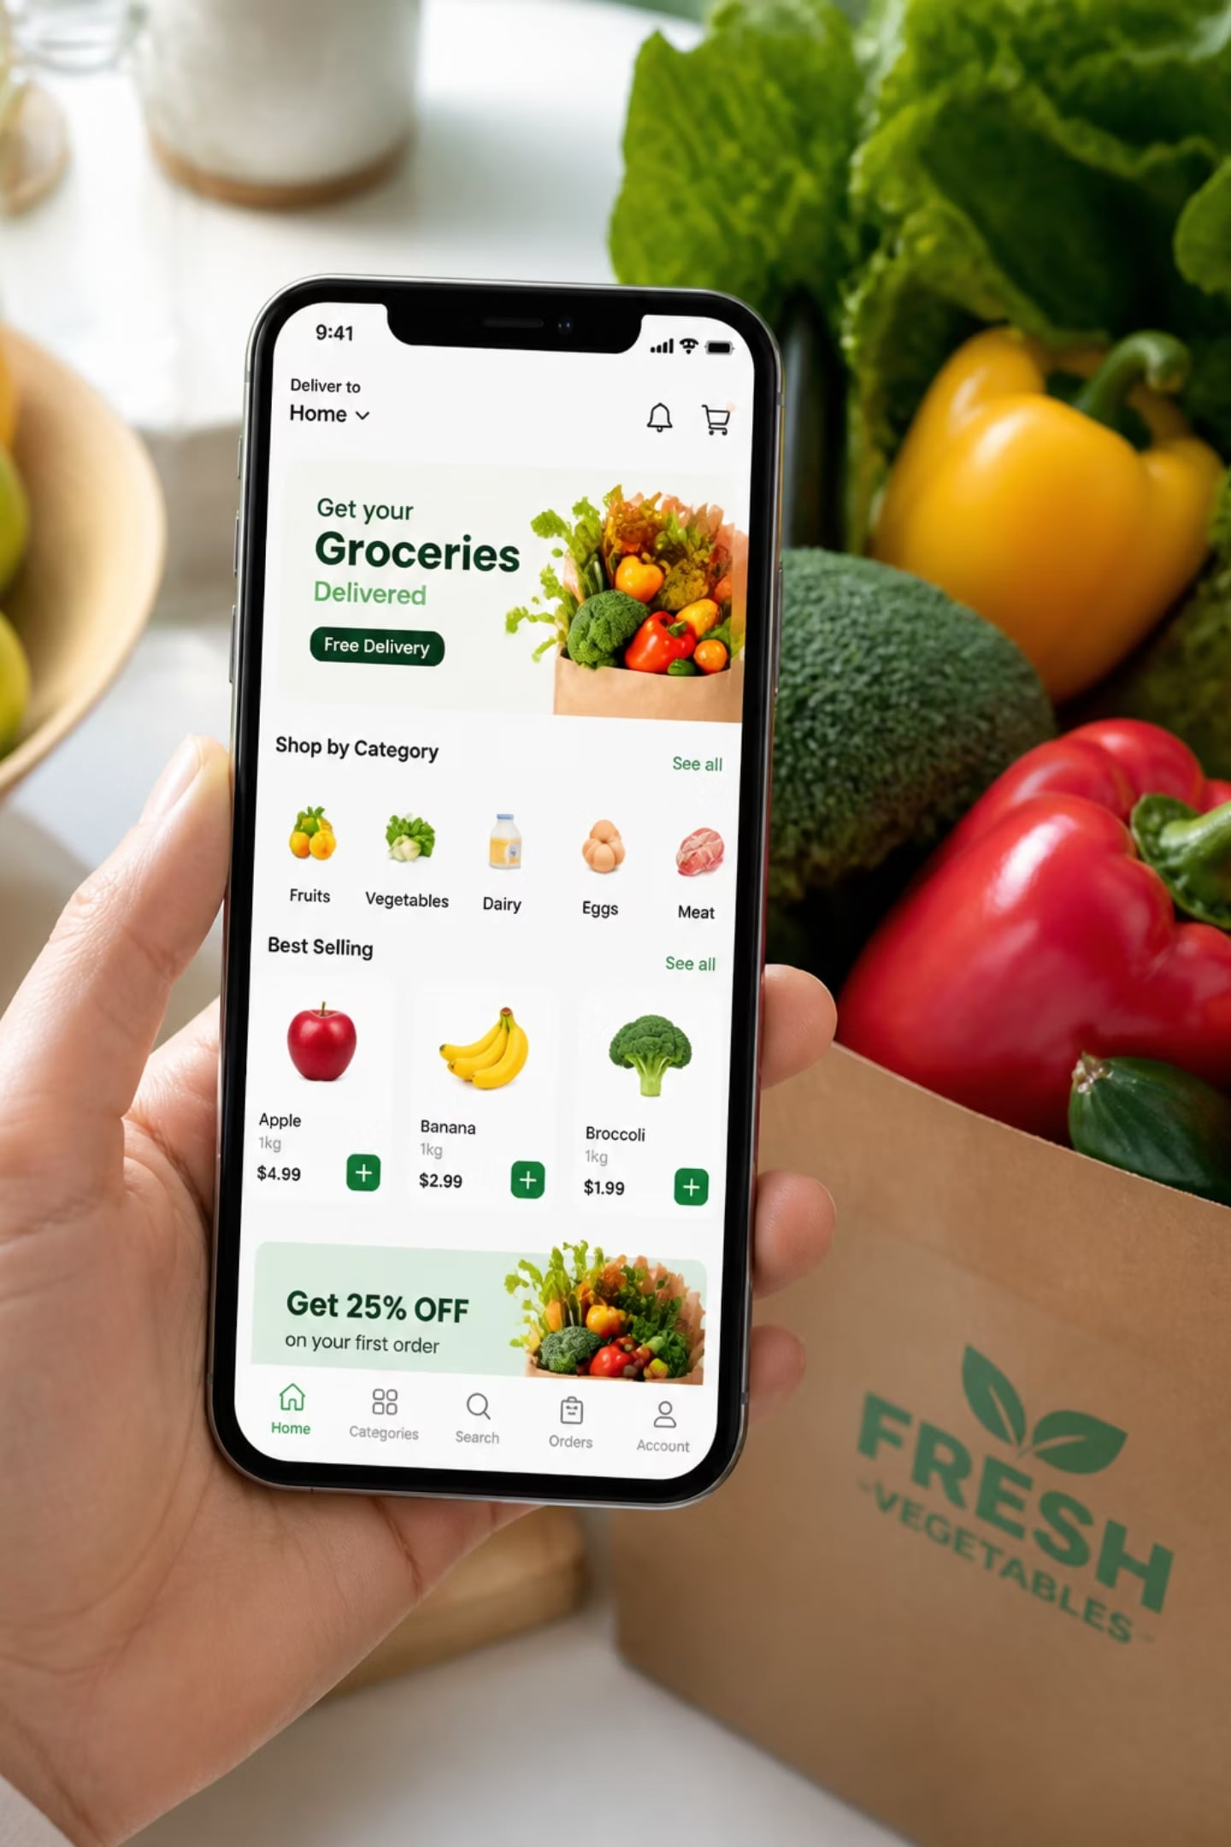
Blinkit Sales Analysis
A data-driven exploration of retail sales performance, customer preferences, and outlet efficiency — using Excel, Python, and Power BI to uncover actionable business insights.

Slide 2
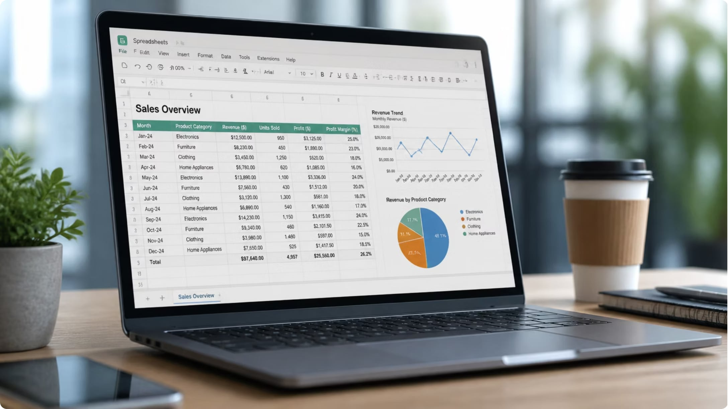
Dataset Overview
Dataset Size
8,523 rows across 12 parameters
Key Columns
Item Fat Content — Low Fat or Regular
Item Type — Category (Dairy, Fruits, Snacks, etc.)
Outlet Location — Tier 1, 2, or 3
Outlet Size — Small, Medium, High
Sales — Target metric for analysis
Rating — Customer product rating

Slide 3

Python Data Preparation
Null Values
1,463 nulls in Item Weight — filled using group-by mean per Item Identifier
Duplicates
No duplicate records found in the dataset
Standardization
Column names converted to snake_case; float values rounded to 2 decimals
SQL Export
Data imported into SQL via SQLAlchemy for structured analysis

Slide 4

Key Metrics at a Glance
₹12L
141
Total Sales
Avg. Sales
Across all outlets and items
Per transaction record
8,523
3.97
Total Items
Avg. Rating
Records in dataset
Customer product rating
Outlet lifespan spans 11 years (2011–2022), providing a robust longitudinal view of sales trends.

Slide 5
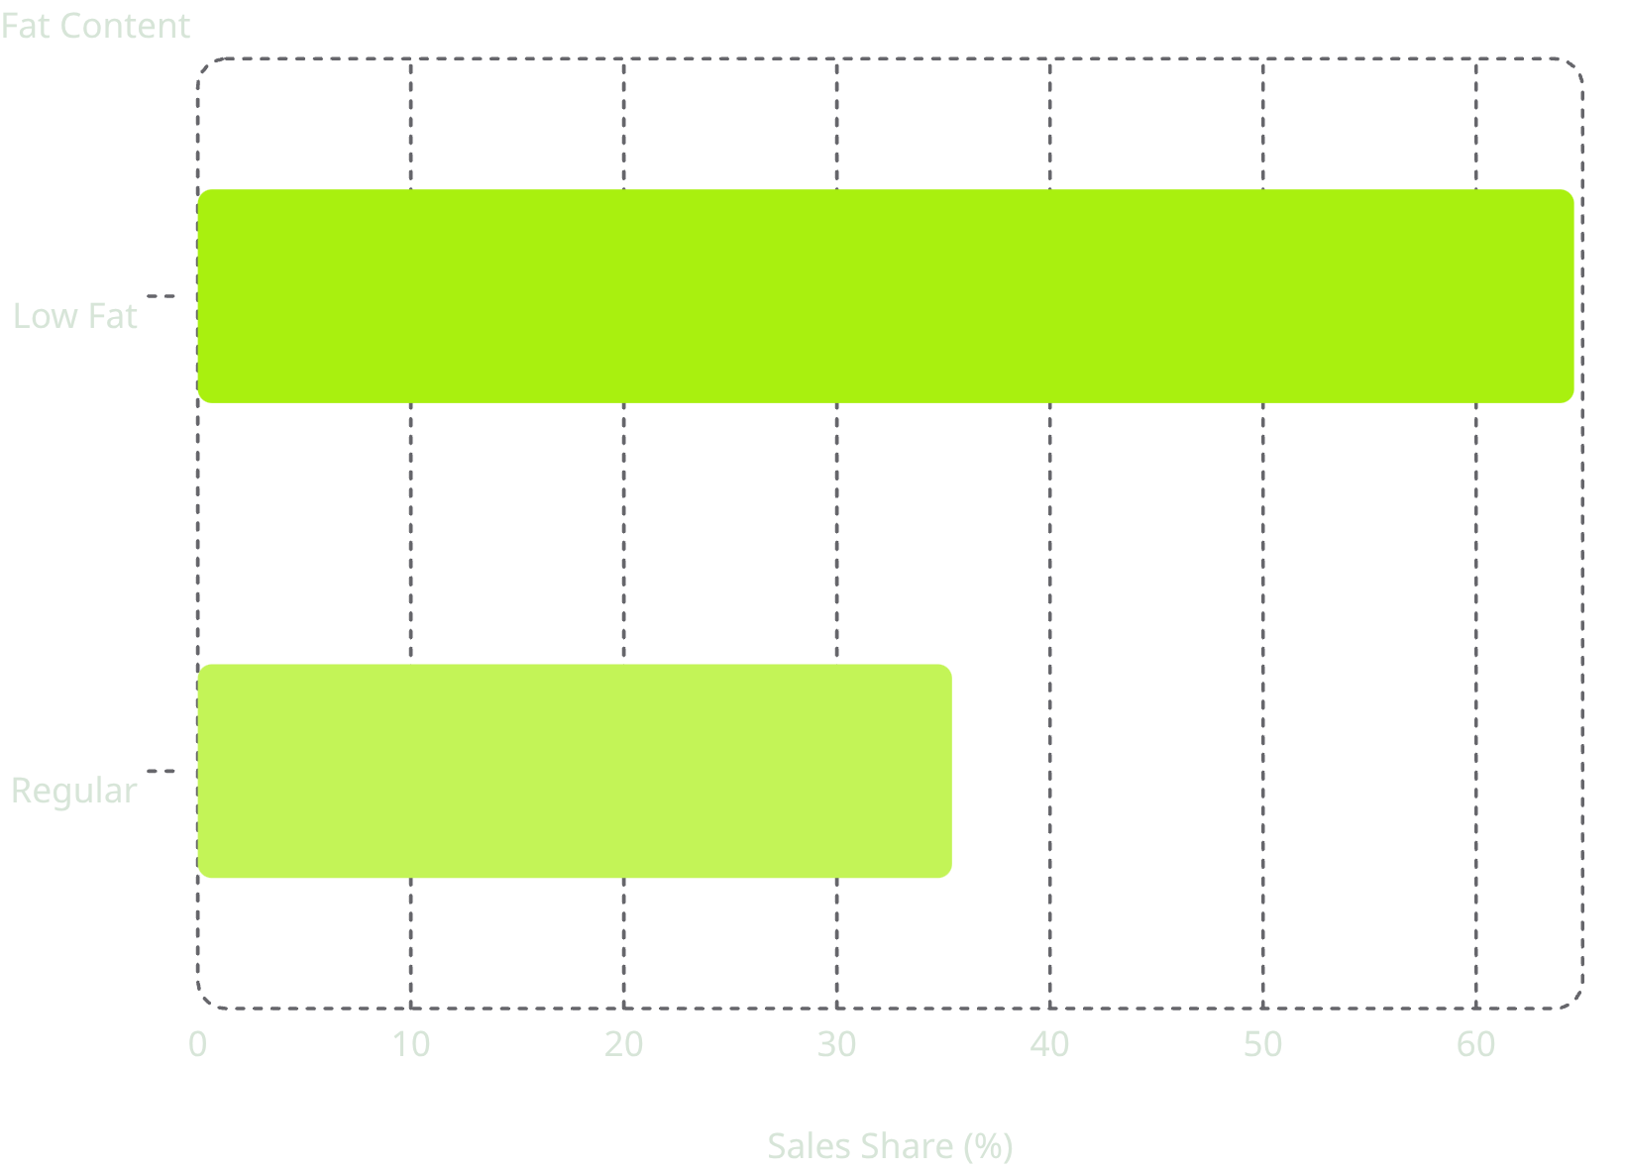
Low Fat Products Dominate Sales
Customer Preference is Clear
Low Fat products account for 64.6% of total sales and 64.73% of orders — a strong signal of health-conscious buying behavior.
Regular Fat products make up the remaining ~35% of both sales and orders.

Slide 6
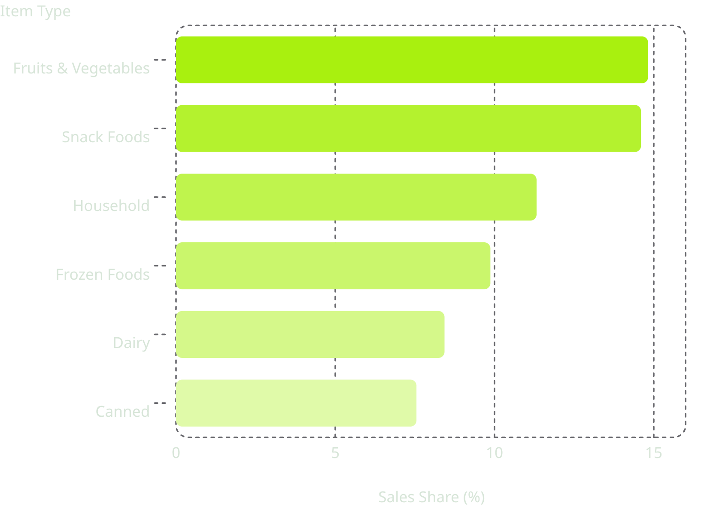
Top Product Categories
Revenue Leaders
Fruits & Vegetables and Snack Foods together drive nearly 30% of all sales and order volumes — the strongest-performing categories on the platform.
Household, Frozen Foods, and Dairy round out the top five.

Slide 7
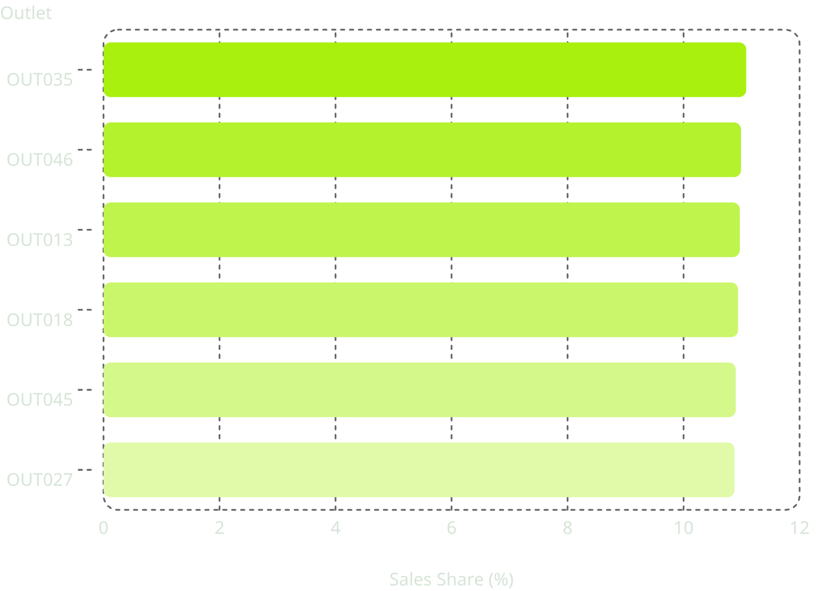
Outlet Performance: Sales & Orders
Top Outlets
The top 8 outlets each contribute ~10.7–11.1% of total sales, showing a balanced distribution. OUT010 and OUT019 contribute notably less (~6.5% and 6.1%).
Order distribution closely mirrors sales share across all top outlets.

Slide 8
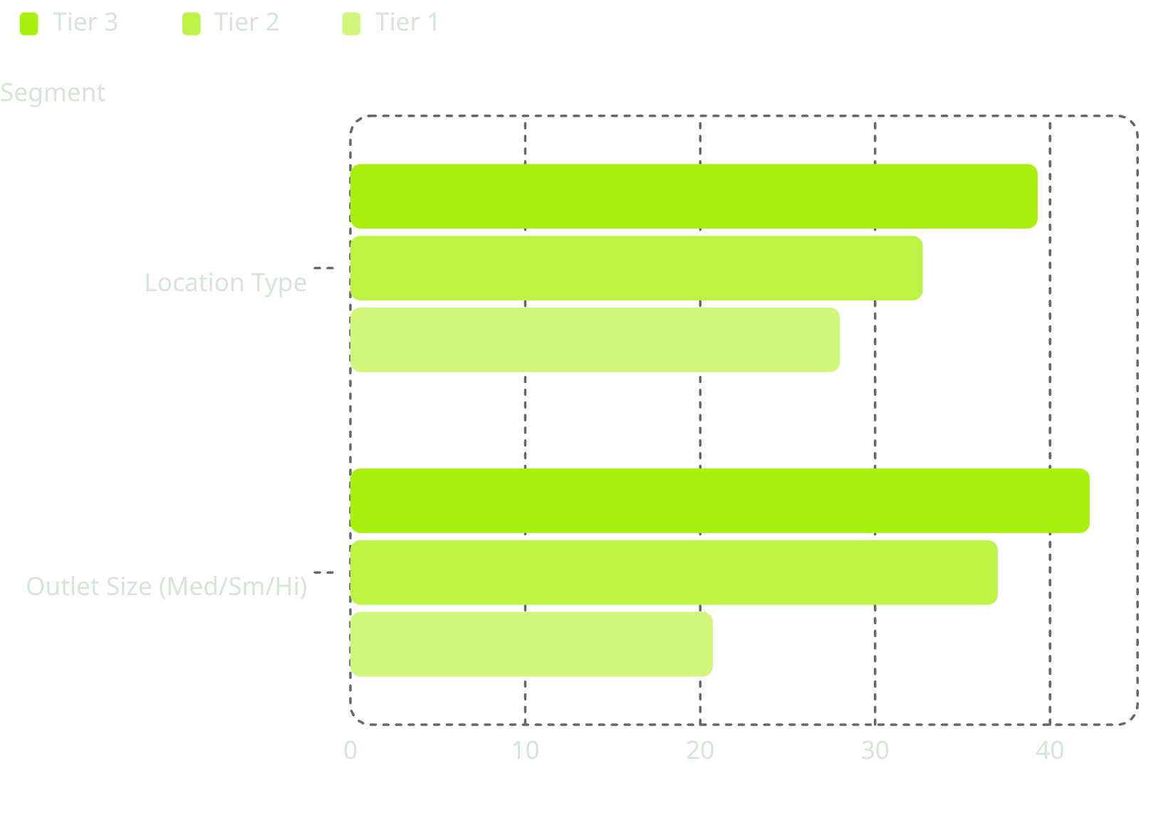
Location, Size & Outlet Type
Where the Demand Is
Tier 3 leads with 39.29% of sales — strongest market potential
Medium-sized outlets deliver 42.27% of sales
Supermarket Type1 dominates with 65.54% of all sales

Slide 9
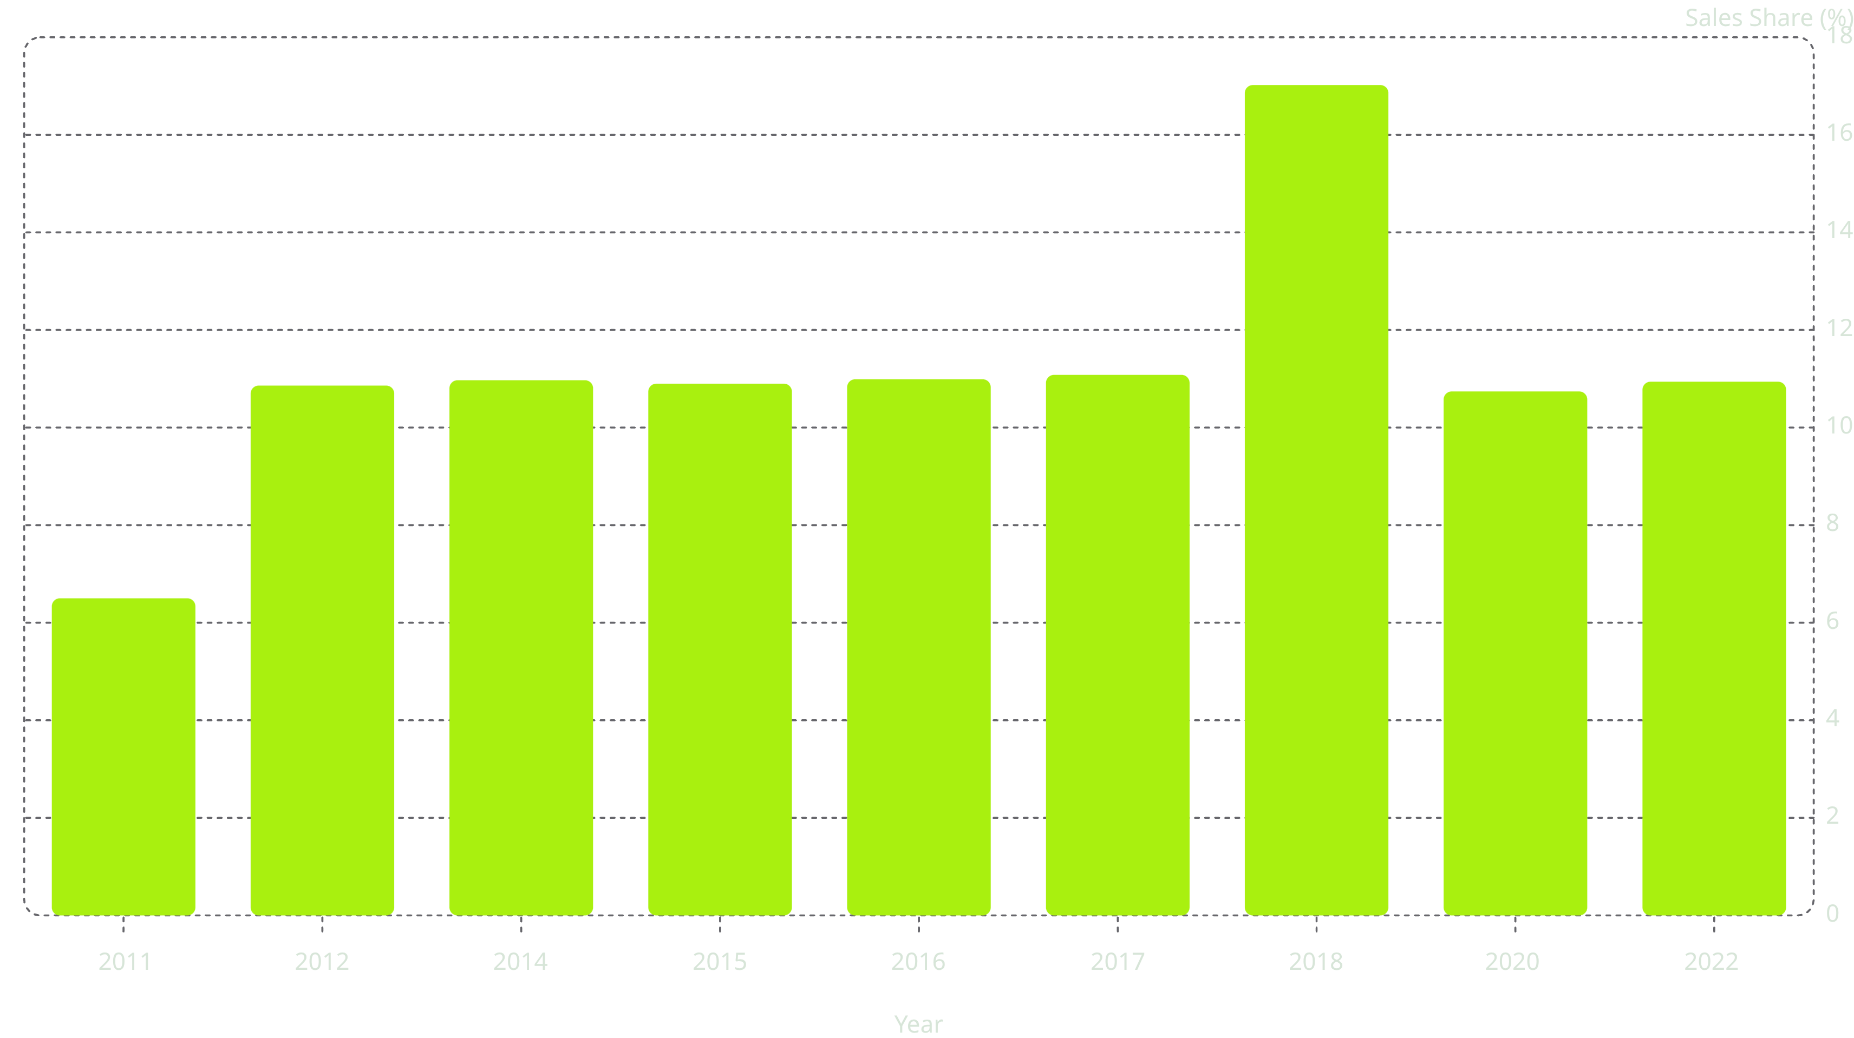
Sales Trend Over Time
2018 was a standout year, contributing 17.02% of total sales and 17.17% of orders — significantly above the ~11% average of other years. 2011 had the lowest contribution at 6.50%.

Slide 10


Key Insights & Recommendations
🥗 Expand Low Fat Portfolio
🥦 Prioritize Fruits & Snacks
📍 Target Tier 3 Markets
65% of sales come from Low Fat products — invest in this segment.
Top revenue categories — maintain inventory and boost visibility.
Highest sales share (39%) — ideal for expansion.
🏪 Scale Medium Stores
🛒 Replicate Supermarket Type1
Best sales-to-capacity balance — prioritize this format.
65% of sales — replicate its model across other formats.

