Slide 1
Deep learning using python
Pradeep .T
Data analyst
LTI - Larsen & Toubro Infotech

Slide 2
Schedule
2.00 - 2.30 : Introduction to deep learning
2.30 - 3.30 : Deep learning demo
3.30 - 4.00 : Discussion

Slide 3
What is deep learning
Deep Learning is a subfield of machine learning concerned with algorithms inspired by the structure and function of the brain called artificial neural networks.
Deep learning means using a neural network with several layers of nodes between input and output
Deep learning is the series of layers between input & output do feature identification and processing in a series of stages, just as our brains seem to.

Slide 4
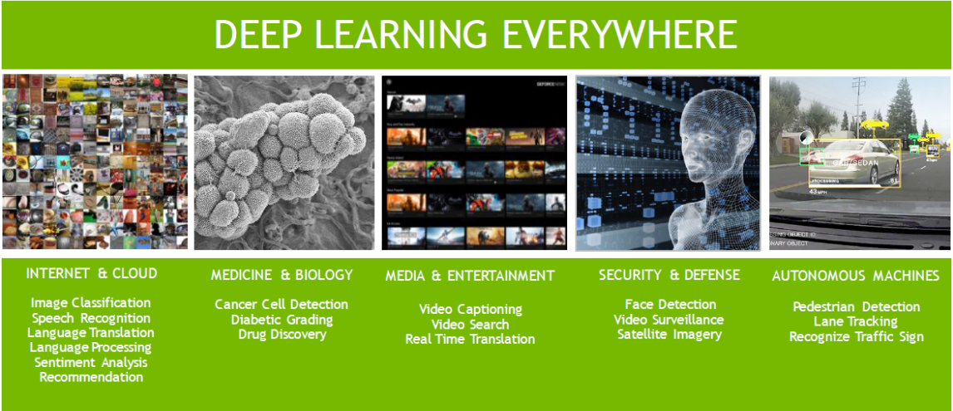

Slide 5
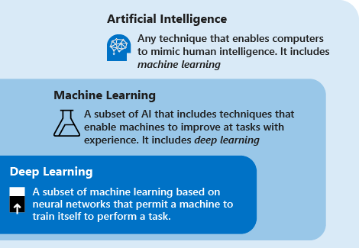
ML vs DL

Slide 6
Why Deep learning
Deep Learning outperforms other techniques if the data size is large. But with small data size, traditional Machine Learning algorithms are preferable.
Maximum utilization of unstructured data.
When there is lack of domain understanding for feature introspection, Deep Learning techniques outshines others as you have to worry less about feature engineering
Deep Learning really shines when it comes to complex domains such as image and speech processing.

Slide 7
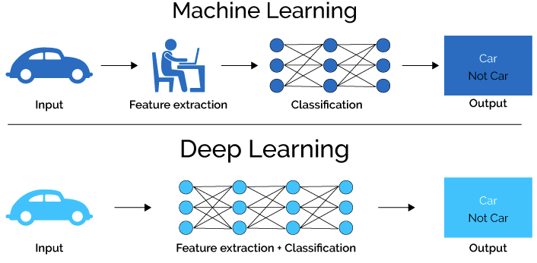

Slide 8
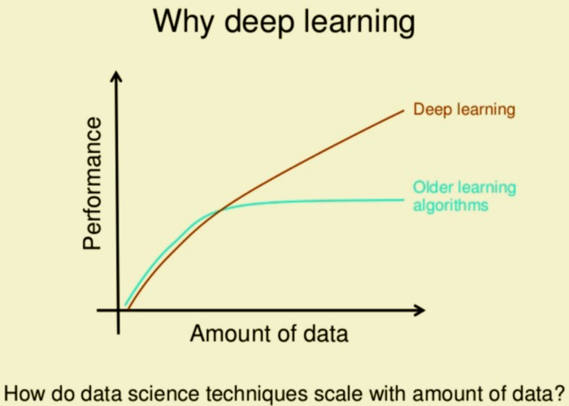

Slide 9
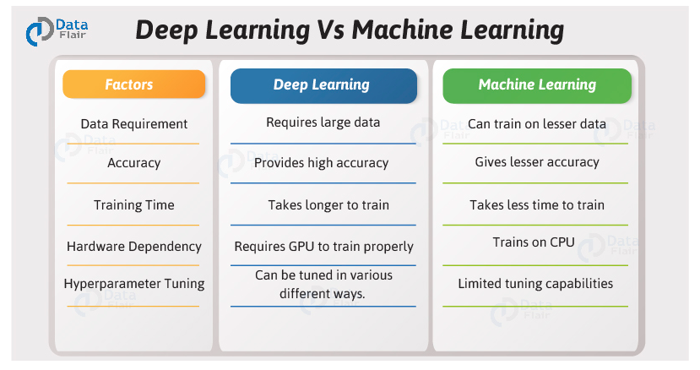

Slide 10
Deep learning frameworks

Slide 11
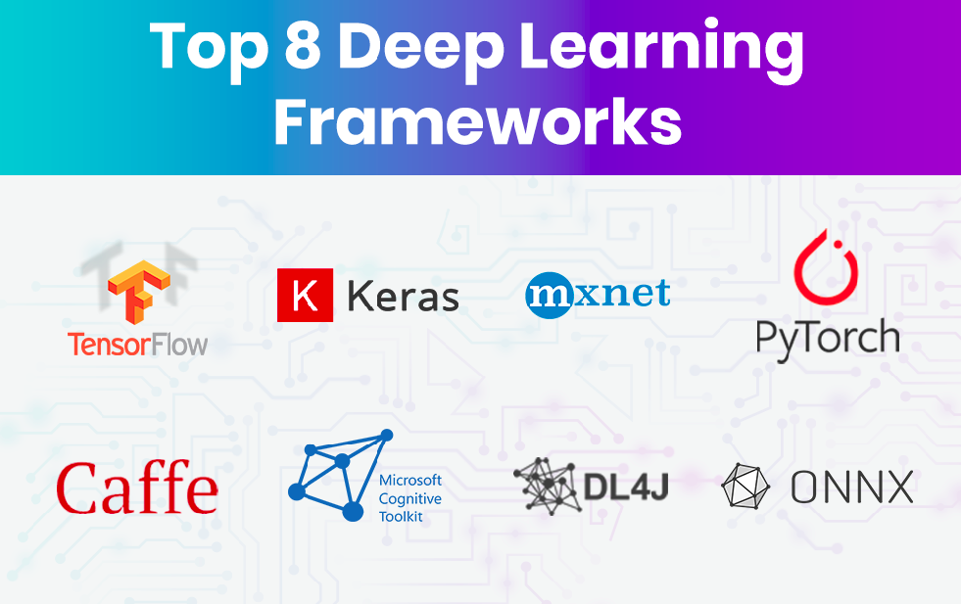

Slide 12
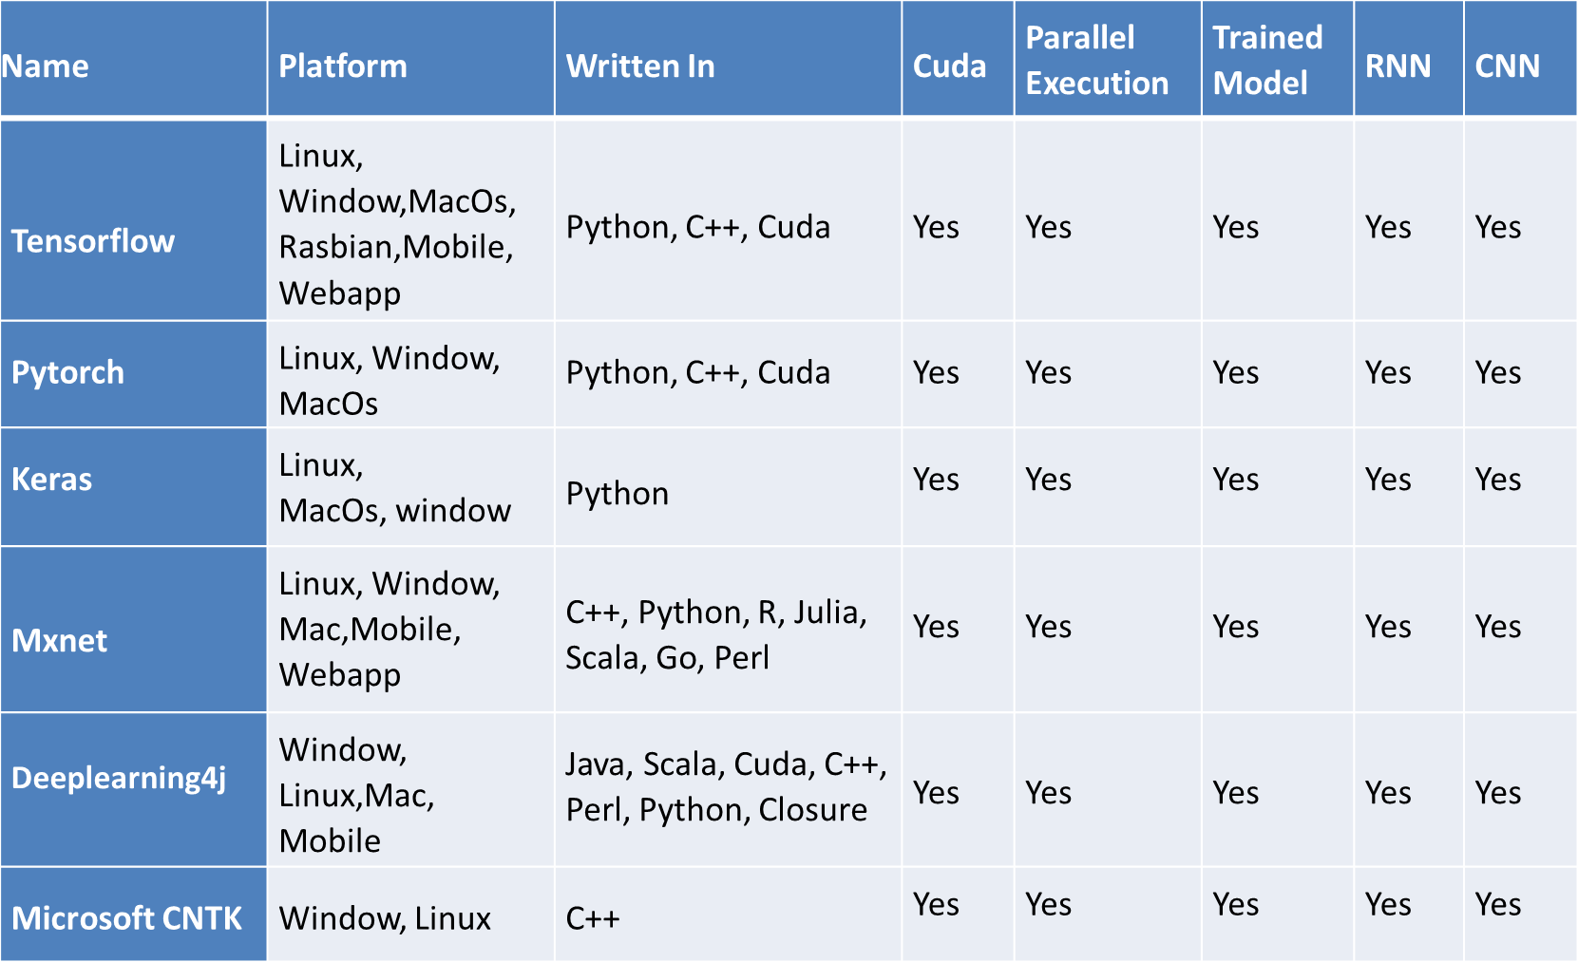
Frameworks comparison

Slide 13
Why Keras
Pythonic in nature
Beginner friendly
Rapid prototyping
More flexibility
Better functionality
Supports Threading and Queues
User has more control
Easy integration

Slide 14
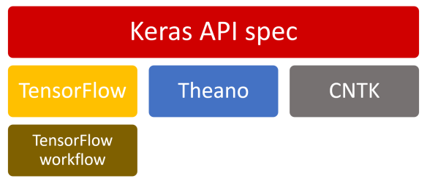

Slide 15
Deep learning using Keras
Using Multi-Layer Perceptrons(feed-forward neural networks)
Multiple neurons that are organized in layers
Outputs of one layer serve as the inputs for the next layer
3 types of layers
  Input layer
  Hidden layers
  Output layer
More number of layers can represent more complex decision boundaries

Slide 16
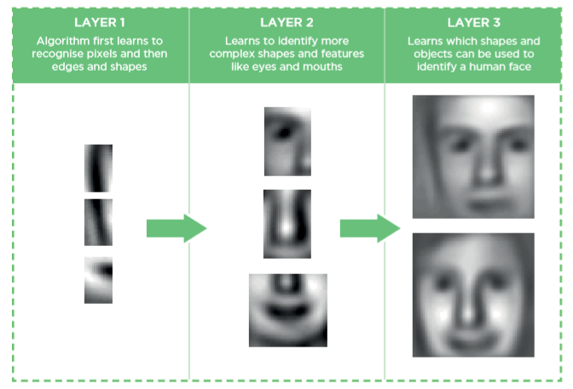
Face detection using DL

Slide 17
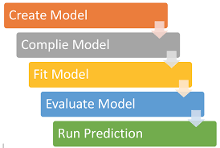
Keras DL model workflow

Slide 18
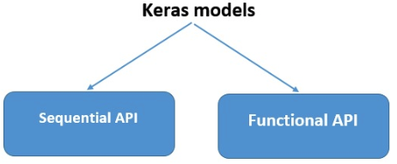
Model creation methods
Keras supports two types of model creation
  Sequential API
  Functional API

Slide 19
Keras layers

Slide 20
Keras Core layers
Input object
Embedding layer
Activation layer
Dense layer
Masking layer
Lambda layer

Slide 21
Keras Convolution layers
Conv1D layer
Conv2D layer
Conv3D layer
SeparableConv1D layer
SeparableConv2D layer
DepthwiseConv2D layer
Conv2DTranspose layer
Conv3DTranspose layer

Slide 22
Keras Pooling layers
MaxPooling1D layer
MaxPooling2D layer
MaxPooling3D layer
AveragePooling1D layer
AveragePooling2D layer
AveragePooling3D layer
GlobalMaxPooling1D layer
GlobalMaxPooling2D layer
GlobalMaxPooling3D layer
GlobalAveragePooling1D layer
GlobalAveragePooling2D layer
GlobalAveragePooling3D layer

Slide 23
Keras Recurrent layers
LSTM layer
GRU layer
SimpleRNN layer
TimeDistributed layer
Bidirectional layer
ConvLSTM2D layer
Base RNN layer

Slide 24
Keras Regularization layers
Dropout layer
SpatialDropout1D layer
SpatialDropout2D layer
SpatialDropout3D layer
GaussianDropout layer
GaussianNoise layer
ActivityRegularization layer
AlphaDropout layer

Slide 25
Keras Core layers

Slide 26
Input object
Instantiate a Keras tensor
A Keras tensor is a TensorFlow symbolic tensor object
tf.keras.Input(shape=None, batch_size=None,name=None,dtype=None, sparse=False,tensor=None,ragged=False,**kwargs)
Eg : shape=(32,) indicates that the expected input will be batches of 32-dimensional vectors

Slide 27
Embedding layer
Turns positive integers (indexes) into dense vectors of fixed size
This layer can only be used as the first layer in a model
tf.keras.layers.Embedding(input_dim,output_dim, embeddings_initializer="uniform", embeddings_regularizer=None,activity_regularizer=None,embeddings_constraint=None,mask_zero=False,input_length=None,**kwargs)
No activation function is applied
Eg : shape=(32,) indicates that the expected input will be batches of 32-dimensional vectors

Slide 28
How embedding layer works
Input sentences
  “Hope to see you soon”
  “Nice to see you again”
Encoding sentences with unique integer names
  [0, 1, 2, 3, 4]
  [5, 1, 2, 3, 6]
Create embedding layer
  Embedding(7, 2,5)
    Vocabulary size = 7
    Output dimesion = 2
    Input length = 5

Slide 29
How embedding layer works
Create embedding vector table
Index | Embedding
0 | [1.2, 3.1]
1 | [0.1, 4.2]
2 | [1.0, 3.1]
3 | [0.3, 2.1]
4 | [2.2, 1.4]
5 | [0.7, 1.7]
6 | [4.1, 2.0]
weight initializers
RandomNormal
RandomUniform
TruncatedNormal
Zeros
Ones
GlorotNormal
GlorotUniform
Identity
Orthogonal
VarianceScaling

Slide 30
How embedding layer works
Embedding layer output
“Hope to see you soon”
Hope to see you soonHope to see you [0, 1, 2 [5,1,2,3,6] 4]
[[0.7, 1.7], [0.1, 4.2], [1.0, 3.1], [0.3, 2.1], [4.1, 2.0]]

Slide 31
Activation layer
Applies an activation function to an output.
Different activation functions
  Relu -> max(x, 0)
  Sigmoid -> 1 / (1 + exp(-x))
  Softmax -> exp(x) / tf.reduce_sum(exp(x)).
  Softplus -> log(exp(x) + 1)
  Softsign -> x / (abs(x) + 1)
  Tanh -> ((exp(x) - exp(-x))/(exp(x) + exp(-x)))

Slide 32
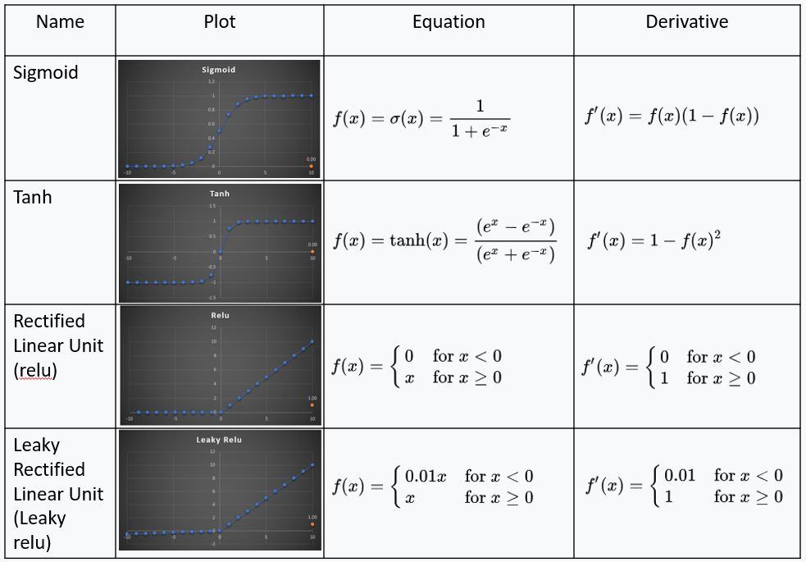

Slide 33
LSTM layer
Long Short-Term Memory layer - Hochreiter 1997.
Implements Recurrent neural networks (RNN)
tf.keras.layers.LSTM(units,activation="tanh",recurrent_activation="sigmoid",use_bias=True,kernel_initializer="glorot_uniform",recurrent_initializer="orthogonal",bias_initializer="zeros",unit_forget_bias=True,kernel_regularizer=None,recurrent_regularizer=None,bias_regularizer=None,activity_regularizer=None,kernel_constraint=None,recurrent_constraint=None,bias_constraint=None,dropout=0.0,recurrent_dropout=0.0,implementation=2,return_sequences=False,return_state=False,go_backwards=False,stateful=False,time_major=False,unroll=False,**kwargs)

Slide 34
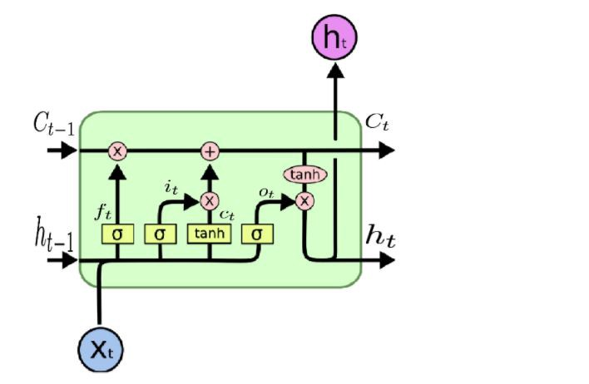
LSTM layer
3 Gates
  Input gate
  Output gate
  Forget gate
2 States
  Hidden state(state_h)
  Cell state(state_c)

Slide 35
LSTM layer
Default activation function is tanh
return_sequences
  True :- For getting hidden state output for each input time step
  False :- For getting the last hidden state of LSTM layer(Default)
  Must set return_sequences=True when stacking LSTM layers
return_states
  output hidden states(ht) and cell states(ct)
  True :- For accessing the hidden state output (state_h) and the cell state (state_c)(Only use with Functional API)
  False :- Doesnt return last state in addition to the output(Default)

Slide 36
Dense layer
Regular densely-connected NN layer
output = activation(dot(input, weights) + bias)
tf.keras.layers.Dense(units,activation=None,use_bias=True,kernel_initializer="glorot_uniform",bias_initializer="zeros",kernel_regularizer=None,bias_regularizer=None,activity_regularizer=None,kernel_constraint=None,bias_constraint=None,**kwargs)
units: Positive integer, dimensionality of the output space.
activation: Activation function to use. If you don't specify anything, no activation is applied (ie. "linear" activation: a(x) = x).

Slide 37
Dropout layer
Applies Dropout to the input
Helps to prevent overfitting
The Dropout layer randomly sets input units to 0
tf.keras.layers.Dropout(rate, noise_shape=None, seed=None, **kwargs)
rate: Float between 0 and 1. Fraction of the input units to drop.
Inputs not set to 0 are scaled up by 1/(1 - rate) such that the sum overall inputs is unchanged

Slide 38
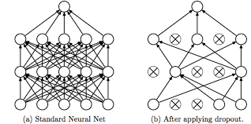
Dropout layer
Dropout layer works during training phase ie, no values are dropped during inference

Slide 39
Model compilation

Slide 40
Model compilation
Configures the model for training.
Model.compile(optimizer="adam",loss=’categorical_crossentropy’,metrics=None,loss_weights=None,weighted_metrics=None,run_eagerly=None,steps_per_execution=None,**kwargs)
Optimizers
  SGD
  RMSprop
  Adam
  Adadelta
  Adagrad
  Adamax
  Nadam
  Ftrl

Slide 41
Model compilation
Losses
  Classification losses
    BinaryCrossentropy class
    CategoricalCrossentropy class
    SparseCategoricalCrossentropy class
    Poisson class
    binary_crossentropy function
    categorical_crossentropy function
    sparse_categorical_crossentropy function
    poisson function
    KLDivergence class
    kl_divergence function
Regression losses
  MeanSquaredError class
  MeanAbsoluteError class
  MeanAbsolutePercentageError class
  MeanSquaredLogarithmicError class
  CosineSimilarity class
  mean_squared_error function
  mean_absolute_error function
  mean_absolute_percentage_error function
  huber function
  LogCosh class
  log_cosh function

Slide 42
Calculation of parameters
Embedding layer
  Parameters = vocabulary_size * output_size
LSTM layer
  Parameters = 4*( ( (input_size+1)*output_size )+ (output_size)^2 )
Convolution layer
  Parameters = output_chanels *((input_channels * window_size +1)
Dense layer
  Parameters = output_size * (input_size +1)

Slide 43
Model fitting

Slide 44
Model fitting
Model training
Model.fit(x=None,y=None,batch_size=None,epochs=1,verbose=1,callbacks=None,validation_split=0.0,validation_data=None,shuffle=True,class_weight=None,sample_weight=None,initial_epoch=0,steps_per_epoch=None,validation_steps=None,validation_batch_size=None,validation_freq=1,max_queue_size=10,workers=1,use_multiprocessing=False)
The model can save in two ways
  Save weights only
  Save weights with model architecture

Slide 45
Prediction

Slide 46
Prediction
Generates output predictions for the input samples
Model.predict(x,batch_size=None,verbose=0,steps=None,callbacks=None,max_queue_size=10,workers=1,use_multiprocessing=False)
Predicition can implement in 3 ways
  Direct prediction after training without saving the model
  Load the saved model for prediction
  Load the saved weights and integrate the weights with model architecture

Slide 47
The Future of Deep Learning Can Be Broken Down Into These 3 learning paradigms
Hybrid learning — How can modern deep learning methods cross the boundaries between supervised and unsupervised learning to accommodate for a vast amount of unused unlabeled data?
Composite learning — How can different models or components be connected in creative methods to produce a composite model greater than the sum of its parts?
Reduced learning — How can both the size and information flow of models be reduced, both for performance and deployment purposes, while maintaining the same or greater predictive power?

Slide 48
Deep learning trends -2020
Transformers are everywhere
Transfer learning
N-shot learning
DL integration with IOT
DL integration with block chain
Federated learning
Artificial general intelligence

Slide 49
Thank you...
For further contacts
  Pradeep .T
  Data analyst
  LTI - Larsen & Toubro Infotech – Bangalore
  Mobile : 8086877459
  Linkedin : https://www.linkedin.com/in/pradeep-t-ab670888/
  Github : https://github.com/pradeepdev-1995/
  Twitter : https://twitter.com/pradeepdev_01

