Slide 1


PHX: Memory Speed HPC I/O with NVM
Pradeep Fernando
Sudarsun Kannan, Ada Gavrilovska, Karsten Schwan

Slide 2
Node Local Persistent I/O ?
Node local checkpoint/ restart
Recover from transient failures ( node restart)
Transient/ soft failures – not permanent failures
More soft failures in future machines
Locally stored analytics output
Co-running analytics

Slide 3
NVRAM is Ideal for Persistent I/O
Read/ write latencies comparable to DRAM
100x faster than SSD
Persistent data writes
Data retention time is >10 years for Memristor
Denser memory
Low chip area per bit -> more capacity
Memory device -> load/ store operations

Slide 4
NVRAM Bandwidth?
HPC applications move data in bulk
I/O after implicit/explicit synchronization
More I/O in future Exascale simulations
- More cores per node -> more data
Poor bandwidth scaling of NVRAM
Device physics
RAID like structures -> more energy

Slide 5
Key Idea: Aggregate Bandwidth Checkpoints
NVRAM provides denser persistent memory, but has limited bandwidth
DRAM has superior bandwidth compared to NVRAMs (4x-8x)
Accelerate critical path data movement with bandwidth aggregation
DRAM
NVRAM

Slide 6
Phoenix (PHX) Design

Slide 7
Problem : Software Stack Overheads
Using NVRAM as a block device under file system lengthens the I/O path.
write
read
Store
Load
User space
Kernel Space
VFS
User space
Mapped memory
File system
map/ brk
Generic block device
NVRAM
Device driver
NVRAM

Slide 8
Problem : NVRAM Access Latencies
NVRAM writes/ reads are expensive
- Writes takes 4x more time than DRAM
Application works with a DRAM allocated object
Application
Object handles/ keys: foo, bar
Checkpoint call
foo
bar
foo:v1
bar:v1
foo
bar
DRAM
NVRAM

Slide 9
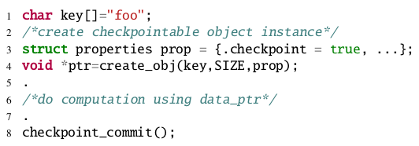
Resulting PHX C/R API
Allocate checkpoint object
Create a versioned copy and move it to NVRAM

Slide 10
Problem: Limited NVRAM Bandwidth
Simultaneous bandwidth usage of both NVRAM and DRAM
Split the objects to DRAM & NVRAM
DRAM Staging Buffer
De-stage
NVRAM
Objects snapshots from application heap

Slide 11
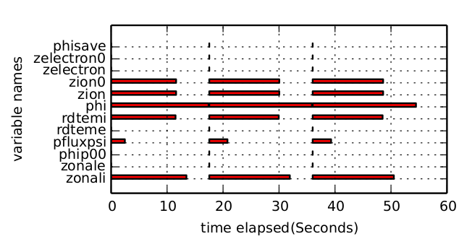
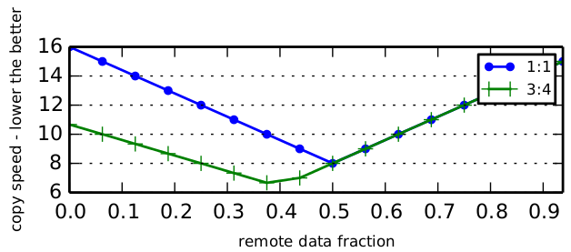

Checkpoint Data Split
Optimal data split ratio is same as the device bandwidth ration
Prioritize staging for late access variables – immune to optimizations (e.g. Pre-copy)
Memory budget allocated for staging.

Slide 12
Fault Tolerance of Staged Data

Slide 13

Staging Buffer Data Loss
Staged data is vulnerable to transient node failures.
Node restart
DRAM Staging Buffer
De-stage
NVRAM
Persistent data loss

Slide 14
Buddy Node Replication (N=2)
Node restart
DRAM staging buffer
Buddy node
Replicate and de-stage
NVRAM
DRAM
Consistent restart state using buddy replica of staging buffer

Slide 15
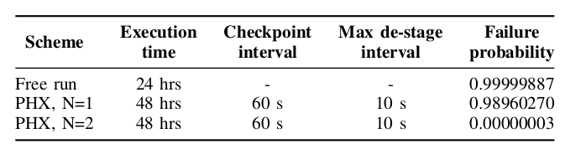
Failure Probability of Staged Data
N=2, buddy replication scheme brings down the staged data loss probability to negligible level.

Slide 16
Energy Cost Analysis

Slide 17



Energy Overheads of PHX
PHX energy overheads
- Checkpoint staging
Stage buffer replication
Depends on
Interconnect technology
Distance to buddy
DRAM write costs
Additional energy costs
Buddy replication
Energy costs of data staging

Slide 18
Energy Savings of PHX
Fast PHX checkpoints cut down the total simulation time.
Energy savings!
Execution
time – naive
Execution
time – PHX
Time reduction

Slide 19
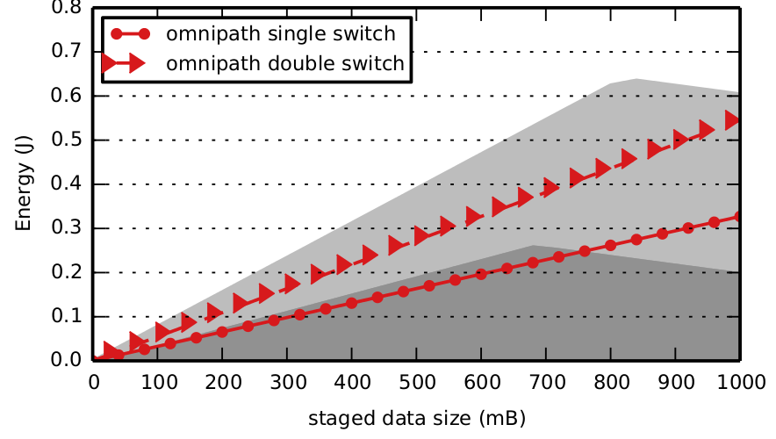
PHX Saves Energy
Careful selection of PHX configuration parameters will lead to
both fast checkpoints and energy savings.
Break even point
For DRAM:NVRAM bandwidth ratio of 2:1 PHX can stage up to ~750 MB (total checkpoint size is 1GB) when the buddy node is one switch away

Slide 20
Evaluation
Four node cluster run in the stampede supercomputer
Emulated NVRAM using software delays
Three application benchmarks
GTC
CM1
S3D

Slide 21
GTC Benchmark
Checkpoint data-intensive application
Staging buffer size -- 50% of checkpoint data per interval
Lot of early access variables

Slide 22
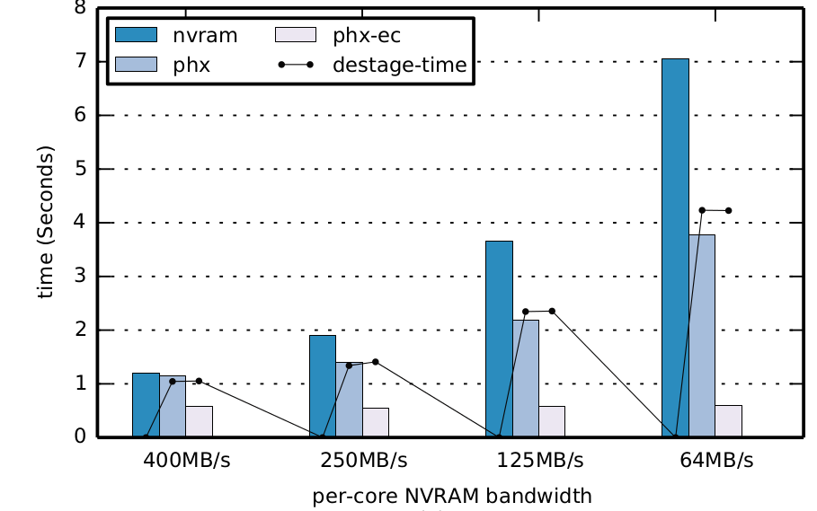
GTC Benchmark
2x Improvement
12x
Checkpoint time is 37% compared to compute
NVRAM bandwidth seen by a core.

Slide 23
CM1 Benchmark
Compute heavy application
Staging buffer = 50% checkpoint data per interval
No early access variables

Slide 24
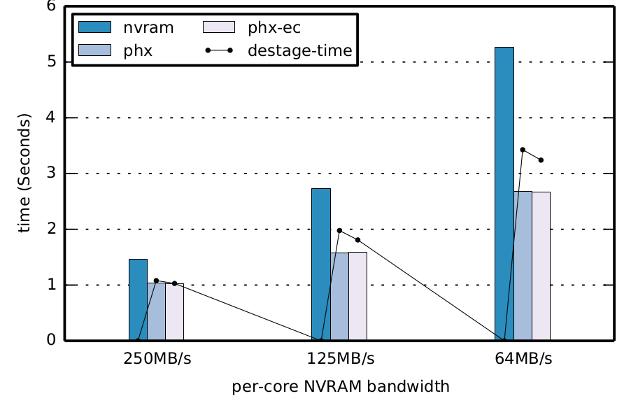
CM1 Benchmark
2x time reduction

Slide 25
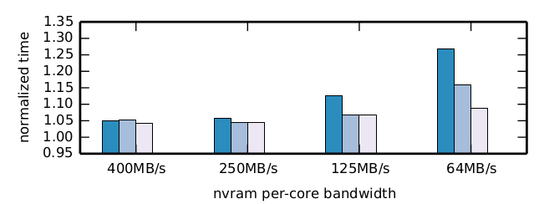
Total Simulation Time
Application – GTC
Total time over 10 compute iterations
18% improvement

Slide 26
Summary
PHX – a bandwidth aware checkpoint/ restart scheme for NVM
Reduce C/R time , accelerate simulation time
Reduce energy requirements
The technique shows promising results in the evaluated scale
C/R costs will only increase with scale, so solutions like PHX will only gain importance
Future work
Evaluate against analytics workloads
Deployment and evaluation at scale
Will be carried out as part of the UNITY SSIO/ SICM ECP projects, funder by US DoE

Slide 27
Thanks!
Pradeep Fernando
pradeepfn@gatech.edu
Sudarsun Kannan, Ada Gavrilovska, Karsten Schwan
We thank IEEE TCPP and the National Science Foundation for providing travel support to attend IEEE HiPC 2016
Q&A

