Slide 1
HDFS Yarn Architecture
..Venu Katragadda

Slide 2
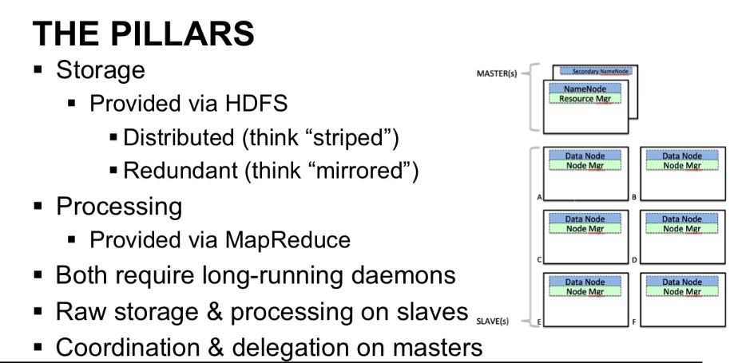
Main pillars in Hadoop

Slide 3
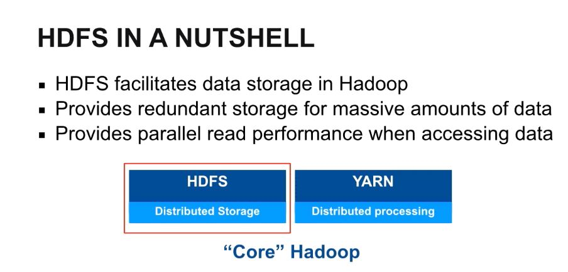
HDFS

Slide 4
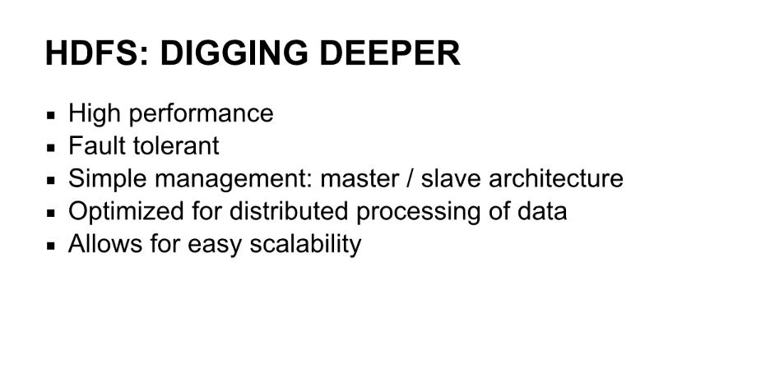
HDFS - Store the data

Slide 5
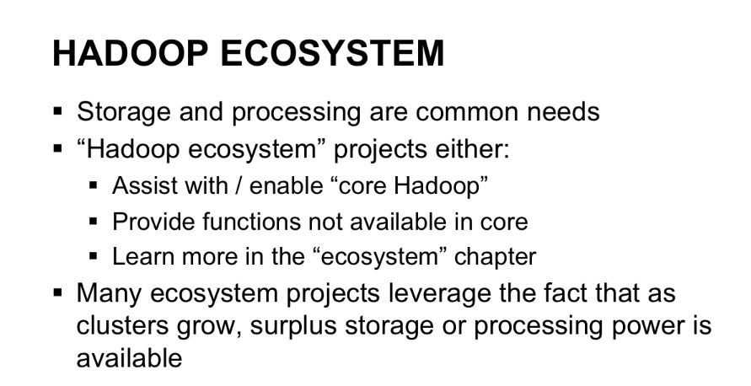
Overview of Hadoop ecosystems

Slide 6
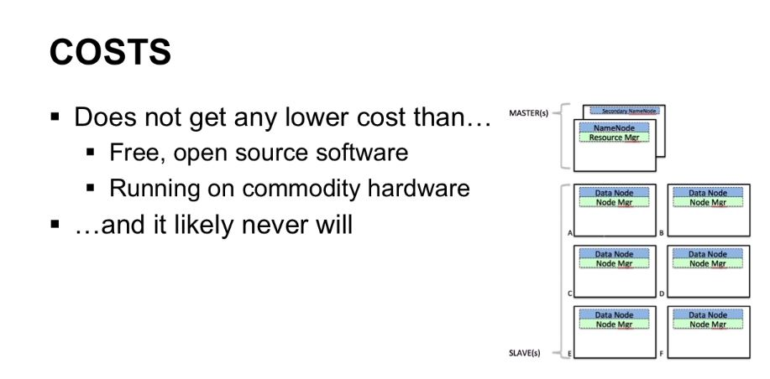
Why HDFS/Hadoop?

Slide 7
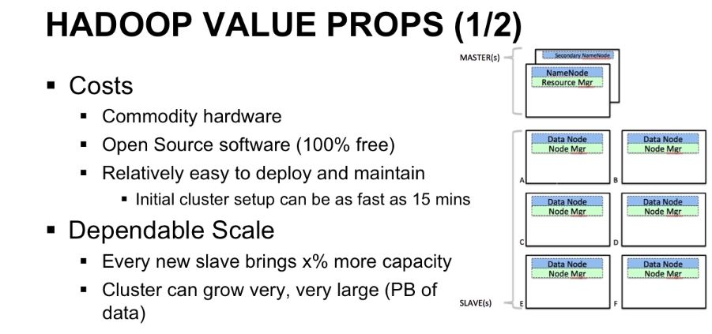

Slide 8
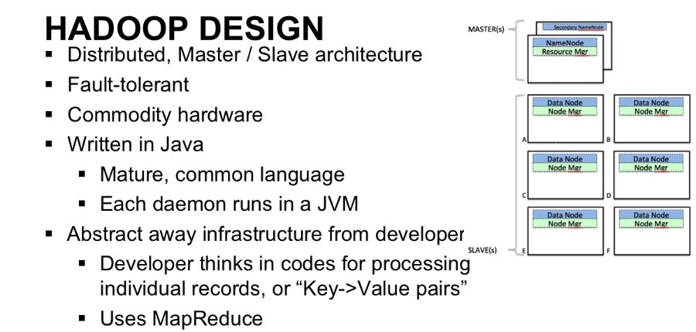
HDFS Model

Slide 9
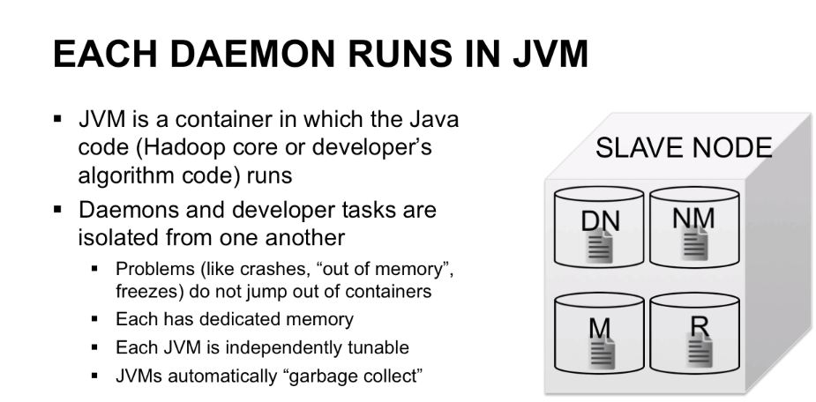
How each Daemon work?

Slide 10
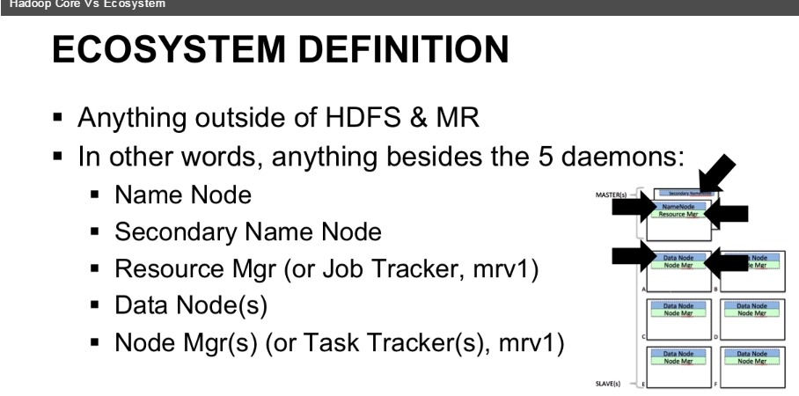
What is Hadoop Ecosystems?

Slide 11
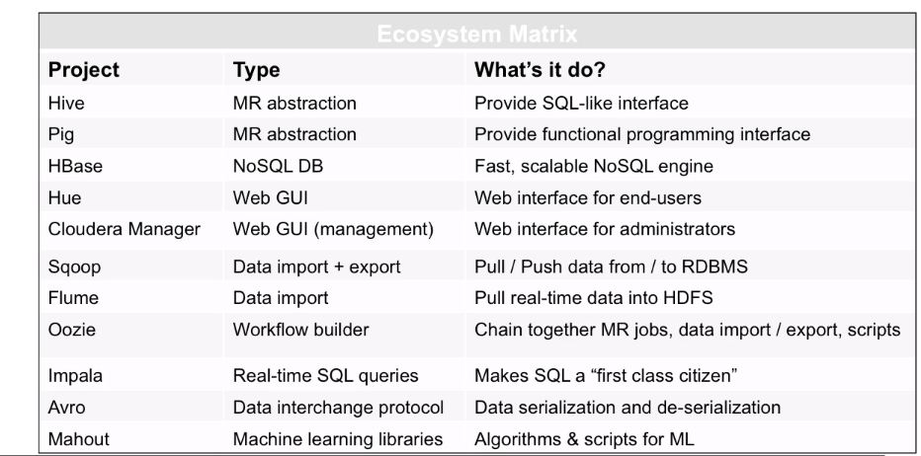
Hadoop Ecosystems Usecases

Slide 12
What is Daemon?
A processing thread that runs in the background called Daemon.
Useally any process completed shortly. After process there is no use to do it, so that Daemon can used to do that temporary task.
Hadoop has five daemons such as Namenode, secondary name node, Resource manager, node manager, datanode.

Slide 13
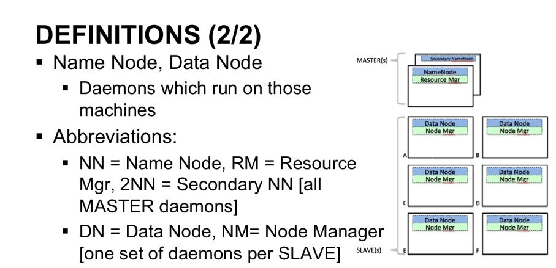

Slide 14
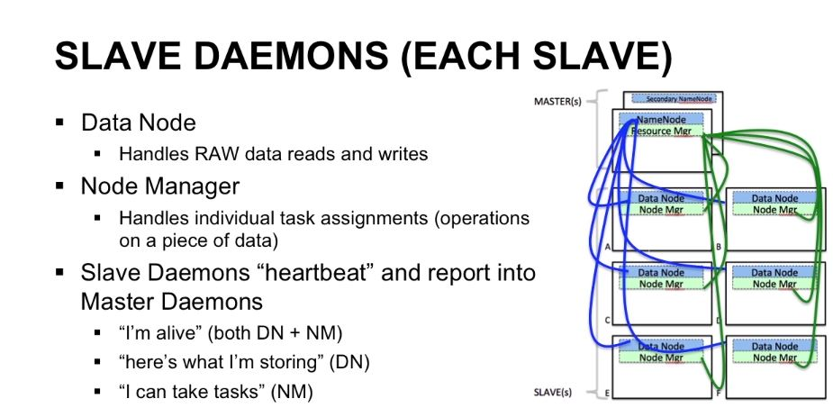

Slide 15
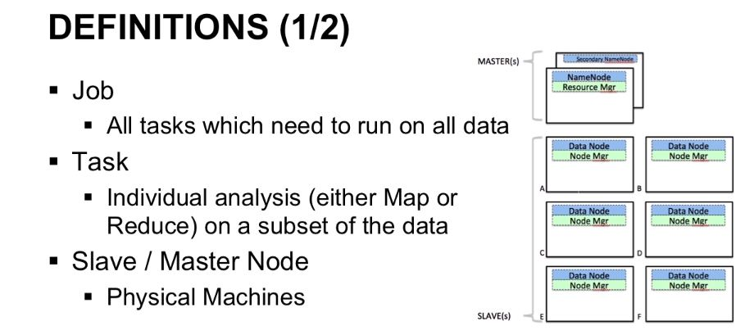

Slide 16
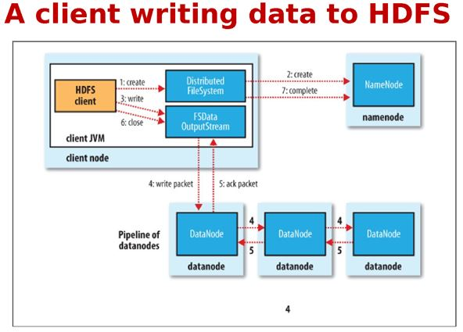
How HDFS writes data?

Slide 17
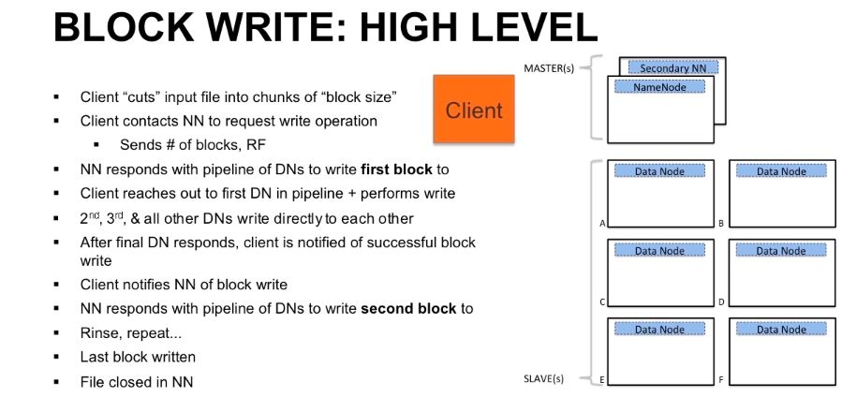

Slide 18
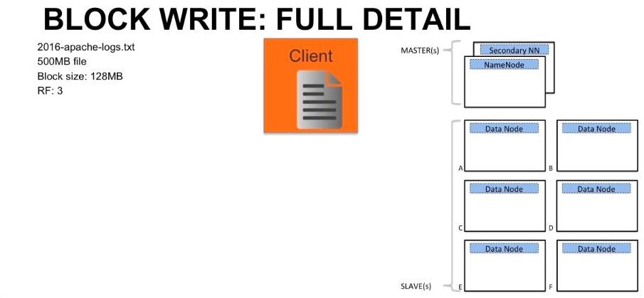

Slide 19
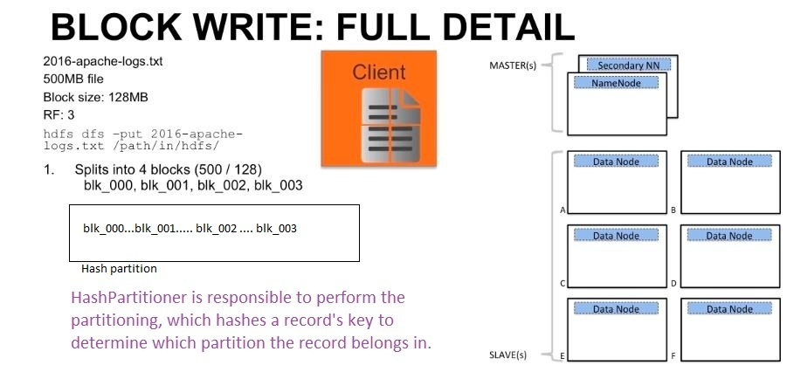

Slide 20
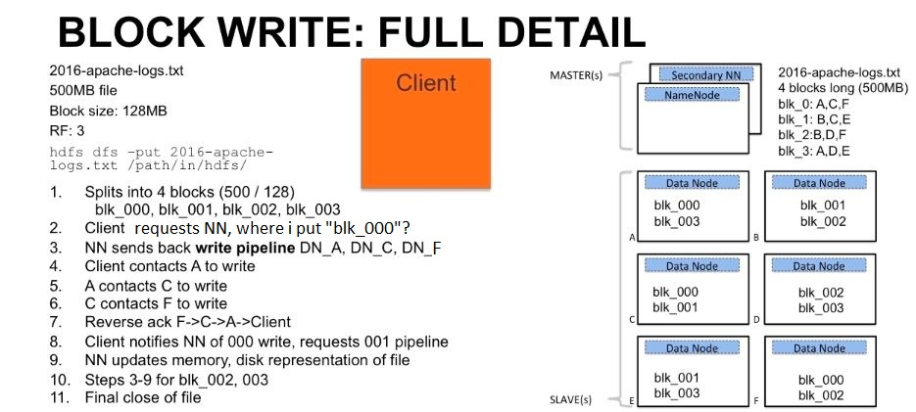

Slide 21
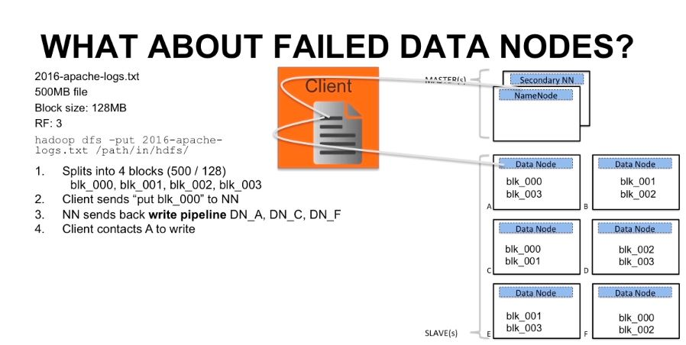

Slide 22
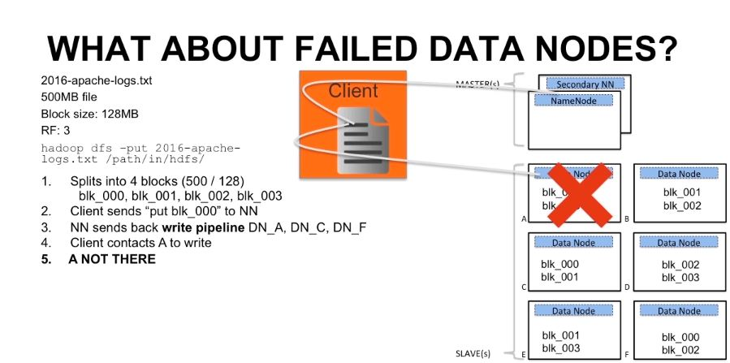

Slide 23
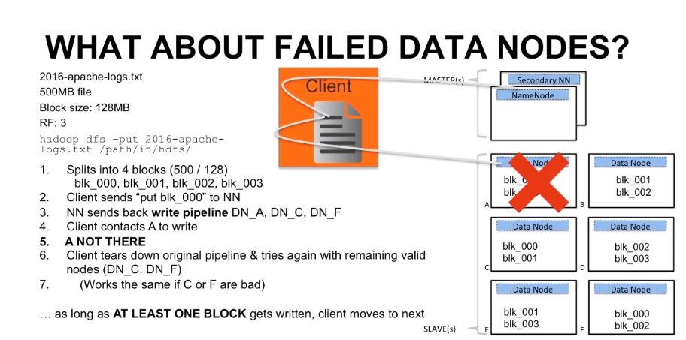

Slide 24
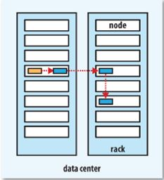
How replicate the data?
First replica store in Local
System, second replica store
nearest rack, third replica
store nearest rack.
It's by default

Slide 25
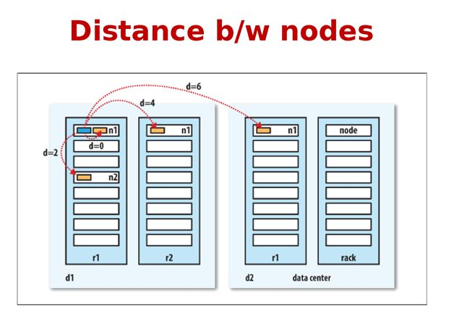
Recommended replication

Slide 26
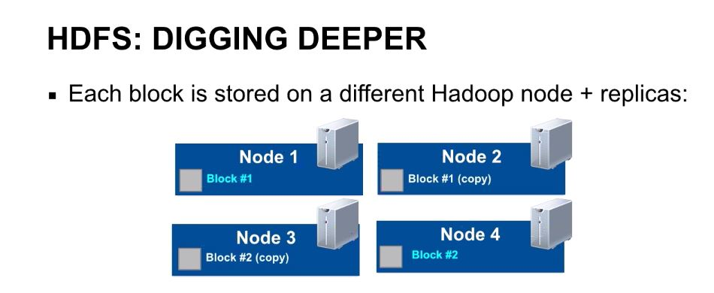
Replicate in Different nodes

Slide 27
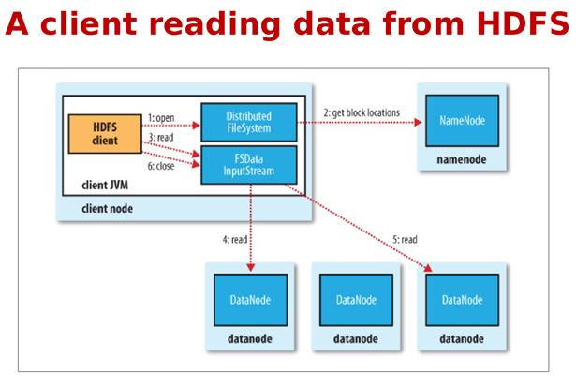
How HDFS reads the file

Slide 28
Hdfs Reads
HDFS reads data parallelly , but write Sequencilly

Slide 29
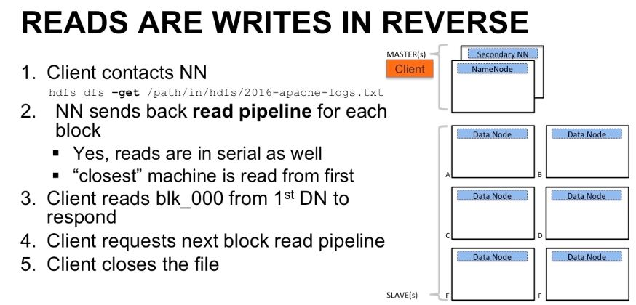

Slide 30
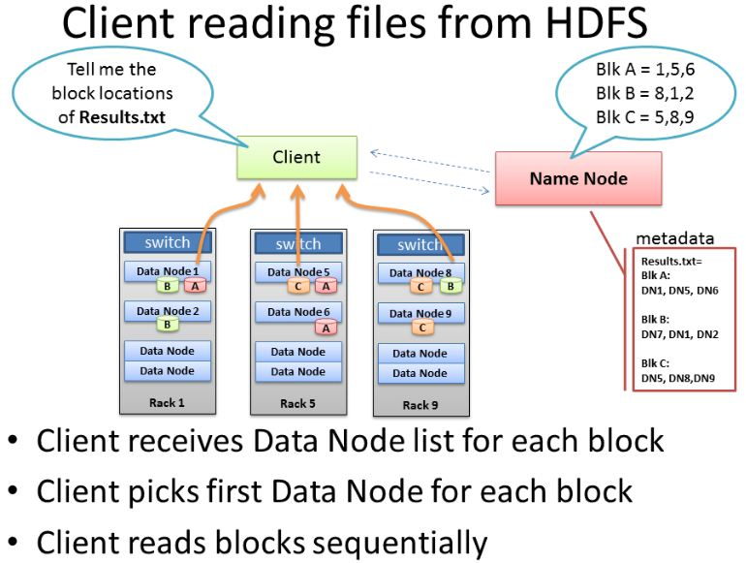

Slide 31
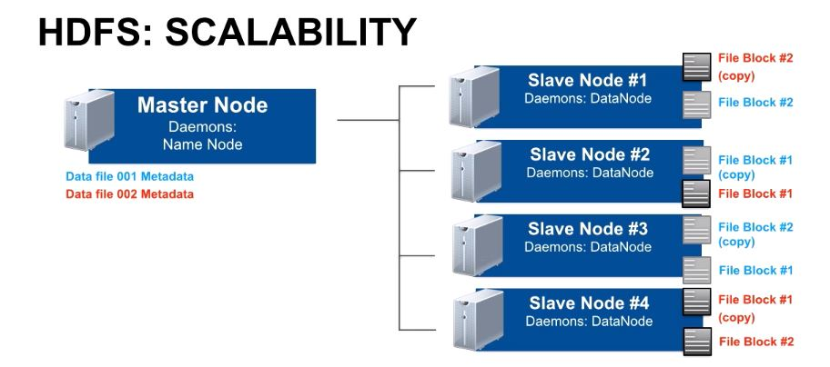
Power of HDFS is Scalability

Slide 32
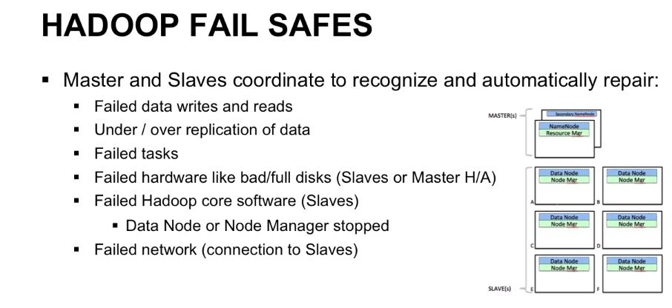
Hadoop Auto repair

Slide 33
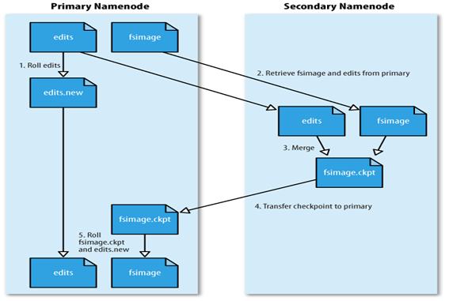
Secondary NameNode

Slide 34
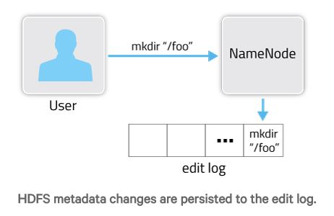
Internally What happen (metadata)
Everything namenode store in Edit log

Slide 35
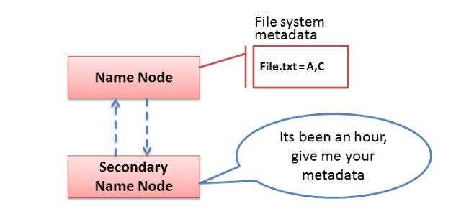
NameNode Vs Secondary NameNode
Periodically Store the Namenode data in Secondary Name Node

Slide 36
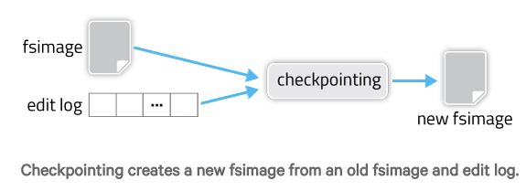
Internally What happen (metadata)
Merge old metadata (fsimage) and new changes(edit log)
and persist in Secondary namenode

Slide 37
Editlogs Vs Fsimage
editlogs – This keeps tracking of each and every change that is being done on HDFS. (Like adding a new file, deleting a file, moving it between folders..etc)
fsimage – Stores the node details like modification time, access time, access permission, replication.

Slide 38
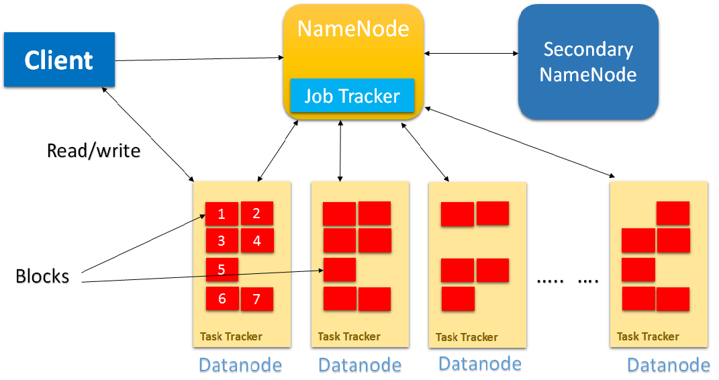
Final HDFS architecture

Slide 39
Namenode Responsibility
NameNode manages file system metadata
The Active NameNode is responsible for all client operations in the cluster
Based on Datanode's block report, allocate new blocks to store & replicate data
Flush the editlog data to Secondary NN

Slide 40
Datanode Responsibilities
Follow the Namenode instructions.
Serving read and write requests from the file system’s clients
Store the actual data in HDFS in the form of blocks.
Every 3 seconds give heartbeat to Active & StandBy Namenode
every 30 seconds give block report to Namenode

Slide 41
StandBy Namenode responsibilities
It's acting as a slave.
Take metadata info from Slave nodes.
Merge fsimage and edit log data in fsimage.
Based on election systems choose which is the active and standby namenode.

Slide 42
Secondary Namenode Responsibilities
For every one hour take editlog data from namenode
merge the editlog and fsimage data using checkpoint
flush the new fsimage data to namenode

Slide 43
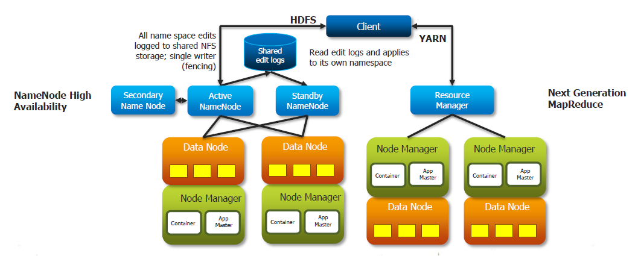
Hadoop 2.x High avalability

Slide 44
Each Datanode send Heartbeat/block report to Active NN & StandBy NN.
Based on Election system choose Active, standBy NN.
If Active NN goes down, switch to StandBy NN.
It means Namenode take care of Datanode' metadata and Zookeeper take care of Namenode's metadata.

Slide 45
Lets Break to dig into Yarn.

Slide 46
YARN
In another words it's distributed OS to the HDFS

Slide 47
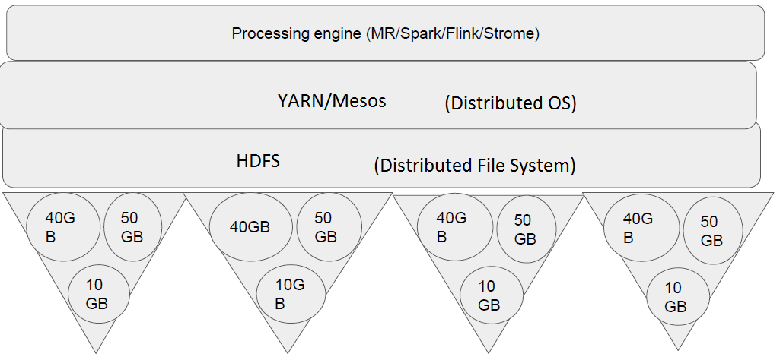
HDFS/YARN Architecture

Slide 48
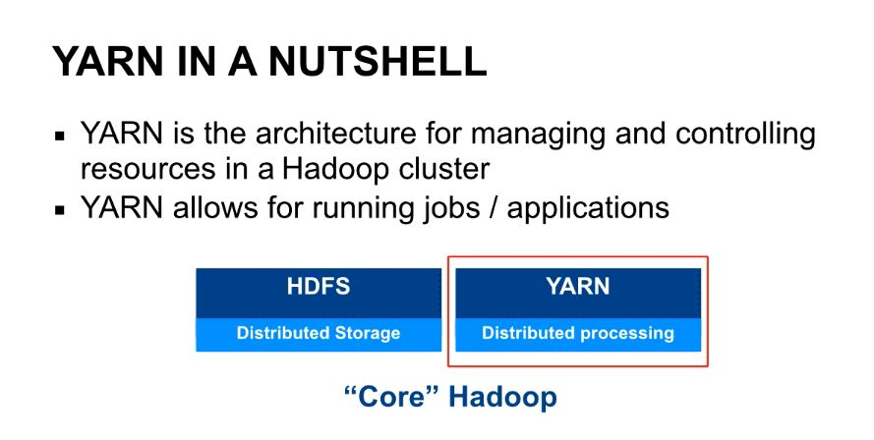

Slide 49
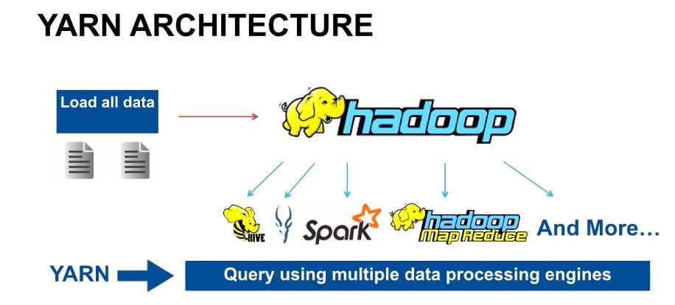
YARN: Process any type of data at a time

Slide 50
What is Daemon?
A processing thread that runs in the background called Daemon.
Useally any process completed shortly. After process there is no use to do it, so that Daemon can used to do that temporary task.
Hadoop has five daemons such as Namenode, secondary name node, Resource manager, node manager, datanode.

Slide 51
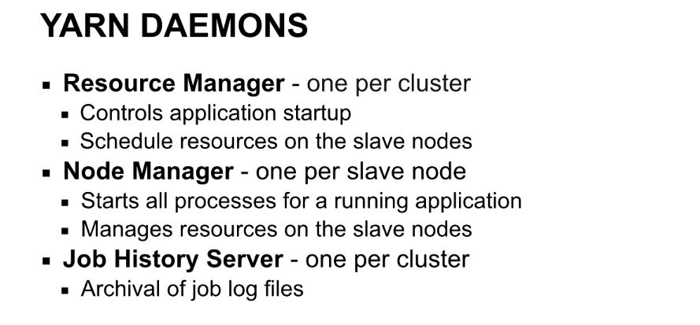

Slide 52
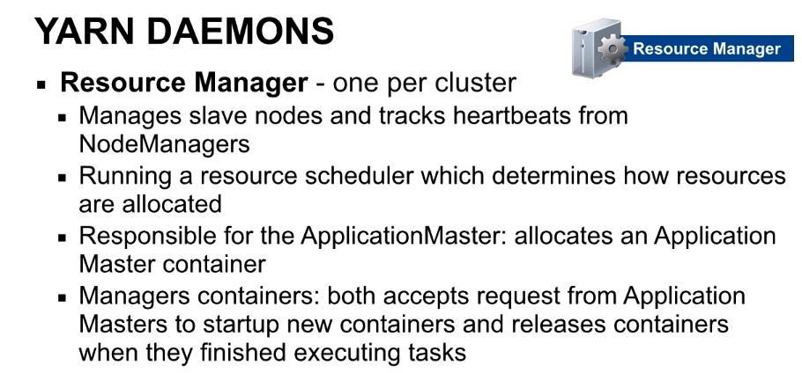

Slide 53
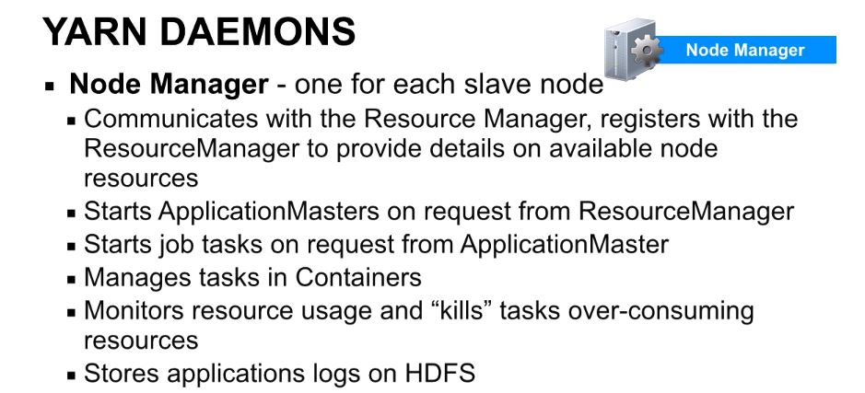

Slide 54
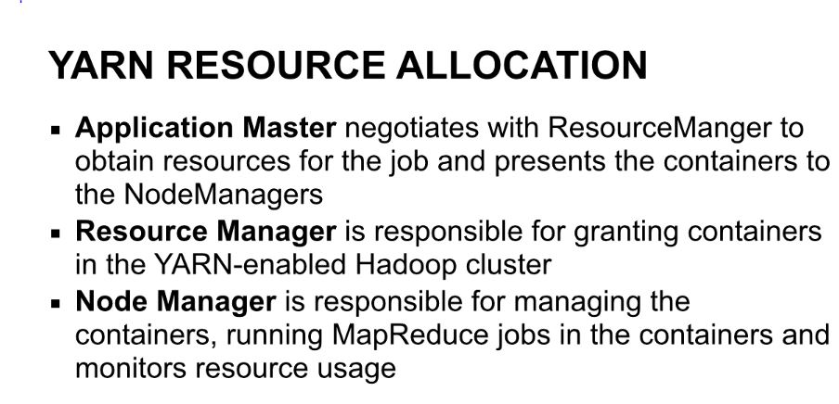

Slide 55
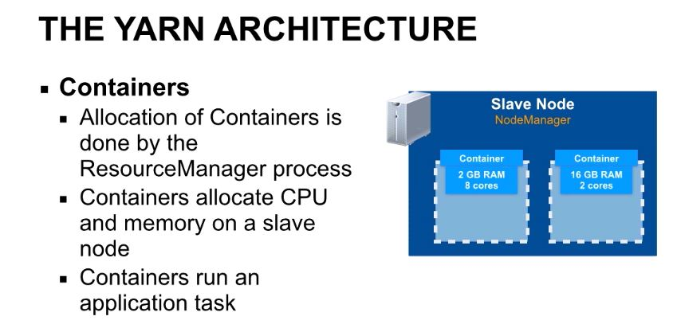
Containers: To do Computation

Slide 56
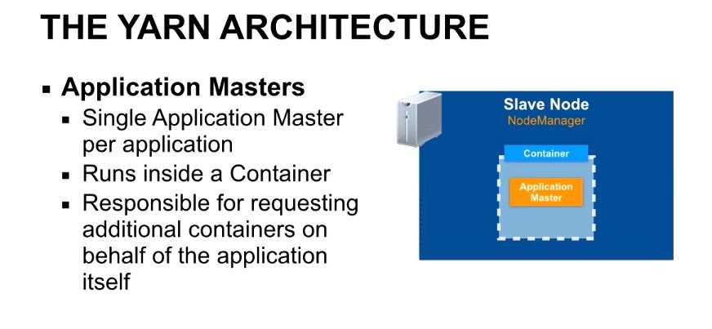
Application Master to manage Application

Slide 57
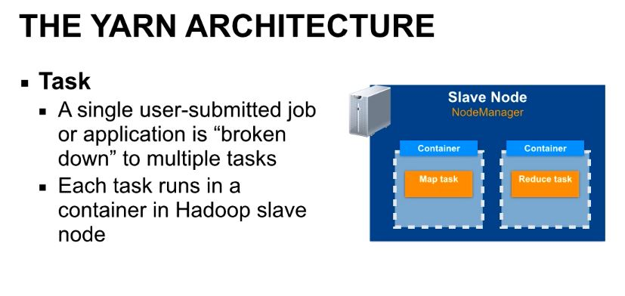
Application Master launch Tasks in each container

Slide 58
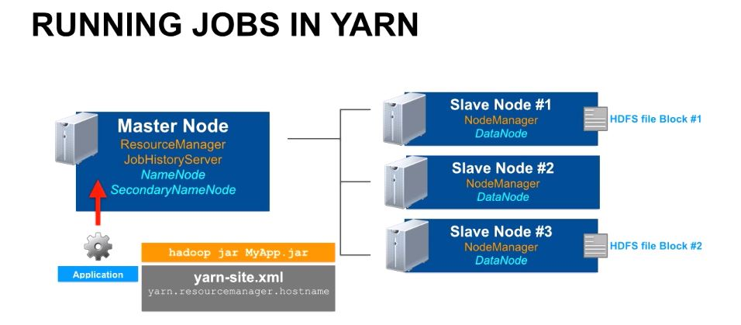

Slide 59
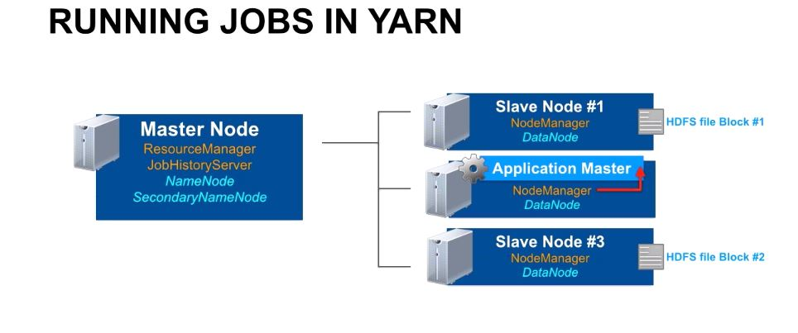
Resource manager launch Application Master to manage Applications

Slide 60
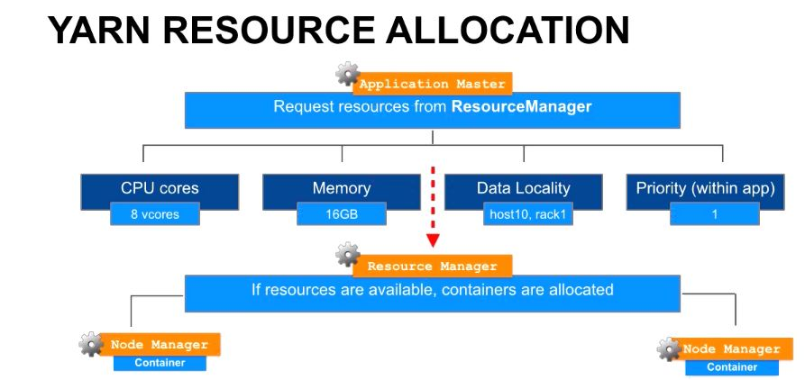

Slide 61
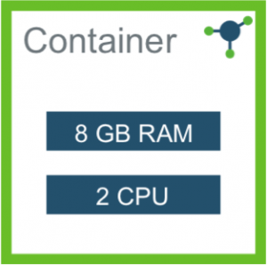
RM allocate memory to containers to process data
Node manager
Each Node manager has multiple Containers to process multiple Jobs

Slide 62
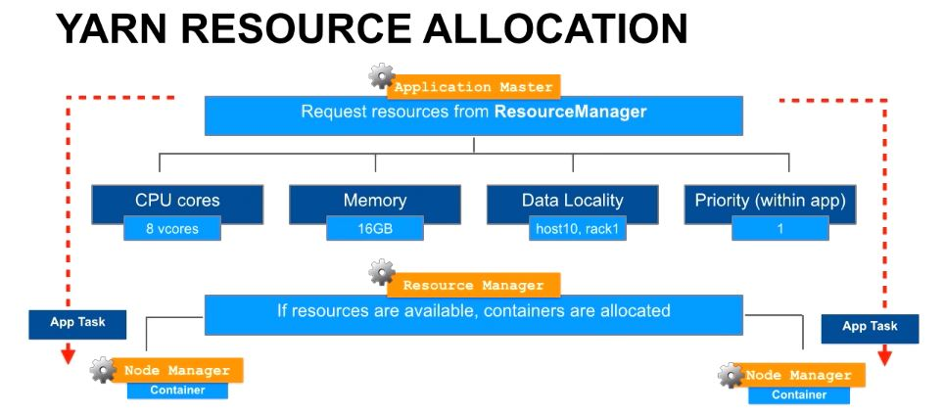
Resource manager allocated Containers,
App manager launch application tasks within the containers

Slide 63


Slide 64

YARN total Architecture

Slide 65

Single point of Failure in YARN

Slide 66


Slide 67


Slide 68


Slide 69


Slide 70
Thank you!

