Slide 1
Azure DF :Metadata driven data processing Framework-POC
Apr 2020

Slide 2

Overview
Problem
Challenges
Solution
Benefits
This Metadata driven Transformation Framework orchestrated by Azure Data Factory leverages Spark-Scala and Azure services. This framework integrates various azure services to perform medium level data transformation and load data to different layers . User only have to furnish few mandatory information in parameter file and the framework takes care of rest.
Very minimal effort is required to transform and move data from one layer to another layer for new files.
Same framework can be reused again for files with medium level complexity with just updating the few parameter and HQL files.
Big data ecosystem generally involves transforming and loading Incoming data to raw , curated and Consumption layers. Azure provides many services to achieve this End to End data transformation. But without a proper framework team ends up building non-reusable code again and again for each incoming file.
Apart from data transformation there are other process like incoming file sanity verification ,error reporting, trigger file generation and status updates . Teams will have to build individual workflows for each file which is time consuming and error prone.

Slide 3
Azure Services used in the workflow
Azure Service | Purpose
Data Factory | To Orchestrate End to End data workflow. Invoke Azure's various data and compute services. Event Trigger based on incoming file. Identify parameter file for each incoming file type and cascade them through workflow.
Azure Function | Sanity verification.
HDInsight Cluster | Hive - Execute HQLs. Spark - Execute Metadata driven Spark-Scala Jars.
Logic Apps | Email notification for error reporting. Status update. Trigger File Generation.
Azure Key vault | Secure Azure services.
Azure Data Lake Gen2 | Data Storage

Slide 4

Workflow
Azure Data Factory
RAW Layer
Curator Layer
ADF-Event Scheduler
Azure Functions
Metadata driven Transformation Code
HD Insight Hive
Source
HQL Execution based on parameter file.
These serverless functions will perform sanity check on incoming files.
Logic app
ADF-Event scheduler monitors for new incoming files in source container. It will kick start the workflow with metadata of new file.
Lookup
Email Notification
Parameter file identification and cascading
Trigger File
Trigger file built in Raw layer will have required info
Trigger File
Error Reporting
Azure Key vault
Storage Layer Storage Layer
Azure Data Lake – Generation -2

Slide 5
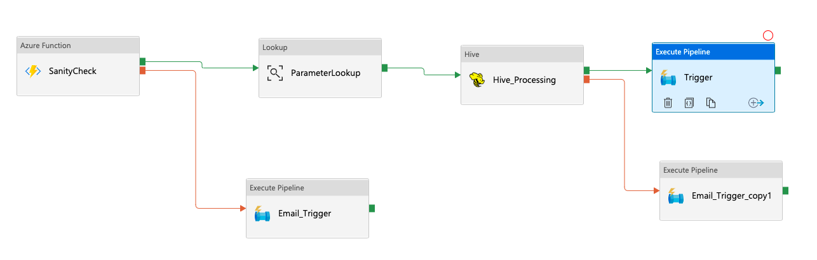
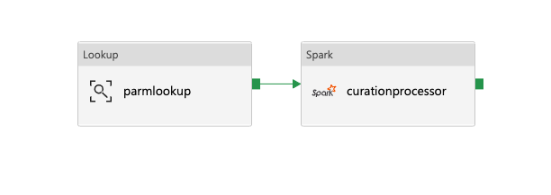
Major stages screen Grabs
Stage1 Pipeline
Stage2 Pipeline

