Slide 1
Open Agent Hackathon 2026 · Track: The Agent That Can Explain Why
AI SaaS Cost Advisor
Problem: A founder spent over $15,000 building with an AI app-builder,
and no tool estimated what the app would cost to build or to run.
Users: Solo founders building an AI SaaS product who need evidence-backed
AI operating costs before they commit.
Judging (100 pts): Impact 30 · Technical 20 · Innovation 15 · Demo 15 · Product & UX 10 · Sponsor Tech 10
Demo video: 1–4 minutes (recommended 2:30–3:30). This spoken deck ~3:15.
Eight required deck points follow — consistent with README and demo.
Notes:
0:00–0:20 (~20s)
Name Track: The Agent That Can Explain Why. Problem + solo founders in one or two sentences. Mentally note scoring weights for judges; do not read the whole table aloud.

Slide 2
1–2 · Solution — input, process, output
Input: idea + 2–5 AI features + growth stages (+ optional revenue/budget).
Live data via Zetaris/Nightshift, or SAMPLE/OFFLINE synthetic (real agent logic, no network).
Process: Controller orchestrates Planner → Analyst → Critic under a spend cap.
Output (DecisionPack): monthly AI cost by stage, revenue/AI margin, measured vs estimated tokens,
deterministic checks, Critic flags, limitations, JSONL trace of every step.
Unmeasured values stay estimated / projected only / unknown — never invented.
We never claim dollar “savings.” Estimates are planning figures, not financial advice.
Why it matters: a founder can act on stage costs and gaps before they spend on build.
Notes:
0:20–0:40 (~20s)
Input → process → output. Say sample vs live. Emphasize actionable DecisionPack and honest labels. No savings claims.

Slide 3
3 · Agent workflow — collaboration & feedback loop
Named roles (real interdependence — not one agent with three labels):
• Planner — domain risks (Nemotron Lightning via Nightshift)
• Analyst — Zetaris prices, candidates, measured feature×model samples
• Critic — flags only; proposes one action (Nemotron Ultra via Nightshift)
Collaboration / loop: Critic findings → controller validates → ≤1 repair re-run.
Shared state: Meterless H-MEM recalls founder assumptions; saves accepted decisions.
Gates: spend reserved before each Nightshift call; ≤30 attempts; rubric + human review
decide quality (models do not grade). Trace shows agent-to-agent steps.
Notes:
0:40–1:05 (~25s)
At least two agents collaborating with critique/repair — show the loop. Name H-MEM. Name Lightning/Ultra via Nightshift.

Slide 4
4 · Technical stack
run.py — JSON in / JSON out · Streamlit UI (ui_service → same entry; no forked economics)
Controller · Pydantic contracts · Decimal economics · durable SQLite dispatch
Adapters: Zetaris · Meterless Nightshift · Meterless H-MEM (Node bridge, pinned engine)
NVIDIA Nemotron via Nightshift: Lightning (Planner) · Ultra (Critic) — logged model IDs
SAMPLE_MODE=true offline path · pytest + sample checker · organizer JSONL traces
Public repo: github.com/pradeepgnd/cost-optimizer · .env.example placeholders only
Framework choice is not scored; working sponsor integration and reliability are.
Notes:
1:05–1:15 (~10s)
Quick stack pass. Point to public repo and sample mode.

Slide 5
5 · Zetaris + Meterless (+ NVIDIA) doing real work
Zetaris (required data layer): agent queries pinned price/catalog snapshots (typed, hashed);
evidence publisher writes measured runs back; outbox + retry if write fails; query IDs in trace.
Meterless Nightshift (primary AI provider): every model call — Planner, candidates, Critic, repair;
one real request returns usage (N in / N out) with requested + resolved model IDs.
Meterless Engine — H-MEM (working feature): recall at start, save decisions at end;
conformance/self-test: save, restart recall, isolation, audit (tests/docs).
NVIDIA: Nemotron Lightning + Ultra through Nightshift in working Planner/Critic features
(logs show the Nemotron model — not only meterless/auto).
Notes:
1:15–1:40 (~25s)
Must-show: Zetaris query, H-MEM engine feature + test, one Nightshift request with model name, Nemotron where we claim NVIDIA.

Slide 6
6 · What was unique about our sponsor use
Same sponsor tools that run the agent also produce the cost evidence.
Live finding (26 Oct): shared Nightshift meterless-scope leaked prior answers into
similar prompts — identical text across models and inflated input tokens (e.g. 1542 vs 751).
Fix: per-request scopes (eval-<random>); re-measure; discard contaminated numbers.
For accurate token accounting, catching that was load-bearing sponsor use — not a bolt-on.
Notes:
1:40–1:55 (~15s)
One concrete unique behaviour from SPONSOR_PARAGRAPH. Optional DEMO_SCRIPT 10s insert.

Slide 7
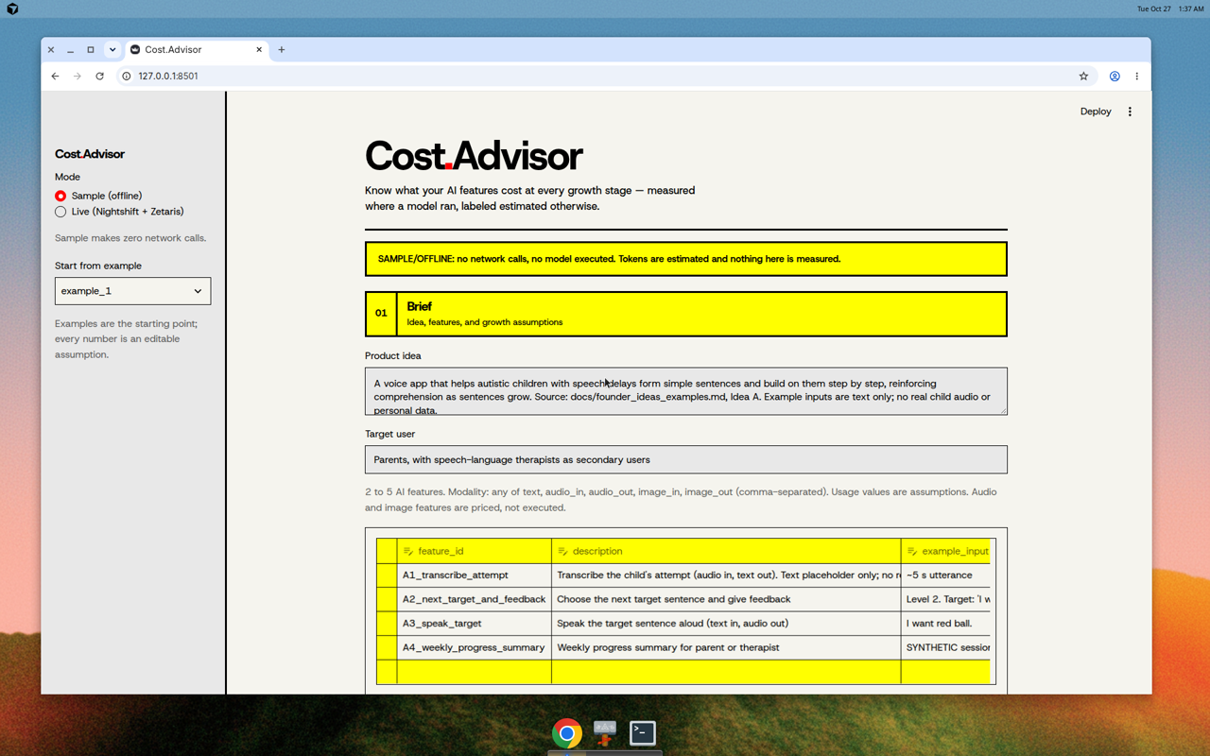
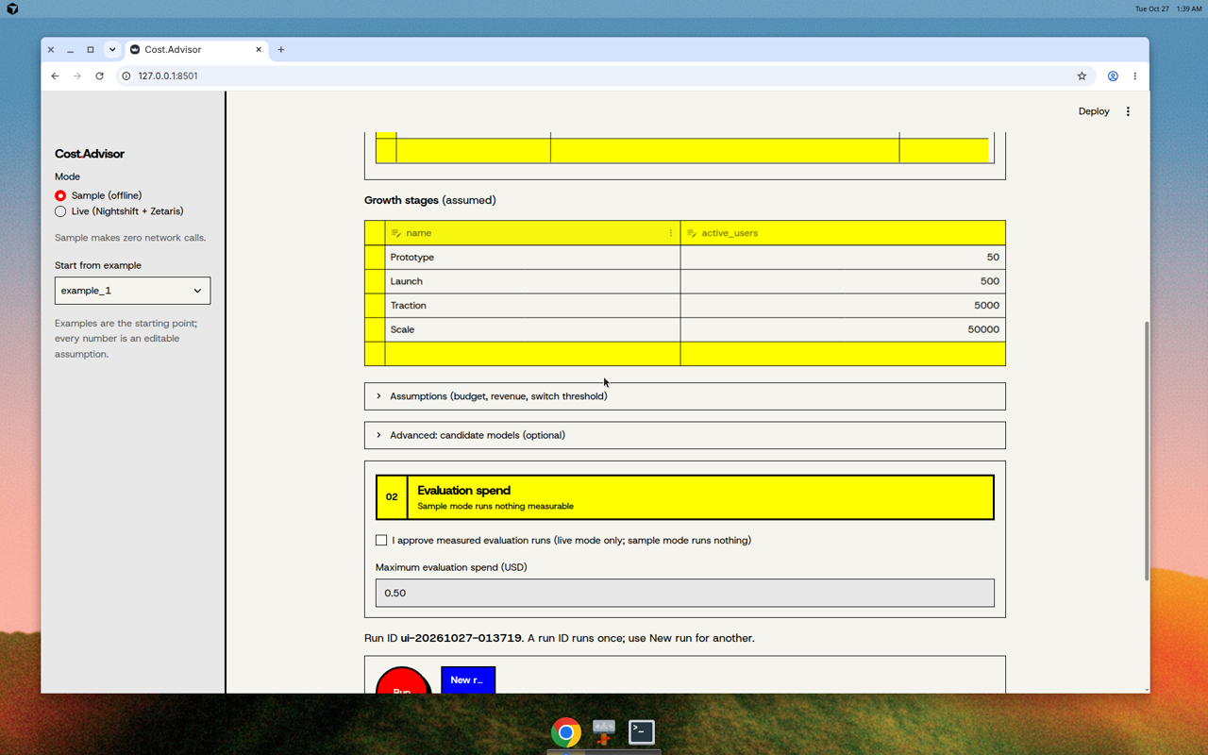
7 · Product visuals — Brief → Run (real Streamlit UI)
Approval + spend cap · progress: H-MEM → Zetaris → Nightshift → Planner/Critic (Nemotron)
Notes:
1:55–2:15 (~20s)
Show Brief and Run. Live or recorded real/synthetic run. Mention approval/cap.

Slide 8
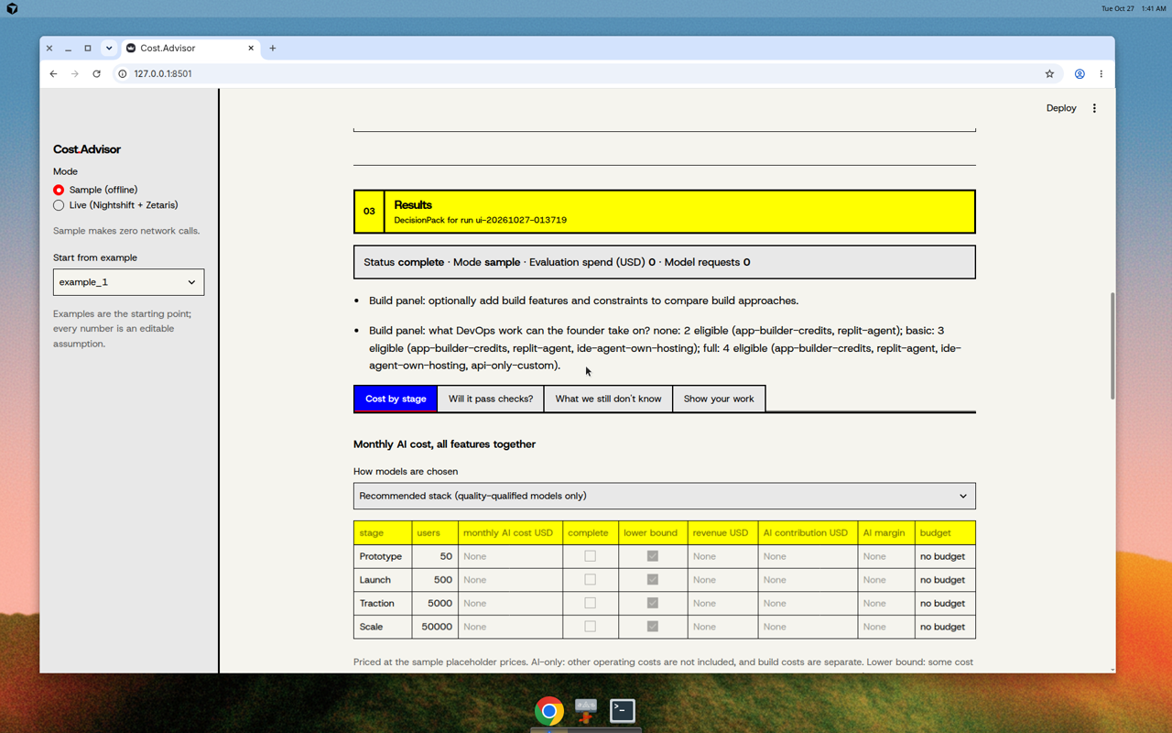
7 · Product visuals — final output a founder can use
Stage costs · margin · measured vs estimated · Critic flags · full trace — unknown stays unknown
Notes:
2:15–2:45 (~30s)
Final output + why it matters. Measured vs estimated. Trace proves collaboration. No savings claim.

Slide 9
8 · Future enhancements (not built yet)
• Human-review UI so recommended stacks can unlock
• Switch-point views after quality gates
• H-MEM decisions influencing a later run (next step in sponsor notes)
Repo: github.com/pradeepgnd/cost-optimizer
SAMPLE_MODE=true python run.py … · python -m streamlit run streamlit_app.py
Zetaris · Meterless Nightshift · Meterless H-MEM · NVIDIA Nemotron
Evidence-backed costs for Track 02 — agents that explain why, with a trace.
Demo aim 2:30–3:30 · hard cap 4:00.
Notes:
2:45–3:15 (~30s)
Future short and clearly unbuilt. Close with sponsors + repo + sample mode. Stop by 3:15–3:30.

