Slide 1

Fraudulent Claim Detection CaseStudy-Report
Submitted By
Pradeep Harry Michael
Pavan Kumar BN

Slide 2
Contents
Problem Statement
Analysis and Model Building
Business Summary
1> Data Preparation and Cleaning
2> EDA
3> Feature Engineering
4> Model Building (LR / Random Forest)
5> Predicting and Evaluation

Slide 3

Problem Statement
Challenge: Global Insure, a major player in the insurance industry, is experiencing substantial financial losses due to a high volume of fraudulent claims. The existing fraud detection system relies heavily on manual inspections, which are not only time-consuming and labour-intensive but also inefficient. As a result, many fraudulent claims are detected only after payouts have been made, limiting the company's ability to prevent losses and straining operational resources.
Objective: To address this issue, Global Insure seeks to enhance its fraud detection capabilities by leveraging data-driven insights and advanced analytics. The goal is to implement an intelligent system that can accurately classify claims as fraudulent or legitimate at an early stage in the approval process. This proactive approach would help the company significantly reduce financial losses, improve the speed and accuracy of claims processing, and optimize overall efficiency in claims management.

Slide 4

Data Preparation and Cleaning
(38577, 54)
Data Understanding and Cleaning activities performed
Drop Columns which do not have any values across all Rows.
Drop Rows which have all column values as NA or Null
Data type Changes
Drop Columns which have large portion of values as unique
Drop rows where features have invalid negative values
Handle missing data like ‘?’ as ‘Unknown’
Outcome
The initial Data Frame of shape(rows , columns) (1000,40) was reduced to (908, 36)
The Key Columns for analysis were identified
Numerical Fields
months_as_customer, age, policy_deductable
policy_annual_premium, umbrella_limit, capital-gains, capital-loss
incident_hour_of_the_day, number_of_vehicles_involved, bodily_injuries
witnesses, total_claim_amount, injury_claim, property_claim
vehicle_claim, auto_year
Categorical Field
policy_state, policy_csl, insured_sex
insured_education_level, insured_occupation, insured_hobbies
insured_relationship, , incident_type, collision_type
incident_severity, authorities_contacted, incident_state
incident_city, incident_location, property_damage
police_report_available, auto_make, auto_model
DateField
incident_date
policy_bind_date
Target Field
fraud_reported

Slide 5
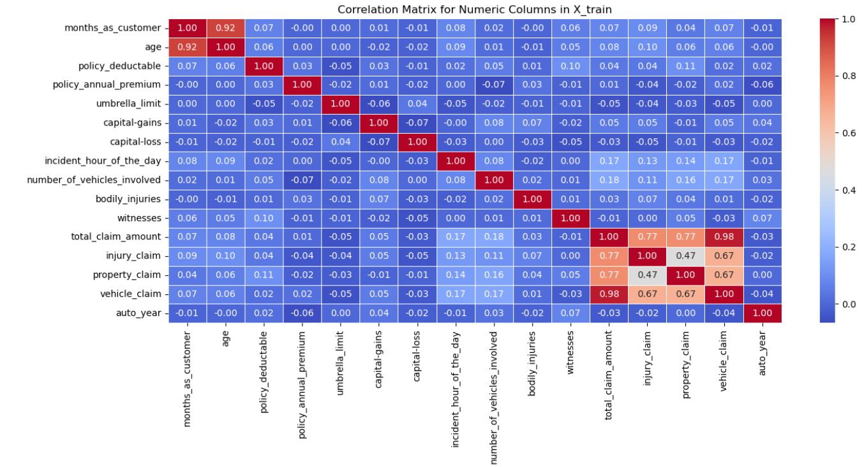
EDA : Numeric Correlation
High Correlation Identified between the following fields
1> vehicle_claim and total_claim_amount
2> months_as_customer and age

Slide 6
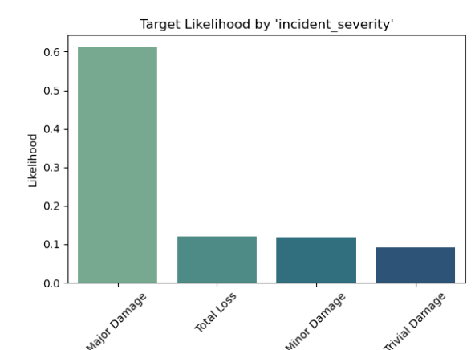
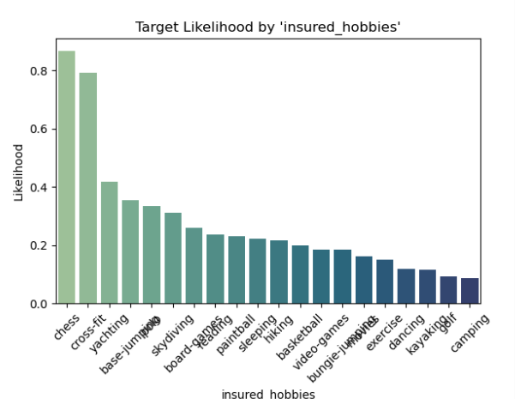
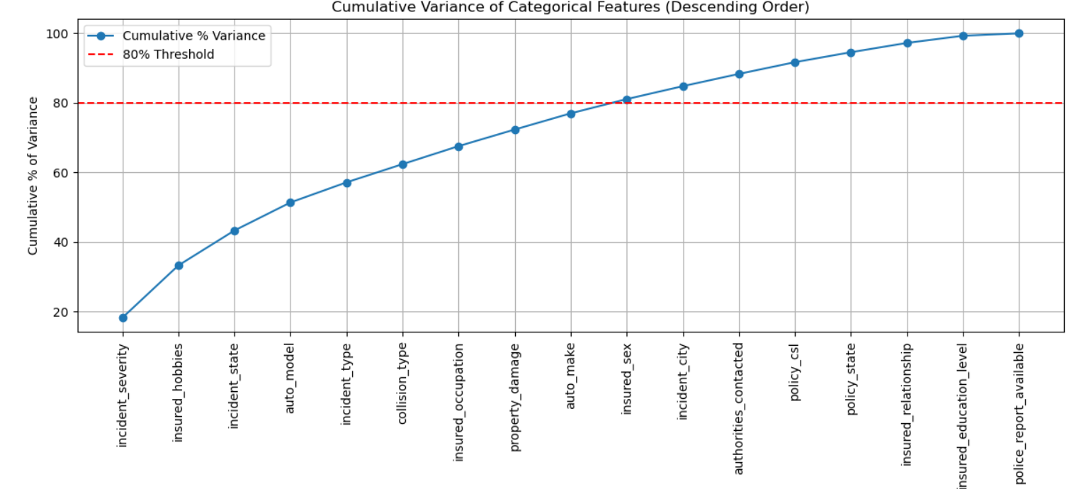
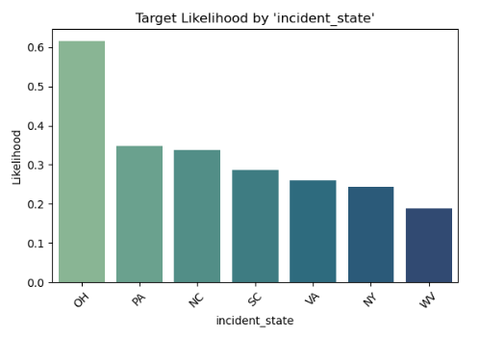
EDA : Target Likelihood for Categorical Variables
Top 5 Categorical Features with Highest Variation in 'Y' Likelihood:
incident_severity
insured_hobbies
incident_state
auto_model
incident_type

Slide 7
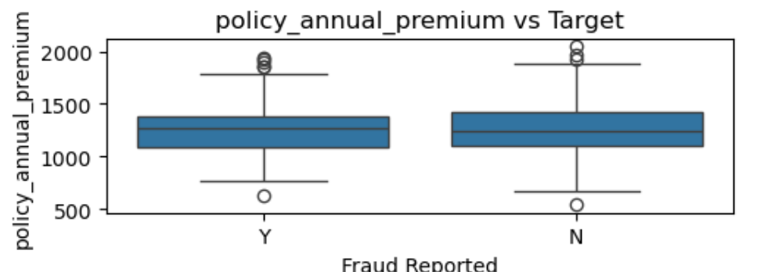
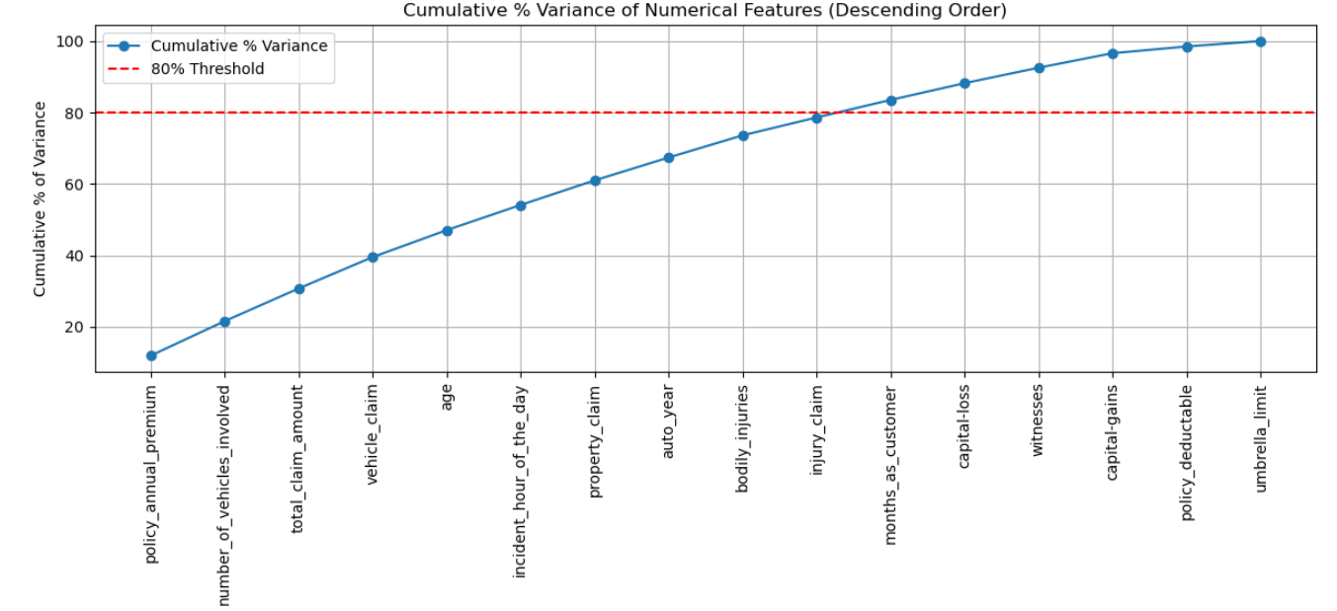
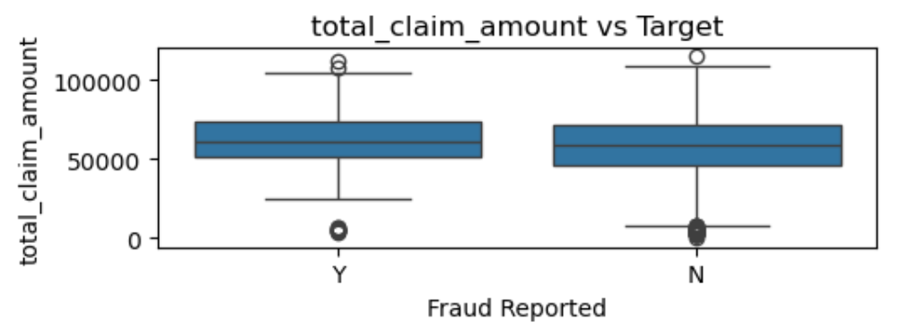
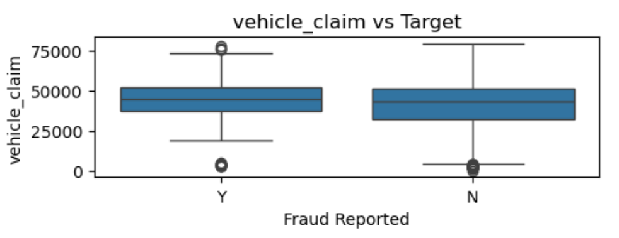
EDA : Target Likelihood for Numerical Variables
Top 5 Numerical Features with Highest Variation in 'Y' Likelihood:
policy_annual_premium
number_of_vehicles_involved
total_claim_amount
vehicle_claim
age

Slide 8
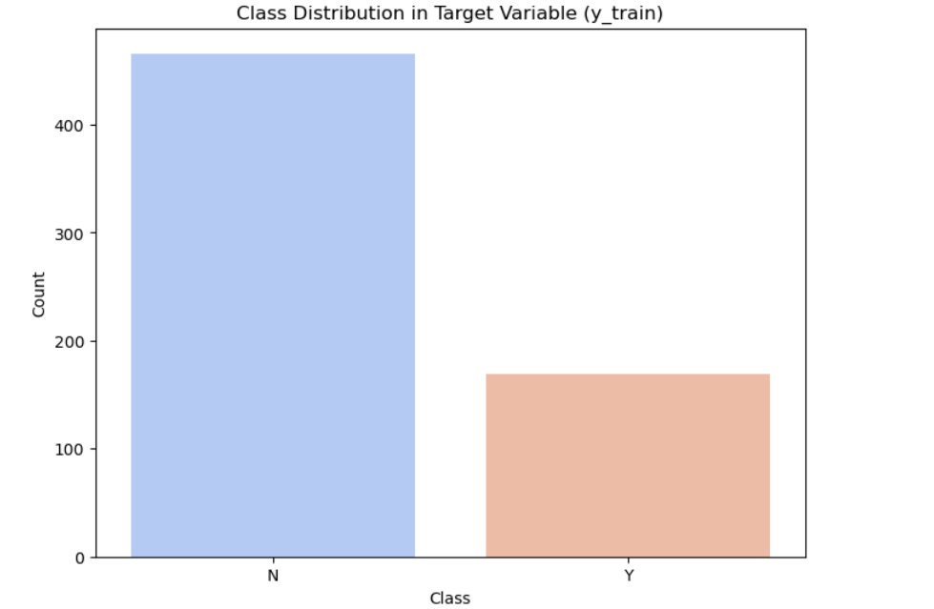
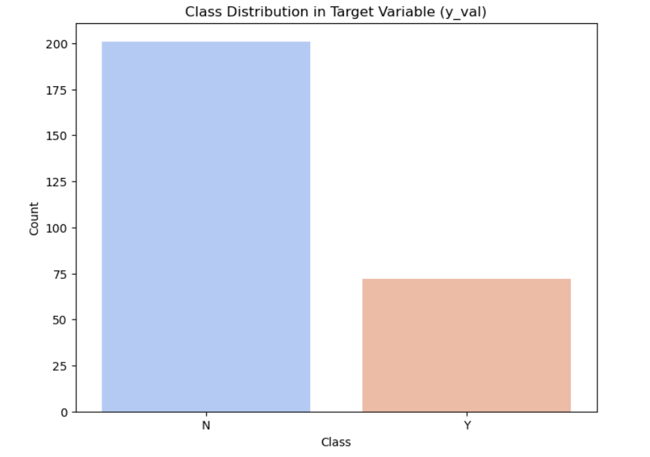
Feature Engineering :
Resampling using RandomOverSampler to handle Class Imbalance
Deriving new Features from Date Columns
Combining Features like auto model and auto make
Handle Redundant Columns
Dummy Variables for Categorical Columns
Feature Scaling

Slide 9
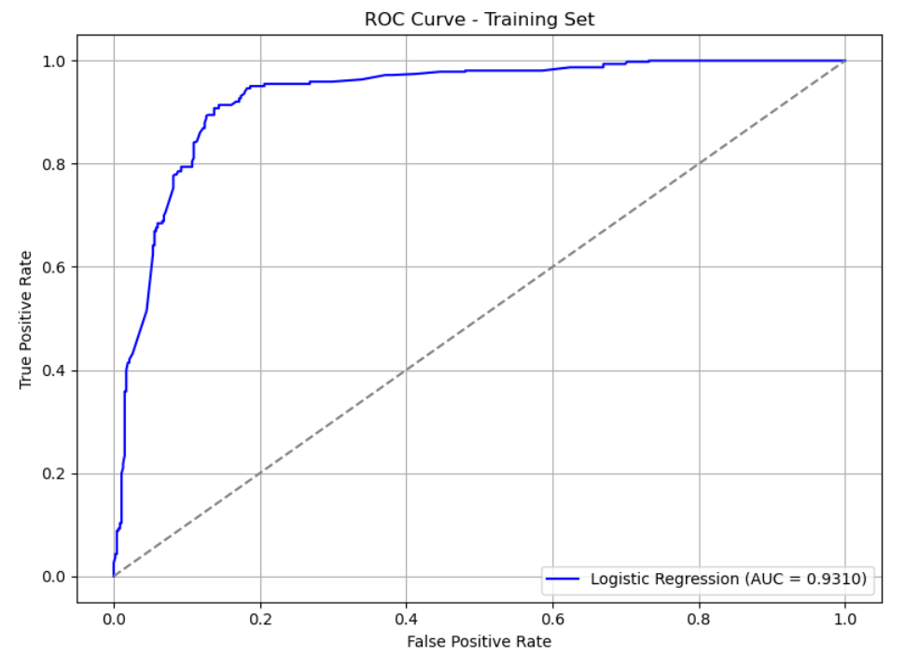
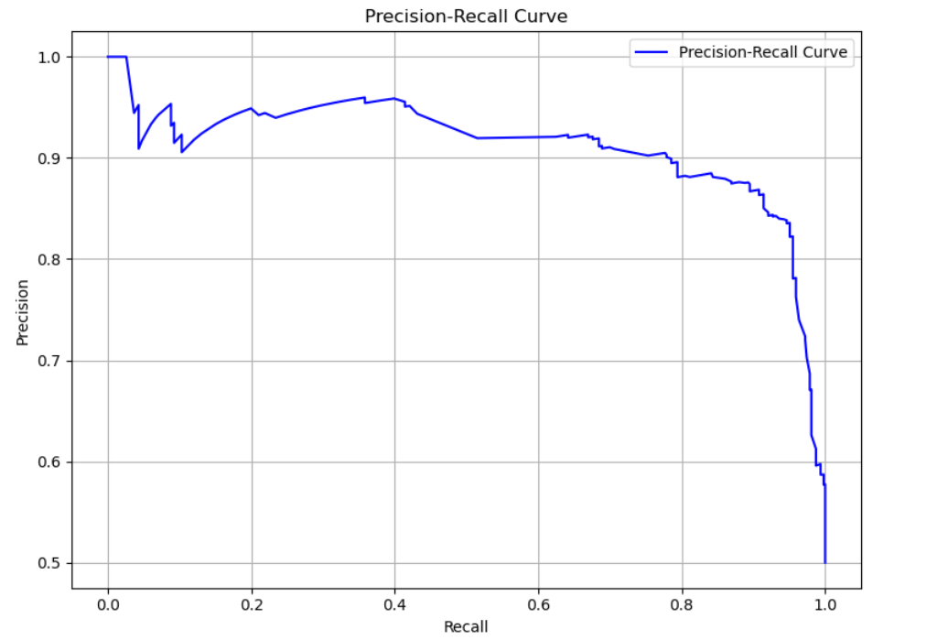
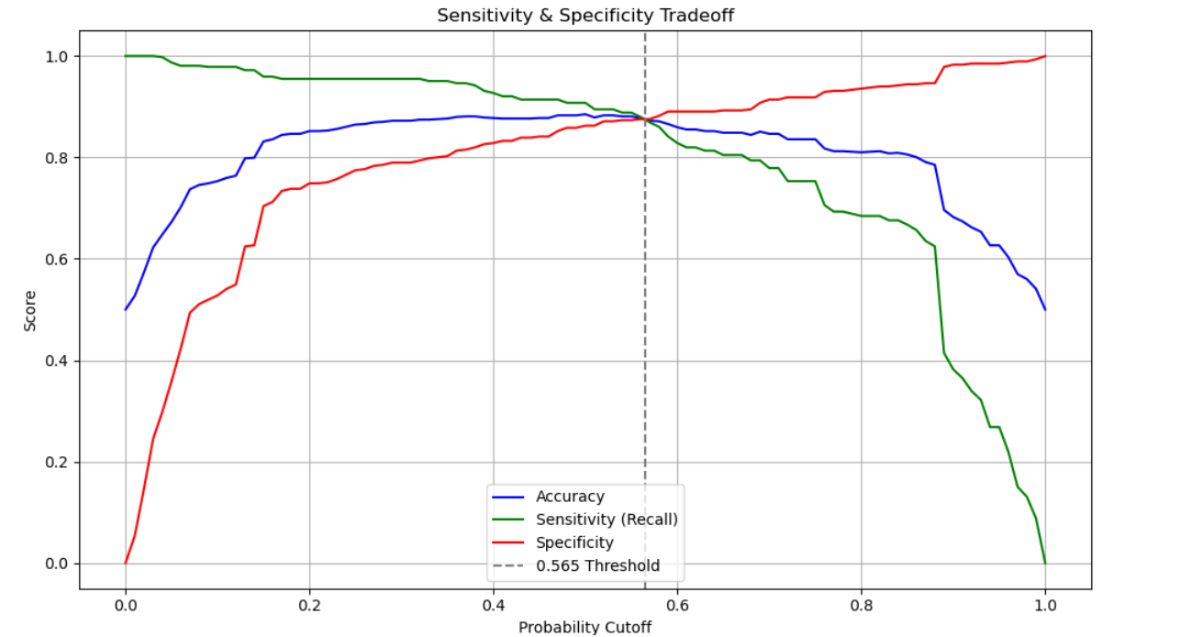
Model Building : Logistic Regression
Summary of Model (Training)
Probability Cutoff Chosen: 0.565
Model Accuracy at Optimal Cutoff (0.565): 0.8766
Sensitivity (Recall): 0.8777
Specificity: 0.8755
Precision: 0.8758
Recall: 0.8777
F1 Score: 0.8767

Slide 10
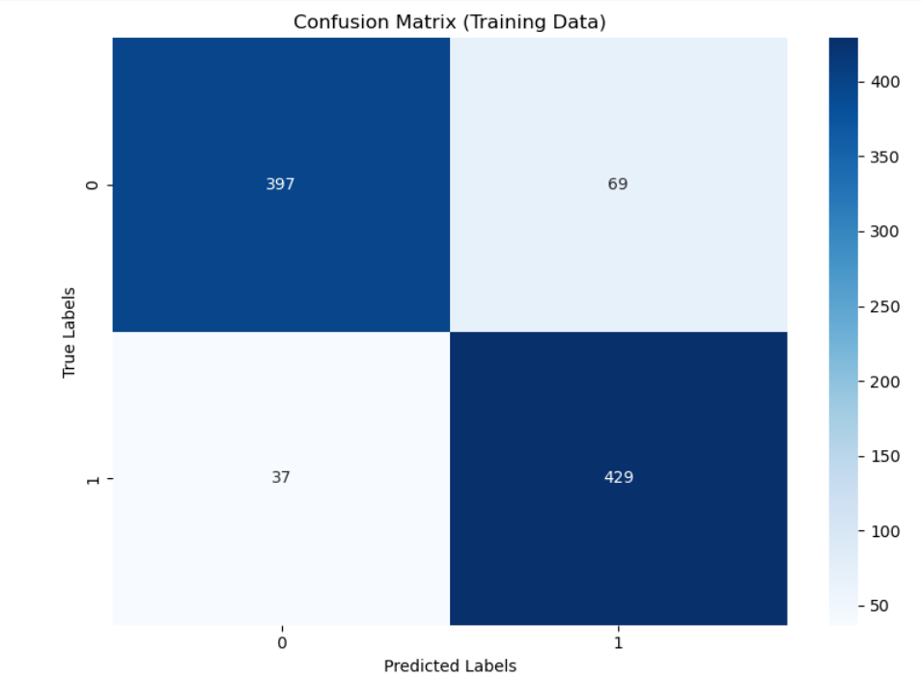
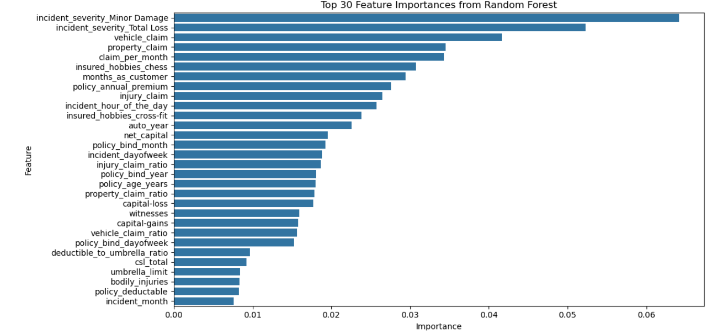
Model Building : Random Regression
Summary of Model (Training)
Best Hyperparameters Found:
{'max_depth’: 10, 'max_features’: 12, 'min_samples_leaf': 10, 'min_samples_split': 20, 'n_estimators’: 20}
Training Accuracy: 0.8863
Sensitivity (Recall): 0.9206
Specificity: 0.8519
Precision: 0.8614
F1 Score: 0.8900

Slide 11
Model Building : Prediction and Evaluation
Model | Tuning | Training Set Performance | Validation Set Performance
Logistic Regression | Probability Cutoff Chosen: 0.565 | Model Accuracy at Optimal Cutoff (0.565): 0.8766 Sensitivity (Recall): 0.8777 Specificity: 0.8755 Precision: 0.8758 Recall: 0.8777 F1 Score: 0.8767 | Model Accuracy at Optimal Cutoff (0.565): 0.8388 Sensitivity (Recall): 0.8194 Specificity: 0.8458 Precision: 0.6556 Recall: 0.8194 F1 Score: 0.7284
Random Forest | Best Hyperparameters Found: {'max_depth’: 10, 'max_features’: 12, 'min_samples_leaf': 10, 'min_samples_split': 20, 'n_estimators’: 20} | Training Accuracy: 0.8863 Sensitivity (Recall): 0.9206 Specificity: 0.8519 Precision: 0.8614 F1 Score: 0.8900 | Validation Accuracy: 0.8388 Sensitivity (Recall): 0.8889 Specificity: 0.8209 Precision: 0.6400 F1 Score: 0.7442

Slide 12
Business Summary
(38577, 54)
A data-driven approach to analyze historical claim records has revealed clear patterns associated with fraudulent behaviour.
Both Logistic Regression and Random Forest models were trained to predict fraud probability, with Random Forest achieving slightly better performance.
Categorical and numerical likelihood analysis identified features that significantly influence the likelihood of fraud.
High-variation features like incident_severity, insured_hobbies , policy_annual_premium, total_claim_amount(vehicle/property/injury) were strong fraud indicators.
Low-impact features (e.g., insured_relationship, policy_state,insured_education_level) contributed minimally and can be deprioritized or dropped to reduce noise.

