Slide 1

Lending Club Case Study
Submitted By
Pradeep Harry Michael
Aman Gupta

Slide 2
Contents
Problem Statement
Analysis and Outcomes
Business Summary
1> Data Understanding and Cleaning
2> Univariate/Bivariate for numerical
3> Bivariate for Categorical Data

Slide 3

Problem Statement
The consumer finance company faces a critical challenge in making loan approval decisions that minimize financial risks. When an applicant applies for a loan, the company needs to assess whether the applicant is likely to repay the loan. Approving loans to applicants who are likely to default results in significant financial losses, while rejecting loans from creditworthy applicants means missed business opportunities.
The primary concern for the company is identifying "risky" applicants—those who are most likely to default. These defaulters cause the largest amount of credit loss. To address this, the company aims to analyze past loan data to identify patterns that predict whether an applicant is likely to default. By uncovering these patterns, the company can take proactive measures, such as denying loans to high-risk applicants, adjusting loan amounts, or charging higher interest rates. This data-driven approach will help the company reduce credit loss and better manage its loan portfolio, ensuring financial stability.

Slide 4

Analysis : Data Understanding And Cleaning
Data Understanding and Cleaning activities performed
Drop Columns which do not have any values across all Rows.
Drop Columns which have more than 50% of the Rows with empty values.
Change values of columns like loan status to business standard like "Default" and "Non-Default"
Drop Rows which have all column values as NA or Null
Data type Changes
Drop Rows which are duplicate
Outcome
The initial Data Frame of shape(rows , columns) (39717, 111) was reduced to (39717, 54)
The Key Columns for analysis were identified
Numerical Fields
int_rate
annual_inc
loan_amnt
dti
delinq_2yrs
inq_last_6mths
Categorical Field
term,grade,sub_garde
emp_length , home_ownership,issue_d
verification_status , purpose , addr_state
pub_rec,pub_rec_bankruptcies
Target Field
loan_status

Slide 5
Analysis : Data Understanding And Cleaning
Description of Data Columns which are being considered for Analysis
Column Name | Description
loan_amnt | The Loan Amount borrowed
int_rate | Interest Rate on the loan
annual_inc | The self-reported annual income provided by the borrower during registration.
dti | A ratio calculated using the borrower’s total monthly debt payments on the total debt obligations, excluding mortgage and the requested LC loan, divided by the borrower’s self-reported monthly income
delinq_2yrs | The number of 30+ days past-due incidences of delinquency in the borrower's credit file for the past 2 years
loan_status | Current status of the loan containing values 'Default' , 'Non-Default' and 'Current'
term | The number of payments on the loan. Values are in months and can be either 36 or 60.
grade | LC assigned loan grade
sub_grade | LC assigned loan subgrade
emp_length | Employment length in years. Possible values are between 0 and 10 where 0 means less than one year and 10 means ten or more years.
home_ownership | The home ownership status provided by the borrower during registration. Our values are: RENT, OWN, MORTGAGE, OTHER
verification_status | Indicates if income was verified by LC, not verified, or if the income source was verified
purpose | A category provided by the borrower for the loan request.
addr_state | Number of derogatory public records
pub_rec_bankruptcies | Number of public record bankruptcies

Slide 6
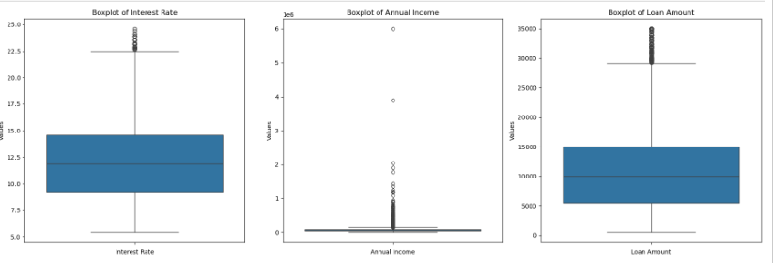
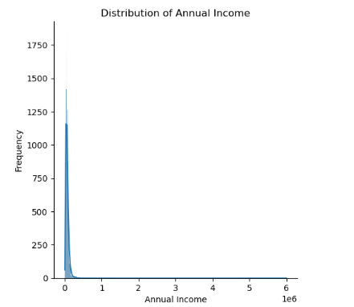
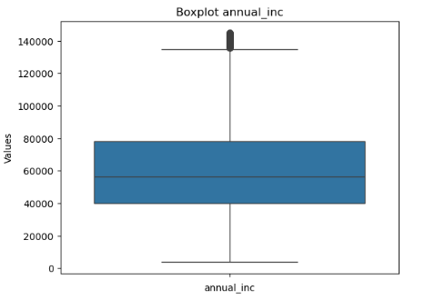
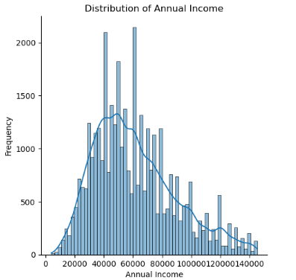
Analysis :Univariate and Bivariate for Numeric
Identified Outliers and removed
Box plots indicated Outliers for ‘annual_inc’ field . The IQR logic was used to remove Outliers since it did not have a Normal Distribution
Outcome After removing Outlier for
‘annual_inc’

Slide 7
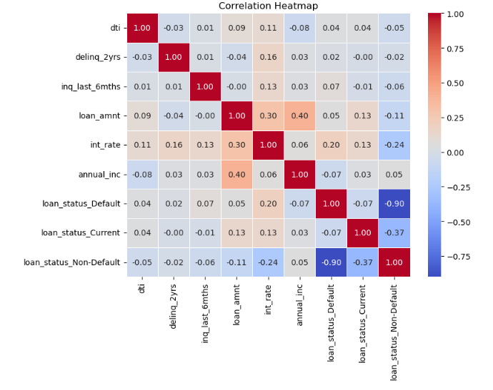
Analysis :Univariate and Bivariate for Numeric
Heat Map between the Numeric Fields along with Loan Status

Slide 8
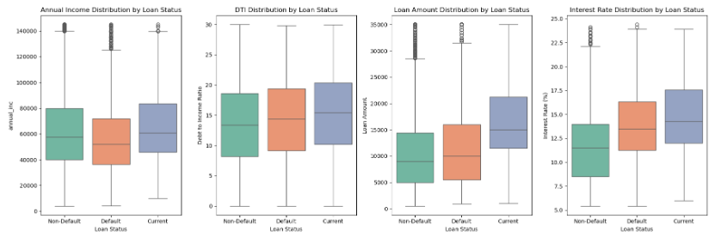
Analysis :Univariate and Bivariate for Numeric
Distribution Analysis was performed with fields ‘annual_inc’ , ‘dti’, ‘loan_amt’ , ‘int_rate’ against ‘loan_status’
i
Outcome
int_rate (Interest Rate)indicates that Loans with higher int_rate have more risk of getting Defaulted
dti (Debt to Interest Rate Ratio) indicates that higher dti ratio are at higher risk of getting Defaulted
annual_inc (Annual Income) even though the correlation is not very prominent but still lower annual_inc have higher risk of getting Defaulted
loan_amt (Loan Amount) even though the correlation is not very prominent but still higher loan_amt have higher risk of getting Defaulted

Slide 9
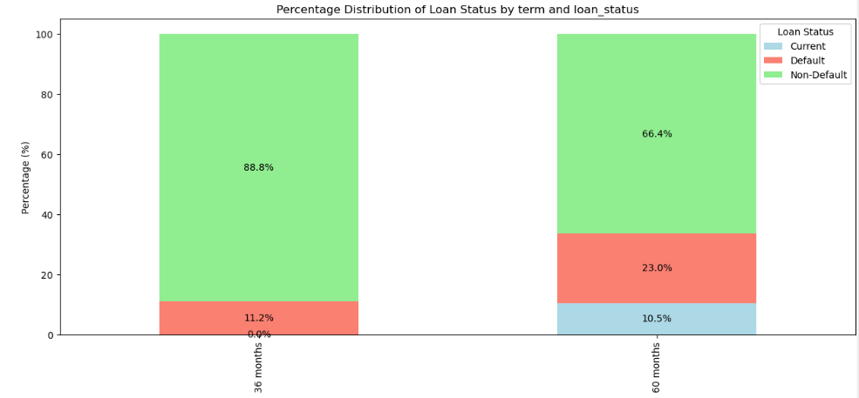
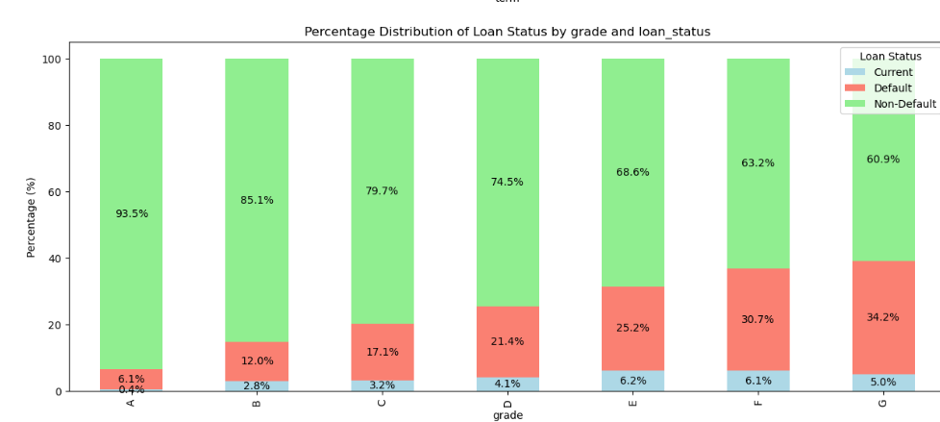
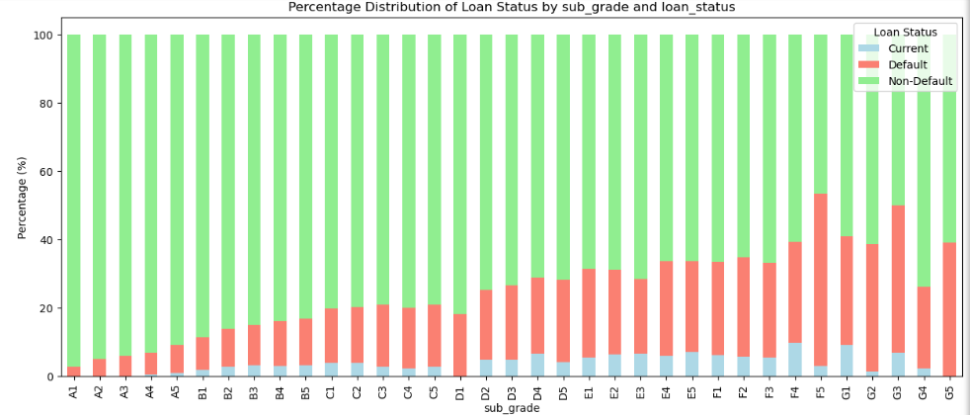
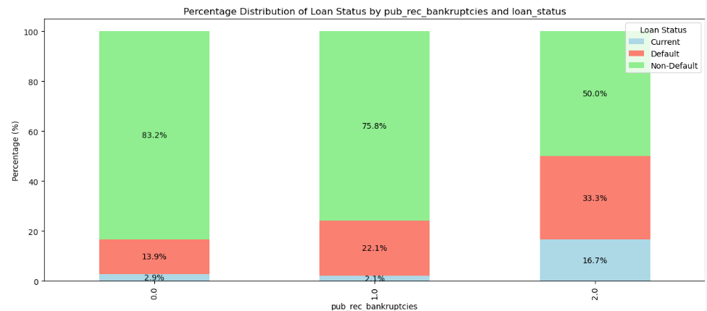
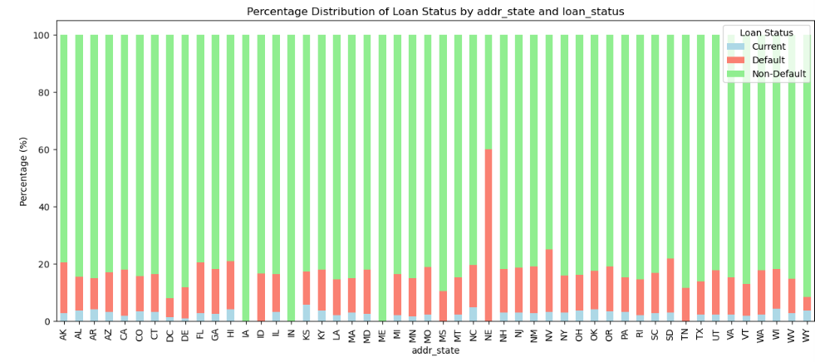
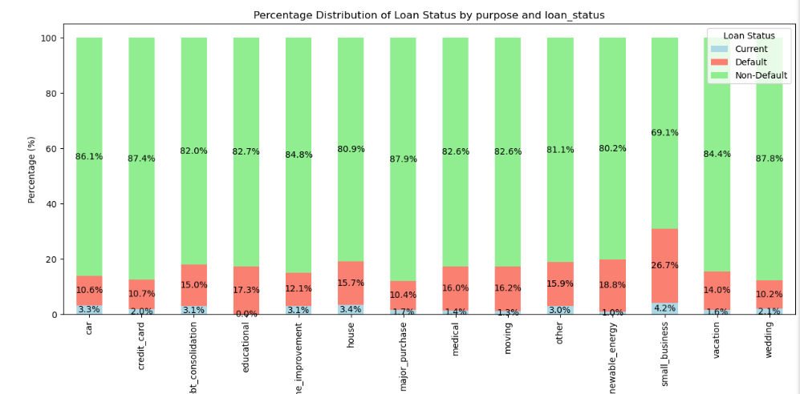
Analysis :Bivariate Analysis of Categorical Fields
Bivariate analysis indicating following fields have a considerable impact on the status of loan and contribute to whether it is likely to Default

Slide 10
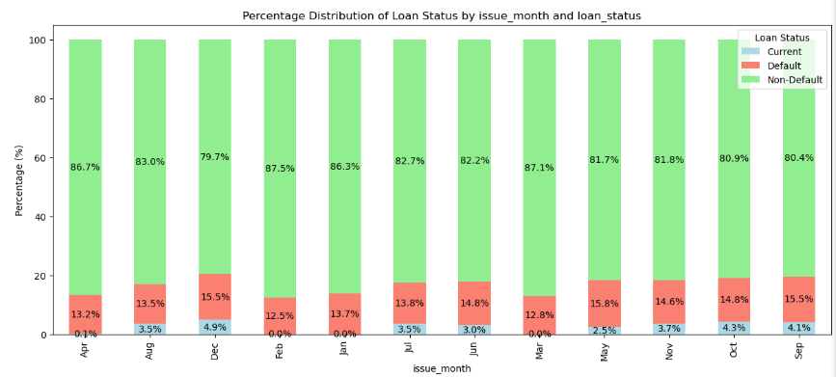
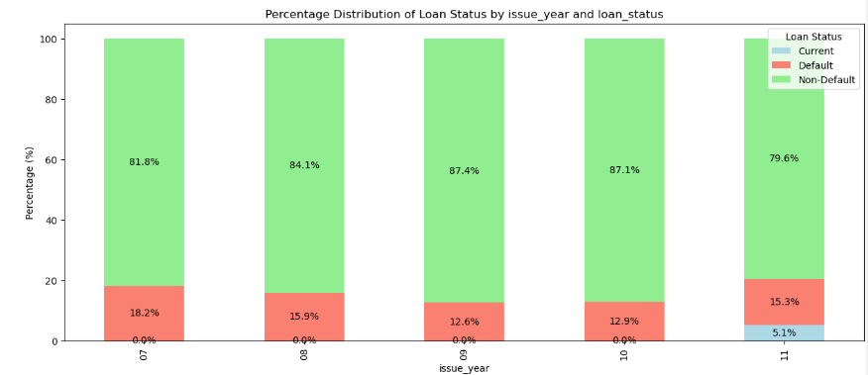
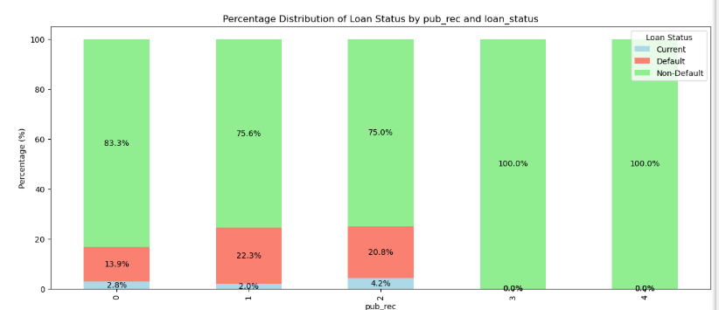
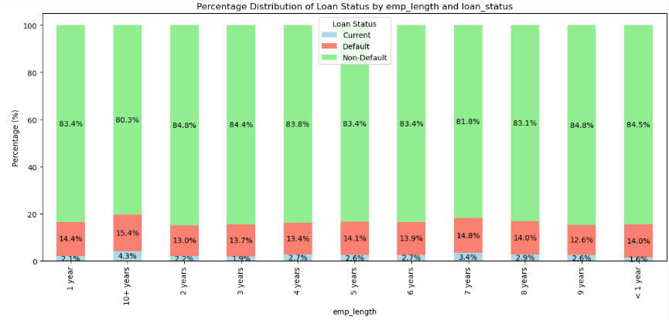
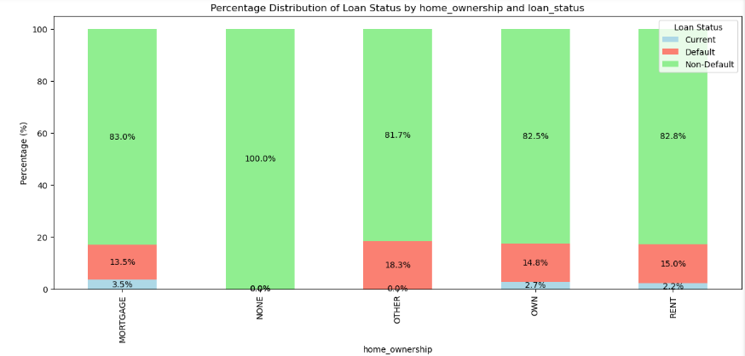
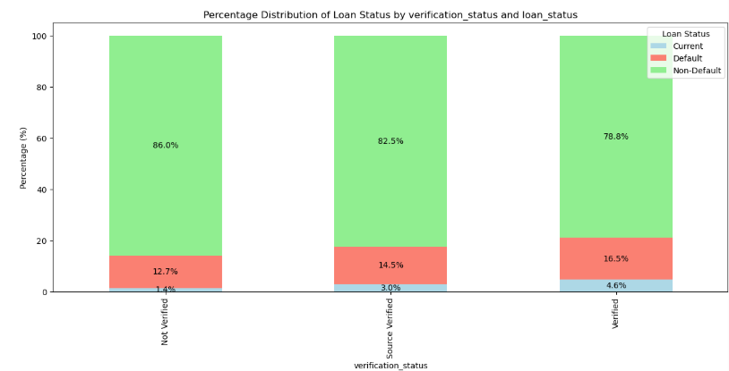
Analysis :Bivariate Analysis of Categorical Fields
Bivariate analysis indicating following fields do not have a considerable impact on loan status

Slide 11
Analysis :Bivariate Analysis of Categorical Fields
OutCome of Bivariate Analysis for Categorical Fileds
The following Categorical Variables have a considerable impact on Loan getting Defaulted
term , Higher Term like 60 months are at a higher risk of getting defaulted
grade and sub_grade , lower the grade then higher is the risk of getting defaulted
purpose , the purpose named “small business” has a higher probability of getting defaulted in comparison to other purposes
addr_state , the state 'NE' has a higher probability of getting defaulted though the count of samples considered are very less
pub_rec_bankruptcies, higher the number of publicly recorded bankruptcies relates to higher risk of getting Defaulted
The following Categorical Variables do not have a significant or prominent impact on Loan getting Defaulted
emp_length
home_ownership
verification_status
pub_rec
issue_d

Slide 12

Business Summary
The consumer finance company is facing a critical challenge in balancing the risk of financial losses with the opportunity for growth through loan approvals. The company needs to identify high-risk applicants—those likely to default—while ensuring it does not miss potential business opportunities by rejecting creditworthy customers. The objective is to minimize credit loss while maintaining a healthy portfolio. The company intends to achieve this by leveraging past loan data to identify patterns and factors that predict loan default.
Through analysis, several key factors have been identified that influence the likelihood of default. Numerical analysis, loans with higher interest rates (int_rate) or higher Debt to Income Ratio show a higher risk of default, as well as loans taken by employees with lower annual income (annual_inc) or higher loan amounts (loan_amt). While the correlations for annual income and loan amounts with loan status are not overwhelmingly strong , these factors still play a role in assessing risk.
From a categorical analysis perspective, certain variables significantly impact the likelihood of default. Loan term plays a crucial role, with longer terms (e.g., 60 months) being associated with higher default risk. Additionally, loan grade and sub-grade indicate that lower grades correlate with a higher risk of default. Purpose of the loan also affects risk, particularly loans for "small business" purposes, which show a higher probability of default. The state 'NE' also demonstrates a higher default rate, though this is based on a smaller sample size. Publicly recorded bankruptcies (pub_rec_bankruptcies) have a strong correlation with default risk—the higher the number of bankruptcies, the greater the chance of default.
On the other hand, some factors do not show a significant impact on the likelihood of default, such as employment length (emp_length), homeownership status (home_ownership), verification status, public record (pub_rec), and the issue date of the loan.
By understanding these patterns and utilizing this data-driven approach, the company can proactively manage its loan portfolio. It can deny loans to high-risk applicants, adjust loan amounts, or increase interest rates for those who pose a higher risk, thus reducing credit loss and ensuring financial stability. This strategic approach not only protects the company’s financial health but also allows it to make more informed, risk-aware lending decisions.

