Slide 1

Shop Assist 2.0 Function Call API Enhancement
Submitted By
Pradeep Harry Michael

Slide 2
Contents
Problem Statement
Enhancements Made
Summary

Slide 3

Problem Statement
🧠 Problem Statement: Enhancing ShopAssist AI with Function Calling for Improved Efficiency and User Experience
The current version of ShopAssist AI lacks the architectural flexibility and conversational fluidity required to meet modern chatbot standards. With the introduction of the Function Calling API, there is an opportunity to significantly upgrade the system by streamlining its architecture and improving its interaction capabilities. The challenge lies in transforming ShopAssist into ShopAssist 2.0, a more efficient and intuitive chatbot that leverages function calling to deliver dynamic, context-aware responses.
Objective: Upgrade ShopAssist AI using the Function Calling API
Goals:
Improve chatbot efficiency
Enhance user experience
Simplify architecture
Deliver structured, actionable insights

Slide 4

Enhancements : Function Description
(38577, 54)
Function Name | Purpose
extract_user_info | Extracts 6 key user preferences from conversation Parses user input for: GPU intensity Display quality Portability Multitasking Processing speed Budget
confirm_intent | Validates completeness and format of user inputs Ensures all 6 fields are present and valid Prevents incomplete or ambiguous recommendations
classify_laptop_features | Converts raw laptop descriptions into structured attributes (low/med/high) Translates product specs into standardized values Enables accurate matching with user preferences

Slide 5
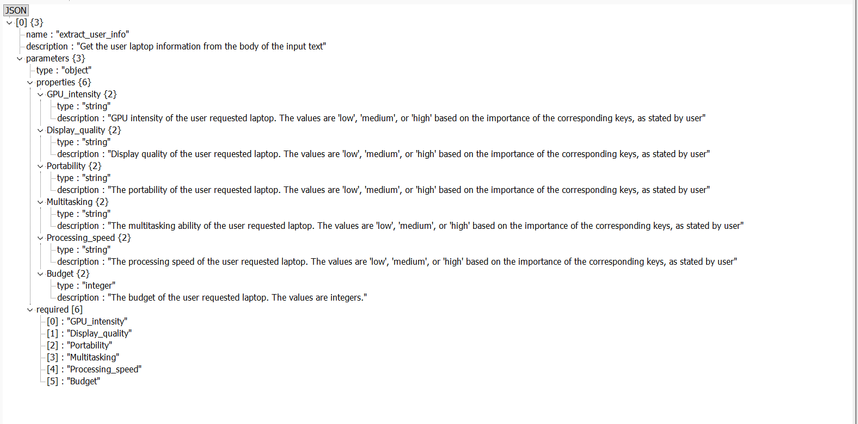
Enhancements : extract_user_info Function Schema
(38577, 54)

Slide 6
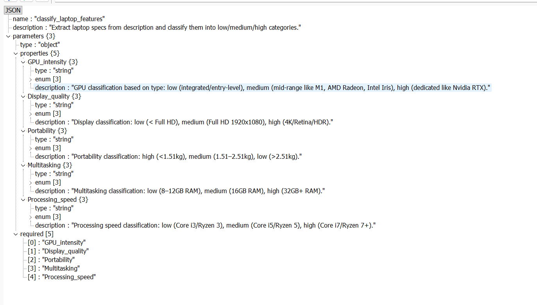
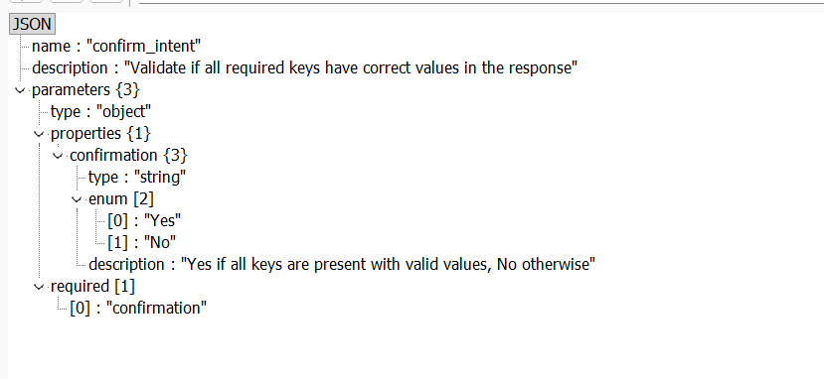
Enhancements : confirm_intent and classify_laptop_features Function Schema
(38577, 54)

Slide 7
Enhancements : Updated Conversation Flow
(38577, 54)
Step 1: User shares needs
Step 2: extract_user_info captures preferences
Step 3: confirm_intent validates input
Step 4: Laptop descriptions processed via classify_laptop_features
Step 5: Chatbot recommends best-fit laptops

Slide 8
Enhancements : Updated Method with Function Call Integration
(38577, 54)
Function | Purpose | Function API Used
initialize_conversation() | Sets up expert assistant prompt & starts structured dialogue
get_chat_model_completions(messages) | Gets assistant’s next message via Chat API
moderation_check(user_input) | Ensures input/output safety via moderation
get_user_requirement_string(response) | Converts response to readable preference string
get_chat_completions_func_calling(input) | Extracts structured preferences using function calling | extract_user_info
intent_confirmation_layer(response) | Validates 6 user preferences (5 keys + budget ≥ 25000) | confirm_intent
compare_laptops_with_user(profile) | Scores laptops from CSV based on user match
recommendation_validation(recommendation) | Filters laptops with score > 2
initialize_conv_reco(products) | Starts product-focused conversation
product_map_layer(description) | Classifies laptop specs into 5 categories | classify_laptop_features
dialogue_mgmt_system() | Orchestrates moderation, flow, matching, and dialogue

Slide 9
Summary
(38577, 54)
⚙️ Why Function Calling API Is Essential for Smarter Chatbots
🔍 Problem with Traditional Chatbots
Rely on rigid, rule-based parsing
Struggle with extracting structured data from natural language
Require manual validation and formatting
Limited scalability and adaptability
Benefit of Function Calling API | Impact
🧠 Structured Data Extraction | Automatically converts user input into clean JSON format
✅ Intent Validation | Ensures all required fields are present and correctly formatted
🔄 Dynamic Flow Control | Enables modular, context-aware conversation management
📦 Simplified Architecture | Reduces need for custom parsing layers and manual logic
📈 Scalability & Maintainability | Easier to extend, debug, and maintain over time
💡 Result: Function Calling transforms ShopAssist into a more intelligent, responsive, and efficient assistant, capable of delivering personalized recommendations with precision.

