Slide 1
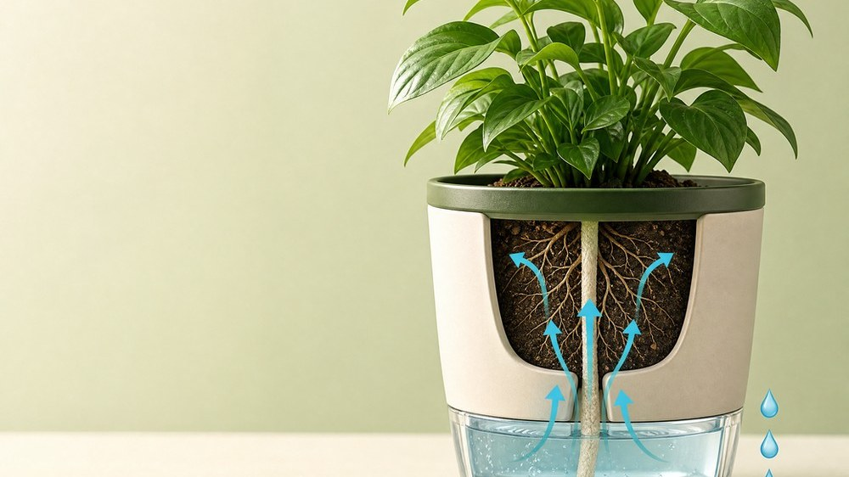

DIGITAL MARKETING ASSIGNMENT · SESSION 2026–27
SEO Strategy for
JalNest
An SEO plan for the ORIVYAA · JalNest landing page on Wix Studio — a self-watering planter with a visible water reservoir — covering keyword research, on-page, off-page and technical SEO.
SUBMITTED BY
Pradeep Jatav
BCA · 2nd Year
Dezyne École College, Ajmer
Landing page analysed
divyanshkumar47473.wixstudio.com/orivyaa

Slide 2
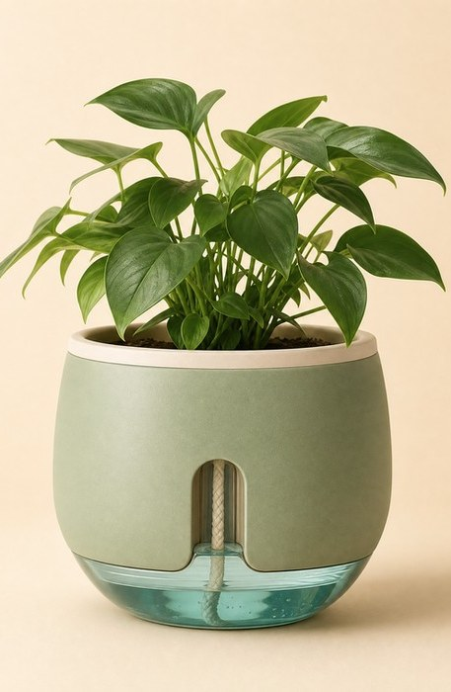

DIGITAL MARKETING · ASSIGNMENT FOLIO
ASSIGNMENT REPORT
ASSIGNMENT FOLIO OF
Digital Marketing
SUBMITTED TO
Dezyne École College
Toward Digital Marketing · Topic: Search Engine Optimization (SEO)
BY
BCA (Bachelor of Computer Applications) · 2nd Year
Pradeep Jatav
Dezyne École College · 106/10, Civil Lines, Ajmer
www.dezyneecole.com · 2026–27
SEO for JalNest — Digital Marketing Assignment
JalNest in Sage Current — one of the three finishes on the ORIVYAA landing page.
Session 2026–27 · 02 / 18

Slide 3
DIGITAL MARKETING · ASSIGNMENT FOLIO
ACKNOWLEDGEMENT
Acknowledgement
We take this opportunity to express our sincere gratitude to Dezyne École College for providing us with the knowledge, resources and guidance essential to the successful completion of this project.
Our deepest thanks to our respected Principal, Dr. Vinita Mathur, for her visionary leadership and continuous encouragement. Her commitment to academic excellence and student growth has been a constant source of motivation and pride.
We are equally thankful to all our faculty members for their consistent support, expert advice and valuable insights that shaped our learning and helped us achieve this milestone.
Lastly, we extend heartfelt thanks to everyone who directly or indirectly contributed to the success of this project. We are proud to be part of Dezyne École College, an institution that truly nurtures professionalism, innovation and purpose.
With sincere appreciation,
Pradeep Jatav
Department – BCA · Dezyne École College, Ajmer
SEO for JalNest — Digital Marketing Assignment
Session 2026–27 · 03 / 18
Care, patience and guidance — what grows a plant is also what grew this project.

Slide 4

DIGITAL MARKETING · ASSIGNMENT FOLIO
CASE STUDY
SEO Optimization
OBJECTIVE
To improve the search-engine visibility, organic traffic and overall website performance of the ORIVYAA · JalNest landing page built on Wix Studio, by implementing effective On-Page, Off-Page and Technical SEO strategies.
Optimising the ORIVYAA · JalNest page — on-page, off-page & technical.
01
02
03
04
Website & Keyword Planning
On-Page SEO Implementation
Off-Page SEO Activities
Technical SEO Optimization
Analysed the single-URL landing page (divyanshkumar47473.wixstudio.com/orivyaa) and performed keyword research to identify primary and long-tail keywords based on search intent.
Reviewed every element search engines read — title tag, meta description, canonical URL, heading hierarchy (H1–H3) and semantic HTML — and planned the optimisations.
Building high-quality backlinks through guest posting, partner sites, social media and video platforms to increase domain authority and referral traffic.
Checked HTTPS, mobile responsiveness, crawlability and indexing — including robots.txt, the missing XML sitemap and the default Wix favicon.
SEO for JalNest — Digital Marketing Assignment
Session 2026–27 · 04 / 18

Slide 5
DIGITAL MARKETING · ASSIGNMENT FOLIO
CASE STUDY · WHY SEO
Importance of SEO for JalNest
ORIVYAA's JalNest page is a newly launched, single-URL Wix Studio site with no search history and no backlinks. SEO is the only channel that brings free, high-intent buyers to it month after month — the six pillars below make up this assignment.
Content Creation
02
04
On-Page Optimization
Plant-care guides, FAQ answers and product pages built around those keywords.
Title tag, meta description, canonical URL, one H1 and a clean H2–H3 hierarchy.
SEO
Keyword Research
01
05
Link Building
Find the exact phrases plant parents type — “self watering planter”, “planter with water level indicator”.
Backlinks from gardening, décor and sustainability sites to grow authority.
Search Engine
Optimization
Technical SEO
03
06
Traffic Analysis
Fast loading, mobile-first layout, HTTPS, robots.txt and the missing XML sitemap.
Track rankings, visitors and conversions in Search Console & Analytics.
SEO for JalNest — Digital Marketing Assignment
Session 2026–27 · 05 / 18

Slide 6
DIGITAL MARKETING · ASSIGNMENT FOLIO
KEYWORD RESEARCH
Keyword Research Framework
PRIMARY KEYWORD ANALYSIS
Primary Keywords
Keyword research identifies the words and phrases people type into Google when they look for a self-watering planter. Each keyword is mapped to a search intent, so the page can rank for the searches that actually lead to a purchase.
KEYWORD
SEARCH INTENT
self watering planter
Transactional
TARGET RESULT — HOW THE PAGE SHOULD APPEAR IN SEARCH
self watering planter India
Transactional
J
ORIVYAA
plant self watering system
Transactional
#1 Target
divyanshkumar47473.wixstudio.com › orivyaa
JalNest by Orivyaa — Self-Watering Planter, 21 Days Per Refill
JalNest Orivyaa planter
Navigational
A self-watering planter with a clear water reservoir and a cotton wick that keeps plants watered for up to 21 days. Three finishes — Ivory, Sage and Terracotta. From ₹799.
planter with water level indicator
Commercial
Recommended result for the primary keyword “self watering planter” — the live page currently shows only “How it works | Orivyaa” with no meta description.
how to water plants while travelling
Informational
Transactional
Informational
Navigational
Commercial
These terms describe JalNest's core product and brand. People searching them are ready to buy — or are looking specifically for JalNest — so they become the focus of the title tag, H1 and canonical URL.
SEO for JalNest — Digital Marketing Assignment
Session 2026–27 · 06 / 18

Slide 7

DIGITAL MARKETING · ASSIGNMENT FOLIO
KEYWORD RESEARCH · LONG-TAIL
Long-Tail Keyword Targeting
self watering planter for
Long-tail keywords are longer, more specific phrases with lower search volume but much higher purchase intent and far less competition — ideal for a new page that cannot yet outrank Amazon or Ugaoo for broad terms.
self watering planter for balcony in india
self watering planter for money plant indoor
self watering planter for 3 weeks travelling
LONG-TAIL KEYWORD
SEARCH INTENT
self watering planter that prevents root rot
“best self-watering planter for balcony in India”
Commercial
“how often to refill a self watering planter”
Informational
“can you overwater a self watering planter”
Informational
“which plants work in a self watering planter”
Informational
“buy self watering planter online India price”
Transactional
“self-watering planter that prevents root rot”
Informational
Why they matter: the page's FAQ section already answers six of these questions verbatim — turning those answers into headings can win the phrases with no backlinks at all.
SEO for JalNest — Digital Marketing Assignment
Session 2026–27 · 07 / 18
Long-tail searches are specific questions — the page already answers six of them in its FAQ section.

Slide 8
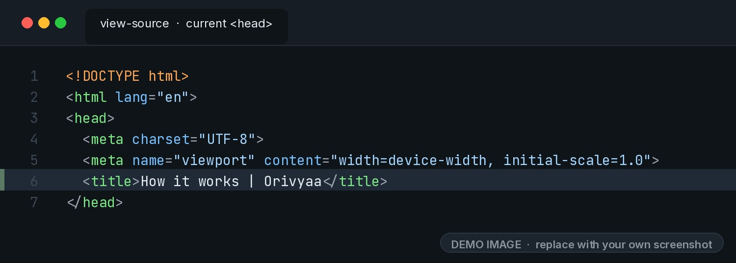
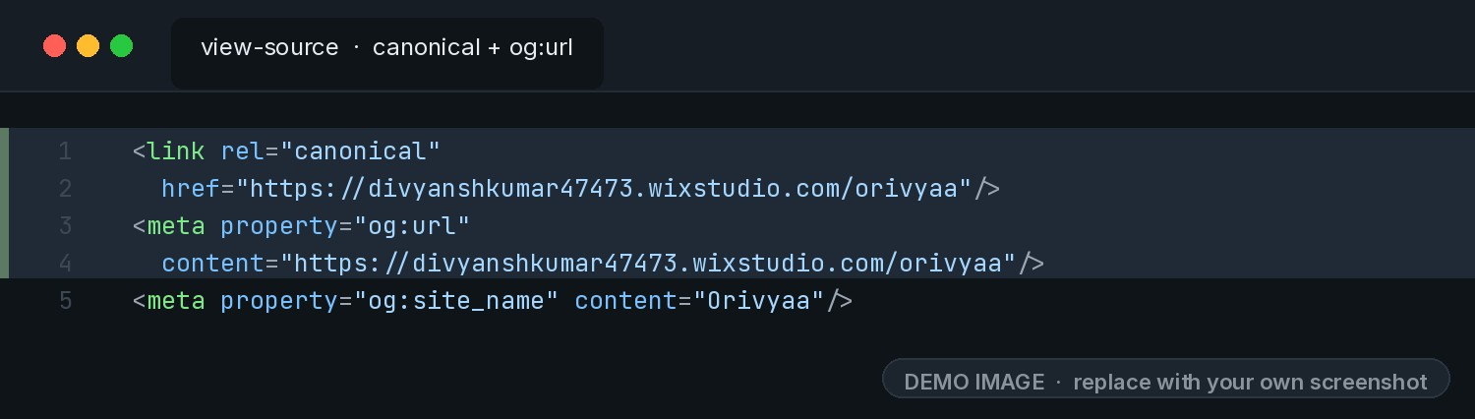
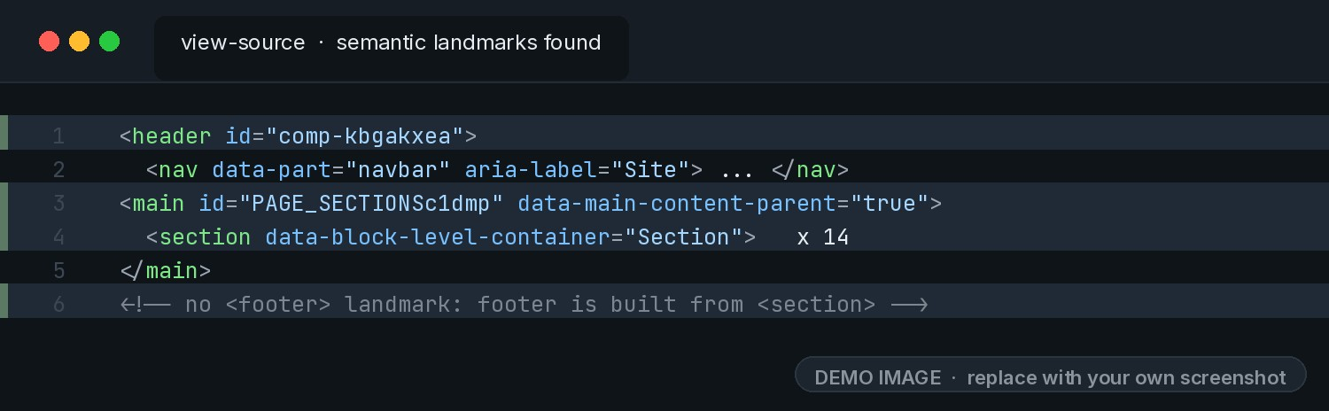
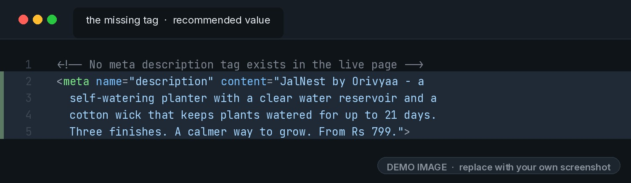
DIGITAL MARKETING · ASSIGNMENT FOLIO
ON-PAGE SEO
On-Page SEO
Every element a search engine reads on the ORIVYAA · JalNest page itself — its current value, and the code where it lives.
PAGE-LEVEL OPTIMIZATION
Title Tag →
URL / Canonical →
<title>How it works | Orivyaa</title>
https://divyanshkumar47473.wixstudio.com/orivyaa
Semantic Tags →
Meta Description →
<header>
<nav>
<main>
<section> ×14
no <footer>
alt text
Not present in the live page. Recommended: “JalNest by Orivyaa — a self-watering planter with a clear reservoir and a cotton wick that keeps plants watered for up to 21 days.”
SEO for JalNest — Digital Marketing Assignment
Session 2026–27 · 08 / 18

Slide 9
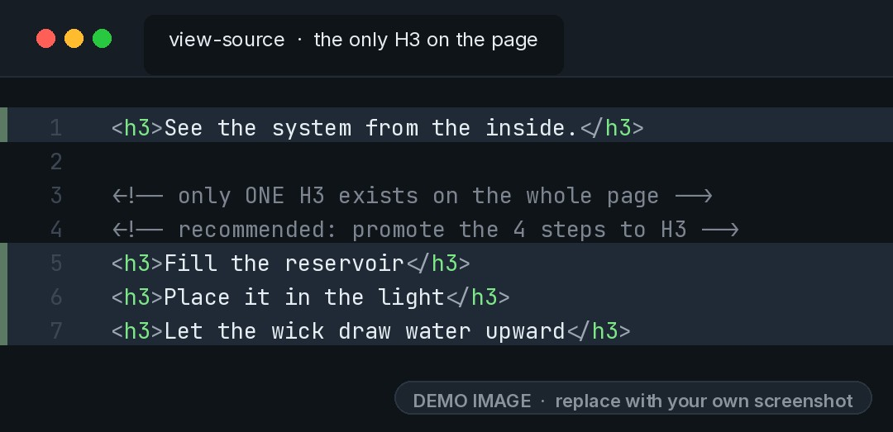
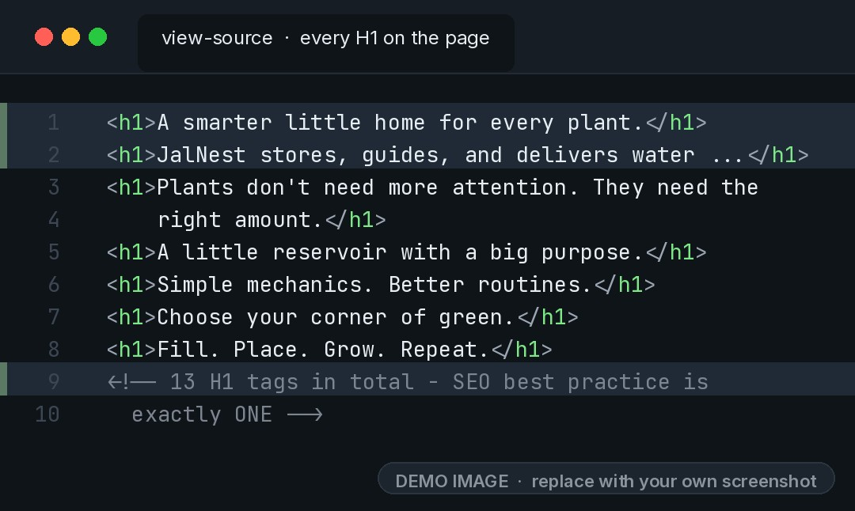
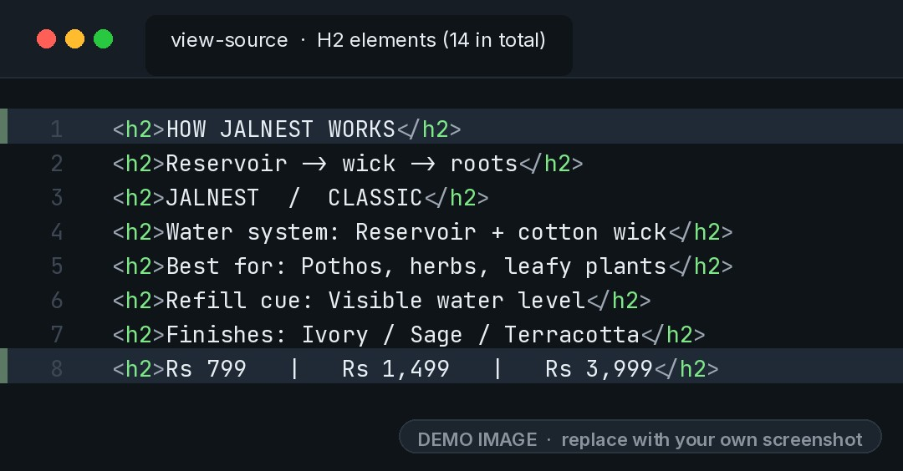
DIGITAL MARKETING · ASSIGNMENT FOLIO
ON-PAGE SEO · HEADINGS
Heading Hierarchy
One H1 with the primary keyword, H2s for each section and H3s for supporting points — the same outline Google uses to understand the page.
H1
13 found · only 1 needed
H2
14 found · sections + prices
H3
1 found · room for more
The hero line deserves H1. The remaining twelve H1 tags (section openers, finish names, price blocks) should become H2 or H3.
Sections like “HOW JALNEST WORKS” are correct — but the three price figures and the spec labels are also marked H2.
Supporting points have no heading level at all. The four setup steps and each FAQ question belong here.
ON THE ORIVYAA PAGE
ON THE ORIVYAA PAGE
See the system from the inside.
ON THE ORIVYAA PAGE
HOW JALNEST WORKS
Fill the reservoir
A smarter little home for every plant.
Reservoir → wick → roots
Let the wick draw water upward
JALNEST / CLASSIC
SEO for JalNest — Digital Marketing Assignment
Session 2026–27 · 09 / 18

Slide 10
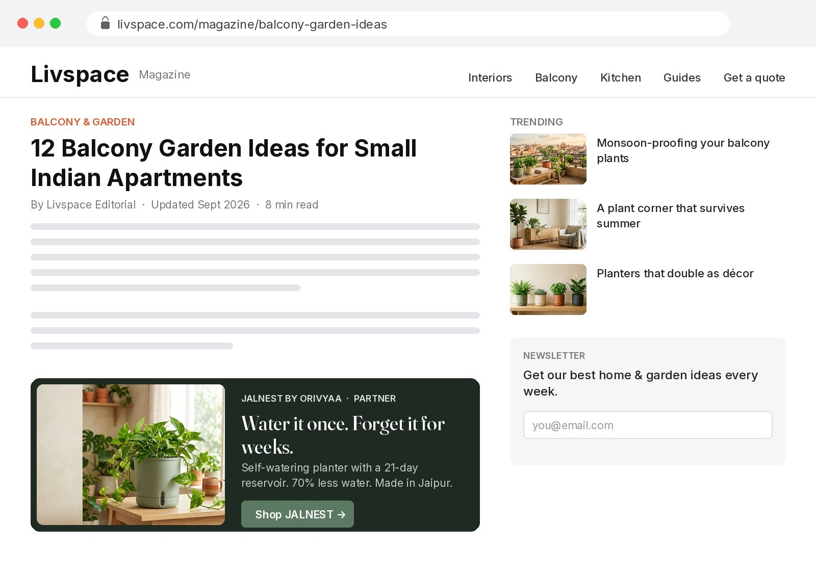
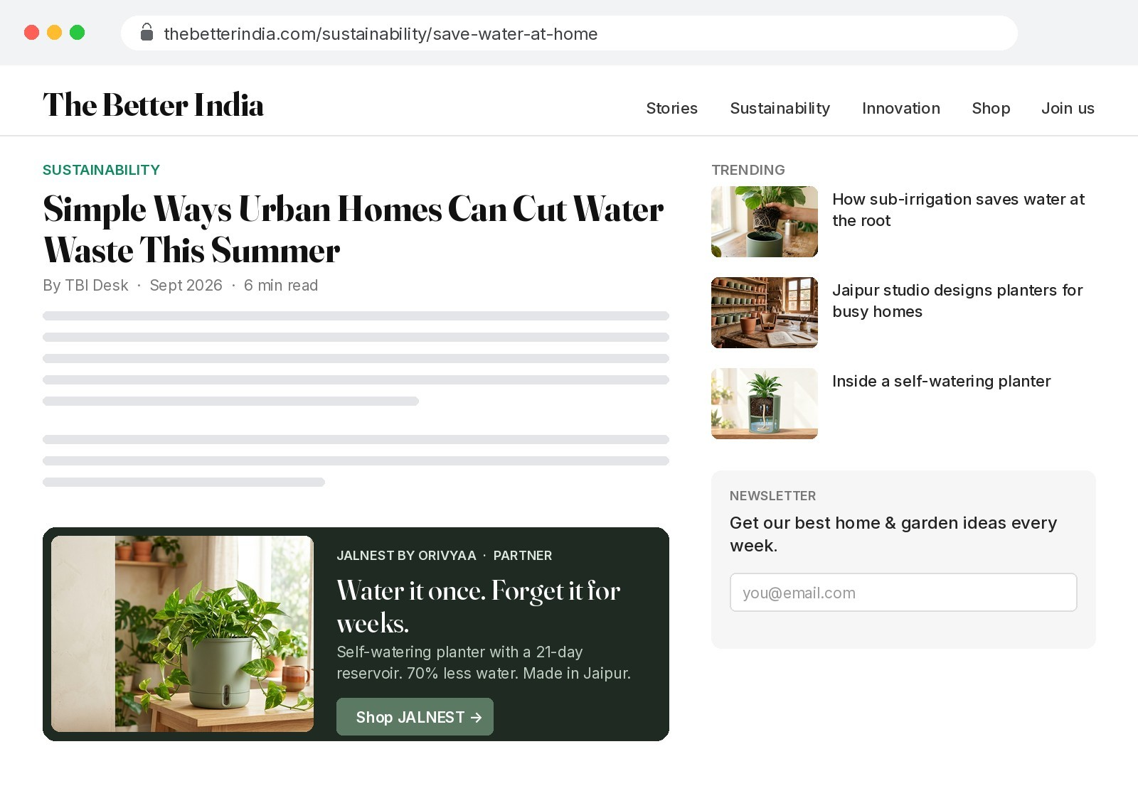
DIGITAL MARKETING · ASSIGNMENT FOLIO
OFF-PAGE SEO
Off-Page SEO
Authority is earned outside the page: relevant sites in plant care, home décor, video and sustainability that link to the JalNest page.
BACKLINK BUILDING
Plant Care & Gardening
Home Décor & Interiors
Video Platforms
Sustainability & Water Saving
→ NurseryLive Blog
→ Livspace Magazine
→ YouTube
→ The Better India
Livspace Magazine — JalNest partner banner inside a balcony-garden article
The Better India — banner placed in a water-saving story
SEO for JalNest — Digital Marketing Assignment
Session 2026–27 · 10 / 18

Slide 11
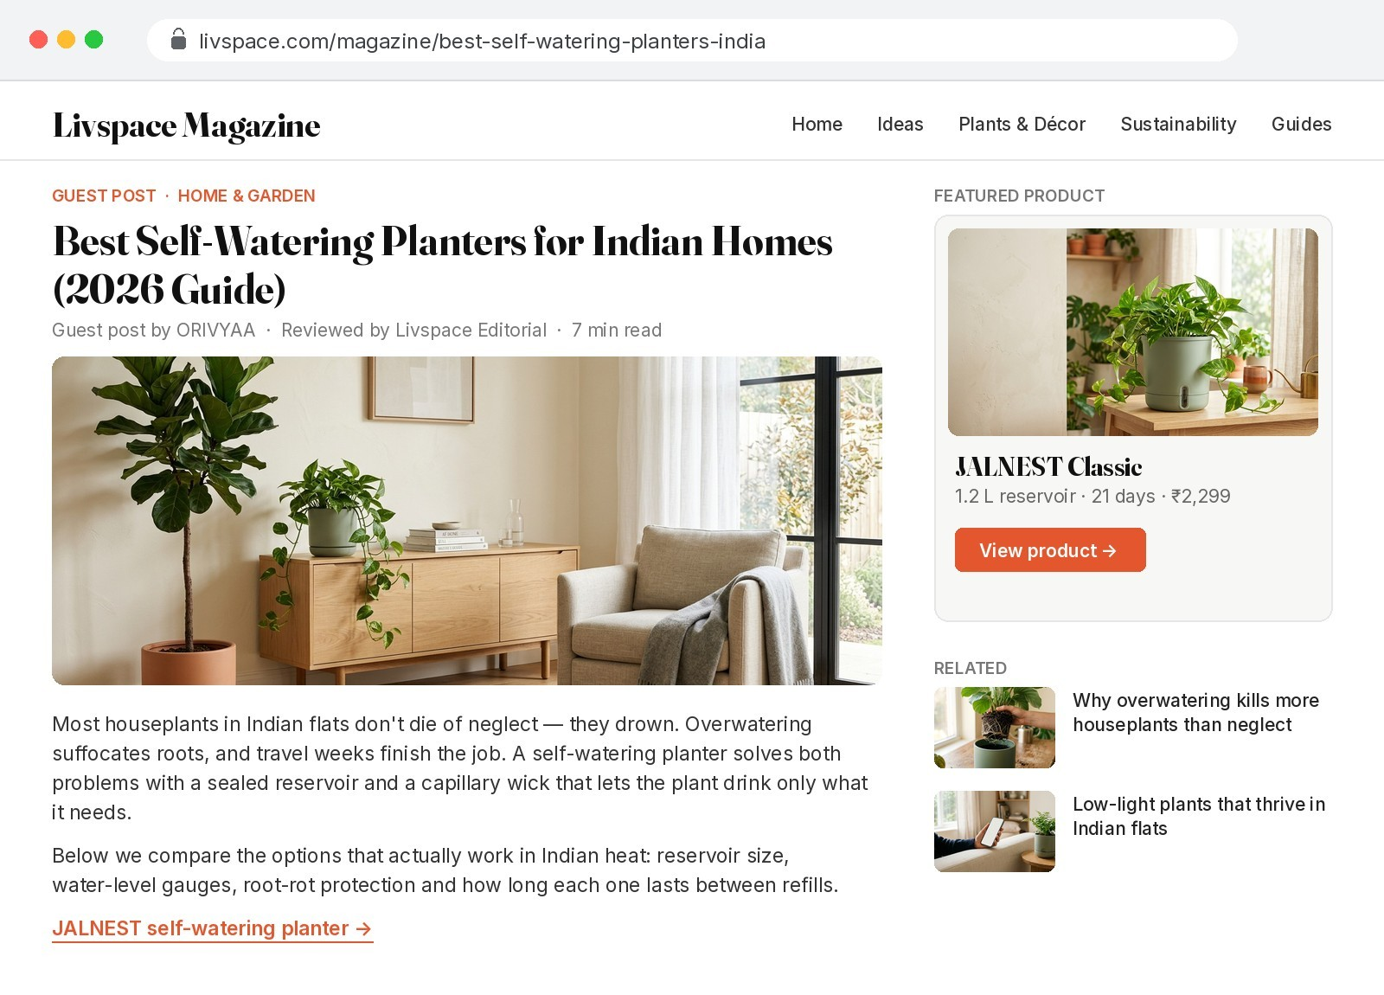
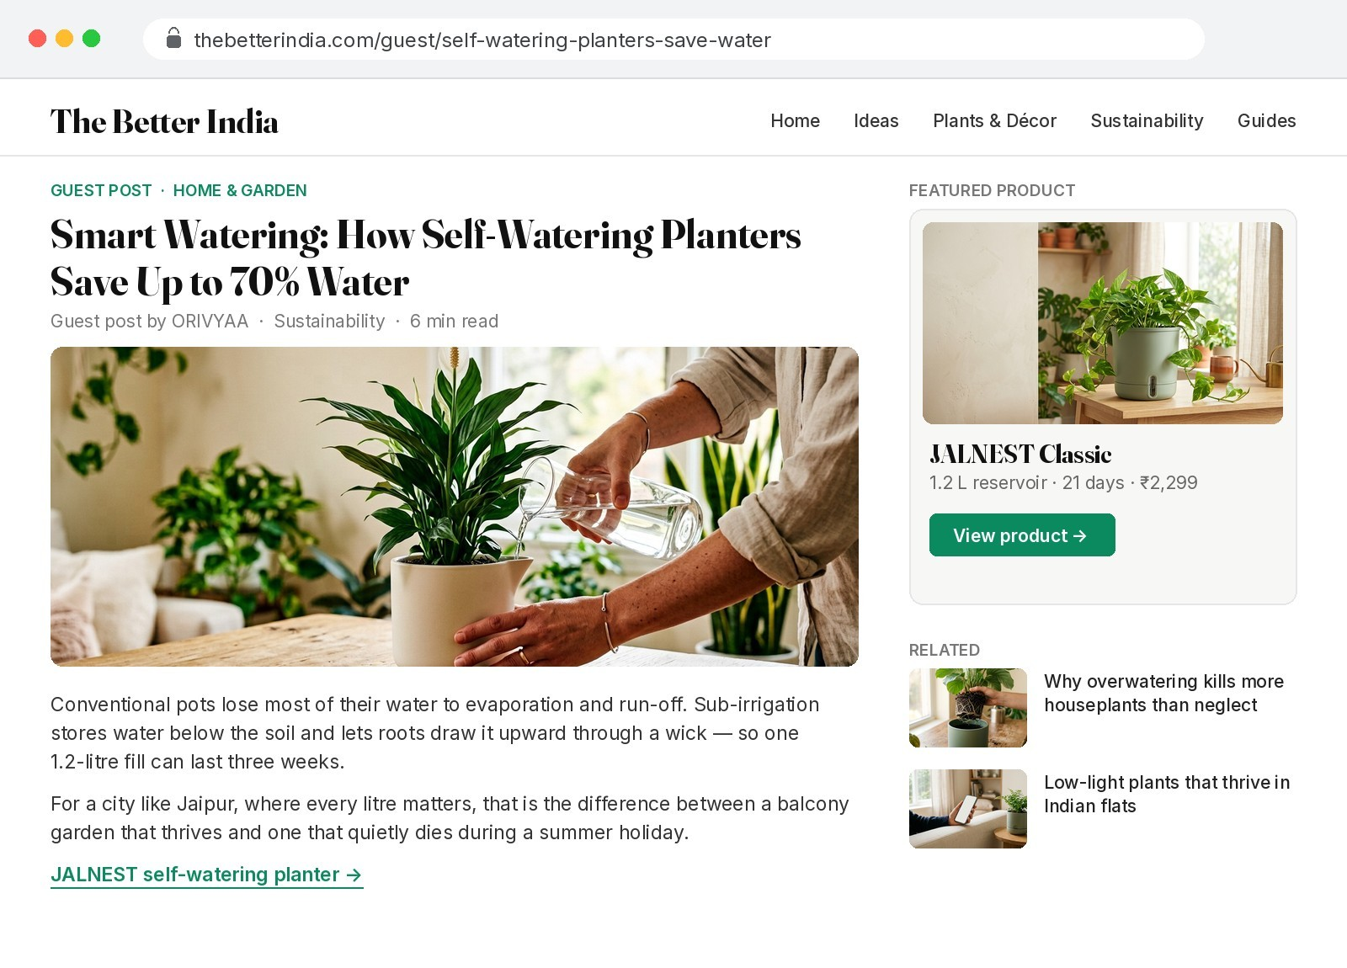
DIGITAL MARKETING · ASSIGNMENT FOLIO
OFF-PAGE SEO · GUEST POSTING
Guest Posting
Useful articles written by ORIVYAA for partner publications — each one earns an editorial backlink to the JalNest page.
Livspace Magazine → Best Self-Watering Planters for Indian Homes (2026 Guide)
The Better India → Smart Watering: How Self-Watering Planters Save Up to 70% Water
SEO for JalNest — Digital Marketing Assignment
Session 2026–27 · 11 / 18

Slide 12
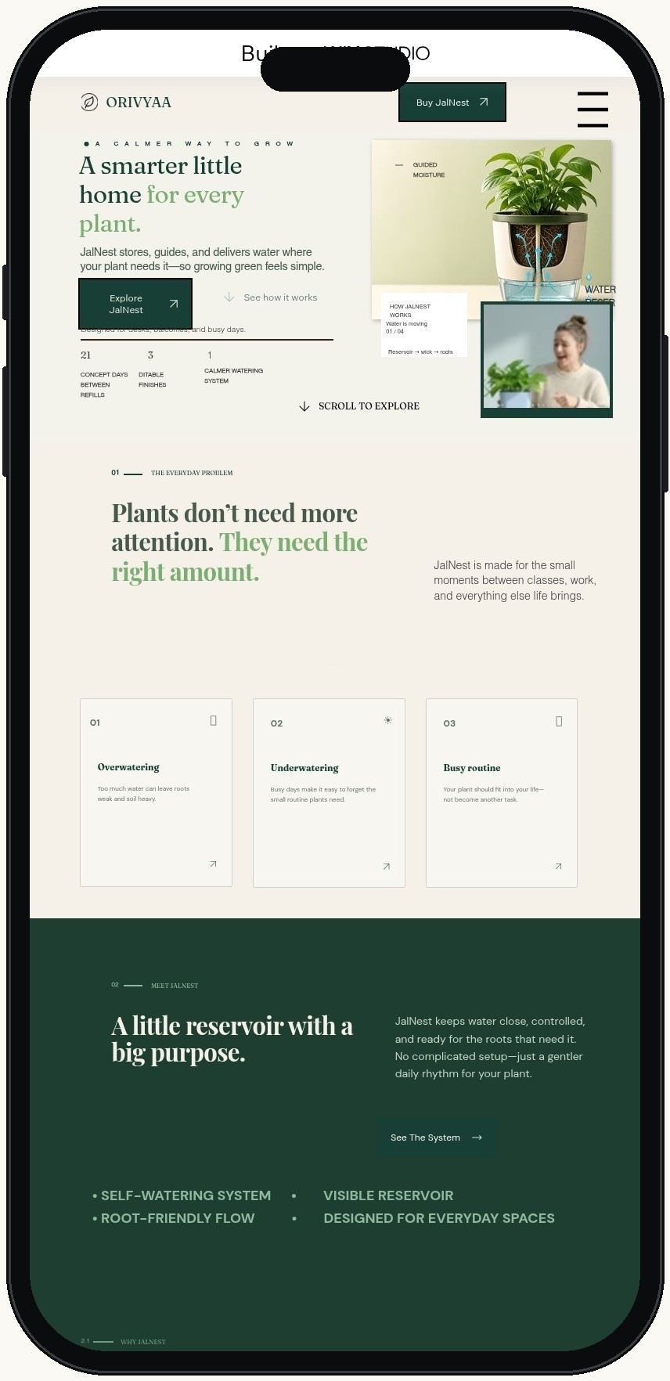
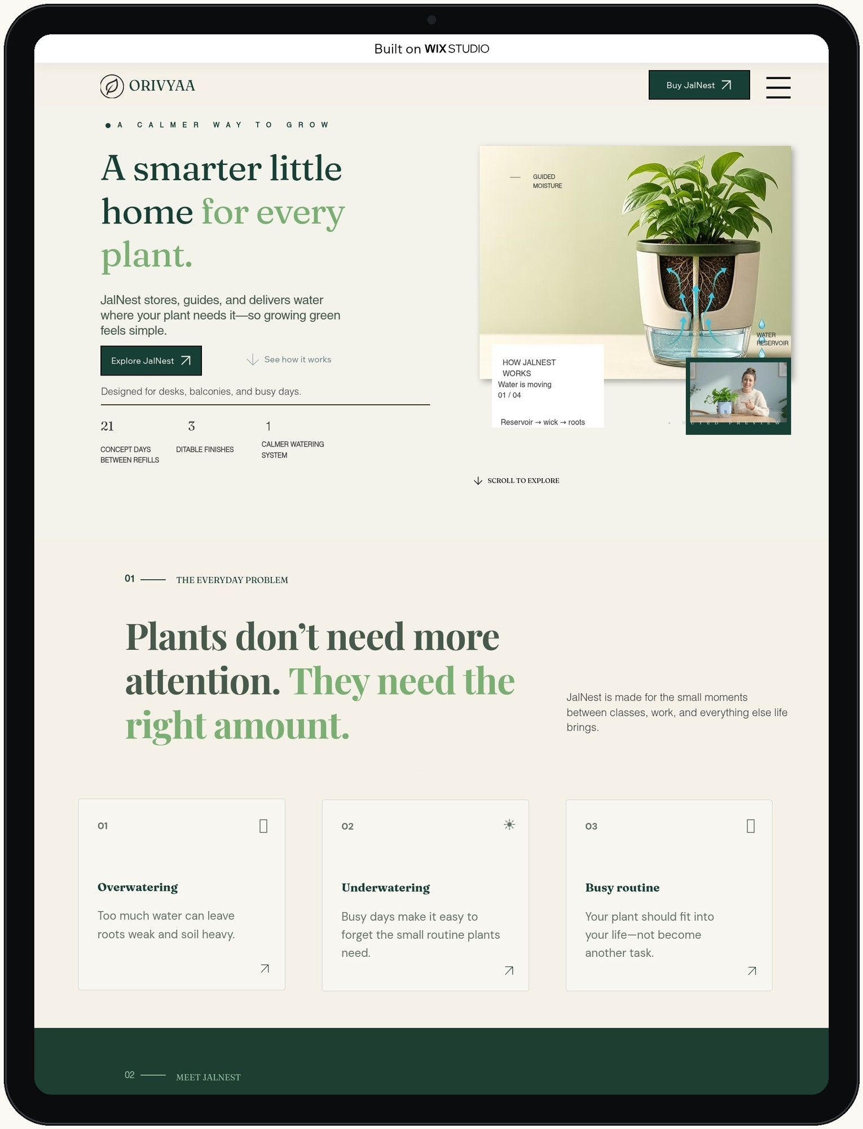
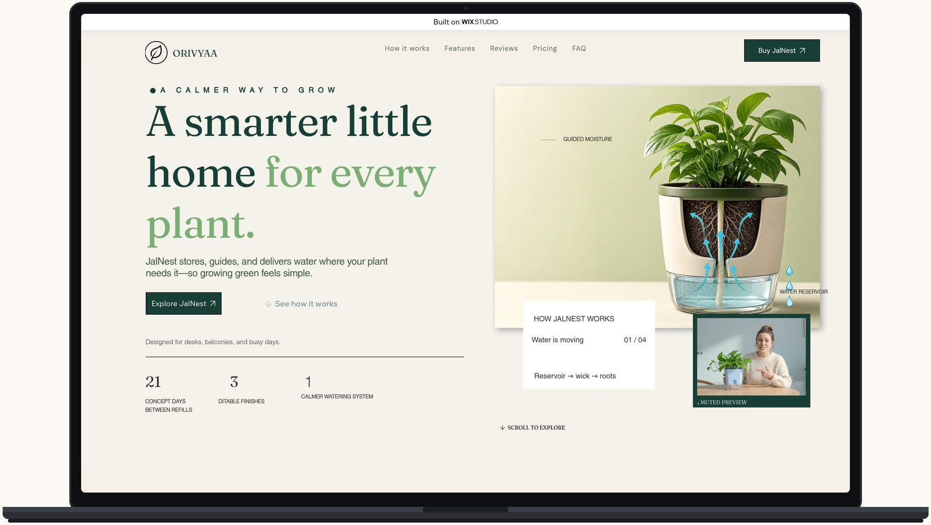
DIGITAL MARKETING · ASSIGNMENT FOLIO
TECHNICAL SEO · MOBILE
Responsiveness
Google indexes the mobile version first. The ORIVYAA page reflows from a single column on phones to a two-column hero on laptops — live screenshots at 390 px, 834 px and 1440 px.
Phone View
Tablet View
390 px · single column, menu collapsed
834 px · hero + 21 / 3 / 1 stats
Laptop View
1440 px · two-column hero + full nav
SEO for JalNest — Digital Marketing Assignment
Session 2026–27 · 12 / 18

Slide 13
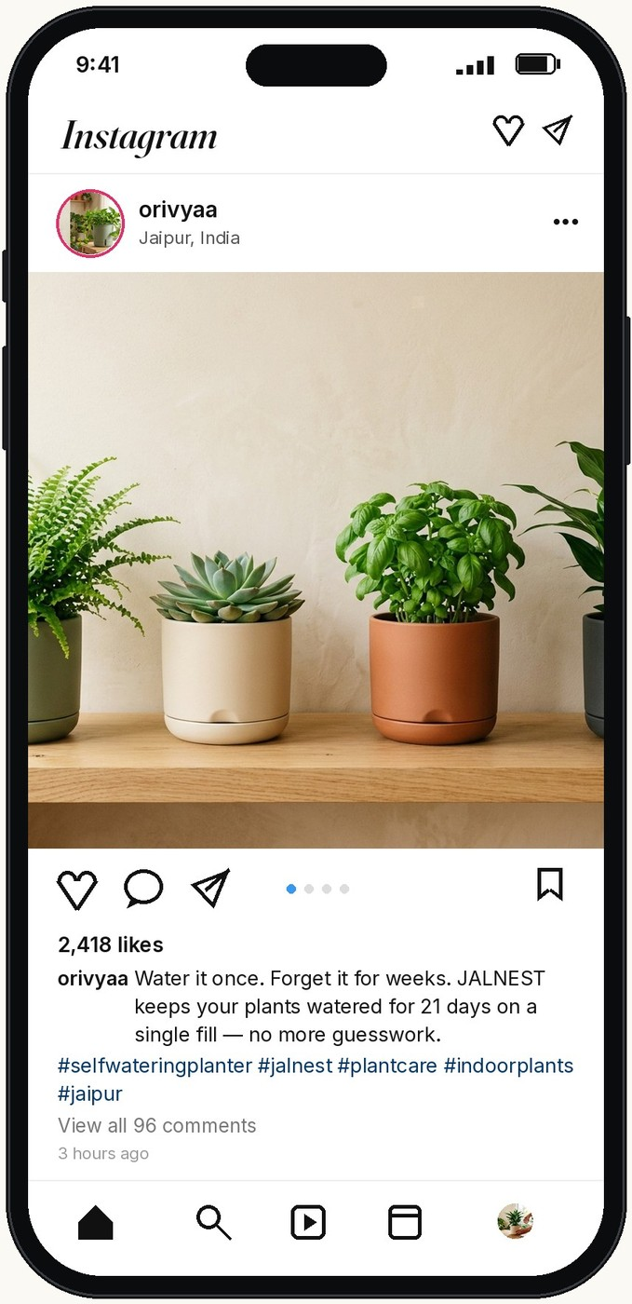
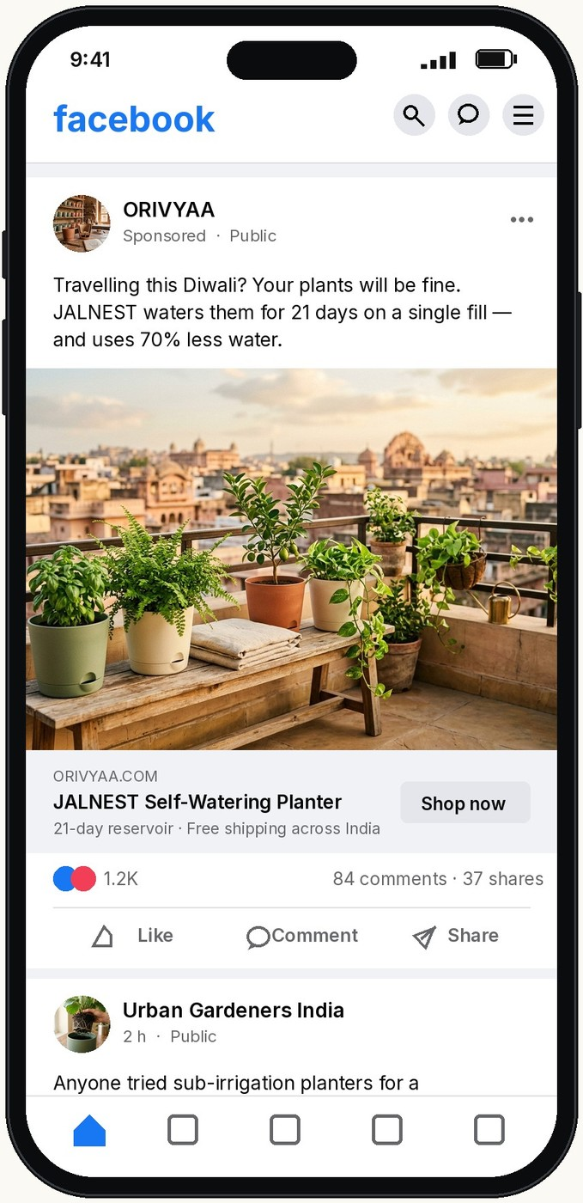
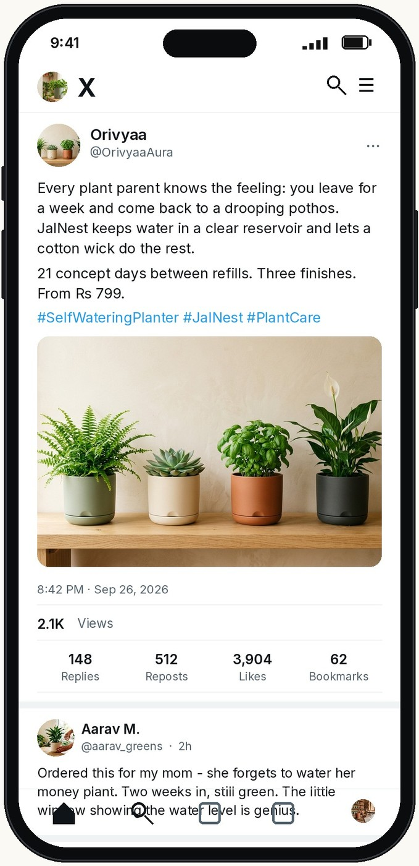
DIGITAL MARKETING · ASSIGNMENT FOLIO
OFF-PAGE SEO · SOCIAL SIGNALS
Social Media
Social profiles do not pass PageRank directly, but they drive brand searches, referral traffic and the shares that turn into backlinks.
Instagram
Facebook
X (Twitter)
Product reels and plant-care carousels from @orivyaa095 — builds brand searches for “JalNest planter”.
The ORIVYAA page plus sponsored posts for Jaipur, Delhi NCR and Bengaluru — sends traffic to the pricing section.
Build-in-public threads from @OrivyaaAura, already linked in the site footer — earns design-community links.
SEO for JalNest — Digital Marketing Assignment
Session 2026–27 · 13 / 18

Slide 14
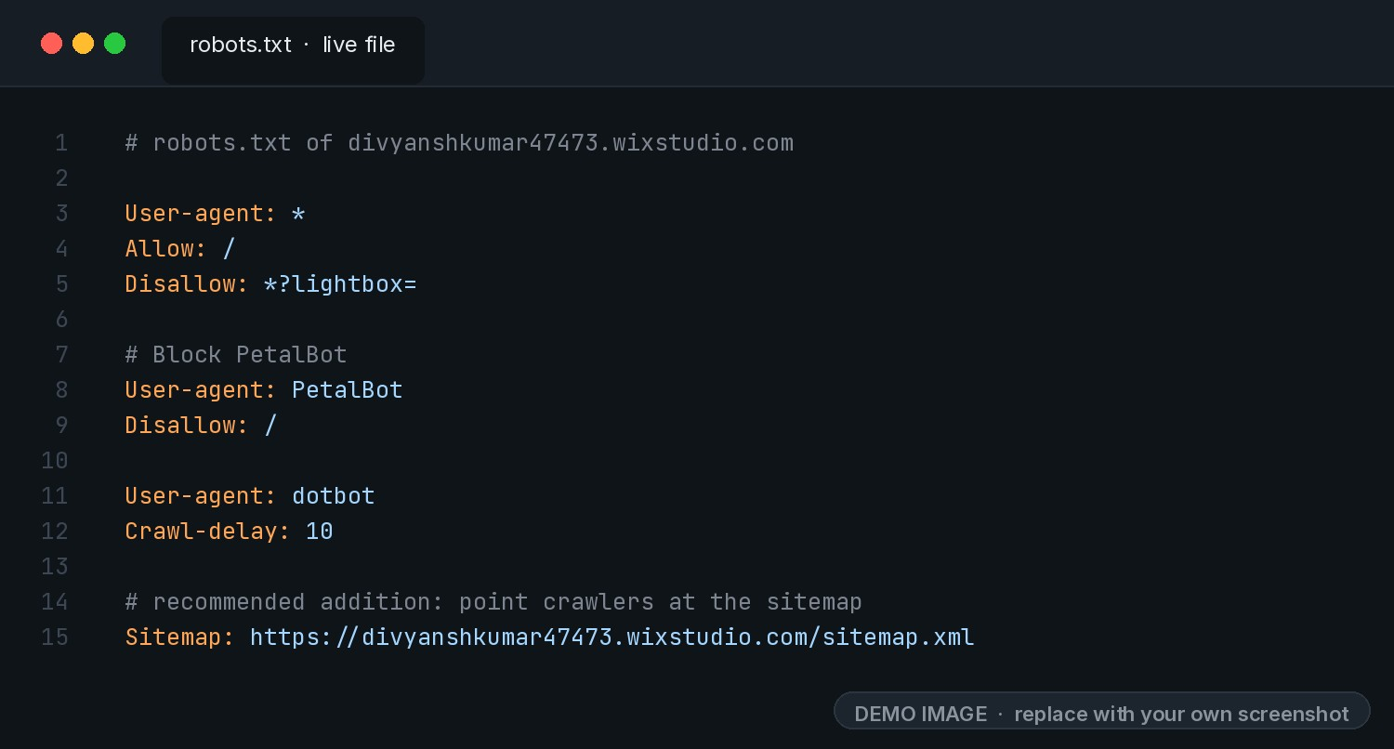
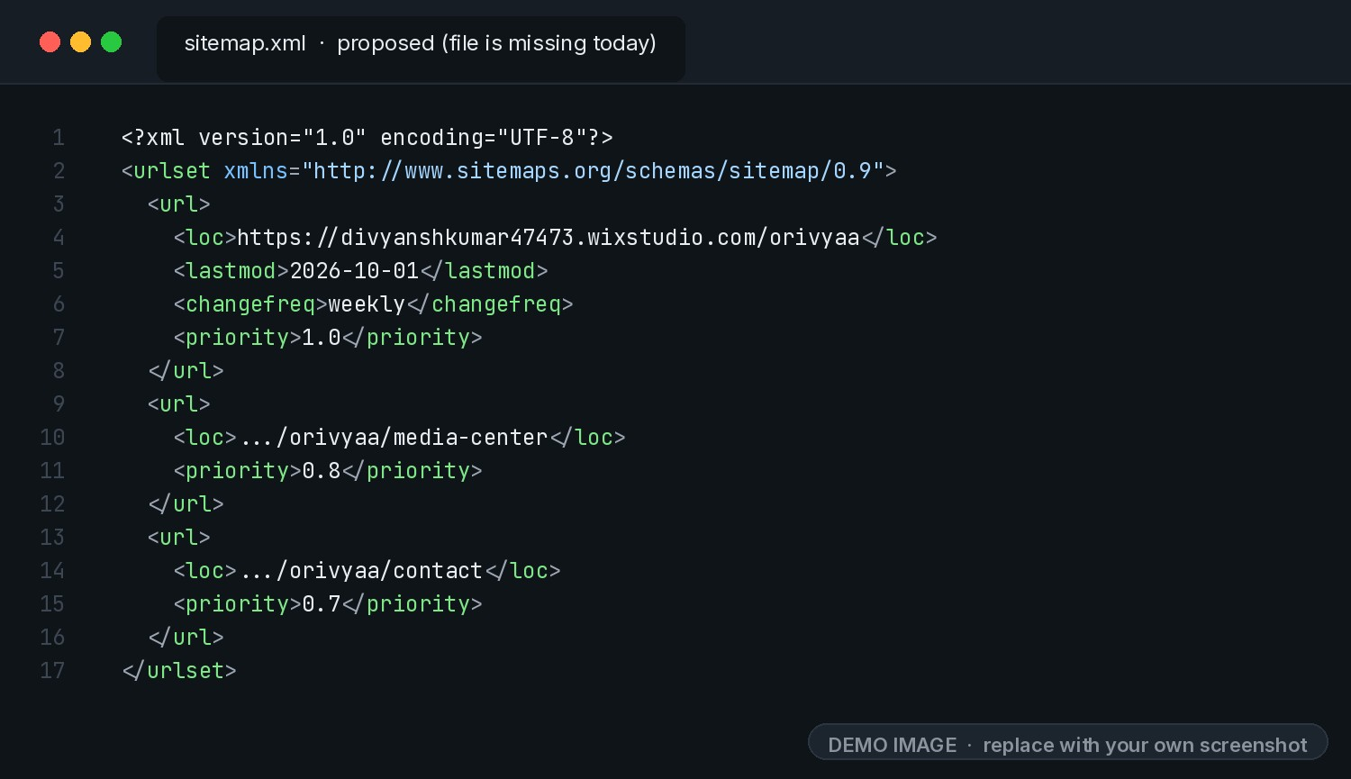
DIGITAL MARKETING · ASSIGNMENT FOLIO
TECHNICAL SEO
Technical SEO
Two small files tell search engines what to crawl and where every important page lives — on this site one is live and one is missing.
robots.txt
XML Sitemap
Live on the site — it allows all crawling, keeps duplicate ?lightbox= URLs out of the index and blocks PetalBot. It does not point to a sitemap yet.
Missing today — /sitemap.xml returns a 404 on the Wix Studio domain. A sitemap listing /orivyaa, /media-center and /contact is proposed.
SEO for JalNest — Digital Marketing Assignment
Session 2026–27 · 14 / 18

Slide 15
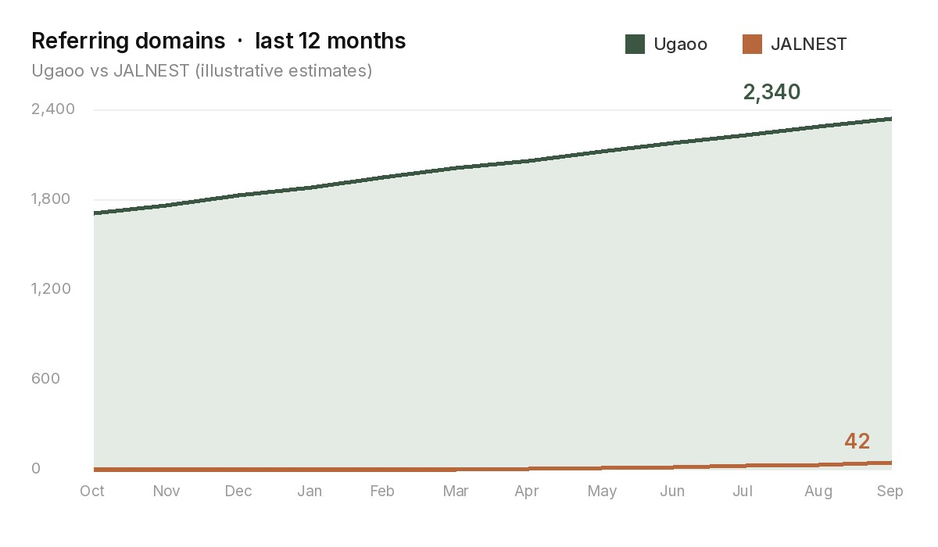
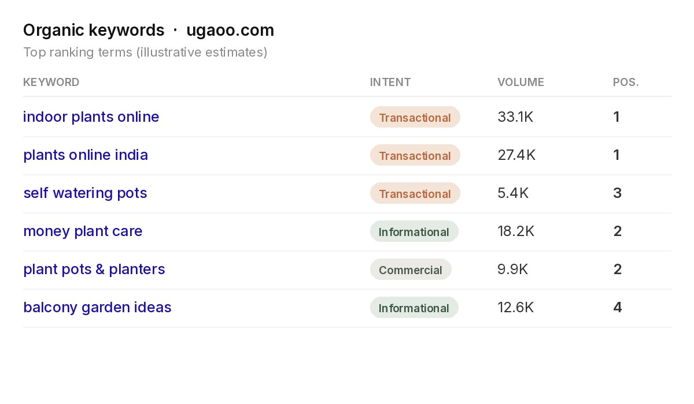
DIGITAL MARKETING · ASSIGNMENT FOLIO
COMPETITION ANALYSIS
Competition Analysis
JalNest by Orivyaa vs Ugaoo — SEO
Domain Authority
Backlink Sources
JalNest: ~8 (new Wix Studio site, 2026)
Ugaoo: ~46 (established since 2015)
JalNest: none yet — partner & guest links planned
Ugaoo: 2,000+ referring domains
Content Strategy
Keyword Strategy
JalNest: one landing page, FAQ + product story
Ugaoo: broad catalogue, large blog
JalNest: niche long-tail, high-intent terms
Ugaoo: high-volume generic plant terms
Illustrative estimates from SEO tools (Moz / Ahrefs style) — Ugaoo's keyword & backlink profile vs JalNest's.
SEO for JalNest — Digital Marketing Assignment
Session 2026–27 · 15 / 18

Slide 16



DIGITAL MARKETING · ASSIGNMENT FOLIO
IMPROVEMENT SUGGESTIONS
Improvement Suggestions
01
Technical SEO Speed
The Wix page loads a large framework bundle on top of full-size images. Compress and serve the hero and gallery images in WebP/AVIF, and link the missing XML sitemap from robots.txt.
02
Content & Keyword Optimization
Write one unique meta description, keep a single H1 instead of thirteen, and promote the setup steps and FAQ questions to H3s. Add keyword-focused pages for Mini, Classic and Trio.
03
User Experience Enhancement
Add a clear buy button to every section, replace the placeholder review slot with verified reviews, and publish final prices so the page converts the traffic SEO brings in.
SEO for JalNest — Digital Marketing Assignment
Session 2026–27 · 16 / 18

Slide 17
DIGITAL MARKETING · ASSIGNMENT FOLIO
CONCLUSION
Conclusion
A focused SEO strategy drives JalNest's digital growth, visibility and market expansion — turning a single well-built Wix Studio page into a steady source of high-intent customers.
Key Takeaways
On-page and technical SEO decide how well the page is understood and indexed — title tag, meta description, canonical URL, one clean H1, a working robots.txt and the missing sitemap.
Future SEO Growth
Off-page strategies — guest posts, partner banners, Instagram, Facebook and X — plus competitor insight will build JalNest's authority beyond Jaipur and its first set of keywords.
SEO Success Factors
01 Keyword Targeting
02 On-Page SEO
03 Off-Page SEO
04 Technical SEO
SEO for JalNest — Digital Marketing Assignment
Session 2026–27 · 17 / 18
Rankings, visitors and conversions — the numbers that show the strategy is working.

Slide 18

Digital Marketing · Assignment Folio · SEO Strategy for JalNest by ORIVYAA
Case study: divyanshkumar47473.wixstudio.com/orivyaa · Submitted by Pradeep Jatav · BCA, 2nd Year
Dezyne École College · 106/10, Civil Lines, Ajmer · www.dezyneecole.com · Session 2026–27

