Slide 1
Linear Regression

Slide 2
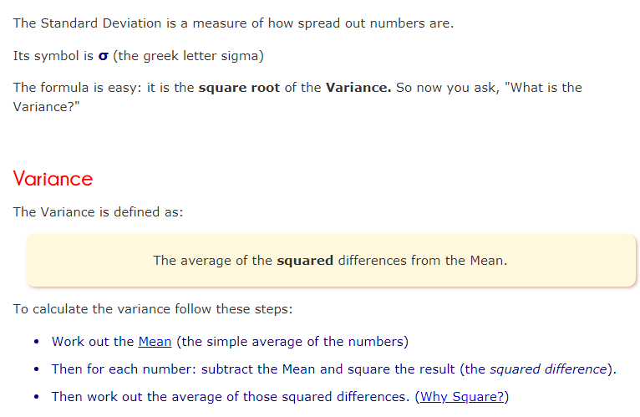
Standard Deviation

Slide 3
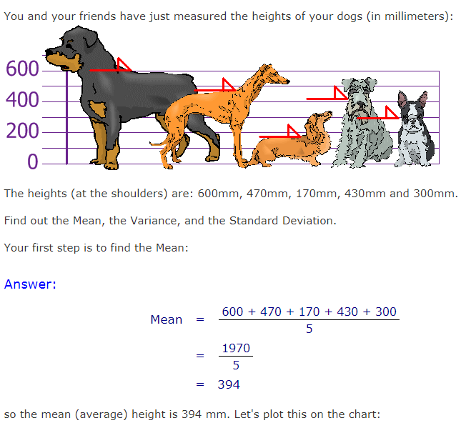
Standard Deviation…

Slide 4
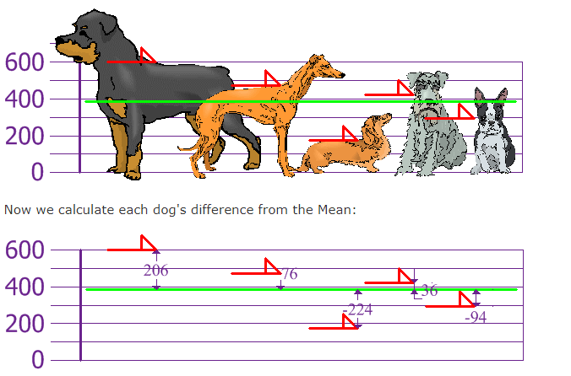
Standard Deviation…

Slide 5
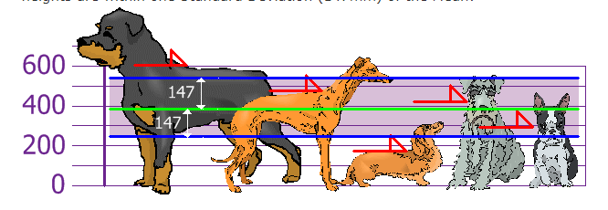
Standard Deviation…

Slide 6
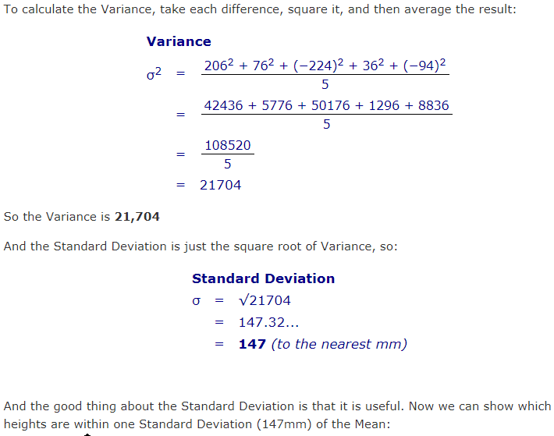
Standard Deviation…

Slide 7
Interpreting Covariance
cov(X,Y) > 0 X and Y are positively correlated
cov(X,Y) < 0 X and Y are inversely correlated
cov(X,Y) = 0 X and Y are independent

Slide 8
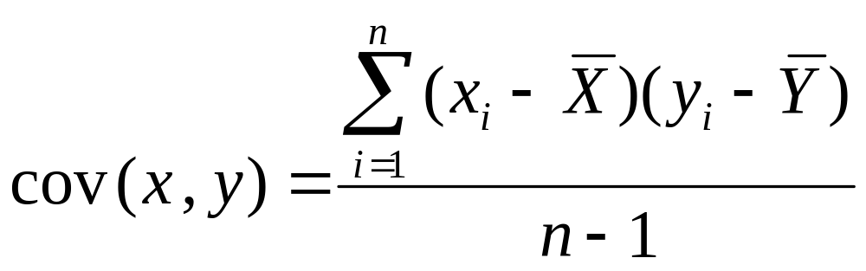
Recall: Covariance

Slide 9
Correlation
Measures the relative strength of the linear relationship between two variables
Unit-less
Ranges between –1 and 1
The closer to –1, the stronger the negative linear relationship
The closer to 1, the stronger the positive linear relationship
The closer to 0, the weaker any positive linear relationship

Slide 10
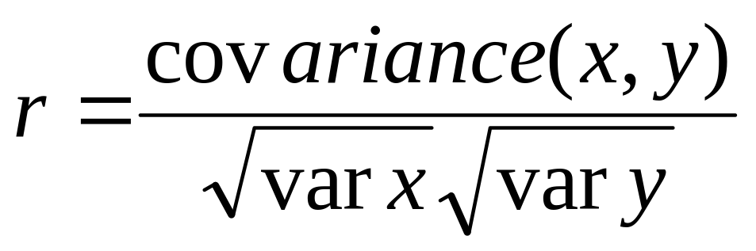
Correlation coefficient
Pearson’s Correlation Coefficient is standardized covariance (unitless):

Slide 11
Scatter Plots of Data with Various Correlation Coefficients
Y
Y
Y
X
X
X
r = -1
r = -.6
r = 0
Y
Y
Y
X
X
X
r = +1
r = +.3
r = 0
Slide from: Statistics for Managers Using Microsoft® Excel 4th Edition, 2004 Prentice-Hall

Slide 12
Linear Correlation
Linear relationships
Curvilinear relationships
Y
Y
X
X
Y
Y
X
X
Slide from: Statistics for Managers Using Microsoft® Excel 4th Edition, 2004 Prentice-Hall

Slide 13
Linear Correlation
Strong relationships
Weak relationships
Y
Y
X
X
Y
Y
X
X
Slide from: Statistics for Managers Using Microsoft® Excel 4th Edition, 2004 Prentice-Hall

Slide 14
Linear Correlation
No relationship
Y
X
Y
X
Slide from: Statistics for Managers Using Microsoft® Excel 4th Edition, 2004 Prentice-Hall

Slide 15
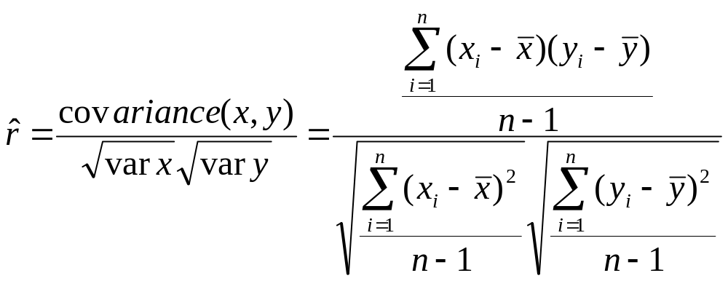
Calculating by hand…

Slide 16
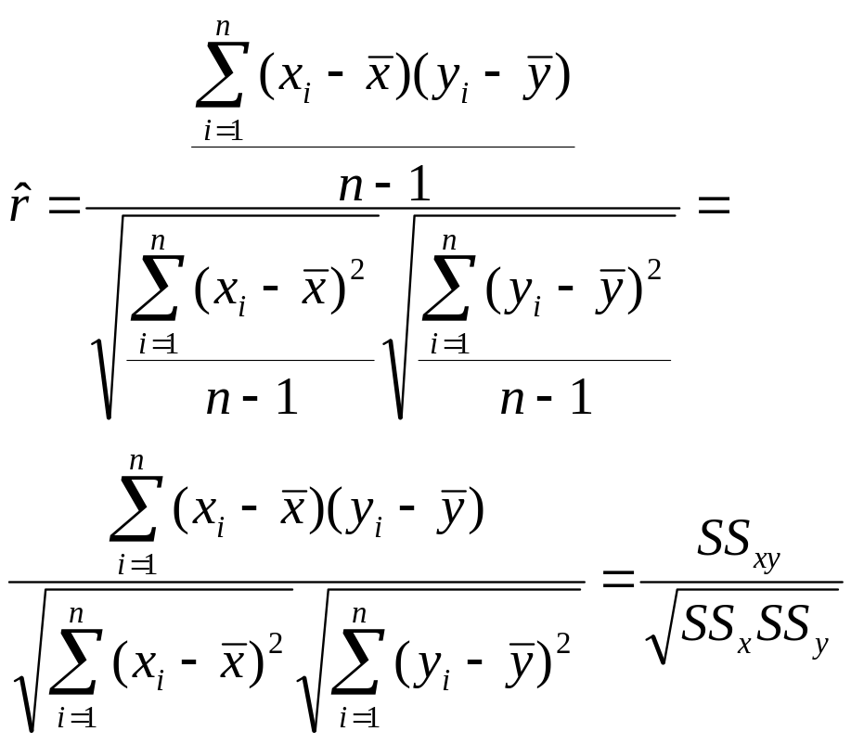
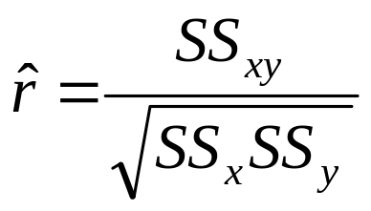
Simpler calculation formula…
Numerator of covariance
Numerators of variance

Slide 17
Linear regression
In correlation, the two variables are treated as equals. In regression, one variable is considered independent (=predictor) variable (X) and the other the dependent (=outcome) variable Y.

Slide 18
What is “Linear”?
Remember this:
Y=mX+B?
m
B

Slide 19
What’s Slope?
A slope of 2 means that every 1-unit change in X yields a 2-unit change in Y.

Slide 20
Prediction
If you know something about X, this knowledge helps you predict something about Y. (Sound familiar?…sound like conditional probabilities?)

Slide 21
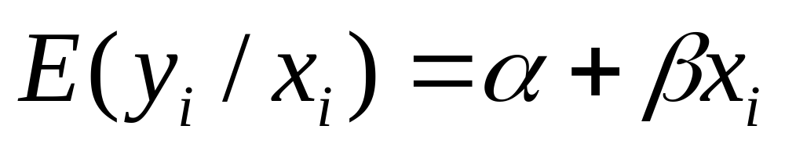
Regression equation…
Expected value of y at a given level of x=

Slide 22
Predicted value for an individual…
y_{i}= α + β*x_{i} + random error_{i}
Fixed – exactly on the line
Follows a normal distribution

Slide 23
Assumptions (or the fine print)
Linear regression assumes that…
  1. The relationship between X and Y is linear
  2. Y is distributed normally at each value of X
  3. The variance of Y at every value of X is the same (homogeneity of variances)
  4. The observations are independent

Slide 24
The standard error of Y given X is the average variability around the regression line at any given value of X. It is assumed to be equal at all values of X.
Sy/x
Sy/x
Sy/x
Sy/x
Sy/x
Sy/x

Slide 25


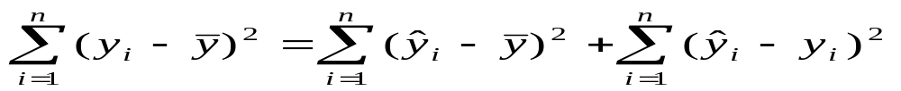
Regression Picture
y_{i}
C
A
B
y
B
A
C
y_{i}
*Least squares estimation gave us the line (β) that minimized C²
x
R²=SSreg/SStotal
A² B² C²
SS_{total}
Total squared distance of observations from naïve mean of y
Total variation
SS_{reg}
Distance from regression line to naïve mean of y
Variability due to x (regression)
SS_{residual}
Variance around the regression line
Additional variability not explained by x—what least squares method aims to minimize

Slide 26
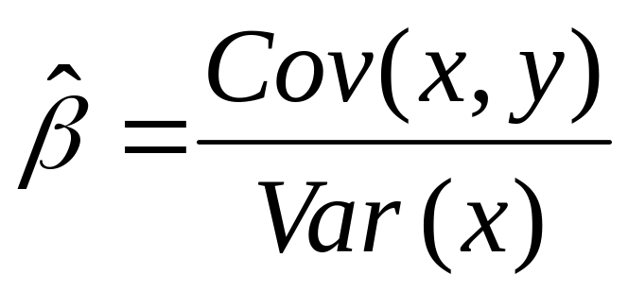
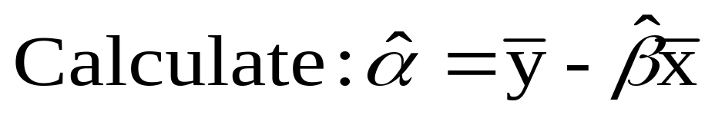
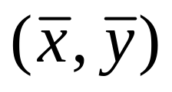
Resulting formulas…
Slope (beta coefficient) =
Intercept=
Regression line always goes through the point:

Slide 27
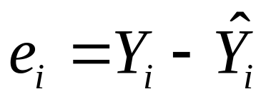
Residual Analysis: check assumptions
The residual for observation i, e_{i}, is the difference between its observed and predicted value
Check the assumptions of regression by examining the residuals
  Examine for linearity assumption
  Examine for constant variance for all levels of X (homoscedasticity)
  Evaluate normal distribution assumption
  Evaluate independence assumption
Graphical Analysis of Residuals
  Can plot residuals vs. X

Slide 28
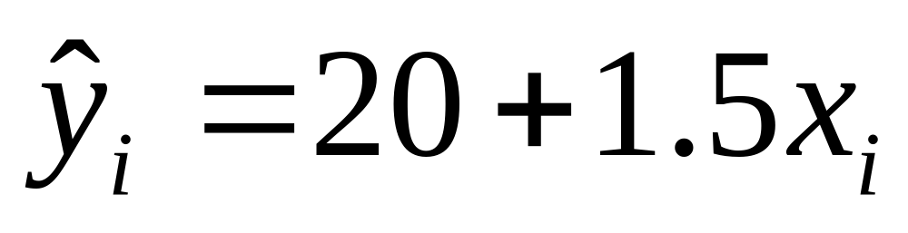
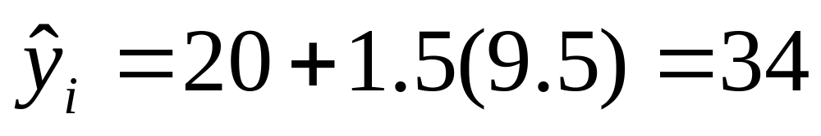
Predicted values…
For Vitamin D = 95 nmol/L (or 9.5 in 10 nmol/L):

Slide 29

Residual Analysis for Linearity
Y
Y
x
x
residuals
x
x
residuals
Not Linear
✓
Linear
Slide from: Statistics for Managers Using Microsoft® Excel 4th Edition, 2004 Prentice-Hall

Slide 30

Residual Analysis for
Homoscedasticity
Y
Y
x
x
residuals
x
x
residuals
✓
Non-constant variance
Constant variance
Slide from: Statistics for Managers Using Microsoft® Excel 4th Edition, 2004 Prentice-Hall

Slide 31

Residual Analysis for Independence
Not Independent
✓
Independent
residuals
X
residuals
X
residuals
X
Slide from: Statistics for Managers Using Microsoft® Excel 4th Edition, 2004 Prentice-Hall

Slide 32
Multiple linear regression…
What if age is a confounder here?
  Older men have lower vitamin D
  Older men have poorer cognition
“Adjust” for age by putting age in the model:
  DSST score = intercept + slope₁xvitamin D + slope₂ xage

Slide 33
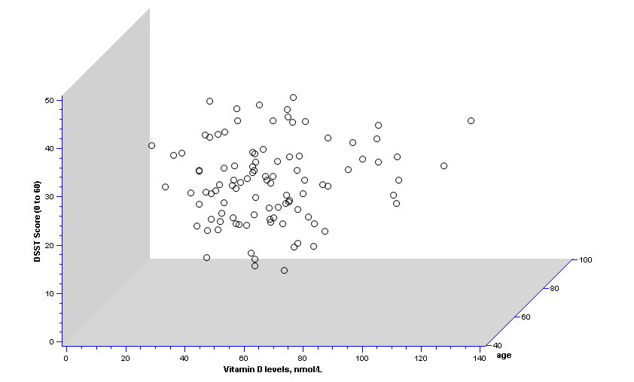
2 predictors: age and vit D…

Slide 34
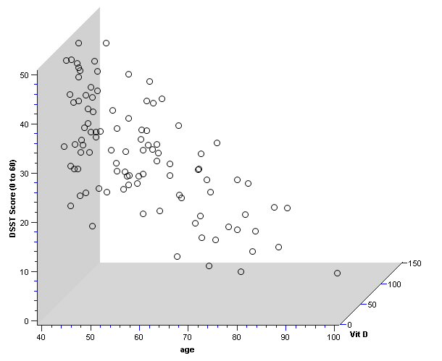
Different 3D view…

Slide 35
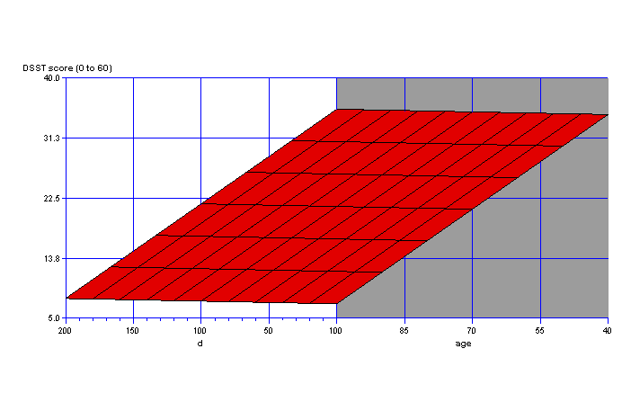
Fit a plane rather than a line…
On the plane, the slope for vitamin D is the same at every age; thus, the slope for vitamin D represents the effect of vitamin D when age is held constant.

Slide 36
Multiple Linear Regression
More than one predictor…
E(y)= α + β₁*X + β₂ *W + β₃ *Z…
Each regression coefficient is the amount of change in the outcome variable that would be expected per one-unit change of the predictor, if all other variables in the model were held constant.

