Slide 1
Designing RESTful Services

Slide 2
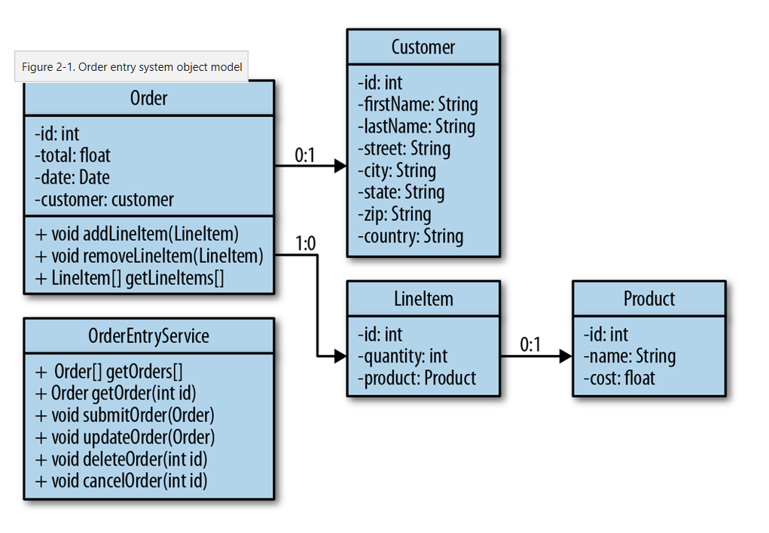
Order Entry System

Slide 3
Model The URIs
In our object model, we will be interacting with Orders, Customers, and Products. These will be our main, top-level resources.
LineItems are aggregated within Order objects so they will not be a top-level resource
Given this, here is a list of URIs that will be exposed in our system
/orders
/orders/{id}
/products
/products/{id}
/customers
/customers/{id}

Slide 4
Defining Data Format
Customer Representation Format
<customer id="117"> <link rel="self" href="http://example.com/customers/117"/> <first-name>Bill</first-name> <last-name>Burke</last-name> <street>555 Beacon St.<street> <city>Boston</city> <state>MA</state> <zip>02115</zip> </customer>

Slide 5
Defining Data Format ...
Product Representation Format
<product id="543"> <link rel="self" href="http://example.com/products/543"/> <name>iPhone</name> <cost>$199.99</cost> </product>

Slide 6
Defining Data Format...
Order Representation Format
<order id="233"> <link rel="self" href="http://example.com/orders/233"/> <total>$199.02</total> <date>December 22, 2008 06:56</date> <customer id="117"> <link rel="self" href="http://example.com/customers/117"/> <first-name>Bill</first-name> <last-name>Burke</last-name> <street>555 Beacon St.<street> <city>Boston</city> <state>MA</state> <zip>02115</zip> </customer> <line-items> <line-item id="144"> <product id="543"> <link rel="self" href="http://example.com/products/543"/> <name>iPhone</name> <cost>$199.99</cost> </product> <quantity>1</quantity> </line-item> </line-items> </order>

Slide 7
Defining Data Format...
Create Product Representation
<product> <name>iPhone</name> <cost>$199.99</cost> </product>

Slide 8
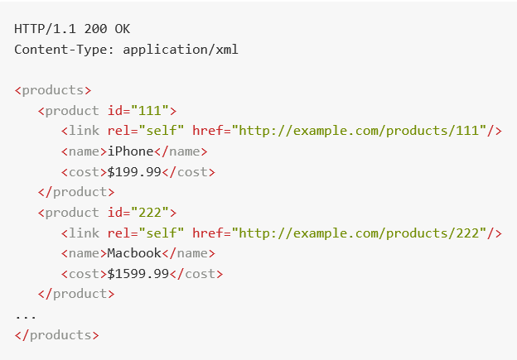
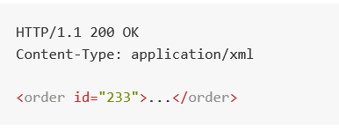
Assign HTTP Methods
Fetch All Orders,Customers or Products
/orders
/products
/customers
GET /products HTTP/1.1
Fetch Individual Order,Customer or Product
/orders/{id}
/products/{id}
/customers/{id}
GET /orders/233 HTTP/1.1

Slide 9
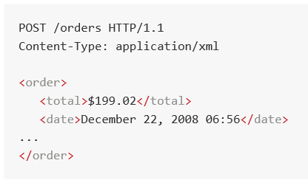
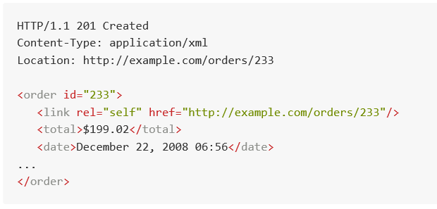
Assign HTTP Methods
Creating with PUT
PUT /orders/233 HTTP/1.1
PUT /customers/112 HTTP/1.1
PUT /products/664 HTTP/1.1
The HTTP specification also states that PUT is idempotent.
PUT is idempotent, because no matter how many times we tell the server to “create” our Order, the same bits are stored at the /orders/233 location.
PUT request will fail and the client won’t know if the request was delivered and processed at the server.
The disadvantage of using PUT to create resources is that the client has to provide the unique ID that represents the object it is creating.
Creating with POST

Slide 10
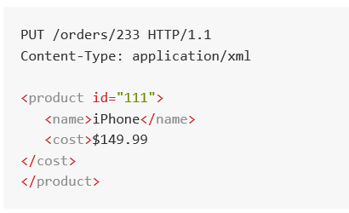
Updating an Order, Customer, or Product
Updating using PUT

Slide 11
Removing an Order, Customer, or Product
Deleting an Order, Customer, or Product using the HTTP DELETE method
The client simply invokes the DELETE method on the exact URI that represents the object we want to remove.
Removing an object will wipe its existence from the system.
DELETE /orders/233
Cancelling an Order
Cancelling an Order is very similar to removing it. Since we are already modeling remove with the HTTP DELETE method.
DELETE /orders/233?cancel=true

Slide 12
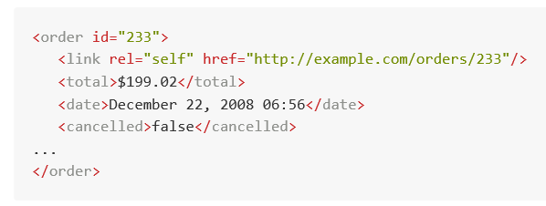
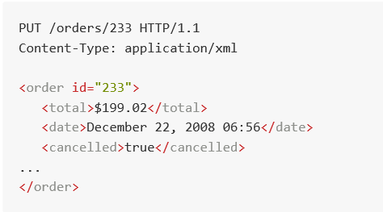
States versus operations
is the operation a state of the resource? If you answer yes to this question, the operation should be modeled within the data format.
DELETE /orders/233?cancel=true

