Slide 1
COURSE RECOMMENDATION SYSTEM
GROUP-
CB.EN.U4CSE20402-ABISHEK.M
CB.EN.U4CSE20403-ADITHYA.S
CB.EN.U4CSE20447-PRADEEP KARTHIK.M

Slide 2
INTRODUCTION
With the increasing amount of online courses and the vast array of subjects available, it can be challenging for users to find courses that match their interests and needs.
Traditional Recommender systems use Machine Learning methods like content-based filtering and collaborative-filtering and larger companies like coursera use deep learning to compare user behaviour to recommend courses.
The issue we experienced with traditional course recommendation systems is that they are really good at recommendation when the user is clear about the topic they want to learn.
For Beginners this is not really efficient since they are not clear about what kind of topic they want to explore. We intent to build a system that could be helpful to anyone who is not clear about what kind of topic they want to explore.

Slide 3
PROBLEM STATEMENT
Traditionally for a Course Recommendation, A User Enters the Topic he is interested in and the system recommends a course which is more relevant to the topic entered by the user.
This is fine when the user is sure about the Topic he wants to learn but for the users who are unsure of the topic they want to choose, this method become inefficient.
The User should be able to give a detailed description / His Profile (usually a Bio/Resume) to the system to get recommendations.
PROPOSED METHOD
To tackle the discussed problem, We suggest using a recommendation system where the user can come in and type his interest and what type of course he is looking for and his expected outcomes from the course.
Based on the detailed Description, we Intent to analyze the likeliness between the user’s description and the Course Descriptions and other parameters of the available courses to suggest the most relevant course to the user.

Slide 4
LITERATURE SURVEY:
Name of the paper | Year of Publication | Medium Of Publish | Links
A Recommendation System for Online Courses | 2017 | World Conference on Information Systems and Technologies | Here
Online Course Recommendation Using Deep Convolutional Neural Network with Negative Sequence Mining | 2022 | Wireless Communications and Mobile Computing | Here
Methods for building course recommendation systems | 2016 | KSE | Here

Slide 5
Name of the paper | Year of Publication | Medium Of Publish | Links
A Collaborative Recommendation System for Online Courses Recommendations | 2019 | IEEE | Here
Online Course Recommendation System | 2019 | IRJET | Here

Slide 6
PROPOSED METHODOLOGY
We propose on exploring Coursera website to learn how its recommendations work to understand how to industry treats the end-user and how we can improve the User-Experience.
Collect the necessary data like Course Description, Skills taught, Course Name, Course Rating, Course Duration, University for training the models.
Try out traditional machine learning methods like Content-based filtering and Collaborative-Filtering to understand how efficient the methods are.
Build a Deep Learning model using RNN (Recurrent Neural Networks) and train the model and make course recommendations based on Description provided by the user.
Build a Deep Learning model using CNN (Convolutionary Neural Networks) and train the model to test the efficiency of CNNs.
Build a Deep Learning model using BERT to get word embedding of the existing course descriptions and the user’s description and check the similarity between them to recommend the most relevant courses.

Slide 7
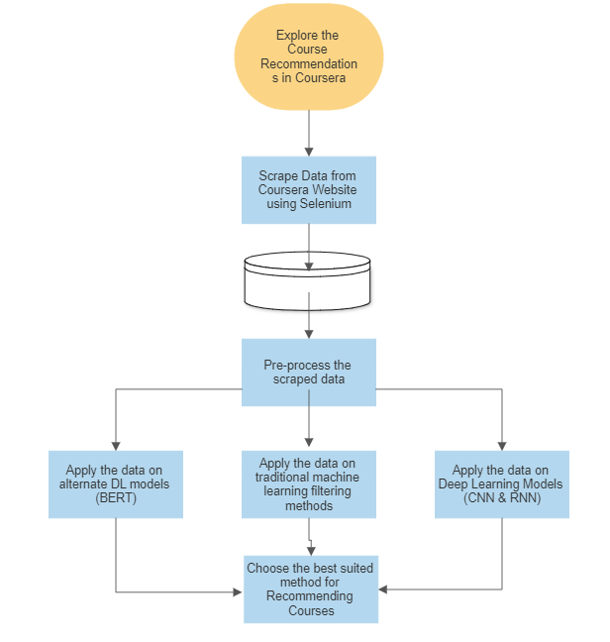
Workflow Diagram

Slide 8
Conclusion:
After trying out various traditional machine learning methods and Deep learning models here are our Conclusions:
Traditional Machine learning models are very good in recommendation similar courses when there is already data about user activity is provided to the system but they are hindered when a new user is trying to get recommendations in the system.
RNN model is really good when coming to processing Long Sequential data and when trained with a large dataset of NLP data, RNN models can be really effective in course recommendation systems.
CNN model is great at feature-extraction and can be used to extract keywords from the user’s description to recommend Courses with similar keywords in its description.
BERT model is trained on large sets of NLP data and has the ability to embed/group similar words together. Hence, after processing the data using BERT, we can use similarity between descriptions to recommend the most relevant courses to the user.

Slide 9
References
https://www.researchgate.net/publication/315848045_A_Recommendation_System_for_Online_Courses
https://Wikipedia.com
https://www.researchgate.net/publication/311313309_Methods_for_building_course_recommendation_systems
https://www.hindawi.com/journals/wcmc/2022/9054149/

Slide 10

TEAM MEMBERS
S. No | Roll Number | Name
1 | CB.EN.U4CSE20447 | Pradeep Karthik M
2 | CB.EN.U4CSE20403 | S Adithya
4 | CB.EN.U4CSE20402 | Abishek M

