Slide 1

Lending Club Case Study
Kaveri Pradeep
03/10/2022

Slide 2
Overview: Lending Club Case Study
Lending Club company is a loan market place company that gives loans to people through an online interface.
Purpose is to identify predictors of loan defaulters so that for future loan applications those variables can be used for loan approval/rejection.
Correct loan approvals/rejections would ensure two things:
Avoid credit loss to company for the cases when loan was approved and the customer is not likely to repay.
Loss of business for the cases where customers can repay the loan but their loan amount was not approved.
Objective
Data
Loan Dataset is available covering past loan details from 2007 to 2011
Only past accepted loan details is available in the dataset.
Three types of loans are available:
Fully paid loans
Currently paying loans
Charged-off loan (defaulters)
Checking facts of data
Data treatment
Treating missing records
Descriptive analysis
Univariate analysis
Bivariate analysis
Total number of rows and columns
% of missing records
Identify Extra columns and drop them
Keeping only Fully paid and Charge-off customers data
Aligning data types of columns
Treating invalid data like leading trailing spaces, invalid characters
Processing data columns
Finding % of missing data for all columns
Recommendation (categorical variables): Replace with mode.
Recommendation (Numerical), checked whether outliers are present or not, if yes then replace with median otherwise with mean.
If replacing with mean/median distorts original data distribution then forward and backward filling is recommended.
Mean for most of the numerical variables was greater than median.
This signifies data is right skewed
Countplot: Analysis of single variable at a time is done for categorical variables
Barplot: Segmented univariate analysis is done for categorical and numerical KPIs
Variables that has impact on customers being defaulted or not are concluded
Heatmap: Correlation matrix is created to study association between different variables
Approach

Slide 3



Assumptions
Customer Variables
Loan Status
Missing Data
Customer behaviour variables are removed as they will not be available at the time of loan application.
Only customers whose loan status is Fully paid or Charged-off are considered analysis.
As per instructions in live class, no data treatment is done for missing records.

Slide 4
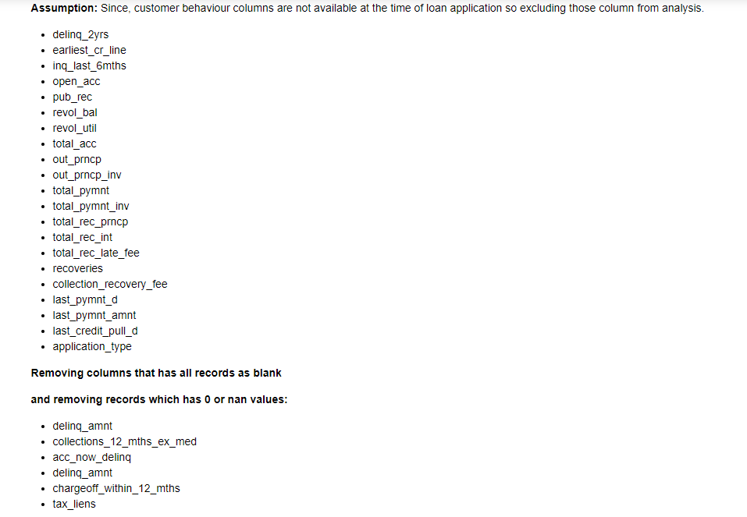
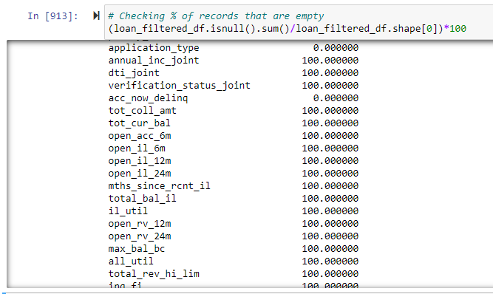
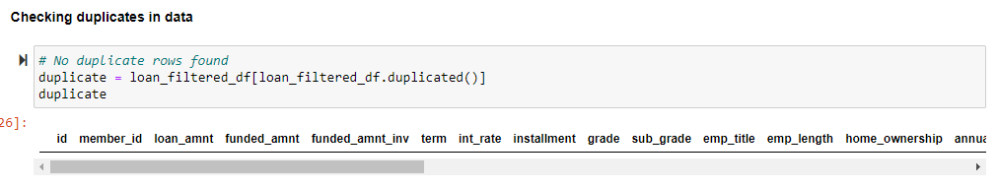
General Facts on Loan Dataset that is used for analysis
Considered only charge-off and fully paid customers
Rows:
38, 577
Columns:
31
Dropping Columns: Customer behaviour and ones that have all rows as Null or 0.
**All dropped column list can be found in the python code.
Missing Data:
>
Business Consideration:
Keeping only Fully paid and Charge- off customers
Checked for duplicates in data:
No duplicates found

Slide 5
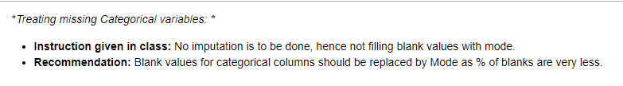
Data cleaning
S.No. | Data Treatment | Columns | Description
1. | Changing Datatype | String: id, member_id, policy_code, int_rate | Column datatype changed to string
2. | Removing leading spaces | term, emp_title | Some records existed in these column with leading spaces. Removed that.
3. | Round to two decimal places | Funded_amnt_inv | Values were rounded off to two decimal place to make it consistent with other float type numerical columns
4. | Replacing invalid row data to blank | Emp_title | 1. There were records in emp_title column where invalid or incomplete data existed. Ex of Invalid Data that existed: 15,1400 , 36,000, 553742017 2. home_ownership: NONE replaced with blank 3. title: “$” is replaced with blank 4. int_rate: “%” replaced with blank
5. | Processing loan date column | Issue_d | Two new columns were created: issue_d_month: Capturing only loan month issue_d_year: Capturing only loan year
Recommendation for missing data treatment:
Categorical Variables
Numerical Variables
Columns such as dti, mths_since_last_record, revol_util,delinq_amnt, chargeoff_within_12_mths, acc_now_delinq,policy_code, collections_12_mths_ex_med, tax_liens don't have any outliers
For these column replace blanks with mean and for other columns blanks should be replaced with median.
After replacing with mean and median if distribution of data gets distorted or gets changed with original distribution then should replace blanks with closer filled values [using ffil of bfill]
>

Slide 6
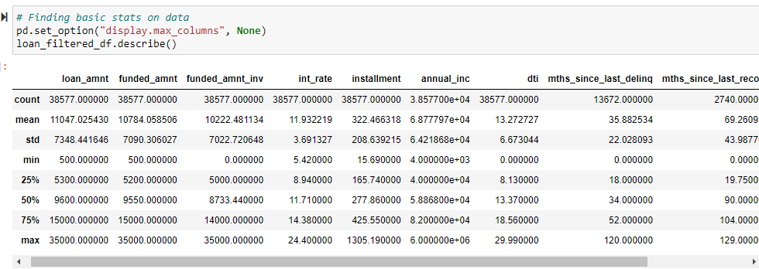
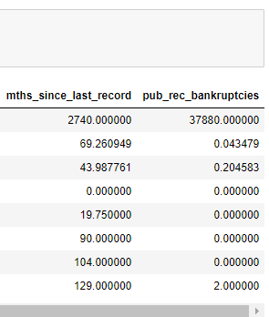
Descriptive Analysis
>
Variables highlighted in above screenshot has higher mean than median.
Higher mean value than median indicates right skewed data.
Quintile values for all highlighted variables show data is well distributed.
Inference:

Slide 7
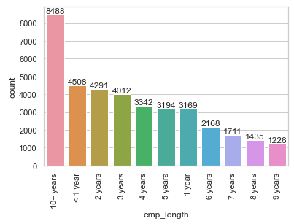
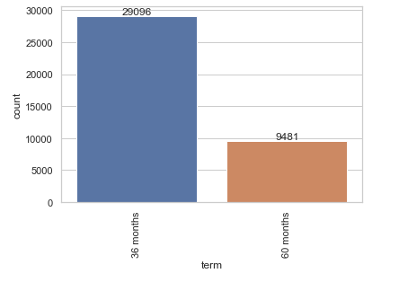
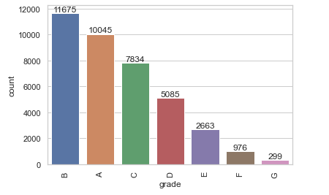
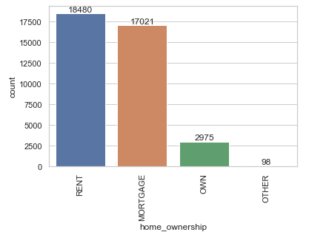
Univariate Analysis – Categorical Variables
Chart used: Countplot
Interpretation: Most of the customers who requested for loan are the one that either has larger employment length of>10years or least emp length <1year, 2years and so on
Interpretation: Most of the people opted for 36months of loan so that they don't have to pay more interest rate and it would be easier to pay who are well off.
People who are not so well off if opted for less term duration are more likely to default. As the instalment amount would be more and risk of them not paying would be more.
Expectation: People who are not well off or capable to pay should opt for larger term period so that they can pay the amount
Interpretation: Number of customers who are grade B customers requested for loan than grade A customers.
Interpretation: Most of the customers who requested for loan are the one that are either living on rented apartments or on mortgage.
Less likely to repay loan.
Expectation: Home ownership status should have been considered while giving out loans
Expectation: More loans should be given out to people considering their grade i.e. as per their likelihood to pay more.

Slide 8
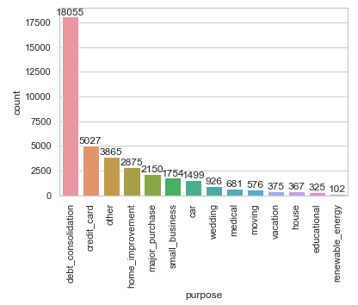
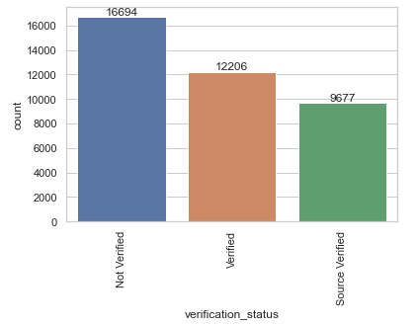
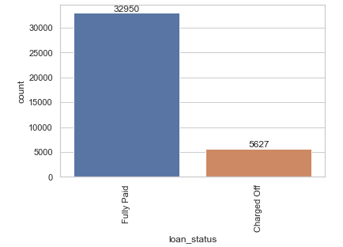
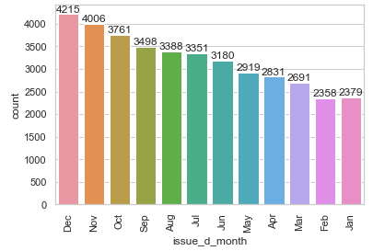
Univariate Analysis – Categorical Variables
Chart used: Countplot
Interpretation: Most of the people who requested for loan are the ones whose source of income was not verified or even if it was verified it was not verified from the source. This means chance of forge verification might occur.
Interpretation: Most of the customers requested for loan for to pay off their consolidated debt amount and credit card bill
Interpretation: Most of the customers who requested for loan actually paid off as well.
Cases of defaulters are less as compared to fully paid customers.
Interpretation: Most of the customers who requested for loan in the month of December, November as these are the festive season in USA (Christmas, New Year and thanksgiving time)

Slide 9
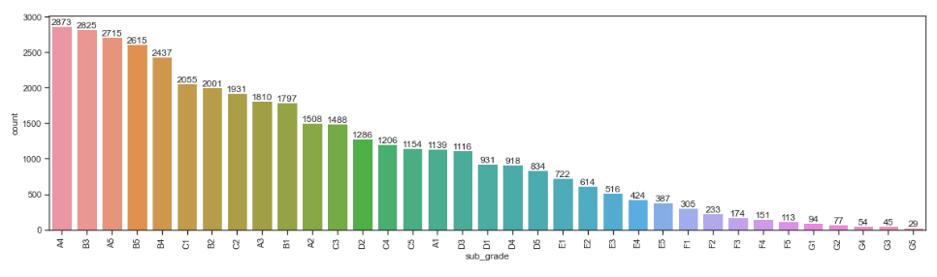
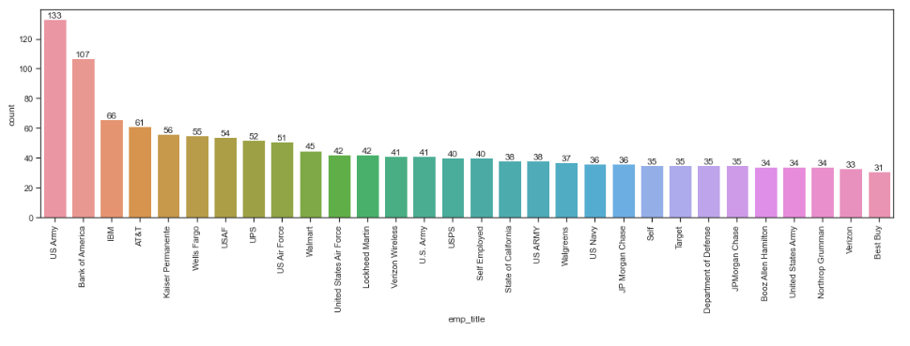
Univariate Analysis – Categorical Variables
Chart used: Countplot
Interpretation: Most of the people who requested for loan are the ones who are tagged to A4, B3,B4,B5, C1.
Recommendation: More loans should be given out to people considering their grade & sub_grade i.e. as per their likelihood to pay more
Interpretation: Loans are mostly given out to people working in government sector, IT sector, Healthcare and financial firms

Slide 10
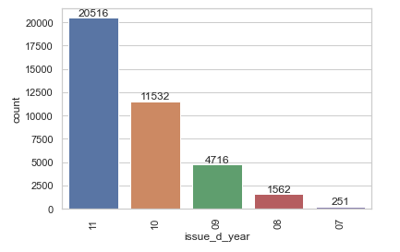
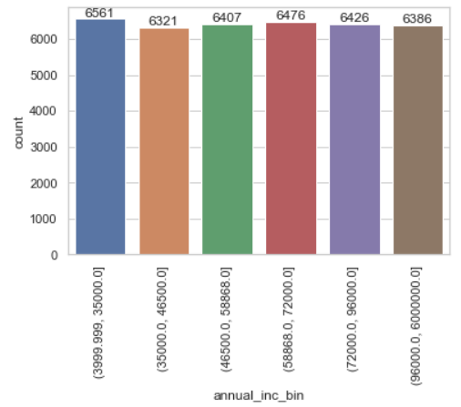
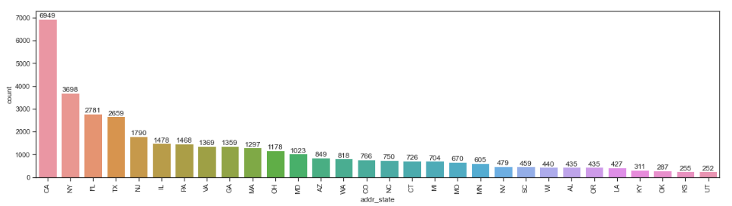
Univariate Analysis – Categorical Variables
Chart used: Countplot
Interpretations: More loan requests came in the year 2010 and 2011.
With time, people come to know about lending club and seeking loan or can be frauds as well who see this as an opportunity to make money by forging.
Interpretations: All income group placed request for loan.
Interpretations: Most of the borrowers belong to California, new york, florida, texas, new jersey state

Slide 11
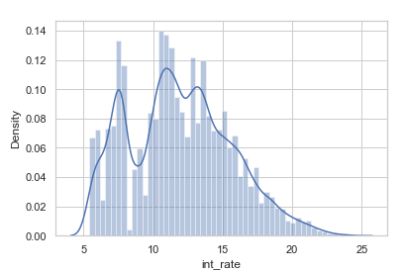
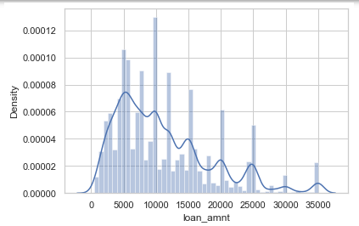
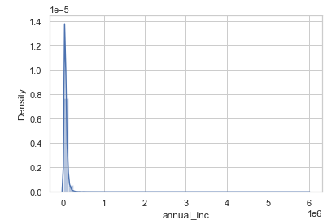
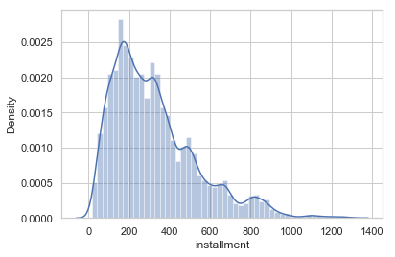
Variables such as loan_amnt, int_rate, annual_inc and instalment show even distribution of data however data is quite right skewed because of outliers
Univariate Analysis – Numerical Variable

Slide 12
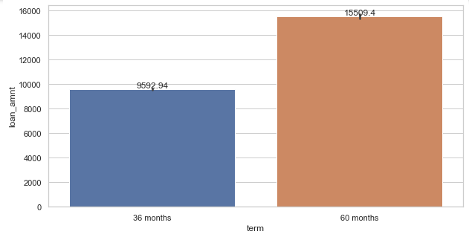
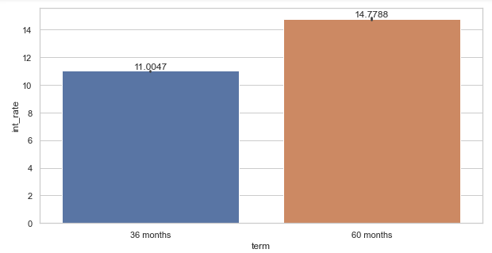
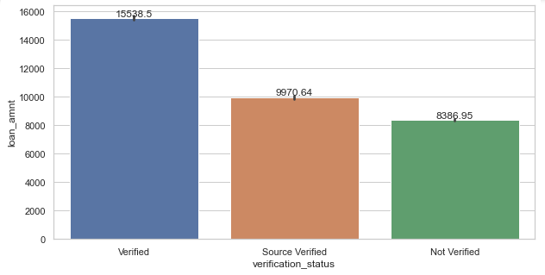
Term, salary verification, LC grade, LC subgrade, annual income and home ownership amongst important factors deriving defaulter and non-defaulter cases.
Segmented Univariate Analysis
Interpretations:
People who opted for 60 months term duration got their loans approved more.
One reason: More interest rate can be charged to customer leading to monitory gain to the company.
Another could be expectation is since term duration is more people would repay the loan amount and leading to less defaulter cases
Interpretations:
Most of the approved loan customers income was “Verified” but not source verified.
Two cases can occur:
Document based verification done: where chances of submitting forge documents can occur.
Verification was not at all done by the company associates owing to laziness.
This can lead to more defaulter cases

Slide 13
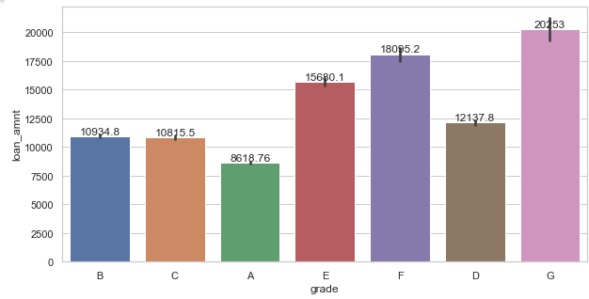
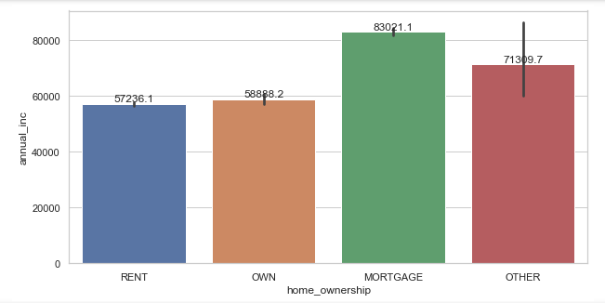
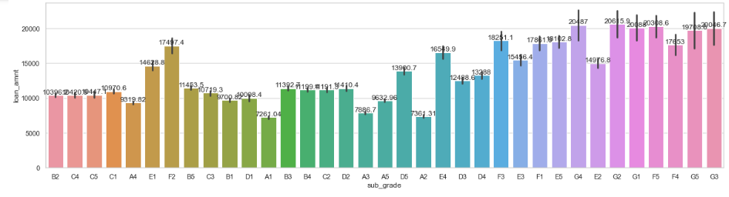
Term, salary verification, LC grade, LC subgrade and home ownership amongst important factors deriving defaulter and non-defaulter cases.
Segmented Univariate Analysis
Interpretations:
Loans are approved for customers who were on mortgage followed by no home ownership status known.
Leading to more defaulter cases
Interpretations:
People who are tagged to lower LC grade got their loans approved. However this should not be the case, as their likelihood to repay loan would be less and would lead to more defaulters.
Interpretations:
Chart of loan_amnt vs sub_grade shows more loan amount is approved for people whose grades are D,E,F,G and sub_grades such as G4,G3,G5,G2,G1,F5 i.e. where likelihood to repay loan is less
More likely to be defaulters.

Slide 14
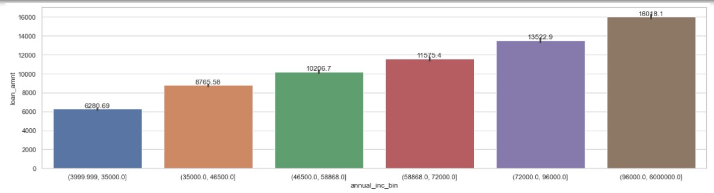
Term, salary verification, LC grade, LC subgrade and home ownership amongst important factors deriving defaulter and non-defaulter cases.
Segmented Univariate Analysis
Interpretations:
People who had higher income had their loans approved

Slide 15
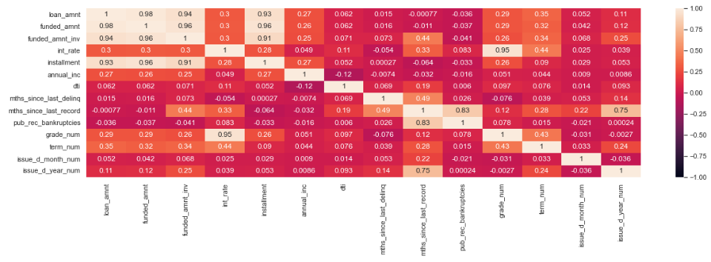
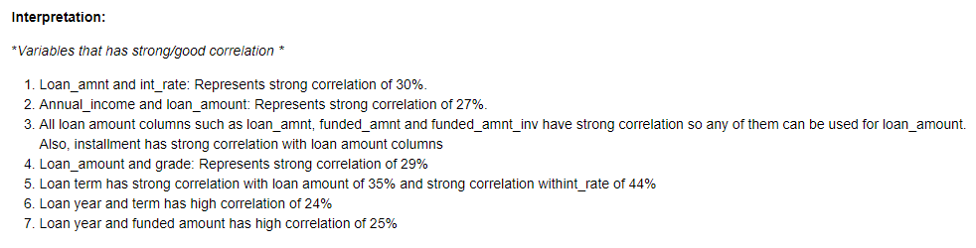
Loan term, grade, annual income, loan month and loan year variables shows strong correlation with loan amount
Bivariate Analysis – Correlation Matrix

Slide 16
Key Driving Factors

Slide 17
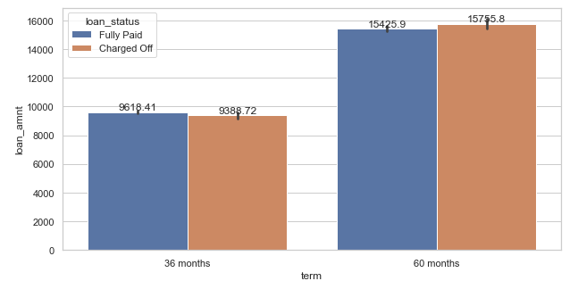
Key driving factors
term
Data trend shows, shorter loan term has less defaulters than fully paid customers.
These are the small loans and constitutes customers who are sincere to repay the loan.
Larger term loans are the loans that are of larger amount and might be taken by business people where risk of repayment is more if business is not performing well.
Strong correlation of 44% between loan_amount and term as per correlation matrix.

Slide 18
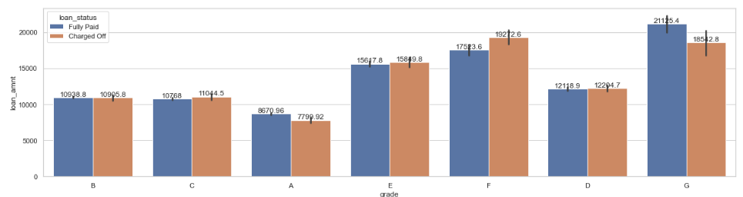
Key driving factors
grade
LC grades are allotted to people on the basis of their past loan repayment records.
Data shows that people with better grades are less defaulters.
Strong correlation of 29% between loan_amount and grades as per correlation matrix.

Slide 19
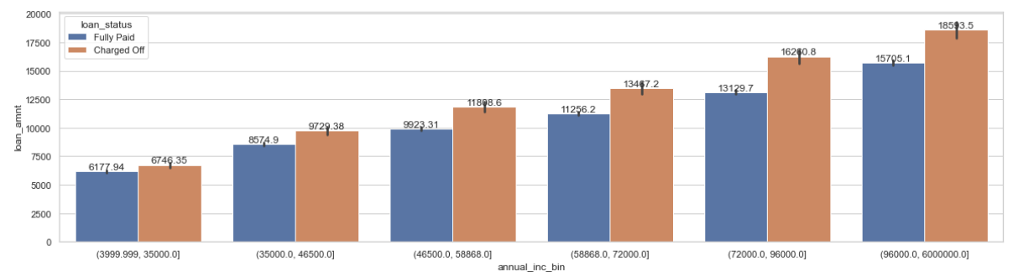
Key driving factors
annual_inc
Data trend shows, customers that had higher annual income had maximum loan approval and were more defaulters as compared to fully paid customers.
Rich people are likely to default more as they have money and they tend to take more loan.
They are the ones who lead a luxurious lifestyle and tend to spend more. Also, they invest amount in stock and all as well and in case market goes down their likelihood to default would be more.
Strong correlation of 27% between loan_amount and annual_inc as per correlation matrix.

Slide 20
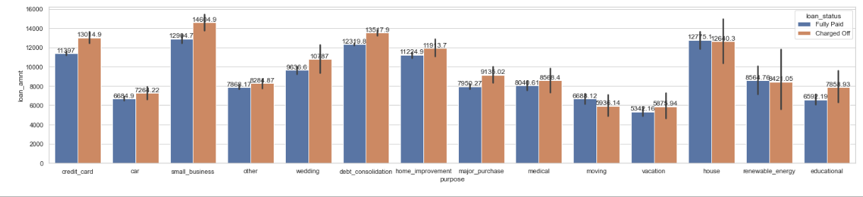
Key driving factors
purpose
Loan defaulters and non-defaulters varies with the purpose for which the loan was taken.
For small business defaulters are more as they are the people who are not very rich and just entering in the business. For those, there are chances that they are not able to repay loan in case their business did not flourish.
For deb consolidation customers, since they are already in debt repaying another loan amount can be challenging and its quite likely for them to default.

Slide 21
Key driving factors
Loan_date (1/2)
Data shows, year end months such as November and December has higher chances of people being defaulters.
Likelihood to repay loan is less as this is the festival time and people might not have sufficient funds to repay or they don’t prioritize repaying over spending time holidaying with family and celebrating.
Year 2007, 2008 and 2011 shows larger incidences of people getting defaulted which means year is making significant role for customers being defaulters.
Loan date has strong correlation of 22-25% with loan amount.

Slide 22
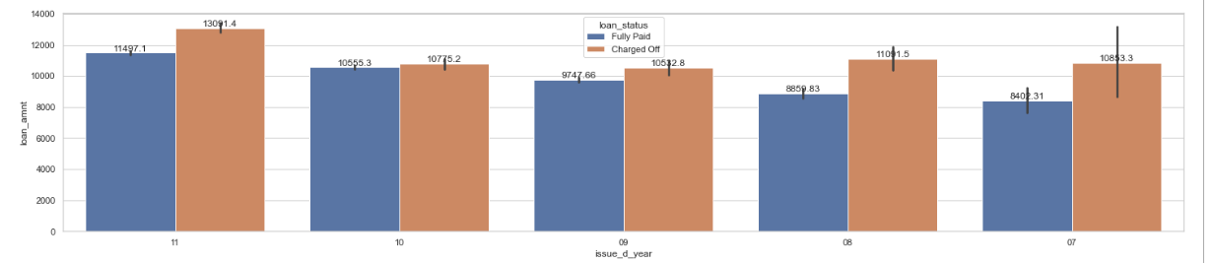
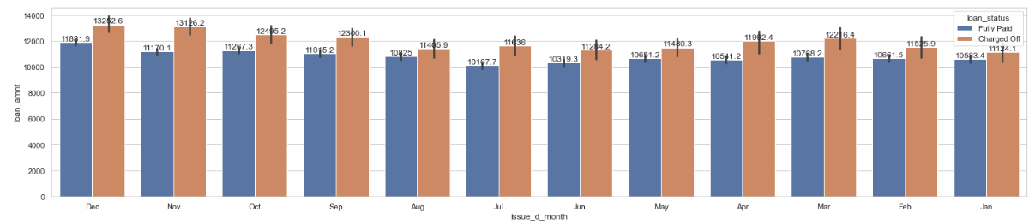
Key driving factors
Loan_date (2/2)

