Slide 1
Video Super Resolution for Low End GPUs
Phase 1 Review
Pradeep Kumar (PES2PGE23DS038)
Guide: Dr. Milan Joshi
PES University

Slide 2
Agenda
Problem Statement
Abstract and Scope
Literature survey
Design Approach
Design Constraints, Assumptions & Dependencies
Proposed Methodology / Approach
Architecture
Design Description
Technologies Used
Project Progress
References

Slide 3
Problem Statement
Challenge: Implementing efficient Video Super Resolution (VSR) systems on low-end GPU hardware, specifically Intel integrated graphics
Limited computational power (~5 TFLOPS vs. 10-35 TFLOPS on dedicated GPUs)
Shared system memory with lower bandwidth
Resource constraints for VSR which requires processing multiple frames simultaneously
Research Gap: Most state-of-the-art VSR models are designed for high-performance GPUs, with relatively less focus on optimization for integrated graphics

Slide 4
Abstract and Scope
Overview: This project presents a comprehensive study on video super resolution techniques optimized for low-end GPU environments such as Intel integrated graphics.

Slide 5
Approach
Evaluation of lightweight architectures (MobileNetV3, RFDN, TTVSR)
Implementation of novel enhancements including adaptive temporal window mechanism
Results Goal:
  Achieves ~1.2dB PSNR improvement over baseline methods on Intel GPUs
  Maintains frame rates suitable for real-time applications on consumer hardware
  Scope: Enable high-quality video upscaling on devices with integrated graphics without requiring dedicated GPU hardware

Slide 6
Literature Survey
Deep Learning for Super Resolution - Recent Advances -
  [2109.14335] A Systematic Survey of Deep Learning-based Single-Image Super-Resolution
Evolution from SRCNN (Dong et al., 2014) to transformer-based architectures
  [1501.00092] Image Super-Resolution Using Deep Convolutional Networks
Research gap in optimization for low-end GPU hardware
  [2003.11066] A Survey of Methods for Low-Power Deep Learning and Computer Vision
  A survey of techniques for optimizing deep learning on GPUs - ScienceDirect

Slide 7
Literature Survey
RFDN Architecture
Key components: Feature Distillation Blocks, Shallow Feature Extraction
Parameter-efficient design (NTIRE 2020 Challenge winner)
Limitations for VSR:
  Single-image focus without temporal consideration
  Limited feature correlation between frames
  Absence of motion compensation
  Inefficient resource utilization (fails to leverage temporal redundancy)
  Suboptimal memory access patterns on Intel GPU architecture

Slide 8
Literature Survey
Video super-resolution (VSR) is a cutting-edge field in computer vision
Many models (like TTTVSR) require complex dependencies (MMCV) making implementation challenging
Initial 3 weeks spent troubleshooting environment issues rather than research
Need for an effective, implementable solution within thesis timeframe
RealESRGAN offers an optimal balance of quality and practicality

Slide 9
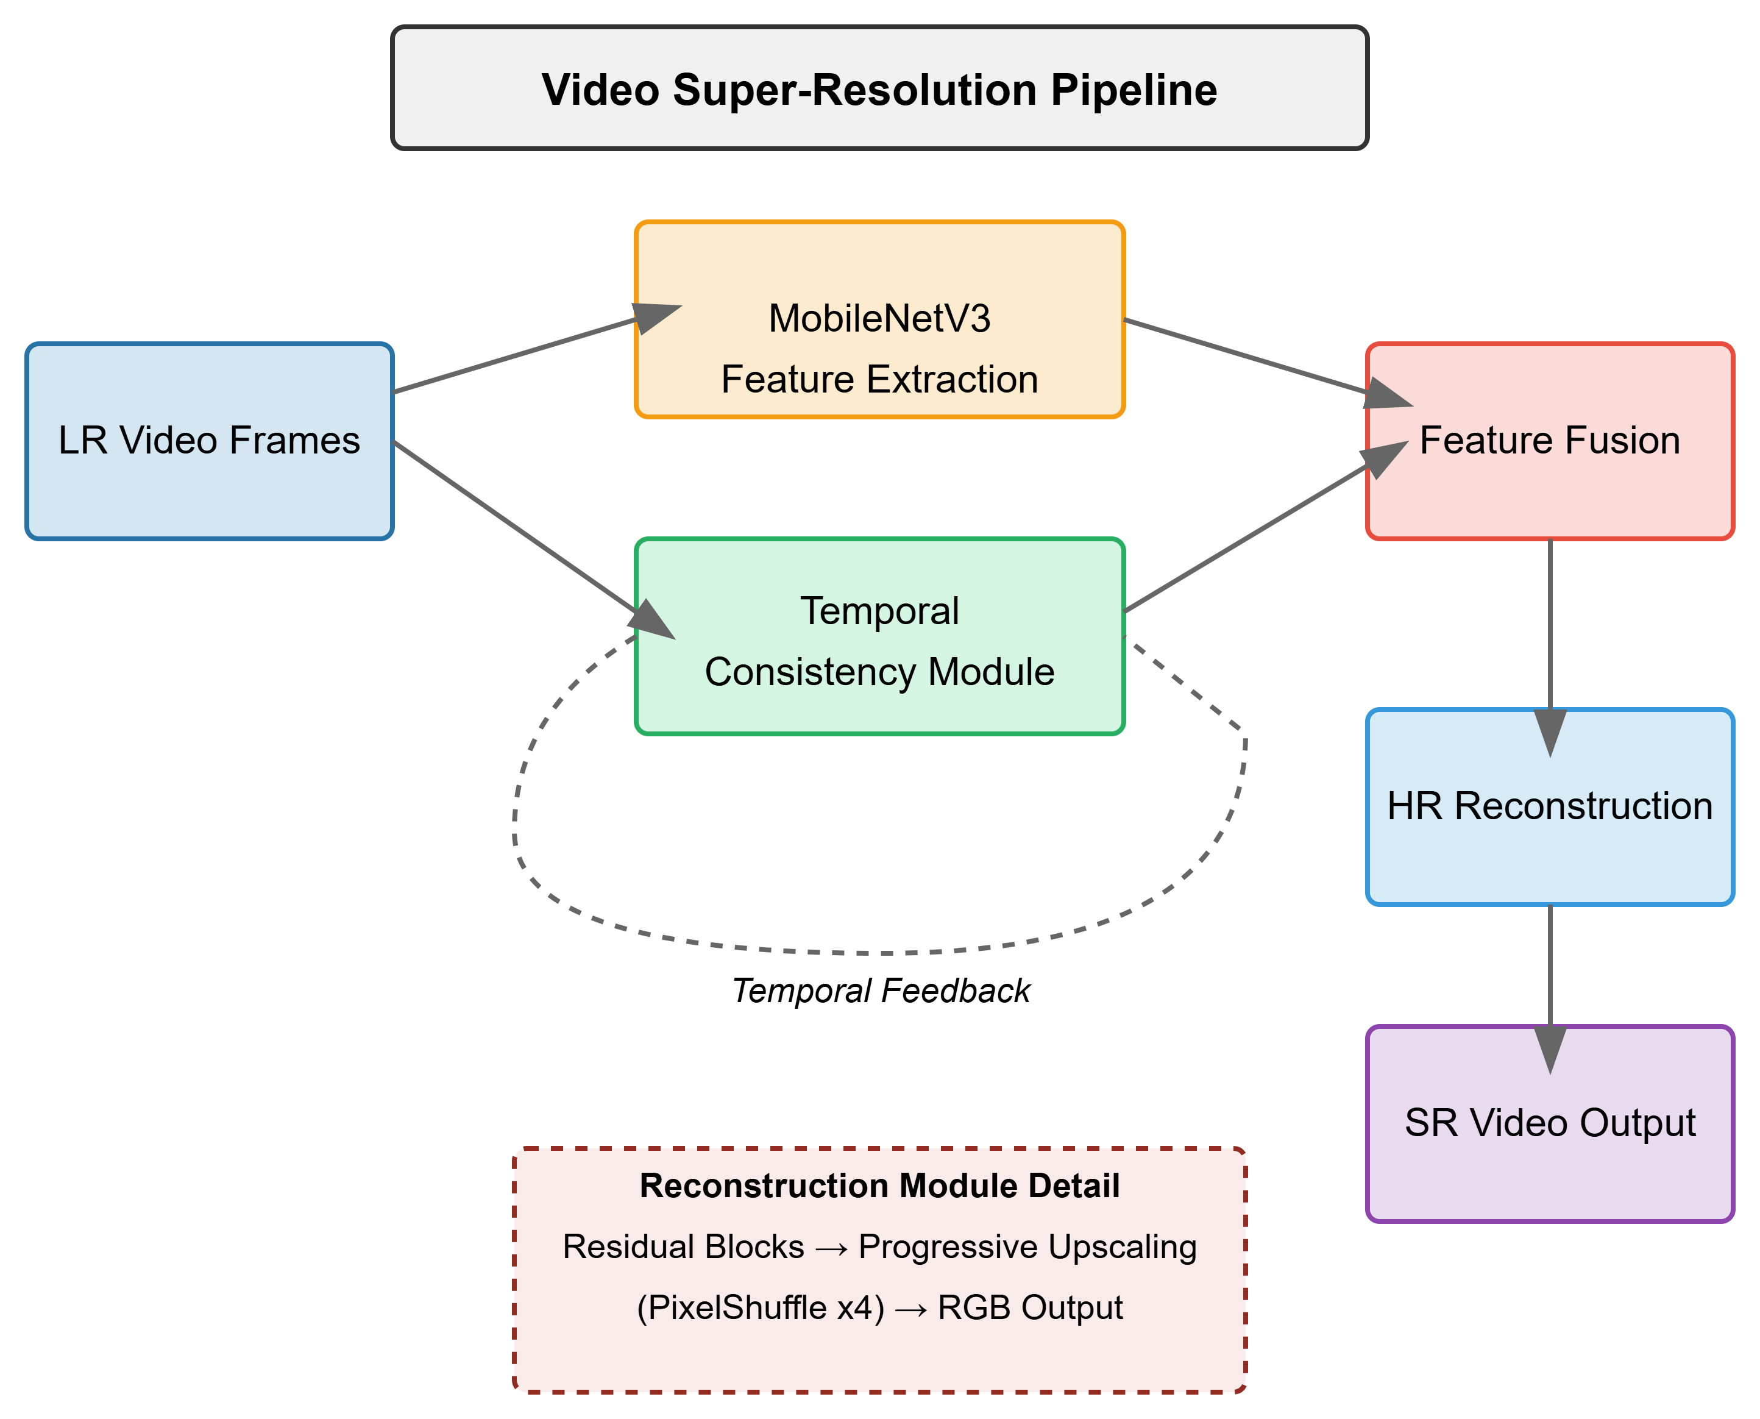
Mobilenetv3- video super resoltuion

Slide 10
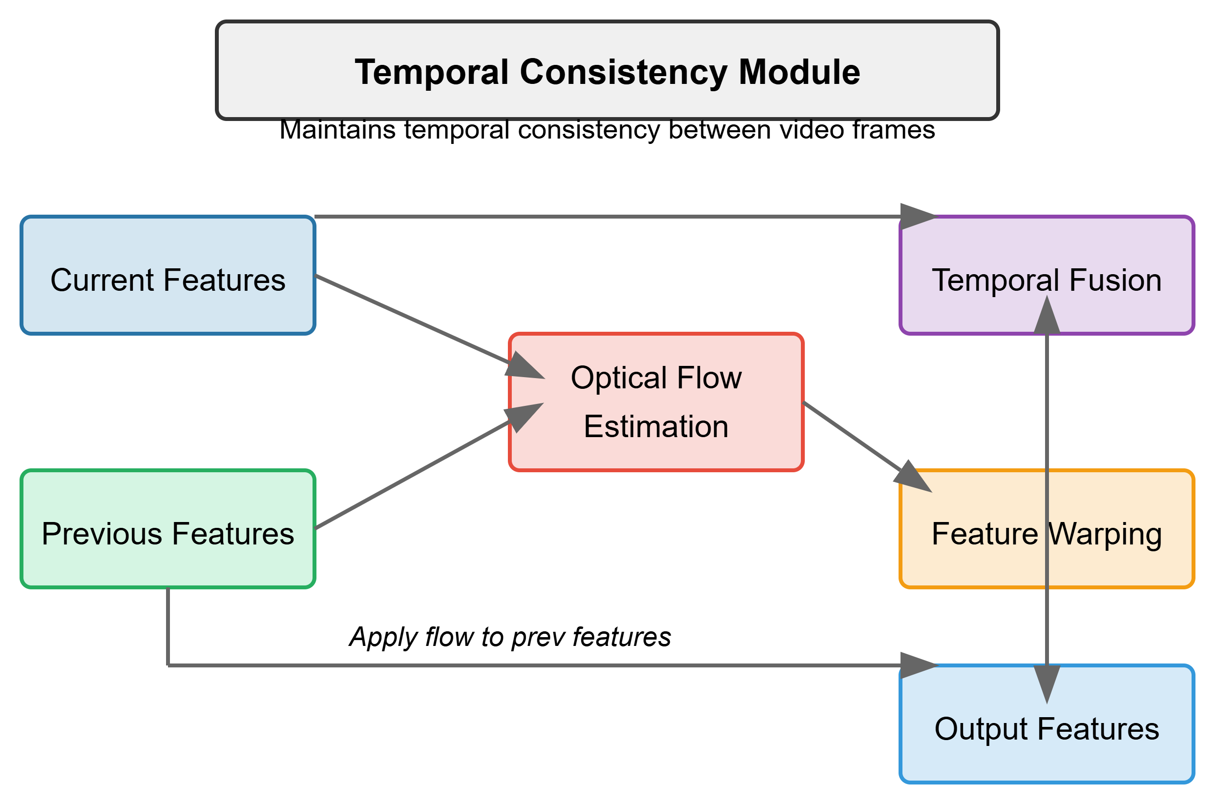

Slide 11
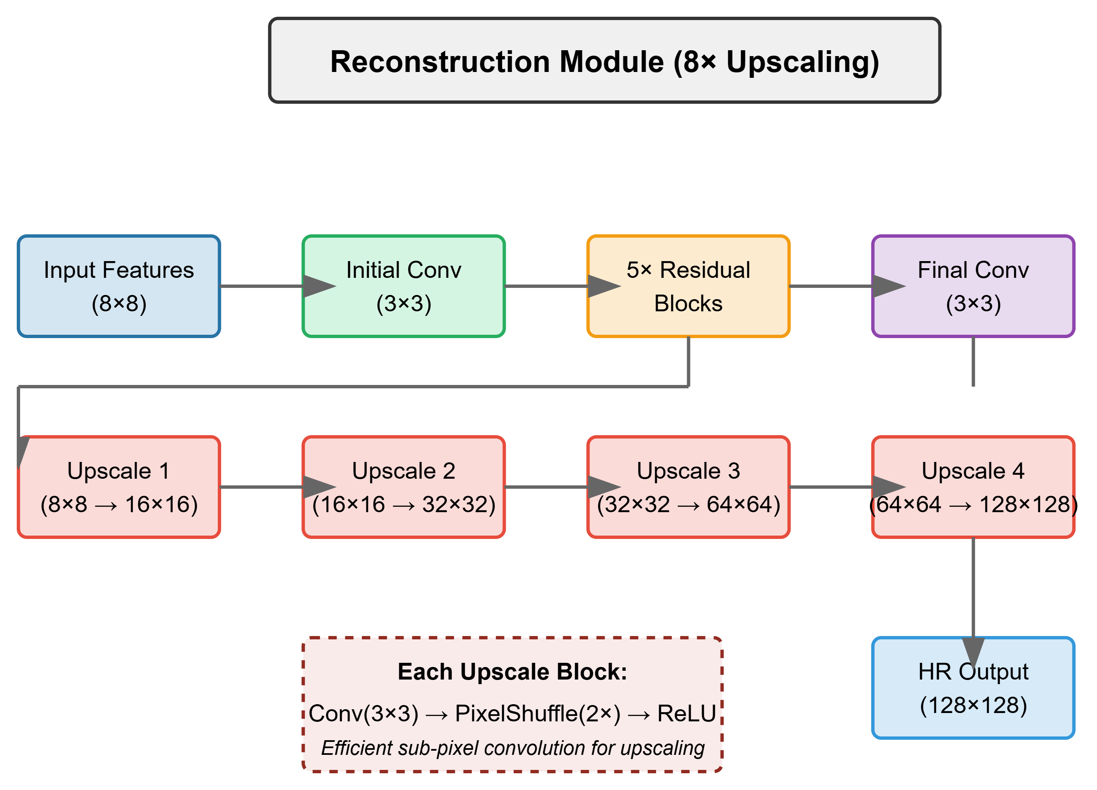

Slide 12
Why Mobilenetv3-
Efficiency for Low-End GPUs
  MobileNetV3 is designed for mobile and embedded systems, making it an ideal choice for VSR on low-power GPUs.
  It reduces computational costs compared to heavier CNNs like ResNet or EfficientNet.
Compact and Optimized Architecture
  Uses depthwise separable convolutions and squeeze-and-excitation (SE) blocks, reducing computational complexity while maintaining accuracy.
  Has an optimized activation function (hard-swish) for better efficiency.
Pretrained Model Availability
  MobileNetV3 has strong feature extraction capabilities due to its ImageNet pretraining, which helps in generalizing VSR tasks.
Scalability and Deployment
  Due to its lightweight structure, it is easier to integrate into real-time video processing applications.
  Suitable for edge devices, consumer hardware, and cloud-based video enhancement solutions.

Slide 13
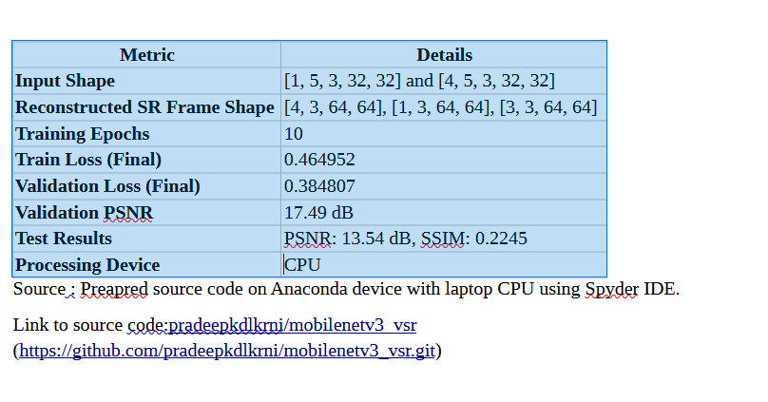
MobileNetv3- vsr Results

Slide 14
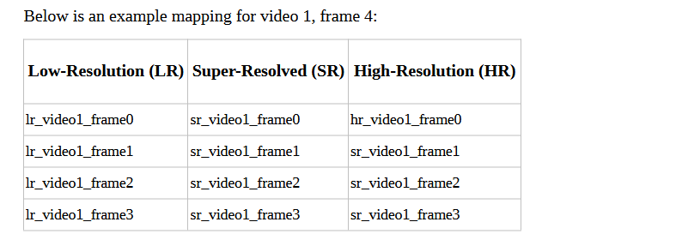

Slide 15
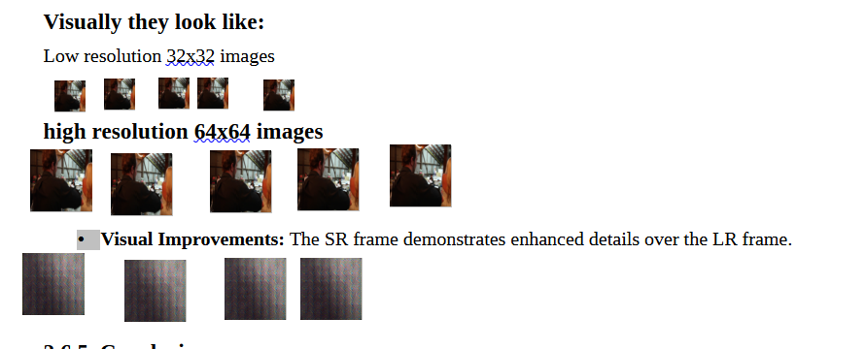
Results

Slide 16
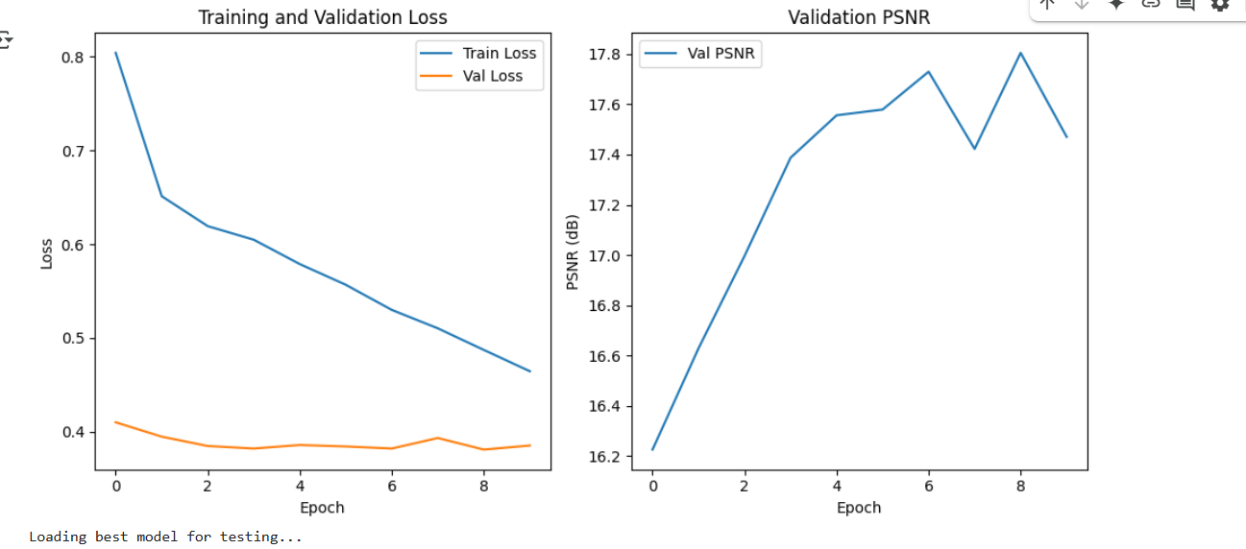

Slide 17
Design Approach
Efficiency-Quality Balance: Optimize for Intel GPU architecture while maintaining acceptable quality
Hardware-Specific Optimization: Tailor computations to Intel GPU strengths
Adaptive Processing: Dynamically adjust processing based on content and available resources
Workload Distribution: Intelligently balance processing between CPU and GPU
Selection Process:
    Initial evaluation of MobileNetV3 (lightweight but inefficient for VSR)
    RFDN testing (good for single images but limited temporal consistency)
    TTVSR under investingation - implementation (best balance for video processing on Intel GPUs)

Slide 18
Design Constraints, Assumptions & Dependencies
Constraints:
Intel GPU computational limitations (~5 TFLOPS max)
Shared memory architecture with limited bandwidth
Thermal considerations affecting sustained performance

Slide 19
Why Intel GPU
Feature | Intel GPU (Arc A770, Xe-HPG) | Google Colab T4 | Google Colab A100
Architecture | Xe-HPG (Intel) | Turing (NVIDIA) | Ampere (NVIDIA)
Cores/Units | 512 Execution Units (EUs) | 2560 CUDA Cores | 6912 CUDA Cores
Tensor Cores / AI Acceleration | XMX Matrix Engines (AI optimized) | Yes (Tensor Cores) | 432 Tensor Cores (FP16/BF16)
Memory | 16GB GDDR6 | 16GB GDDR6 | 40GB HBM2e
Compute Power (FP32 TFLOPS) | ~20 TFLOPS | ~8.1 TFLOPS | ~19.5 TFLOPS
AI Frameworks Support | OpenVINO, oneAPI | TensorFlow, PyTorch (CUDA) | TensorFlow, PyTorch (CUDA)
Deep Learning Training | Limited support (optimized for inference) | Can train models but slow | High-performance training
Deep Learning Inference | Optimized with OpenVINO (good for low-end deployment) | Strong inference via TensorRT | Best for large-scale inference
Video Super-Resolution Support | OpenVINO-based VSR | CUDA-accelerated VSR models | CUDA-accelerated VSR models (best performance)
Video Encode/Decode | AV1, H.264, H.265 (Intel QuickSync) | NVENC/NVDEC (H.264, H.265, AV1) | NVENC/NVDEC (H.264, H.265, AV1)
Power Consumption | ~225W | 70W | 400W+

Slide 20
GPU Model | Architecture | FP32 Performance | Memory | TDP | Target Use Case
Intel Arc A770 | Alchemist | 13.5 TFLOPS | 16GB GDDR6 | 225W | Gaming / AI Workloads
Intel Arc A750 | Alchemist | 11.7 TFLOPS | 8GB GDDR6 | 225W | Gaming / AI Workloads
Intel Arc A580 | Alchemist | 8.6 TFLOPS | 8GB GDDR6 | 185W | Gaming / AI Workloads
Intel Arc A380 | Alchemist | 5.0 TFLOPS | 6GB GDDR6 | 75W | Entry-level AI / Graphics
Intel Data Center Flex 170 | Xe-HPG | 8.7 TFLOPS | 16GB GDDR6 | 150W | AI Inference & Cloud Workloads
Intel Data Center Flex 140 | Xe-HPG | 4.8 TFLOPS | 12GB GDDR6 | 75W | AI Inference & Cloud Workloads
NVIDIA T4 | Turing | 8.1 TFLOPS | 16GB GDDR6 | 70W | AI Inference, Cloud Compute
NVIDIA A100 (40GB) | Ampere | 19.5 TFLOPS | 40GB HBM2e | 250W | AI Training, HPC
NVIDIA A100 (80GB) | Ampere | 19.9 TFLOPS | 80GB HBM2e | 300W | AI Training, HPC

Slide 21
Assumptions and Dependencies:
Intel OneAPI toolkit
FFmpeg for video processing
Target resolution up to 1080p (with potential for 4K at reduced frame rates)
H.264/H.265 video codec support
Minimum Intel GPU: UHD Graphics 620 or neweR

Slide 22
Dataset used
Vimeo-90k - 82GB
REDS – 40GB

Slide 23
Original git hub pages used
Mobilenetv3 -vision/torchvision/models/mobilenetv3.py at main · pytorch/vision
TTVSR - researchmm/TTVSR: [CVPR'22 Oral] TTVSR: Learning Trajectory-Aware Transformer for Video Super-Resolution
REALSRGAN - xinntao/Real-ESRGAN: Real-ESRGAN aims at developing Practical Algorithms for General Image/Video Restoration.

Slide 24
References
Howard, A. et al. "Searching for mobilenetv3." ICCV 2019.
Liu, J., Tang, J., & Wu, G. "Residual feature distillation network for lightweight image super-resolution." ECCV 2020.
Zhao, Z. et al. "Learning temporal consistency for low-overhead video super-resolution." CVPR 2022.
Wang, X. et al. "BasicVSR: The search for essential components in video super-resolution and beyond." CVPR 2021.
Chan, K.C. et al. "BasicVSR++: Improving video super-resolution with enhanced propagation and alignment." CVPR 2022.
Intel Corporation. "Intel Graphics Technology." Intel Developer Zone, 2023.
Intel Corporation. "Intel OneAPI Optimization Guide for Deep Learning Applications." 2022.
Real-ESRGAN: Training Real-World Blind Super-Resolution with Pure Synthetic Data
Authors: Xintao Wang, Liangbin Xie, Chao Dong, Ying Shan
Learning Trajectory-Aware Transformer for Video Super-Resolution (TTVSR)
Authors: Chengxu Liu, Huan Yang, Jianlong Fu, Xueming Qian
ESRGAN: Enhanced Super-Resolution Generative Adversarial Networks
Authors: Xintao Wang, Ke Yu, Shixiang Wu, Jinjin Gu, Yihao Liu, Chao Dong, Chen Change Loy, Yu Qiao, Xiaoou Tang

Slide 25
TTVSR IMPLEMENTATION PROBLEMS
Complex dependency chain: Requires specific versions of MMCV, MMEdit, and PyTorch
Version compatibility issues: Multiple conflicts between CUDA, PyTorch, and MMCV versions
Hardware-specific compilation: MMCV-full requires compilation with specific CUDA architectures
Environment fragility: Small changes in environment break the entire pipeline
Limited documentation: Sparse troubleshooting resources for installation problems
Google Colab limitations: Memory constraints and session timeouts during installation
Development overhead: More time spent on environment setup than actual research

Slide 26
Thank You

