Slide 1
School Bus Route Optimization & Driver Compliance Analytics
Case Study by Pradeep Kodeboina (03/04/2025)

Slide 2
Objective
Analyze
Identify
Evaluate
Analyze the planned route vs. actual bus route.
To get insight on the inefficiencies and identify patterns in actuals routes.
Identify inefficiencies in the planned route.
To make the planned route more efficient to save time, distance and student safety and comfort.
Evaluate diver compliance to planned route.
To understand if driver is adhering to the given route or not.

Slide 3
Data & Tools Used
Planned Route Data
Actual GPS Data
Tools
Planned route data consists:
Types of stops
Geo coordinates
Stop name
Stop time
Actual GPS data consists:
Time stamp
Geo coordinates
Odometer readings
Motionstart & Motionstop
QGIS
MapQuest
OpenStreetMap

Slide 4
Challenges deep-dive
Challenge 1
Challenge 2
Route Optimization
Planned route is less efficient but by rearranging the sequence of few stops we can get more efficient route.
Driver Compliance
Excessive delay at the Start Point.
Stop 6 is skipped everyday.
Overall sequence is followed, but missing stop impacts service quality.

Slide 5
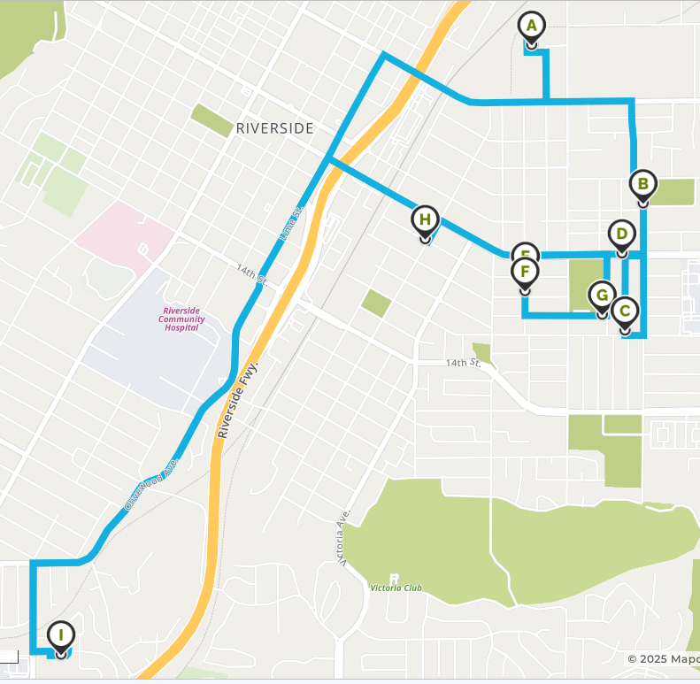
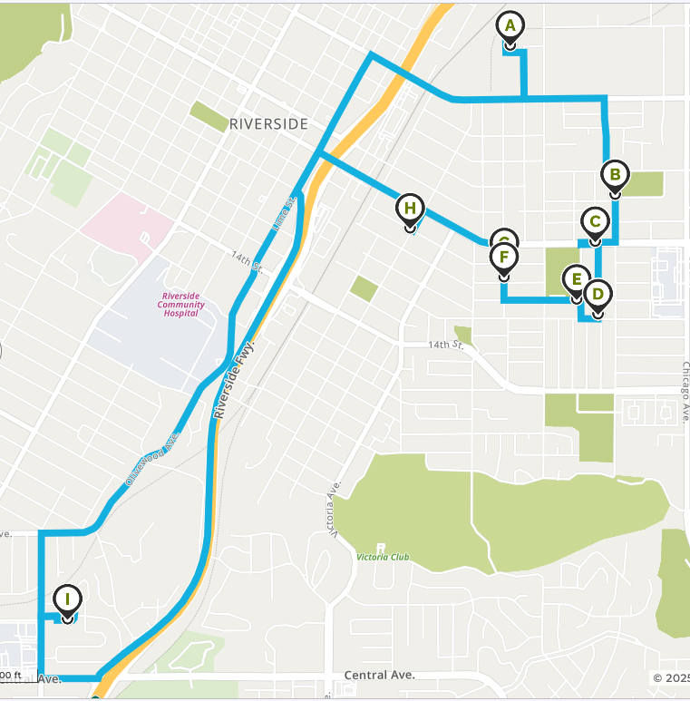
Route Optimization Findings
Planned Route: 9.6 miles in 29 mins
Optimum Route: 9.1 miles in 26 mins
Note: This is only transit time. Service time should be added.

Slide 6
Route Optimization Findings: Calculations
Planned Route
Optimum route
Actuals
Transit time = 29 mins
Service time:
Each student stop ~ 30 secs ~3.5 mins
School stop ~ 5.5 mins
Total time: 38 mins to 40 mins
However, entire route was planned for 46 minutes as per stop time
Transit time = 26 mins
Service time:
Each student stop ~ 30secs ~3.5 mins
School stop ~ 5.5 mins
Total time: 35 mins to 37 mins
Actual time: ~74 mins 85% more than planned and 100% more than Optimum
Actual distance: ~9.66 miles
0.6% more than planned and 6% more than optimum

Slide 7
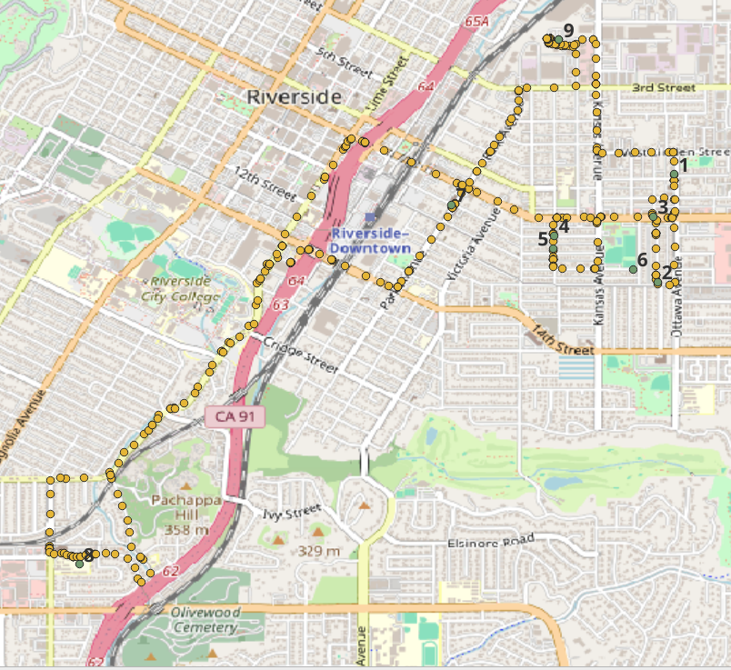
Driver Compliance Findings
Driver is trying to follow the planned route sequence but not achieving it 100% and facing multiple compliance.
1] Time Compliance
2] Distance Compliance
3] Route Compliance

Slide 8
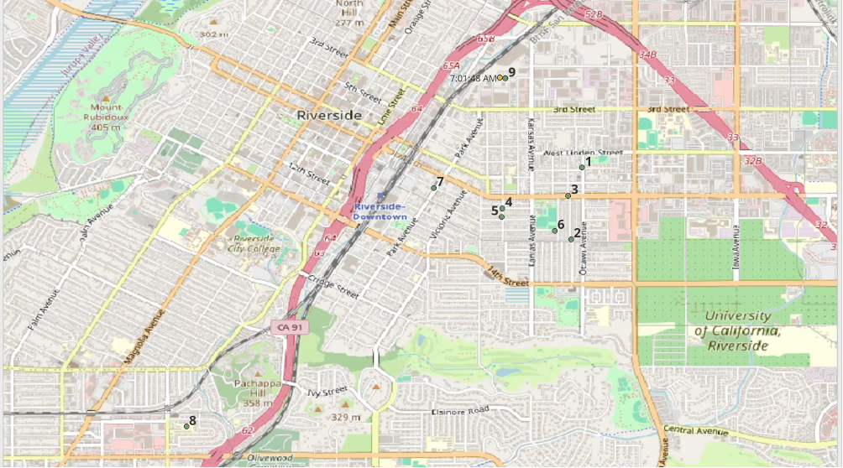
Driver Compliance Findings (GPS trace)

Slide 9
Driver Compliance Findings - Planned vs Actuals
Actual vs Average time in hh:mm
Actual local time vs planned time
Date | Distance (miles) | Total time (hr:mm:ss) | Wait time at DP (mm:ss) | DP to SC (mm:ss) | SC drop time (mm:ss) | SC to DP (mm:ss)
9/23/24 | 9.44 | 1:09:42 | 10:00 | 36:48 | 05:13 | 17:41
9/24/24 | 9.63 | 1:12:05 | 09:14 | 38:22 | 05:37 | 18:52
9/25/24 | 9.54 | 1:11:45 | 09:27 | 38:56 | 05:31 | 17:51
9/26/24 | 9.98 | 1:26:04 | 16:42 | 37:58 | 07:03 | 24:21
9/27/24 | 9.70 | 1:12:29 | 09:43 | 40:09 | 03:22 | 19:15
Average of 5 days | 9.66 | 1:14:25 | 11:01 | 38:27 | 05:21 | 19:36
Date | Start time | First moment | School time | Return start | End
9/23/24 | 7:01:38 AM | 7:11:38 AM | 7:48:26 AM | 7:53:39 AM | 8:11:20 AM
9/24/24 | 7:01:33 AM | 7:10:47 AM | 7:49:09 AM | 7:54:46 AM | 8:13:38 AM
9/25/24 | 6:59:31 AM | 7:08:58 AM | 7:47:54 AM | 7:53:25 AM | 8:11:16 AM
9/26/24 | 6:54:01 AM | 7:10:43 AM | 7:48:41 AM | 7:55:44 AM | 8:20:05 AM
9/27/24 | 7:01:14 AM | 7:10:57 AM | 7:51:06 AM | 7:54:28 AM | 8:13:43 AM
Planned timings | - | 7:16:00 AM | 7:45:00 AM | - | 8:02:00 AM

Slide 10
Driver Compliance Findings
Time Compliance
Distance Compliance
Route compliance
At start point driver is spending 11 mins before starting.
As per route optimization findings its should not take more than 40 mins to complete the route but the driver is taking close to 74 mins
Inturn increasing the compensation to bus driver.
As per odometer readings he is traversing 9.66 miles which is almost similar to plan.
But the driver is skipping one stop.
However, as per optimum route it can be brought down to 9.1 miles.
Driver is missing stop 6 everyday and spending more time at stop 5. Probably waiting for the student at stop 6 to walk to stop 5.
From school, back to start point, it will only take 8-10 mins. But in actuals its taking an average of 19.5 minutes

Slide 11
Key Insights
Planned route is not optimal.
Driver Compliance:
Time:
Wait time at Bus Depot
Return to Bus Depot from School
Route:
Skipping stop 6
Going through long route while returning (not taking the highway).
Distance:
Minimalistic difference but can be optimized and save over 0.5 miles without compromising on route.
Possible reasons for:
Wait time at Bus Depot:
Driver must be warming up the engine, inspecting the vehicle for safety. However, starting the bus before the planned time everyday.
Return to Bus Depot from School:
Not taking the highway, hence seeing lot of inflowing traffic because of school timings.

Slide 12
Business Impact & cost Savings
Fuel Savings
Driver cost savings
By optimizing routes, each bus can save ~1.15 gallons per day, leading to an estimated cost reduction of $4.61 per day per bus.
For a fleet of 100 buses, this translates to a daily savings of 115 gallons (~$461 per day) and an annual savings of ~$168,000 per year
By optimizing routes, for each bus diver we can save ~$12 per trip (assuming $20 per/hr) and ~$24 per day, leading to an estimated cost reduction of $4400 per year per driver (assuming 180 school days per year).
For a fleet of 100 buses, this translates to an annual savings of ~$440,000 per year

Slide 13
Recommendations
1] Optimize the Planned Route:
Implement the new optimum route (9.1 miles in 26 mins) instead of the current planned route to improve efficiency.
Adjust stop sequencing to reduce travel time while maintaining student safety and comfort.
2] Address Driver Compliance Issues:
Reduce start point wait time by setting a strict departure protocol (limit idling to 2-3 minutes).
Ensure Stop 6 is covered by enforcing adherence to the planned stops and analyzing why it is being skipped.
Monitor and enforce compliance metrics (time, distance, and route adherence) via GPS tracking.
3] Improve Return Route Efficiency:
Instruct the driver to take the highway route back to the depot to cut down the return time (from 19.5 minutes to ~10 minutes).
Evaluate traffic conditions regularly and consider alternate efficient routes.
4] Implement a Driver Training Program:
Train drivers on time management and route adherence to minimize inefficiencies.
Encourage proper vehicle warm-up practices to reduce excessive wait times at the depot.
5] Introduce Route Monitoring System:
Utilize real-time GPS tracking to ensure compliance and dynamically adjust routes based on traffic conditions.
Set up alerts for non-compliance (e.g., skipping stops, excessive delays) for real-time intervention.

Slide 14
Next Steps for scaling globally using AI & ML
1] Automate Data Collection & Processing
Centralize GPS, odometer, and route data for all buses using cloud-based storage.
Implement APIs for real-time data ingestion from IoT devices and traffic sources.
2] Develop AI-Powered Route Optimization
Use Graph Theory and ML models to find the most efficient routes similar to MapQuest.
Integrate real-time traffic data to adjust routes dynamically using google maps API.
3] Implement Driver Compliance Monitoring
Define compliance metrics (time, distance, route adherence).
Use anomaly detection to flag non-compliance.
4] Build Predictive Maintenance & Monitoring
Analyze vehicle diagnostics to predict breakdowns and optimize maintenance schedules.
Deploy AI-based alerts for traffic congestion and road hazards.
5] Scale Using Cloud & Distributed Computing
Process large-scale GPS data using Cloud tools.
Develop an API-driven system for real-time route adjustments.
6] Continuous Learning & Optimization
Implement A/B testing for optimized vs. current routes.
Automate reporting using Power BI/Tableau for real-time fleet insights.

Slide 15
Thank You.

