Slide 1

DEPARTMENT OF ARTIFICIAL INTELLIGENCE AND MACHINE LEARNING
PROJECT TITLE
“Intelligent Robot Path Planning Using Reinforcement Learning – Warehouse Delivery Bot (Software Simulation).”
PRESENTED BY
Pradeep Kumar (192425016)
GUIDED BY
Dr.Saravanan.M.S

Slide 2


INDEX
ABSTRACT
INTRODUCTION
PROBLEM STATEMENT AND OBJECTIVES
EXISTING SYSTEM AND PROPOSED SYSTEM
METHODOLOGY
MODULES
RESULTS
IEEE STANDARDS
SDG CONTRIBUTION
CONCLUSION
REFERENCES

Slide 3
ABSTRACT
An Intelligent Robot Path Planning Using Reinforcement Learning – Warehouse Delivery Bot is a fully software simulation of a warehouse delivery robot that learns to navigate to a goal while avoiding obstacles using deep RL (PPO) in Webots.
The robot uses GPS and distance sensors to sense its position and nearby obstacles, learning a policy that maps sensor readings to motion commands.
Purpose of the Project
The project demonstrates that a learning-based controller can autonomously navigate a robot in a simulated warehouse, serving as a proof-of-concept for real autonomous delivery robots.
It replaces hand-tuned navigation rules with an adaptive policy that generalizes to new obstacle layouts and start positions.
It highlights PPO’s value for continuous robot control in warehouse logistics automation.

Slide 4
INTRODUCTION
The Intelligent Robot Path Planning project uses deep reinforcement learning to train a simulated warehouse robot to navigate autonomously in Webots.
It processes GPS position data and distance sensor readings to output linear and angular velocity commands that move the robot toward its goal. Importances :
This project • enables autonomous, learning-based navigation • avoids collisions with static and dynamic obstacles • adapts to new warehouse layouts without reprogramming • removes the need for hand-tuned path-planning rules
It shows that a PPO-trained policy can generalize to unseen start and goal positions.
It offers a scalable, software-only proof-of-concept for real autonomous delivery robots in warehouses.

Slide 5
PROBLEM STATEMENTS AND OBJECTIVES
Problem Statement:
Warehouse robots must navigate between shelves while avoiding static and dynamic obstacles. Classical navigation relies on pre-defined maps and hand-tuned avoidance rules. Traditional approaches struggle with unpredictable changes such as new obstacles or blocked aisles.
Objectives:
For State Observation & Sensing Module:
To fuse GPS position data and distance sensor readings into a usable state representation. To compute distance and direction to the goal accurately in real time.
For RL Control & Automation Module:
To train a PPO policy that maps sensor states to motion commands. To enable the robot to reach delivery points reliably while avoiding collisions.

Slide 6
EXISTING SYSTEM AND PROPOSED SYSTEMS
Existing System:
• Robots rely on pre-defined maps and fixed paths set by engineers. • No adaptive control over navigation when the environment changes. • Path planning depends completely on manual rule design and tuning. • Frequent collisions or stalls occur in dynamic or altered layouts. • No learning from experience to improve navigation over time. Proposed System:
• Uses PPO reinforcement learning to manage navigation automatically. • Learned policy controls linear and angular velocity from sensor states. • GPS and distance sensors help monitor position and obstacles continuously. • Motion commands are issued only based on the current learned policy. • Ensures adaptive, collision-free navigation to the goal.

Slide 7
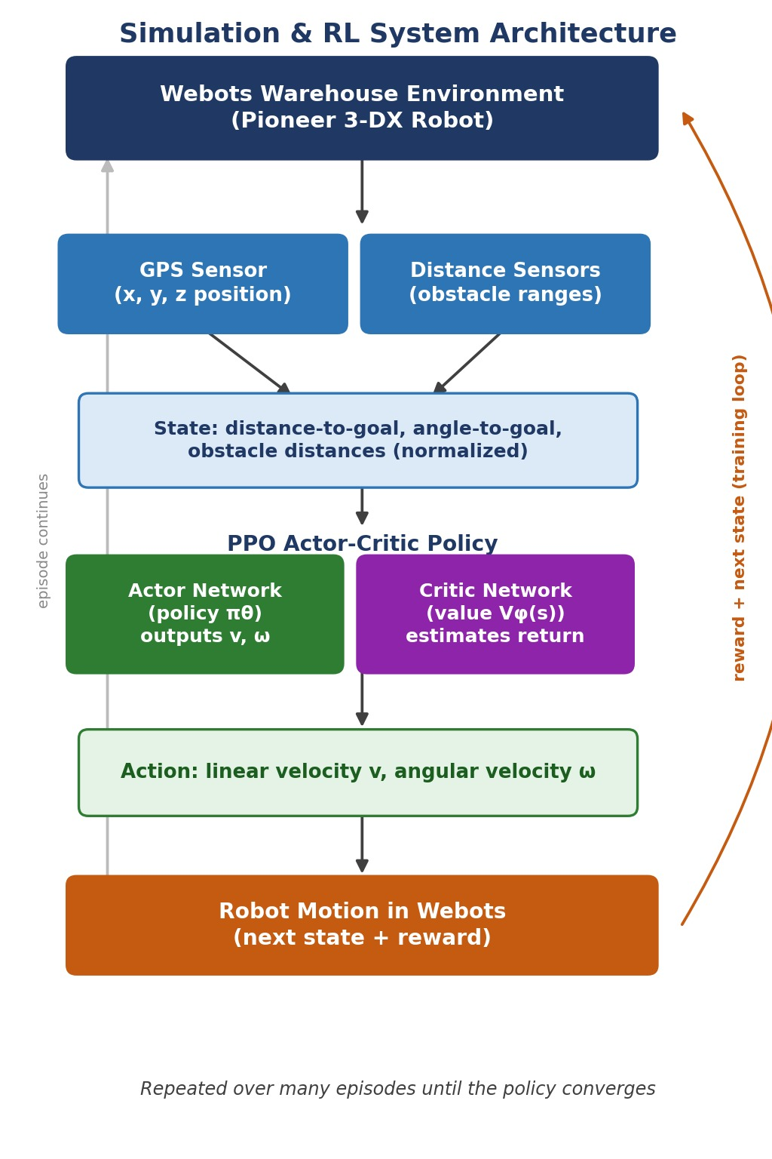
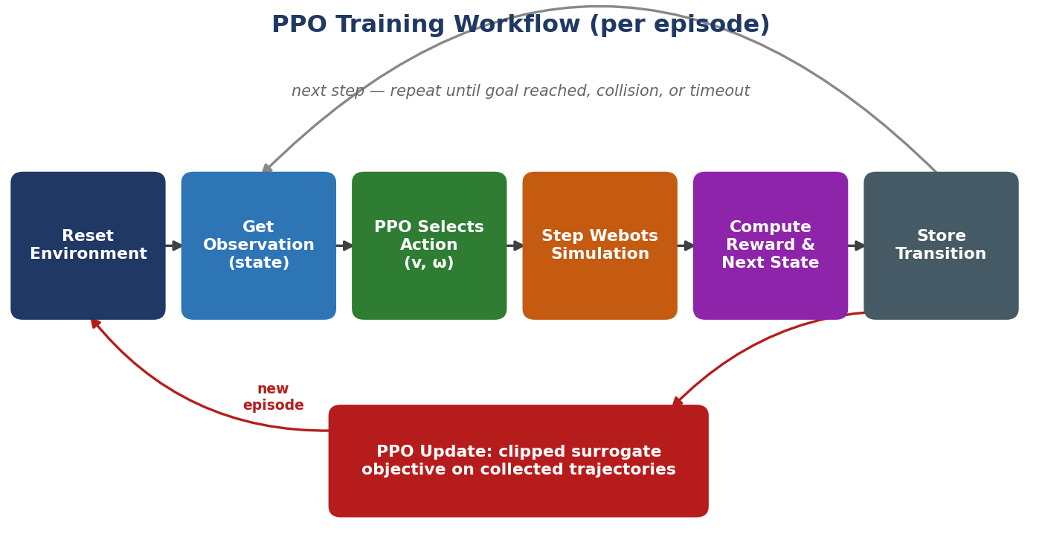
METHODOLOGY
ARCHITECTURE DIAGRAM
TRAINING WORKFLOW DIAGRAM

Slide 8
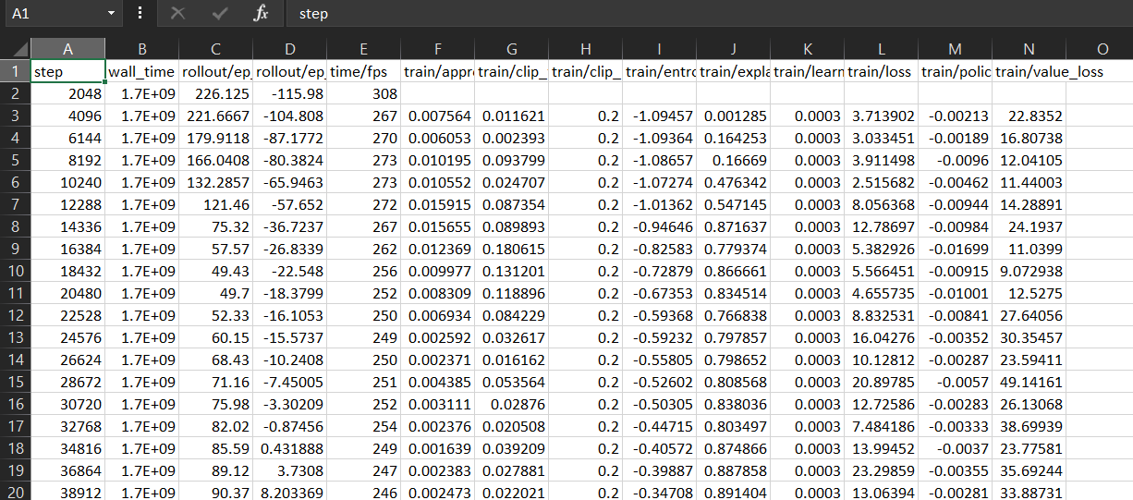
Datasets

Slide 9
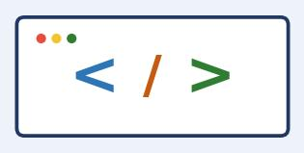




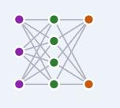
TOOLS USED
3. Python (PyTorch)
2.GPS Sensor
1. Webots Simulator
6.Pioneer 3-DX Robot
4.PPO Algorithm
5. Distance Sensors

Slide 10
Module -1: State & Observation Processing
This module fuses GPS position data and distance sensor readings into the state vector used by the RL agent.
It computes the robot’s distance to goal, angle to goal, and obstacle proximity in every direction.
The raw sensor data is normalized to keep all observation values within a consistent range.
Ensures the policy network receives a clean, informative state at every timestep.
Can adapt to new obstacle layouts without any manual recalibration.
Helps the agent make accurate navigation decisions under uncertainty.
Key Functions:
Fuses GPS and distance sensor data.
Computes distance and angle to goal.
Normalizes all observation values.
Sends the state vector to the PPO policy module.

Slide 11
MODULE 2: PPO Policy (Actor-Critic) Module
This module trains and runs the PPO actor-critic network that outputs motion commands.
It selects linear and angular velocity actions from the current state.
Uses clipped policy updates to keep training stable across episodes.
Works in coordination with the State Observation Module to continuously refine navigation decisions. Key Functions:
Runs actor and critic networks.
Selects velocity actions from the state.
Applies PPO clipped surrogate updates.
Maintains a log of training episodes and rewards.

Slide 12
MODULE -3:Reward & Environment
Reward & Environment Module
This module is responsible for computing the reward signal and stepping the Webots simulation.
Executes the chosen linear and angular velocity commands on the robot each timestep.
Ensures accurate reward shaping based on goal progress, collisions, and time penalties.
Applies proximity and collision penalties to encourage safe navigation.
Can handle episode termination on goal reach, collision, or timeout.
Key Functions:
Computes step-wise goal-progress reward.
Applies collision and proximity penalties.
Ends the episode and resets the environment.
.

Slide 13
MODULE-4: Training Monitoring
Tracks episode reward and success rate throughout training.
Allows visual inspection of the robot moving in the Webots 3D environment.
Stores training metrics and logs for later review and analysis.
Enables remote monitoring of training progress via plots.
Works with the PPO agent to diagnose and tune reward weights.
Key Features:
Real-time episode reward plotting.
Visualization of robot trajectories.
Success-rate and distance-to-goal tracking.
Alerts for training instability or stagnation.
Integration with PPO for adaptive hyperparameter tuning.

Slide 14
RESULTS
The PPO-trained navigation policy was successfully implemented and tested under different warehouse layouts.
The robot accurately navigated from varying start positions to the goal zone.
Navigation occurred autonomously in real time without human intervention.
Distance sensor fusion ensured reliable obstacle avoidance, preventing most collisions.
Training logs recorded episode reward and success rate, confirming steady policy improvement.
The policy adapted to new obstacle placements, generalizing without retraining.
The reward tracking module logged collisions and near-misses, helping detect unstable episodes.
Overall, the system improved navigation reliability and removed the need for hand-coded path planning.
Training data was recorded and analysed for insights into robot behaviour and performance.

Slide 15
IEEE STANDARDS
1. Robotics & Automation Standards
IEEE 1873-2015 – Robot Map Data Representation for Navigation.
2. Autonomous Systems Ontology Standards
IEEE 1872-2015 – Standard Ontologies for Robotics and Automation (CORA).
IEEE 1872.2-2021 – Standard for Autonomous Robotics (AuR) Ontology.
3. Safety Standards
IEEE 7009-2024 – Fail-Safe Design of Autonomous and Semi-Autonomous Systems.

Slide 16
SDG CONTRIBUTION
The project demonstrates safe, adaptive, learning-based navigation for warehouse robots, reducing manual intervention and improving delivery efficiency.
SDG 8 – Decent Work and Economic Growth By automating repetitive warehouse navigation tasks, the system supports safer, more productive logistics workplaces.
SDG 9 – Industry, Innovation, and Infrastructure The RL-based navigation system integrates AI and robotics, fostering innovation in autonomous logistics and smart warehouse infrastructure.
SDG 12 – Responsible Consumption and Production The learned policy minimizes wasted motion and energy by taking efficient, direct paths to delivery points, promoting responsible resource use.

Slide 17
CONCLUSION
Demonstrates reliable, autonomous navigation for a simulated warehouse delivery robot.
Reduces collisions through learned obstacle avoidance using GPS and distance sensors.
Minimizes travel time and energy through efficient PPO-learned paths.
Demonstrates the use of deep reinforcement learning for adaptive robot control.
Generalizes to new start positions and layouts without retraining.
Combines simulation, AI, and robotics into a scalable proof-of-concept for real-world delivery robots.

Slide 18
REFERENCES
Schulman, J., Wolski, F., Dhariwal, P., Radford, A., & Klimov, O. (2023). Proximal Policy Optimization Algorithms — The original paper introducing the PPO algorithm with a clipped surrogate objective for stable policy updates.
IBM Think (2024). Proximal Policy Optimization — overview of PPO’s actor-critic design and use for continuous robot control.
Amrita Vishwa Vidyapeetham (2023). Autonomous Navigation of an AMR Using Deep Reinforcement Learning in Warehouse Environment — motivates RL-based navigation for warehouse robots.

Slide 19


