Slide 1



TECHNICAL PRESENTATION · QUESTION 5
Operating System Functions and System Calls
How a modern OS manages process scheduling, memory allocation and I/O operations
SIMATS Engineering | CSA04 Operating Systems | CO1
Presented by: Name / Reg No
Notes:
Introduce the topic: this deck answers Question 5 - key OS functions, how components interact, and system call examples for each function.

Slide 2

The Problem: Sharing One Machine
THE SCENARIO
Many processes, one CPU
Process scheduling decides who runs, for how long and in what order.
A modern computer runs dozens of programs at once, on one CPU, limited RAM and shared devices.
Limited main memory
Memory allocation gives each process space and keeps them isolated.
Who decides who gets what, and when? The operating system.
Slow, varied devices
I/O operations coordinate disks, keyboards and network cards efficiently.
CSA04 Operating Systems | CO1 | Question 5
2
Notes:
Frame the problem: many programs compete for limited hardware. The OS is the resource manager that resolves this.

Slide 3


Key OS Functions and Why They Matter
Process management
Memory management
I/O management
Creates, schedules and ends processes so the CPU is never idle.
Allocates and reclaims RAM and keeps processes isolated.
Controls devices through drivers, buffers and interrupts.
File management
Protection & security
Together, they make one machine behave like many safe, independent ones.
Organizes data into files and directories with access rights.
Enforces user/kernel mode and permissions.
CSA04 Operating Systems | CO1 | Question 5
3
Notes:
Five core functions. Each protects efficiency, fairness or safety. The dark card summarises the idea of resource virtualisation.

Slide 4
Process Scheduling
PROCESS STATES
New
admit
Ready
dispatch
Running
exit
Terminated
I/O complete
I/O request
Waiting
SCHEDULING ALGORITHMS
FCFS
SJF
Round Robin
Priority
Runs in arrival order. Simple, but short jobs may wait behind long ones.
Shortest burst first. Lowest average waiting time; needs burst estimates.
Each process gets a time quantum. Fair and good for interactive use.
Highest priority first. Aging prevents starvation of low-priority tasks.
CSA04 Operating Systems | CO1 | Question 5
4
Notes:
A process moves between states. The scheduler picks from the Ready queue using an algorithm. Round Robin is the usual choice for time-sharing.

Slide 5
Memory Allocation
Logical pages
Page table
Physical frames
Allocation techniques
Page 0
P0 → F5
Frame 5
Contiguous: first-fit, best-fit, worst-fit
Paging: fixed-size pages map to frames, no external fragmentation
Segmentation: logical units such as code, stack, heap
Virtual memory: demand paging and replacement (FIFO, LRU) let programs exceed RAM
Page 1
P1 → F2
Frame 2
Page 2
P2 → F7
Frame 7
Page 3
P3 → F0
Frame 0
Illustrative mapping: the OS hides the physical layout from each process.
CSA04 Operating Systems | CO1 | Question 5
5
Notes:
Paging maps fixed-size pages to physical frames through the page table. Virtual memory uses demand paging and page replacement so programs can be larger than RAM.

Slide 6
I/O Management
User application (read / write)
Buffering
Spooling
Temporary memory area that smooths speed differences between device and CPU.
Queues jobs such as print requests so a slow device never blocks a process.
I/O subsystem (buffering, caching, spooling)
Device driver (device-specific commands)
Interrupts
DMA
Controller and interrupt handler
Devices signal completion, so the CPU does useful work instead of polling.
Controller moves data to memory directly, freeing the CPU for other tasks.
Hardware (disk, keyboard, network card)
CSA04 Operating Systems | CO1 | Question 5
6
Notes:
A request travels down the layered I/O stack to the hardware. The four techniques on the right keep the CPU busy while slow devices work.

Slide 7
How OS Components Interact
User applications
Example: saving a file
System call interface (the gateway into the kernel)
App calls write() and traps into the kernel
File system finds the disk blocks
Memory manager supplies a buffer
Driver starts the transfer; scheduler runs another process
Interrupt arrives; process is Ready again
Process manager
Memory manager
File system
I/O manager + drivers
Hardware: CPU | RAM | Disk | Devices
CSA04 Operating Systems | CO1 | Question 5
7
Notes:
Components never work alone. One write() call touches the file system, memory manager, I/O manager and scheduler before returning.

Slide 8
System Calls for Each Function
OS function | What the call does | Linux / POSIX | Windows API
Process control | Create, run, wait for and end processes | fork(), exec(), wait(), exit() | CreateProcess(), ExitProcess()
Memory management | Allocate and release memory | brk(), mmap(), munmap() | VirtualAlloc(), VirtualFree()
File management | Create, read, write and close files | open(), read(), write(), close() | CreateFile(), ReadFile()
Device management | Request and control devices | ioctl(), read(), write() | DeviceIoControl()
Information | Get or set system and process data | getpid(), gettimeofday() | GetCurrentProcessId()
Communication | Exchange data between processes | pipe(), socket(), shmget() | CreatePipe()
Protection | Control access permissions | chmod(), chown() | SetFileSecurity()
CSA04 Operating Systems | CO1 | Question 5
8
Notes:
Every OS function is reached through a system call. Linux examples are the main reference; Windows equivalents are shown for comparison.

Slide 9
Life of a System Call: read()
USER MODE
KERNEL MODE
USER MODE
1
2
3
4
5
Call
Trap
Dispatch
Execute
Return
Program calls read(fd, buf, n) via a library wrapper.
A software interrupt switches the CPU to kernel mode.
Kernel validates arguments and finds the call in the system call table.
File system and driver fetch data from disk and copy it to the buffer.
CPU drops back to user mode; read() returns the byte count.
Why two modes? User programs cannot touch hardware directly, so one faulty process cannot crash or spy on others.
CSA04 Operating Systems | CO1 | Question 5
9
Notes:
Walk through the five steps. The mode switch is what makes system calls the only controlled entry point into the kernel.

Slide 10
Key Takeaways
1
The OS is a resource manager
Process, memory, I/O, file and protection functions share hardware fairly and safely.
2
Components cooperate through the kernel
The scheduler, memory manager and drivers work together on every request.
3
System calls are the controlled gateway
fork(), mmap(), open() and ioctl() let programs use kernel services safely.
Thank you | Questions?
Notes:
Summarise the three takeaways and invite questions.

Slide 11
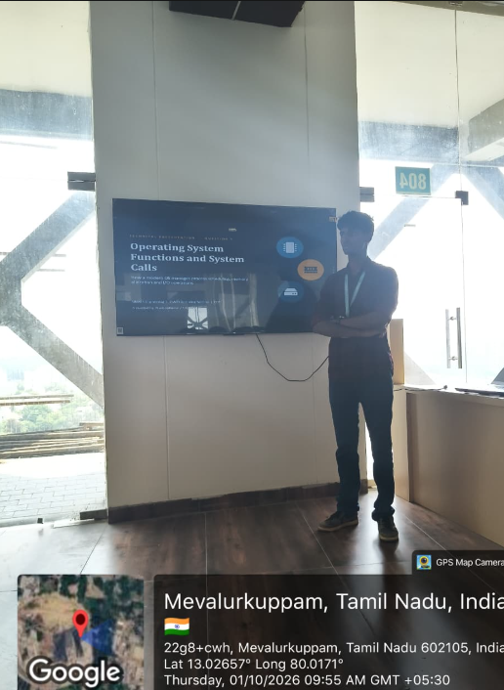
Key Takeaways
The OS is a resource manager
Components cooperate through the kernel
System calls are the controlled gateway
Notes:
Summarise the three takeaways and invite questions.

