Slide 1
EXCEL VBA BUSINESS PROCESS AUTOMATION
FULLY AUTOMATED INVENTORY & BILLING ERP SYSTEM
End-to-End Business Process Automation solution in Microsoft Excel (VBA)
Presented by Pradeep Kumar Kurrey
Advanced Excel & MIS Executive
REAL-TIME INVENTORY · GST INVOICING · REPORTING VBA AUTOMATION · 5,000+ AUDIT RECORDS
Pradeep Kumar Kurrey

Slide 2




01 — SYSTEM FOUNDATION
A Unified Excel Architecture Connecting Stock, Invoicing, and Audits
Eliminates fragmented records by integrating inventory movements, tax billing, and master ledgers into a single ,
tamper-proof Excel VBA environment.
Centralize:
Automate:
Validate:
Audit:
Single-source master sheets for Products, Customers, and Suppliers.
1-Click VBA execution replaces hours of manual calculation.
Active data guards prevent out-of-stock billing and entry errors.
Automated logging of 5,000+ transactions with historical reprint.
FULLY AUTOMATED INVENTORY & BILLING ERP SYSTEM
2
Pradeep Kumar Kurrey

Slide 3
02 — THE OPERATING FRICTION
Manual Spreadsheet Vulnerabilities vs Automated Excel ERP
CHALLENGES
OBJECTIVES
Where work slows down
What the System Delivers
Accidental billing without available inventory
Formula corruption due to manual user tampering
Slow invoice typing and manual tax calculations
Missed reorder dates causing stockouts
Scattered sales records with zero audit trail
Real-time stock deduction on invoice generation
Protected cells and locked automated formula architecture
Instant 1-click GST invoice with VBA NumberToWords
Automated threshold popups with instant supplier details
Centralized Sales Master with 5,000+ permanent rows
The intended value is a more controlled path from stock movement to billing record.
FULLY AUTOMATED INVENTORY & BILLING ERP SYSTEM
3
Pradeep Kumar Kurrey

Slide 4
03 — INFORMATION FLOW
End-to-End Relational Data Pipeline Across 8 connected Modules
Each stage adds structure, control, or context before the information reaches a business review.
01
02
03
Master Database:
Live validation:
1-Click Billing:
Centralized Product, Supplier, and
Customer records.
Dynamic check intercepts stock deficit
before entry.
Auto-fetches prices, computes 18% GST and discounts.
VBA Core Engine:
Ledger Sync:
Master Sales Commit:
Executes multi-sheet updates and generates clean PDF/Print.
Automatically updates Opening, Purchase, and Closing Stock.
Appends transaction row permanently to Sales Master.
Live Implemented Pipeline : 100% verified transactional integrity across all operational sheets.
FULLY AUTOMATED INVENTORY & BILLING ERP SYSTEM
4
Pradeep Kumar Kurrey

Slide 5
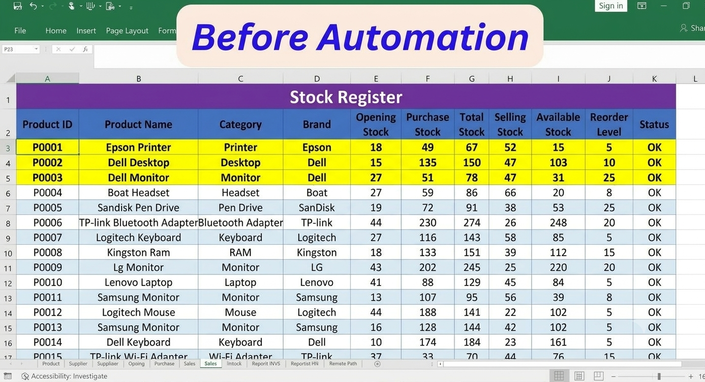
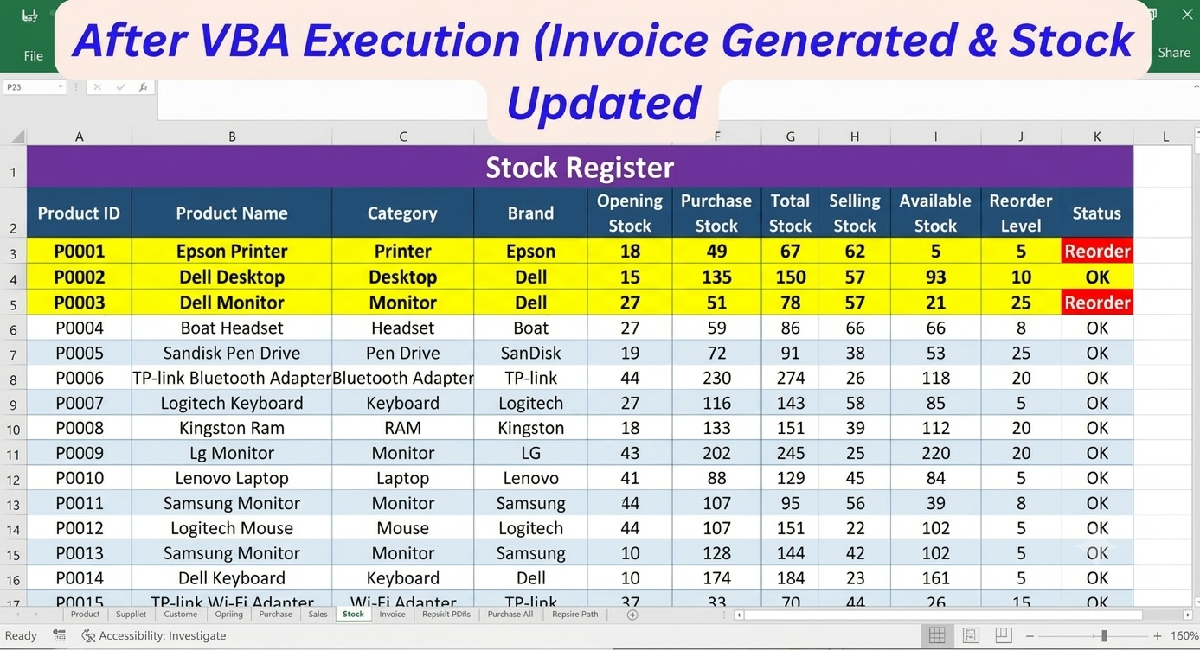
04 — INVENTORY CONTROL
Live Stock Ledger with Automated Reorder Level Triggers
Live Status Highlight:
Automated conditional formatting marks status as “Reorder” (Red) whenever Available Stock falls to or below safety thresholds (e.g. Epson Printer: 5 Pcs, Dell Monitor: 21 Pcs)
Zero Mismatch:
Stock cuts are triggered instantly upon invoice generation.
Ledger Formula:
Closing Stock = Opening Stock + Purchase Stock − Selling Stock
FULLY AUTOMATED INVENTORY & BILLING ERP SYSTEM
5

Slide 6
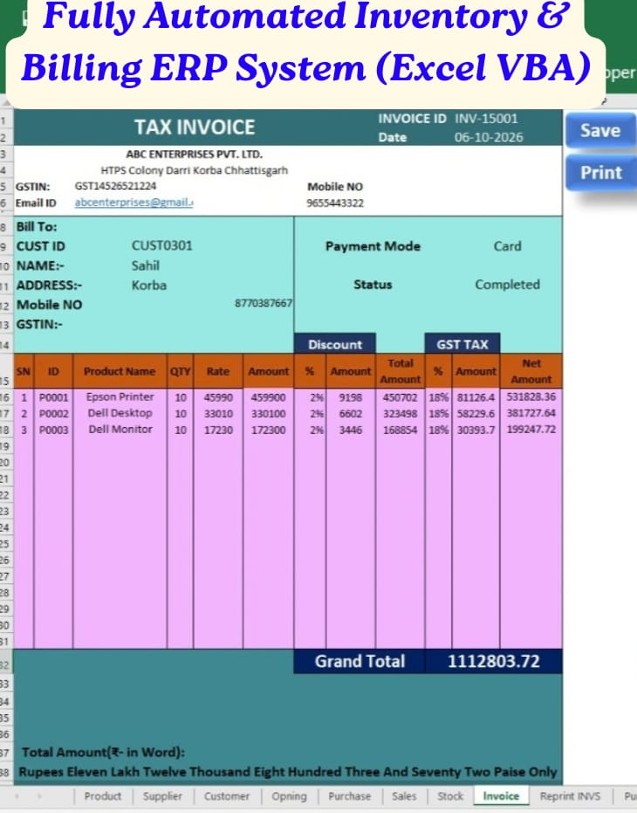
05 — BILLING AUTOMATION
1-Click Tax Invoice Generation with Dynamic Currency Words
CAPTURE: Auto-fetches
Customer (Sahil / CUST0301) and product rates dynamically.
CALCULATE:
Computes line items, discounts (2%), and 18% GST automatically (Grand Total: ₹11,12,803.72).
VBA NUMBER-TO-WORDS:
Built-in custom VBA translates payout into formal words: “Rupees Eleven Lakh Twelve Thousand Eight Hundred Three and Seventy-two Paise Only
1-CLICK ACTION:
Dedicated “Save” and “Print” macro buttons for instant execution.
FULLY AUTOMATED INVENTORY & BILLING ERP SYSTEM
6
Pradeep Kumar Kurrey

Slide 7


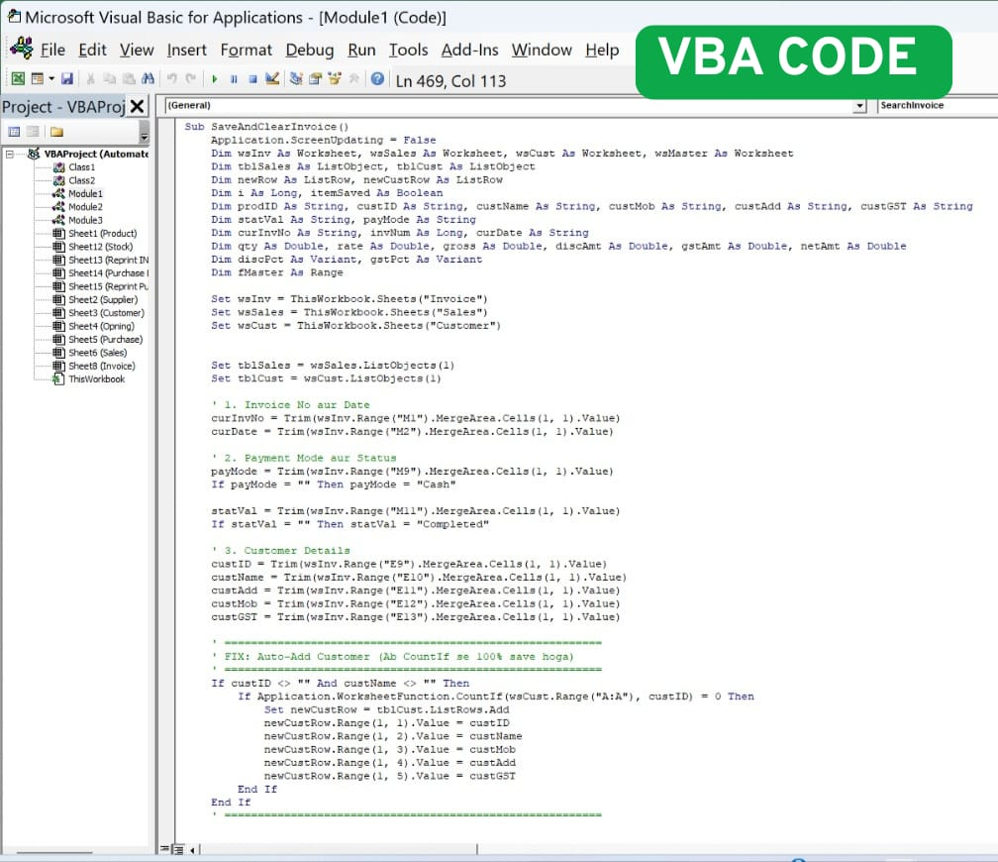



06 — VBA CONTROL PATH
How VBA Macros Bridge User Actions with Protected Ledger Updates
The macro is the bridge between an intentional user action and a visible, reviewable outcome.
Event Trigger (Save Button)
Pre-Execution Validation
User clicks the “Save“ macro
button. VBA initializes
execution and sets Application.
ScreenUpdating=False
for instant processing.
Macro checks live stock available
quantity. If quantity exceeds
stock, execution halts
immediately with an error
prompt
Invoice Engine
Multi-Sheet Database
Generates sequential invoice
ID (INV-15001), computes tax/
discounts, and converts the
grand total into formal Indian
currency words.
Simultaneously deducts Qty from
the Stock Register and appends a
permanent transaction row into
the Sales Master database.
Auto-Reset & Success State
Clears input fields, restores
screen updating and prepares
the workbook instantly for the
next customer entry
FULLY AUTOMATED INVENTORY & BILLING ERP SYSTEM
7

Slide 8
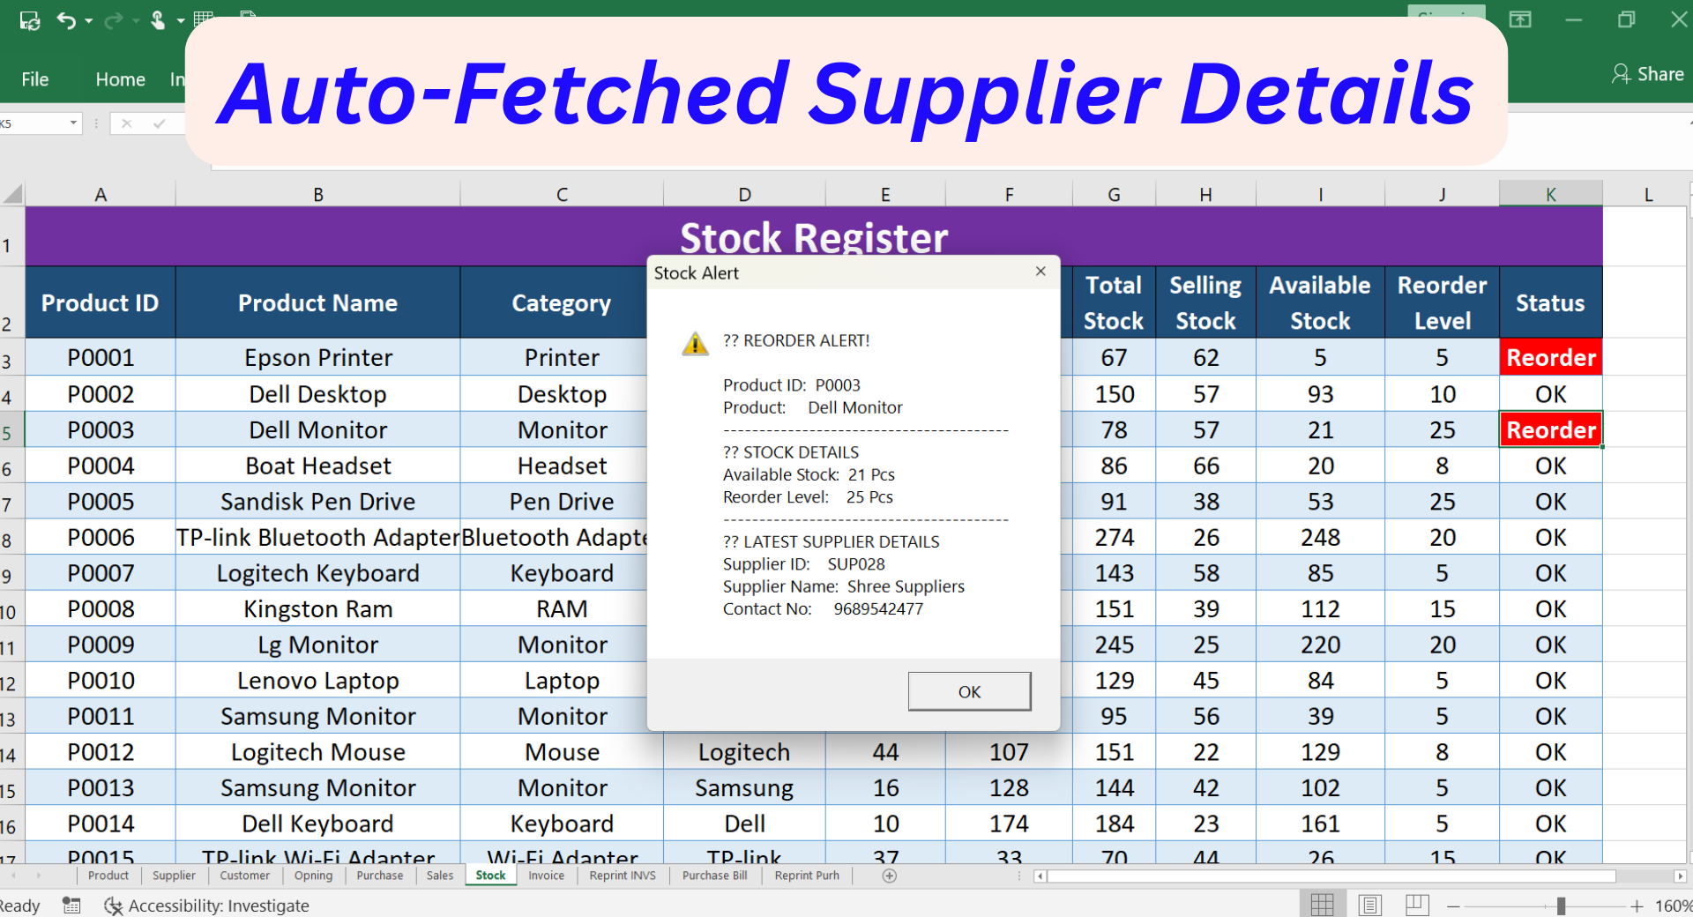




07 — OPERATIONAL REVIEW
Real-Time Inventory tracking Triggers Automated Reorder Alerts & Vendor Fetch
Total Sales
Tracked SKUs
15+ Active IT Hardware
Products
5,000+ Transactions Logged
Stock Accuracy
Active Reorder Alert
100% Real-Time
Mathematical Balance
Triggered for Dell Monitor
(21 Pcs remaining)
“Live reorder alerts auto-fetch supplier details (SUP028 Shree Suppliers) to prevent stockouts.”
FULLY AUTOMATED INVENTORY & BILLING ERP SYSTEM
8
Pradeep Kumar Kurrey

Slide 9
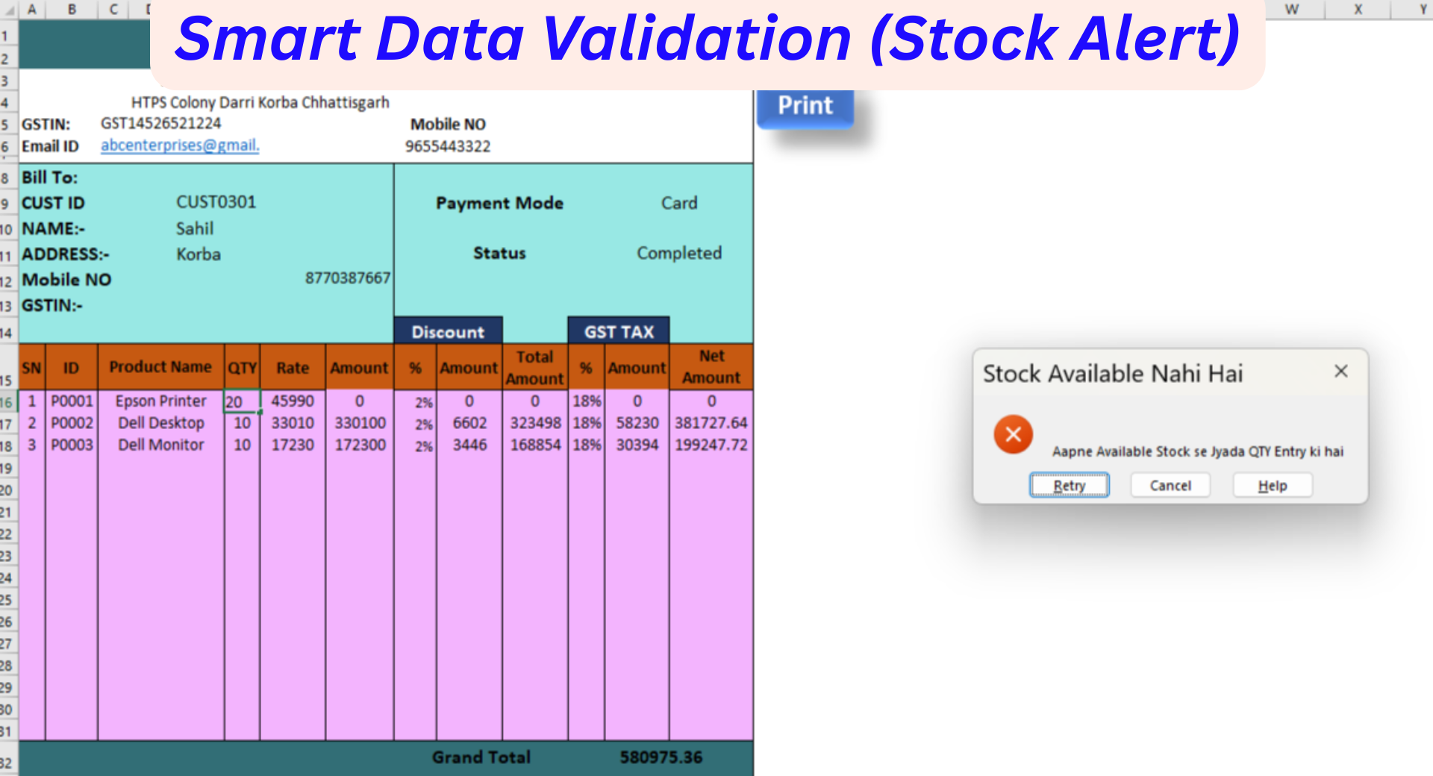




08 — VALIDATION CONTROLS
Active Safeguards Protecting Ledger and Calculation Quality
Over-Order Blocker
Input Validation
Blocks order processing if entered Qty exceeds Available Stock with an instant retry dialog.
Restricts numeric fields (Rates, Tax %, Quantities) against invalid text entries.
ACTIVE SYSTEM CONTROL
ACTIVE SYSTEM CONTROL
ID & Master Integrity
Formula Protection
Dynamic lookup validates Customer ID and Product Code before line-item calculation.
Critical calculation cells locked against accidental manual deletion or formula disruption.
ACTIVE SYSTEM CONTROL
ACTIVE SYSTEM CONTROL
9
FULLY AUTOMATED INVENTORY & BILLING ERP SYSTEM
Pradeep Kumar Kurrey

Slide 10
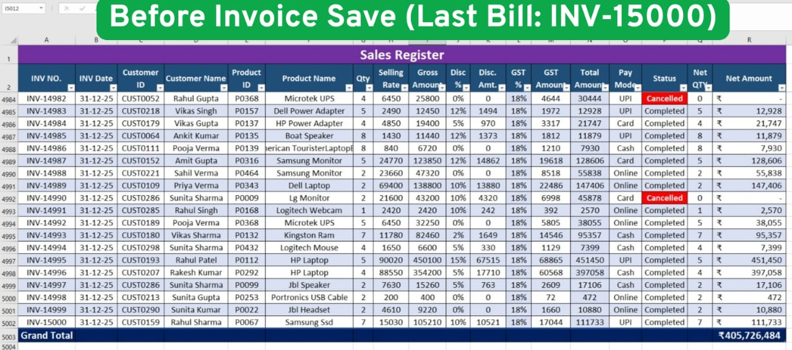
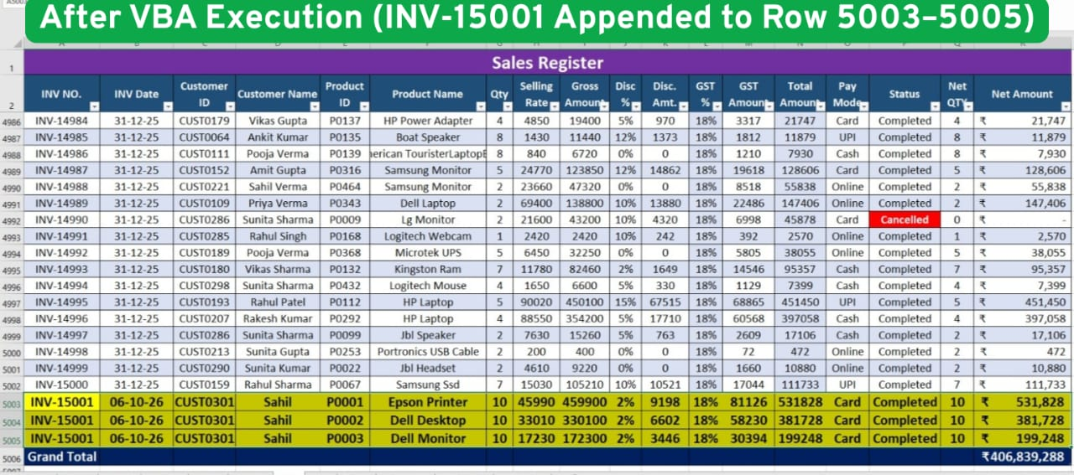
09 — LIVE DEMONSTRATION & AUDIT TRAIL
High-Volume Transaction Engine Supporting 5,000+ Historical Rows
VERIFIED SYSTEM CAPABILITIES
Audit Status :
Zero record duplication.
Instant invoice reprint by Bill No.
₹0 recurring third-party software license.
Baseline State: Sales Master loaded with 5,000 historical transactions up to INV-15000 (Total: ₹405,726,484)
Invoice Trigger: Clicked “Save” macro on invoice INV-15001 for Customer Sahil.
Automated Commit: VBA instantly appended 3 line items into rows 5003,5004,5005.
Instant Math Parity: Grand Total automatically recalculated to ₹406,839,288 (+ ₹1,112,804)
Audit Trail Integrity : Permanent row entry secured with zero duplicate invoice numbers.
FULLY AUTOMATED INVENTORY & BILLING ERP SYSTEM

Slide 11
10 — PROJECT SUMMARY & KEY LEARNINGS
Project Overview, Key Features & Learning Outcomes
PROJECT OVERVIEW
KEY FUNCTIONALITIES
An Excel VBA-based Inventory & Billing ERP System designed to integrate billing , inventory management, stock validation, and sales record maintenance
Automated invoice generation with Save and Print buttons
Automatic stock updates after invoice generation
Low-stock alerts with supplier details
Sales register maintenance and transaction logging
Input validation and protection against over-ordering
Automated amount-to-words conversion
TECHNOLOGY STACK
KEY LEARNING OUTCOMES
Microsoft Excel | VBA Macros | Data Validation | Inventory Management | Business Process Automation
Excel VBA automation and macro development
Multi-sheet data integration
Inventory calculations and validation controls
Invoice processing and sales reporting
FULLY AUTOMATED INVENTORY & BILLING ERP SYSTEM
Pradeep Kumar Kurrey

