Slide 1

CalTalk !
(Voice Command Based Calculator)
Group No.18
Under The Supervision of:-
Mr. Mohd Aamir Khan
(Research Scholar)
Department of CEA
GLA University, Mathura
Presented By:-
Payal Goyal (174200101)
Pradeep Raghav (174200103)
Pradum Kumar (174200104)
Pragati Dubey (174200105)
Prashant Agnihotri (174200108)

Slide 2
Content
Introduction
Problem Statement
Objective
Purpose
Project Scope
Data Flow Diagram
Screenshots
Conclusion
References

Slide 3
Introduction
CalTAlk is based on the voice command Desktop Application which can perform several kind of operations like arithmetic calculations, scientific calculations and conversions etc. more easily.
CalTAlk is more beneficial for students as well as for people who are related with the educational field and it can be used quickly and efficiently for typical operational problems.
CalTAlk is a time saving application in which input can be given by speaking .
This application is implemented on the desktop without any additional hardware requirement.

Slide 4
Problem Statement
This application not only performs mathematical operations but also perform other operations like scientific calculations, unit conversion, currency conversion etc.
Input is easily taken by voice from user which takes less efforts than typing on keyboard.

Slide 5
Objective
Able to take input by voice.
Provide a fast method of input instead of typing.
Useful for people with physical disabilities like handicapped.
Focus on fast calculation i.e. save the time.

Slide 6
Purpose
Easy and time saving.
Occupy less memory space instead of installing different applications for different purpose.
Performs several tasks in a single application.
Takes input by the voice as well as from keyboard.

Slide 7
Project Scope
Easy
Time saving
Intelligent
In-expensive

Slide 8
Data Flow Diagram
LEVEL-0
Choosing Option Voice Based or Keyboard Based
Giving input through Voice
Giving input through Keyboard
CalTalk !
Process
User
Data Invalid Message (if entry is invalid)
Output on Display
Output in Voice

Slide 9
DFD LEVEL -1
Filtration for Valid Data
0.3
Data as Text
Speech to Text
conversion
0.2
(If valid Data)
Data As Speech
Evaluable Expression
(if Invalid Data)
Speech
Recognition
Input By Voice
0.1
User
0.4
Message of Invalid Input to User
Evaluation
System
Input by Keyboard
0.5
Result
Text to Speech
Result as Voice
Resulting Data as text
Result as Text

Slide 10
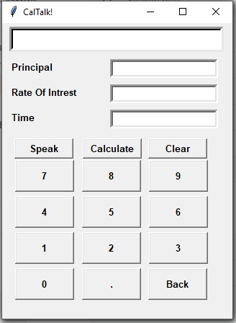
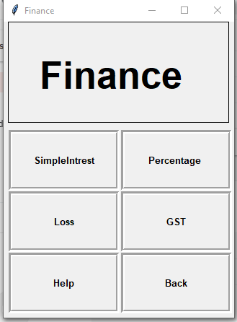
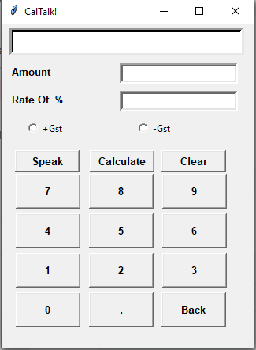
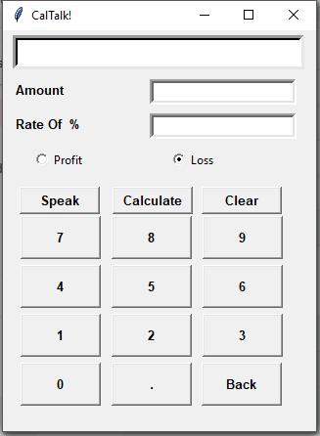
Some Screenshots

Slide 11
Conclusion
Reduces human efforts.
Steps ahead in technology.
Reduces paper work.
Reduces time.

Slide 12
References

Slide 13
THANK YOU!!!

