Slide 1






What is NodeJS Why NodeJS
www.wscubetech.com

Slide 2
NodeJS
Operator.
Node.js is a back-end JavaScript runtime environment.
Node.js runs on the V8 JavaScript Engine and executes JavaScript code outside a web browser.
V8 JavaScript engine.
V8 is Google's open source high-performance JavaScript and WebAssembly engine
www.wscubetech.com

Slide 3
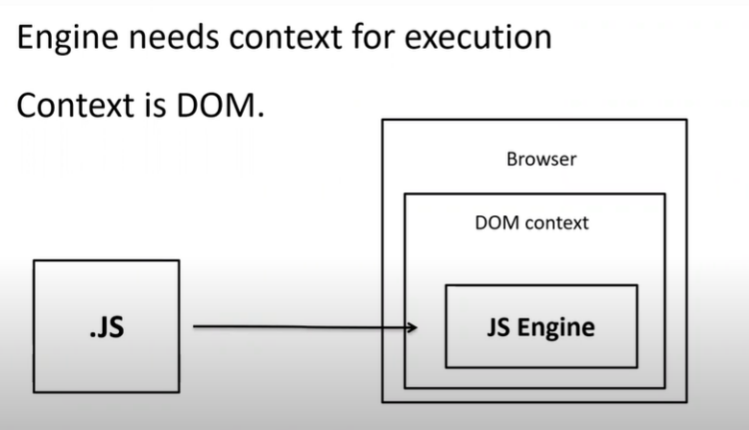
Working of JavaScript
V8 JavaScript engine.
V8 JavaScript engine.
www.wscubetech.com

Slide 4
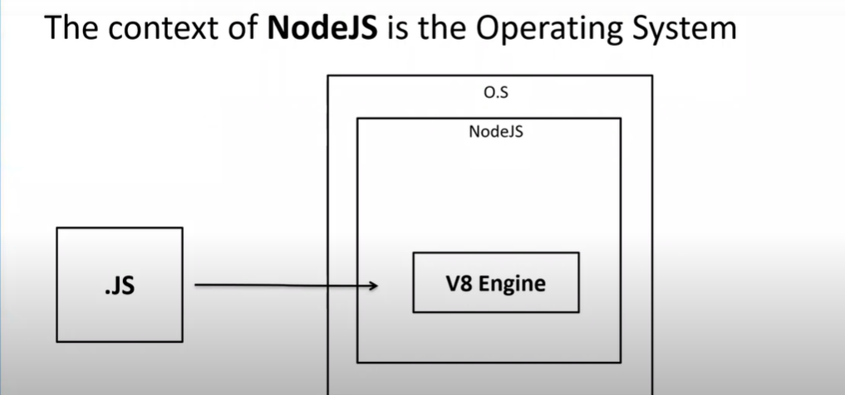
Context of Node JS
V8 JavaScript engine.
www.wscubetech.com

Slide 5
Node JS
V8 JavaScript engine.
Package
Manger [NPM]
React JS (Run & Build)
www.wscubetech.com

Slide 6
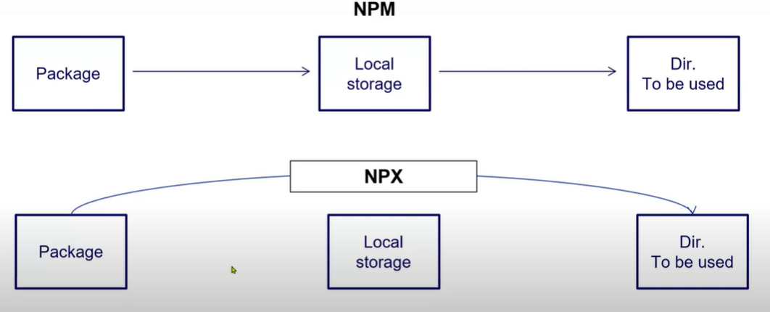
NPM VS NPX
V8 JavaScript engine.
www.wscubetech.com

Slide 7



@wscube
@wscubetech.india
www.wscubetech.com
Subscribe To Get Notified about New Videos

