Slide 1
Cairn plc
Summary of media engagement
2015-2021

Slide 2
Contents
Summary, by year
Summary, by month/year
Top publications
Ten top authors
Agency and opinion articles
Teminology & explanations

Slide 3
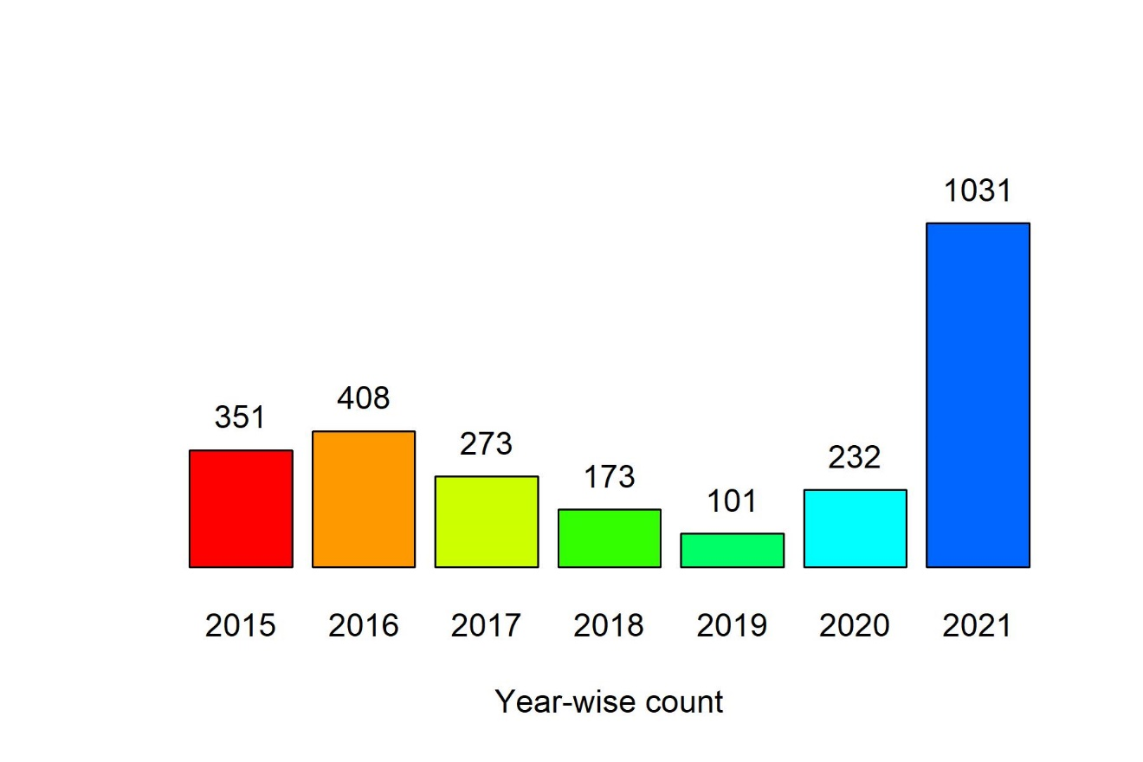
Summary, by year

Slide 4
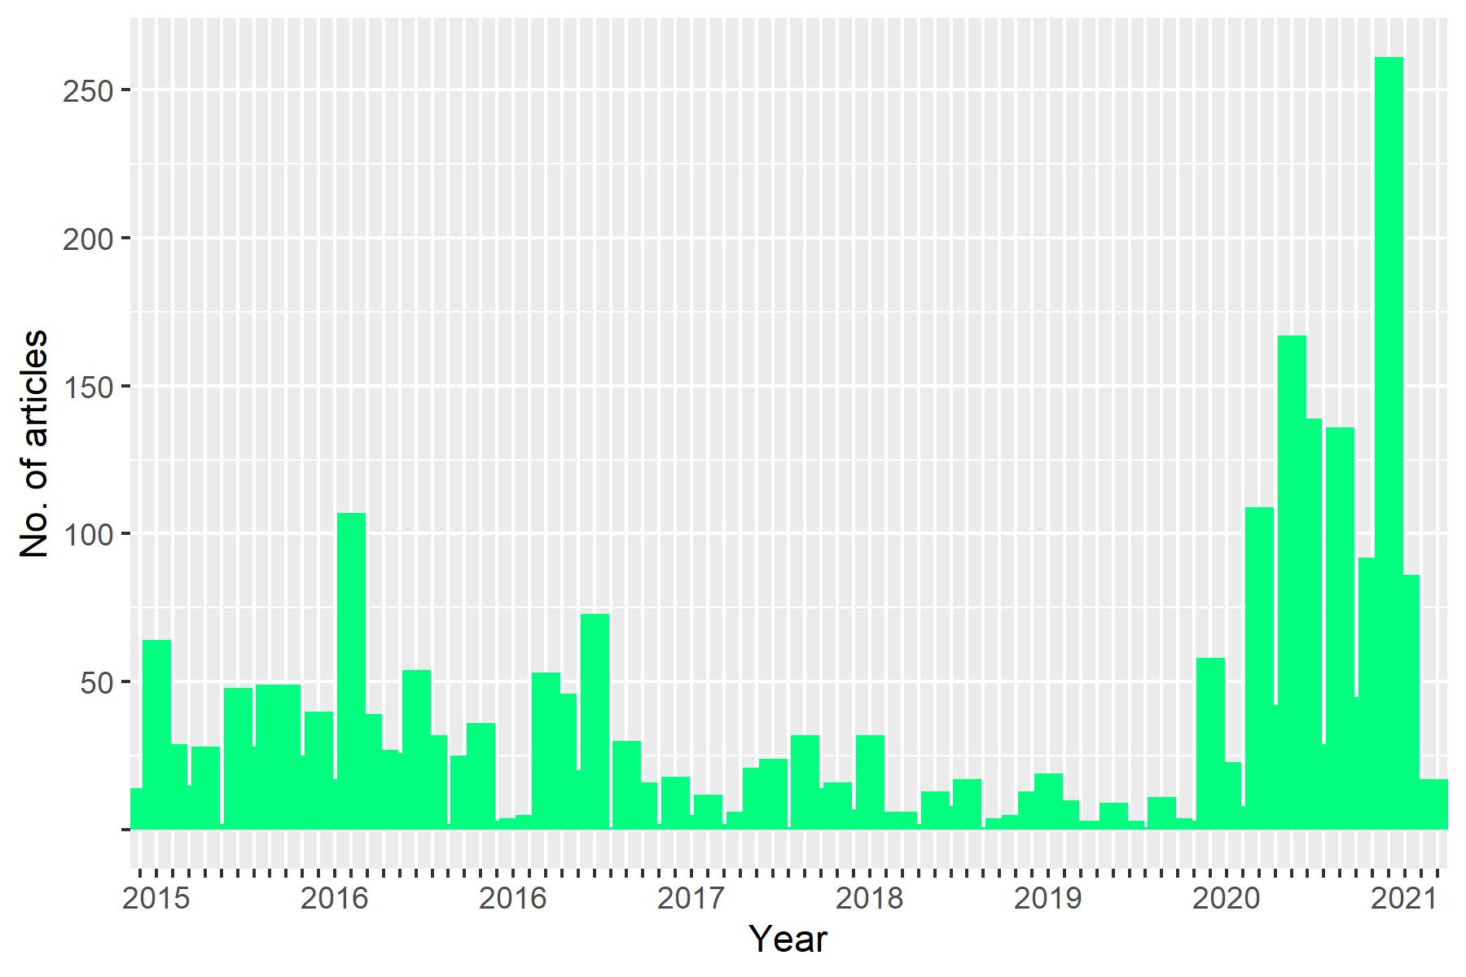
Summary, by month/year

Slide 5
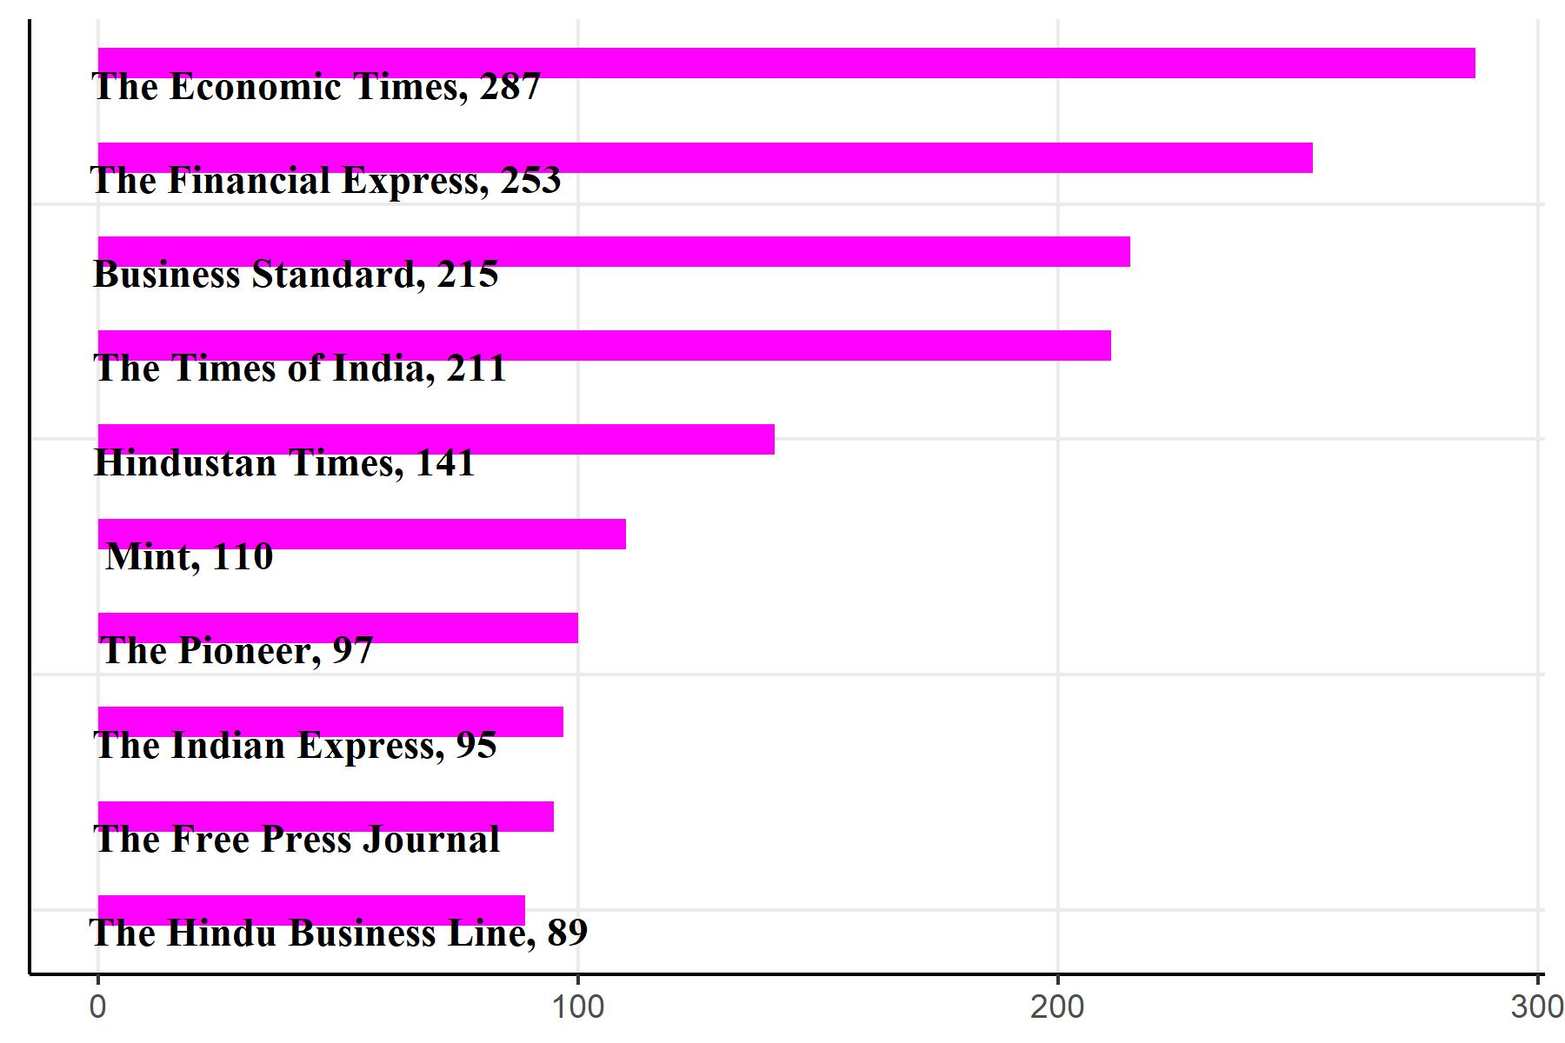
Summary, top ten publications

Slide 6
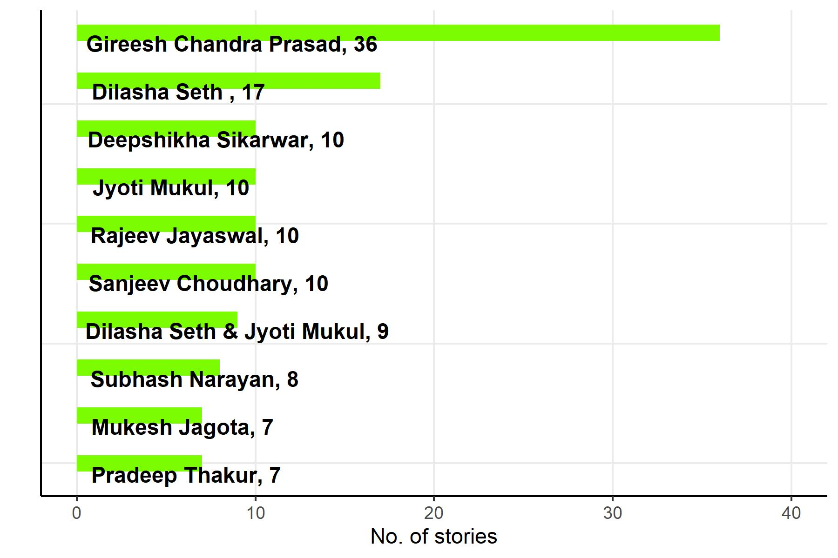

Summary, top ten authors

Slide 7
Opinion articles
Signed opinion pieces: 71
Editorials: 106
Agency coverage:
Bloomberg 14
IANS 2
PTI 681
Reuters 26

Slide 8
Terminology
This mandate started Sep 01, 2015
Archival data is available from Feb 2015
Analysis presented here covers only English media outlets
The by_author tab captures by-lined stories
The by_publication tab captures all the stories (signed and unsigned)
Raw data is attached.
Jpeg files, with 300 dpi resolutions, are also attached.

