Slide 1

Master
Dissertation
Blockchain-based Vaccination Passport using Self-Sovereign Identity with Hyperledger Technology
SIT723 – Presentation
By: Pradeep Ranasinghe
Notes:
https://unsplash.com/photos/2JDDn7iSGH8

Slide 2
Motivation
Covid-19 hit the world by surprise and disrupted our normal way of life. It has badly impacted the world economy and many businesses have disappeared forever.
My main objective of this research is to propose a Blockchain based vaccination passport architecture, that will be utilised globally to safely get us back to our normal way of life and rebuild our economy.
Key points:
a) Learn Blockchan Technology
b) Apply Blockchain Technology to solve realworld problems specially around heatlthcare.
Data Tampering,
Data Breaches
Privacy
Identity Theft

Slide 3
Research Gaps
In Blockchain-based Vaccination Passport systems?
I.
Not fit for purpose
Ethereum Based
Require Platforms Development
Complexity
Ethereum Based
Developed in Isolation
Lack of standards
Block size limit
Smart Contracts
Gas costs
Authentication
Authorizations
development of passport verification on top of a public blockchain
Implement Auth, Verifications, Not much out of the box
Require additional tech stacks
Eg: IPFS

Slide 4
Achievements
Hyperledger Indy Permissioned blockchain
Agent to Agent communication without hampering on the Ledger
Schema and Credential Definition for issuing a vaccination passport using Hyperledger Aries
Fit for purpose 4 layered cost-effective architecture for implementing a vaccination passport

Slide 5
Research Findings
High level summary of research findings
Hyperledger Permissioned blockchain Indy and Aries. Its a fit for purpose 4 layered architecture for implementing a vaccination passport on the blockchain that can be used in a global context in a cost-effective way.
Validated Model
Found the Hyperledger Permissioned blockchain Indy and Aries. Its a fit for purpose 4 layered architecture for implementing a vaccination passport on the blockchain that can be used in a global context in a cost-effective way. Additional benefits Privacy by Design, and Distributed Identities using SSI, Peer to Peer communications.
This helps organisations focus on the business development rather than platform development. Eg: where to store files, key management, authentication and authorization, point to point secure communication to exchange secure content without a 3rd Party.
Architecture
Sequence Diagram
Public vs Permissioned Blockchain
Key actors Issuer, Holder, and Verifier workflows and use cases.
Logical Design
4 Layers of the design. Public ledger, Agent to Agent, Governance Layer
Comparison Table
Secondary data collected to compare the validity of the research.

Slide 6
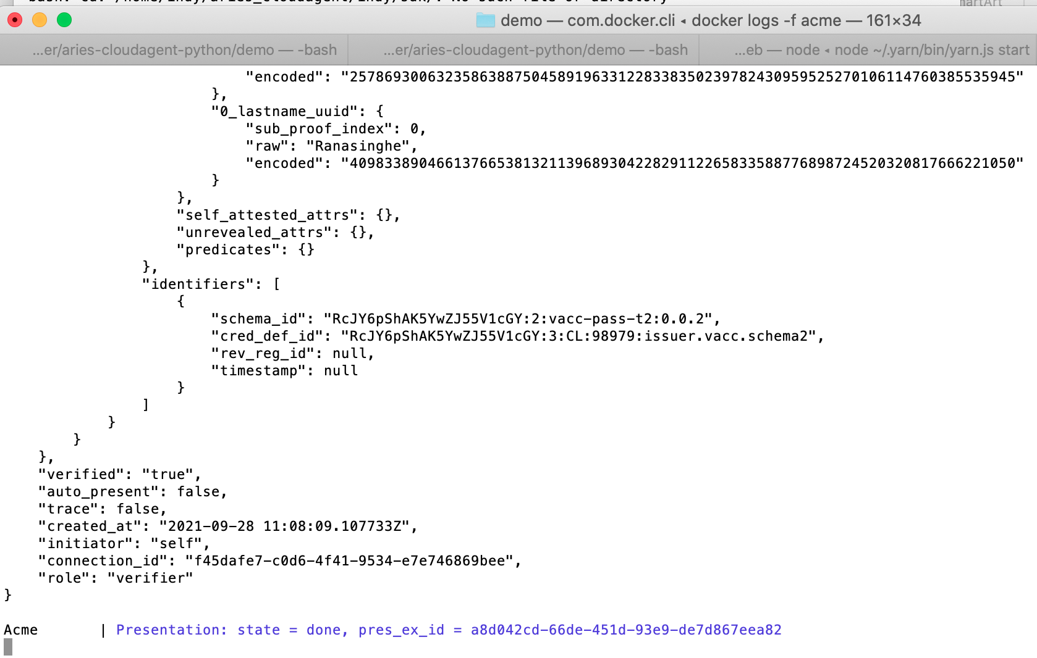
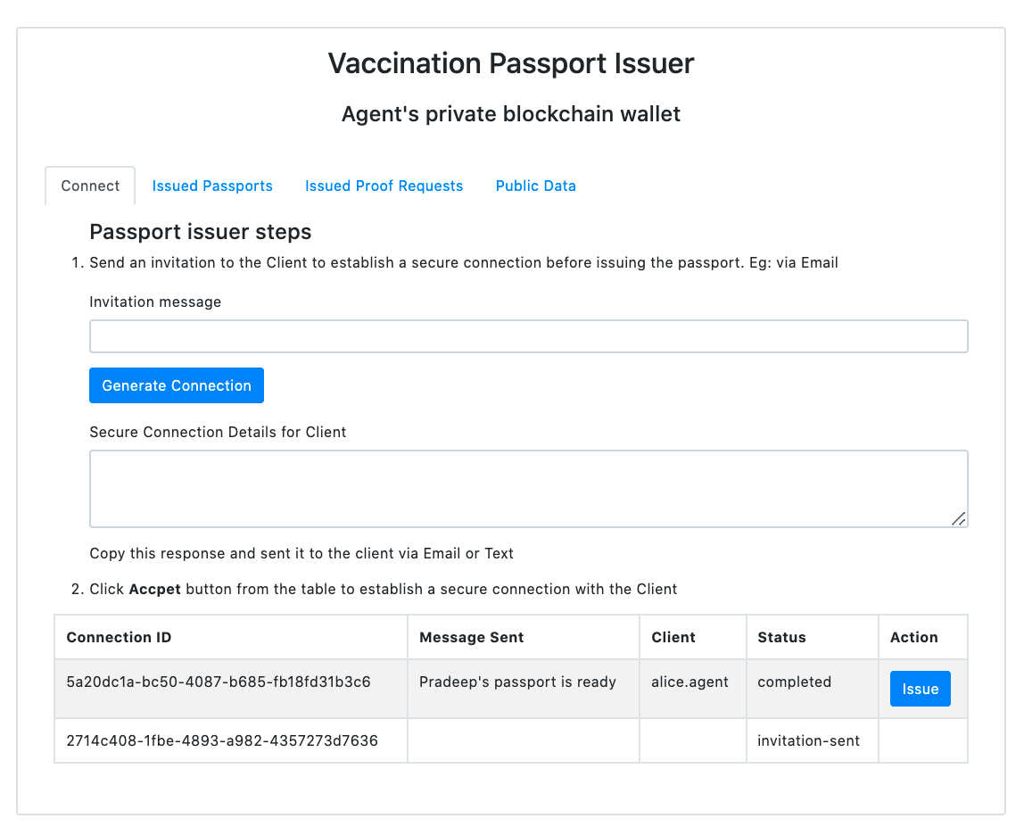
Artifact walkthrough & Results
Demo of the Artifacts developed on Blockchain based vaccination passport using Hyperledger and SSI
Result #01
01
Leveraged Hyperledger Indy a Public Blockchain hosted as Green Dev Ledger by BC Government. Bootstrapped
Issuer, Holder, and Verifier DIDs in the ledger.
Result #02
02
Spun up 3 Python based Hyperledger Aries agent Wallets which provide API access to Ledger and other agents.
Result #03
03
Developed a Demo Web App with different logins to showcase the vaccination passport workflows.
Result #04
04
Defined the Vaccination passport Schema and Credential definitions.
Note: Link to Github screen cast demo: https://github.com/pradeepranasinghe/SIT723/demo.mp4

Slide 7
Future work
Mobile QR Code App
Vaccination Passport Schema
QR code app for Key exchanges.
Standardise vaccination passport schema in a global context.
Blockchain Interoperability
Re-sync Wallet & Ledgers
We cannot force every organisation to use Hyperledger technology. Therefore, we should further research on this.
It appears that agent wallets and the ledger gets out of sync. Need some development in this area.

Slide 8
Thank you, Dr. Sasan
Thank you, Dr. Jinghu/Chetan
Thank you, Library staff!
Thank you, Deakin!
Notes:
You can safely remove this slide. This slide design was provided by SlideModel.com – You can download more templates, shapes and elements for PowerPoint from http://slidemodel.com

