Slide 1

FIFA World Cup Match Analysis Dashboard
Pradeep Reddy Thummala
Master's in Data Science
University of Europe for Applied Sciences
Data Visualization Project

Slide 2
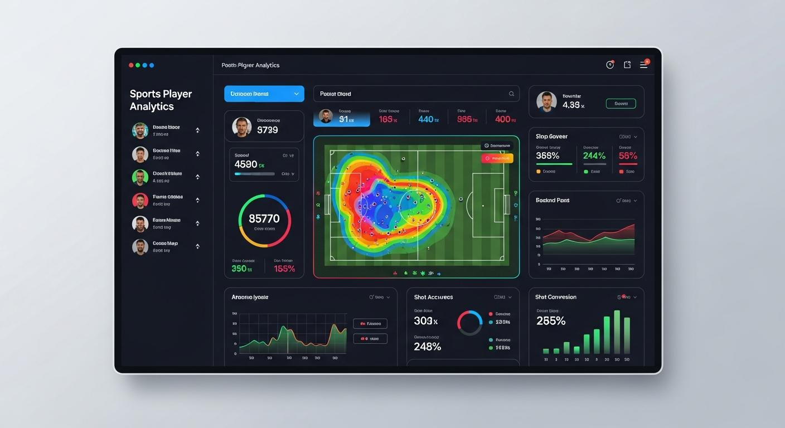
Project Overview
• Analyze FIFA World Cup men's matches (1970–2022)
• Build an interactive Streamlit dashboard
• Perform exploratory data analysis (EDA)
• Visualize key match statistics using Plotly

Slide 3

Dataset & EDA
• Dataset: FIFA World Cup Men's Match Dataset (1970–2022)
• Cleaned missing values and inspected data quality
• Created 'Total Goals' feature
• Applied interactive team filter

Slide 4
Questions 1–3
1. Top Teams by Win Percentage
2. Average Goals by Tournament
3. Possession vs Goals Scored

Slide 5
Questions 4–6
4. Goals Distribution by Stage
5. Top Teams by Average Shots on Target
6. Top Teams by Average Yellow Cards

Slide 6
Questions 7–10
7. Highest Scoring Stadiums
8. Corners vs Goals
9. Average Possession by Team
10. Correlation Heatmap

Slide 7
Streamlit Dashboard
• Interactive team filter
• KPI cards
• 10 interactive Plotly visualizations
• Easy exploration of World Cup match statistics

Slide 8
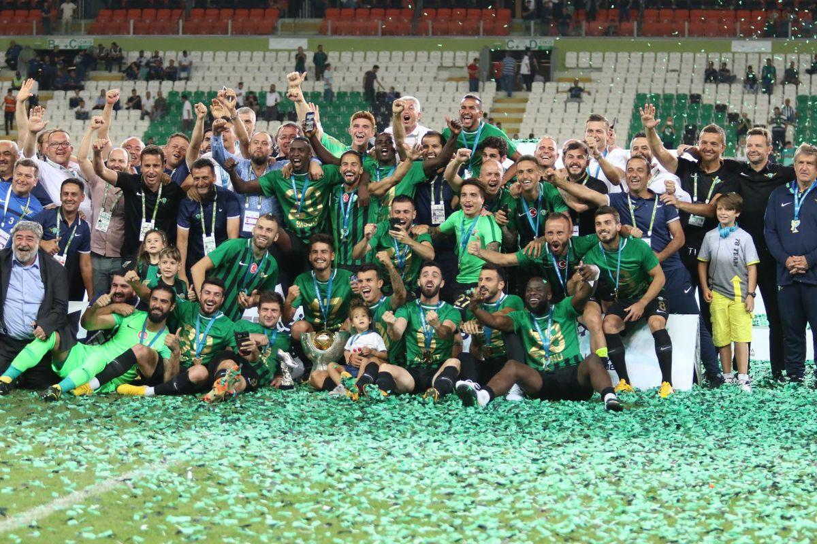

Conclusion
• Identified strong-performing teams
• Compared scoring trends across tournaments
• Explored relationships between possession, shots, corners and goals
• Built an interactive dashboard for analysis

Slide 9
Thank You
Questions?

