Slide 1


FIFA World Cup Match Analysis Dashboard
Pradeep Reddy Thummala
Master's in Data Science
University of Europe for Applied Sciences
Data Visualization Project

Slide 2
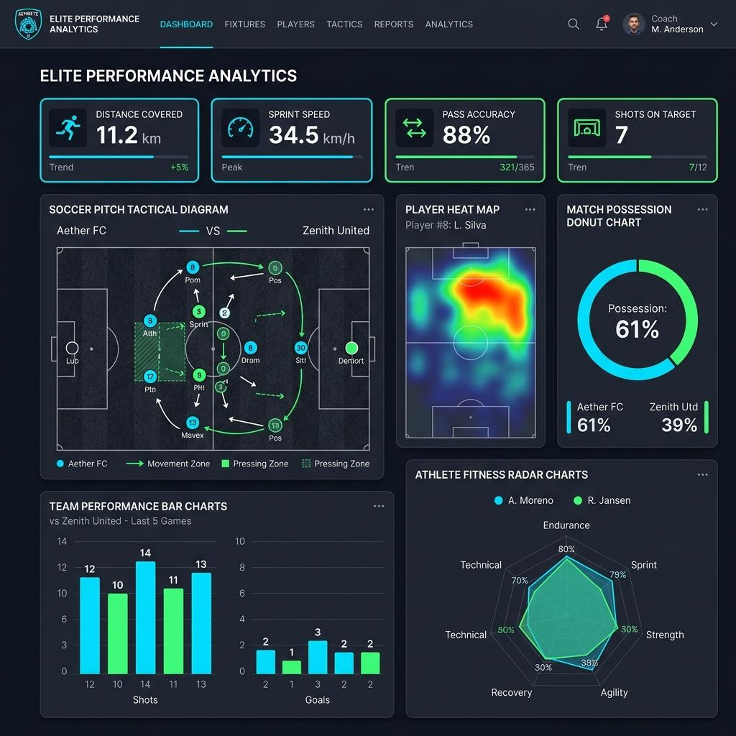
Project Overview
• Analyze FIFA World Cup men's matches (1970–2022)
• Build an interactive Streamlit dashboard
• Perform exploratory data analysis (EDA)
• Visualize key match statistics using Plotly

Slide 3

Dataset & EDA
• Dataset: FIFA World Cup Men's Match Dataset (1970–2022)
• Cleaned missing values and inspected data quality
• Created 'Total Goals' feature
• Applied interactive team filter

Slide 4
Questions 1–3
1. Top Teams by Win Percentage
2. Average Goals by Tournament
3. Possession vs Goals Scored

Slide 5
Questions 4–6
4. Goals Distribution by Stage
5. Top Teams by Average Shots on Target
6. Top Teams by Average Yellow Cards

Slide 6
Questions 7–10
7. Highest Scoring Stadiums
8. Corners vs Goals
9. Average Possession by Team
10. Correlation Heatmap

Slide 7
Streamlit Dashboard
• Interactive team filter
• KPI cards
• 10 interactive Plotly visualizations
• Easy exploration of World Cup match statistics

Slide 8

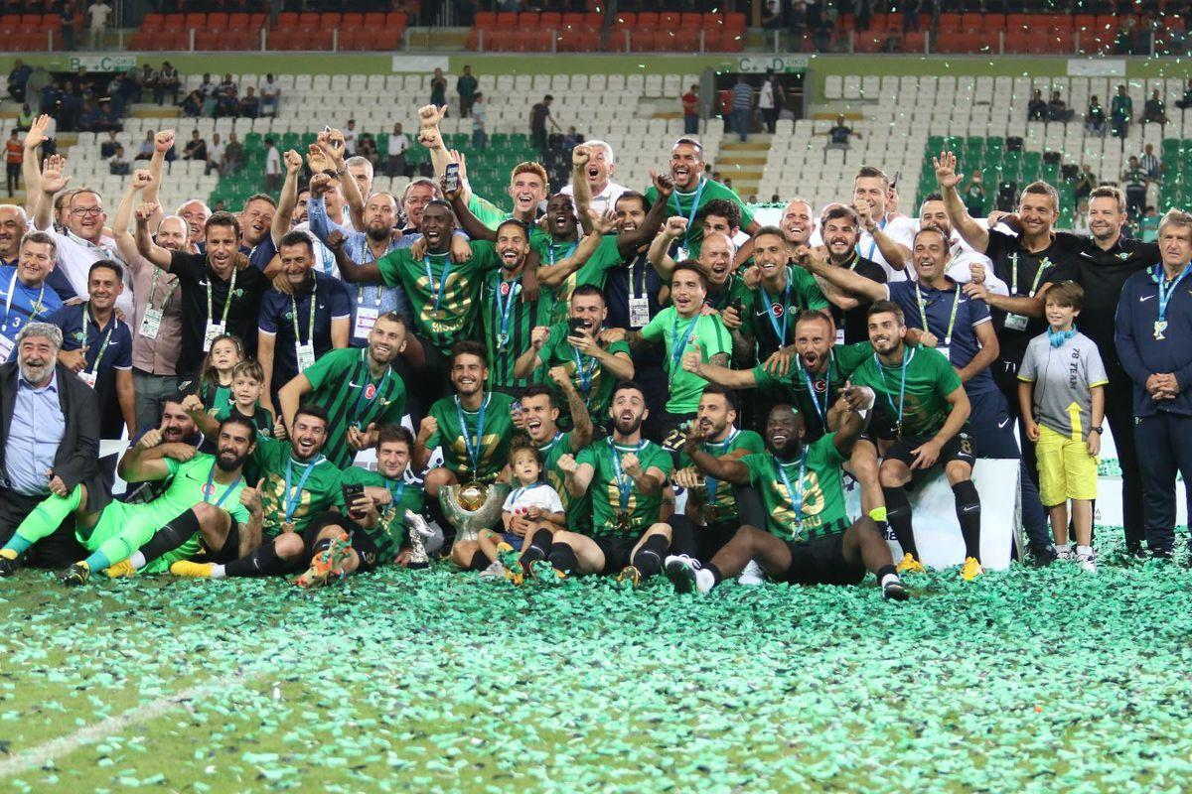
Conclusion
• Identified strong-performing teams
• Compared scoring trends across tournaments
• Explored relationships between possession, shots, corners and goals
• Built an interactive dashboard for analysis

Slide 9
References
https://www.kaggle.com/datasets
1.Plotly Technologies Inc. Plotly Python Graphing Library. https://plotly.com/python/
2.Streamlit Inc. Streamlit Documentation. https://docs.streamlit.io/
3.Pandas Development Team. Pandas Documentation. https://pandas.pydata.org/docs/
4.NumPy Developers. NumPy Documentation. https://numpy.org/doc/
5.McKinney, W. (2022). Python for Data Analysis (3rd ed.). O'Reilly Media.
6.Hunter, J. D. (2007). "Matplotlib: A 2D Graphics Environment." Computing in Science & Engineering, 9(3), 90–95.

Slide 10
Thank You
Questions?

