Slide 1
PCOS Prediction
Result comparison

Slide 2
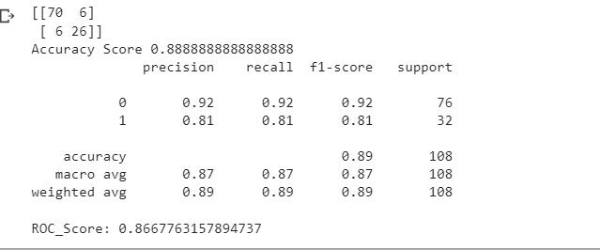
Random forest model on whole data set

Slide 3
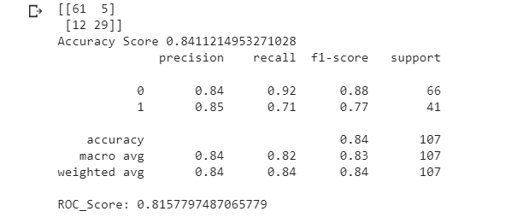
Random forest model with one hot encoding on ‘BMI’

Slide 4
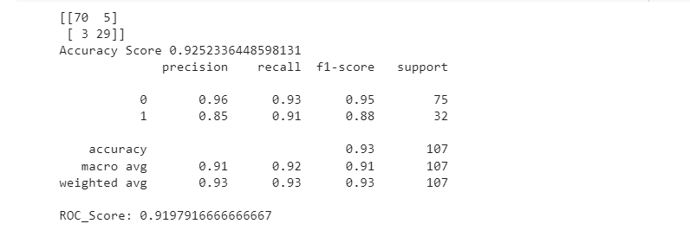
One hot encoding on ’BMI ’,’BP _Systolic (mmHg)’, 'LH(mIU/mL)'

Slide 5
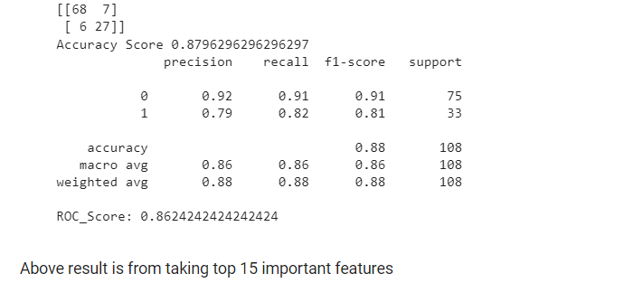
Random forest on top 15 features

Slide 6
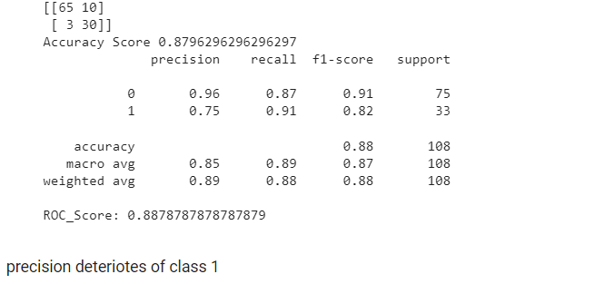
Random forest on top 10 non-invasive features

Slide 7
Conclusions
Making buckets(one hot encoding) on some features playing vital role to predict the PCOS
Model is not able to understand few features internally , so making bucket will help to model understand better
Precision deteriorates on taking the important features

