Slide 1
IFET COLLEGE OF ENGINEERING
(An Autonomous Institution)
DEPARTMENT OF ARTIFICIAL INTELLIGENCE &
DATA SCIENCE
AI-BASED ENERGY MANAGEMENT SYSTEM FOR SMART GRID WITH RENEWABLE ENERGY INTEGRATION
PRESENTED BY
PRADEEP SALAMON J
(421122106039)
GUIDED BY
Mrs. JAYACHITRA, ASSOCIATE PROFESSOR

Slide 2
DOMAIN
SMART ENERGY GRID
A smart grid is a modernized electrical network that uses advanced digital and information technologies to create a more efficient, reliable, and sustainable energy system by enabling two-way communication and control between electricity generators, grid operators, and consumers.
Create a more efficient, reliable, and sustainable power system by integrating advanced communications, controls, and new technologies into the existing electrical infrastructure.

Slide 3
ABSTRACT
The increasing demand for reliable, sustainable, and efficient energy systems has accelerated the adoption of Smart Energy Grids. Unlike conventional power networks, smart grids leverage Artificial Intelligence (AI), advanced communication systems, and IoT-enabled sensors to optimize energy generation, distribution, and consumption. This project focuses on AI-driven optimization techniques, including machine learning for load forecasting, reinforcement learning for demand-side management, and federated learning for privacy-preserving analytics. AI enables real-time fault detection, predictive maintenance, renewable energy integration, and intelligent scheduling of distributed energy resources, thereby reducing peak demand and operational costs.

Slide 4
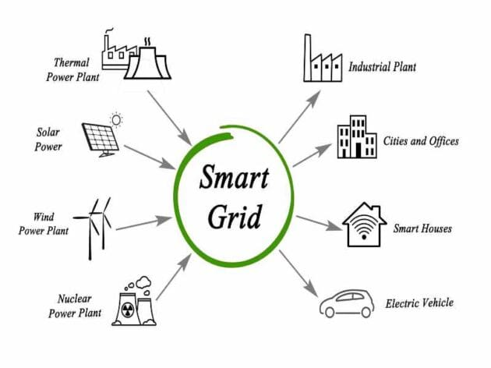
SMART GRID

Slide 5
OBJECTIVE
AI-driven framework for optimizing smart energy grid operations.
Apply machine learning algorithms for accurate load and renewable energy forecasting.
Implement reinforcement learning for demand response and real-time energy scheduling.
Improve efficiency, reduce peak demand, and enhance renewable integration in the grid.
Reduce energy theft using AI-based anomaly detection and monitoring.
Reduce carbon footprint and electricity bills by maximizing the optimized use of clean and renewable energy sources.

Slide 6
REFERENCES
Sankarananth, S., M. Karthiga, and Durga Prasad Bavirisetti. "AI-enabled metaheuristic optimization for predictive management of renewable energy production in smart grids." Energy Reports 10 (2023): 1299-1312.
Liu, Zhi, Ying Gao, and Baifen Liu. "An artificial intelligence-based electric multiple units using a smart power grid system." Energy Reports 8 (2022): 13376-13388.
Omitaomu, Olufemi A., and Haoran Niu. "Artificial intelligence techniques in smart grid: A survey." Smart Cities 4.2 (2021): 548-568.

