Slide 1
Reproducible Results on Clustering MIRC TFS
Source Code Author: Sungmin Script for MIRC Data on Jupiter Python
Modified to Reproduce the results: Pradeep for MIRC Data on raw python

Slide 2
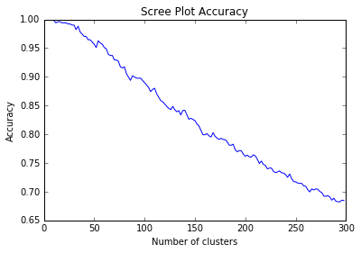
Scree Plot Results to validate Accuracy

Slide 3
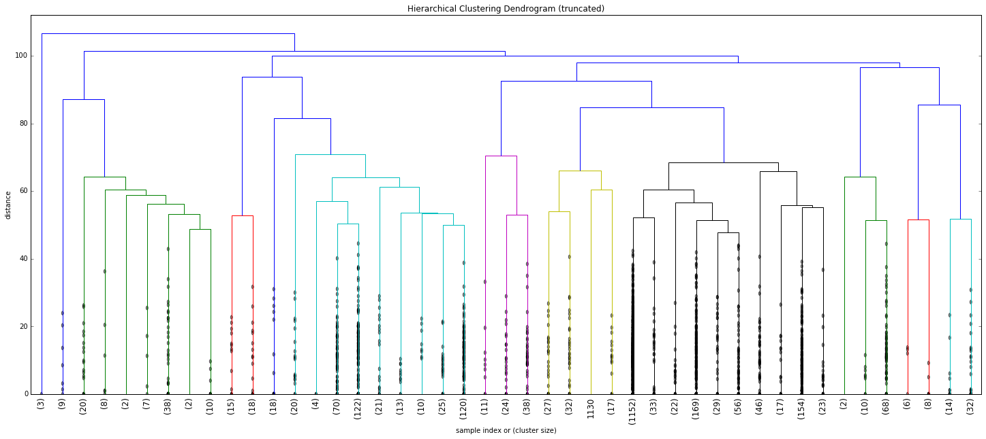
Dendrogram to visualize the Cluster results

Slide 4
Dendrogram to visualize the Cluster results
Cluster1 0.0 Cluster2 185.138888889 Cluster3 108.476315789 Cluster4 262.5 Cluster5 0.0 Cluster6 161.571428571 Cluster7 162.155049787 Cluster8 4.0 Cluster9 55.1555555556 Cluster10 110.60952381 Cluster11 143.947712418 Cluster12 143.307189542 | Cluster13 138.665789474 Cluster14 0.0 Cluster15 114.566666667 Cluster16 145.181343991 Cluster17 174.061904762 Cluster18 54.8974358974 Cluster19 202.566666667 Cluster20 78.6733333333 Cluster21 102.908963585 Cluster22 199.890909091 Cluster23 125.219202899 Cluster24 143.63086771 | Cluster25 111.407407407 Cluster26 159.108870968 Cluster27 99.2205882353 Cluster28 nan Cluster29 77.0232874192 Cluster30 151.151515152 Cluster31 75.79004329 Cluster32 135.801070724 Cluster33 162.352216749 Cluster34 161.930844156 Cluster35 130.953140097 Cluster36 115.169117647 | Cluster37 100.429462694 Cluster38 105.162055336 Cluster39 0.0 Cluster40 39.5888888889 Cluster41 159.370280948 Cluster42 101.3 Cluster43 53.9464285714 Cluster44 70.5714285714 Cluster45 82.5463709677

Slide 5
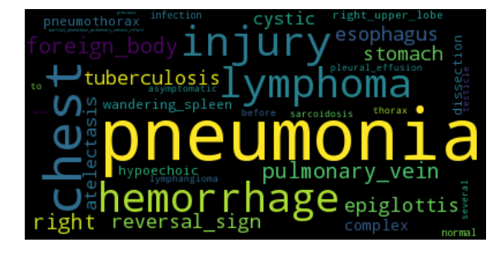
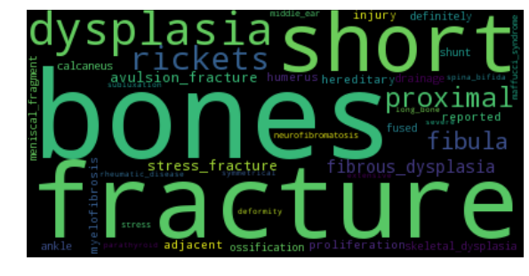
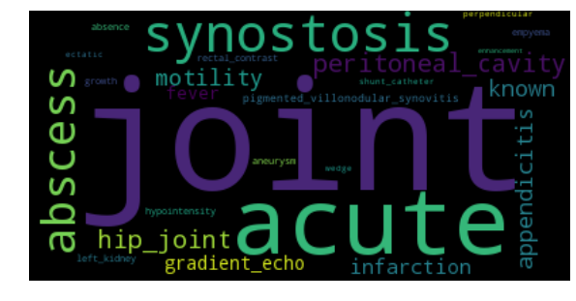
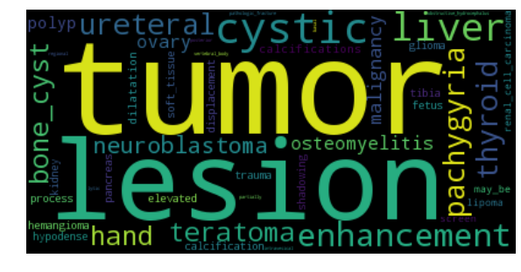
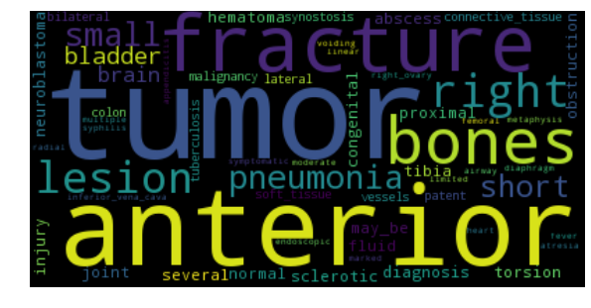
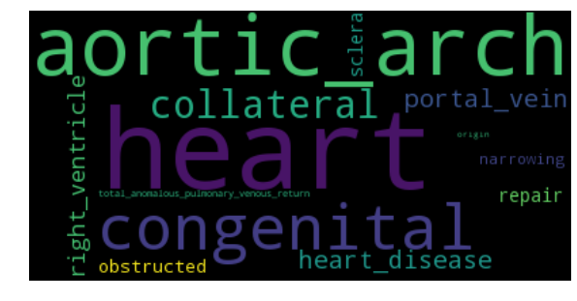
Dendrogram to visualize the Cluster results

Slide 6
Dendrogram to visualize the Cluster results
============CLUSTER 5============== [ 'portal vein => vein => segment of venous tree organ => region of vascular tree => organ segment => organ region => cardinal organ part => anatomical structure => material anatomical entity => anatomical entity => '] ['shunt => flow disorder => mechanical disorder => pathophysiologic finding => clinical finding => '] [ 'liver => lobular organ => parenchymatous organ => solid organ => organ => anatomical structure => material anatomical entity => anatomical entity => '] ['thrombosis => mechanical disorder => pathophysiologic finding => clinical finding => '] ['congenital => disease origin descriptor => Radlex descriptor => '] [ 'blood => portion of body fluid suspension => portion of body fluid => portion of body substance => material anatomical entity => anatomical entity => ']
============CLUSTER 6============== ['right => laterality => location descriptor => Radlex descriptor => '] ['congenital => disease origin descriptor => Radlex descriptor => '] [ 'heart => organ with cavitated organ parts => cavitated organ => organ => anatomical structure => material anatomical entity => anatomical entity => '] ['increased => status descriptor => Radlex descriptor => '] ['obstruction => flow disorder => mechanical disorder => pathophysiologic finding => clinical finding => '] [ 'heart disease => cardiovascular disorder => body-system-specific disorder => pathophysiologic finding => clinical finding => ']

Slide 7
Work Completed: Reproduces the TF results Work in Progress: Results validation Work Planned for next two days: 1. Understanding the Results obtained 2. Understanding the Python code written for MIRC Work Planned for Next Week: 1. Work towards the comments received from meeting

Slide 8
Thank You!

