Slide 1
Reproducible Results on MIRC TFS
Source Code Author: Sungmin Script for MIRC Data on Jupiter Python
Modified to Reproduce the results: Pradeep for MIRC Data on raw python

Slide 2
Work done this week
Work on comments provided during 23June2017 meeting by Prof
Familiarizing the Python code and results reproduced
Interpreting results and starting with Report writing
Connect with Sungmin to get KT on work done so far to reproduce cluster results

Slide 3
Comments received from 23 June 2017 meeting
How RadLex categories are analysed?
How word (frequency) encoded – TF/IDF or Entropy?

Slide 4
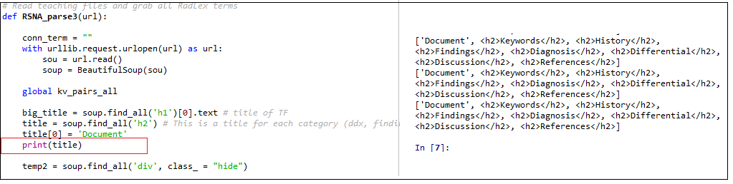
How RadLex Categories are analyzed
Code consider Term Frequency analysis for all categories
Document
History
Findings
Diagnosis
DDX
Discussion
Comments
References

Slide 5
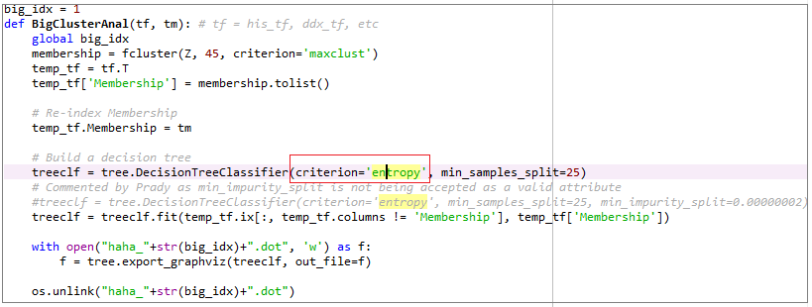
How word(frequency) encoded?
Word frequency is encoded using Entropy criteria
While building decision tree and
During Cluster Analysis

Slide 6
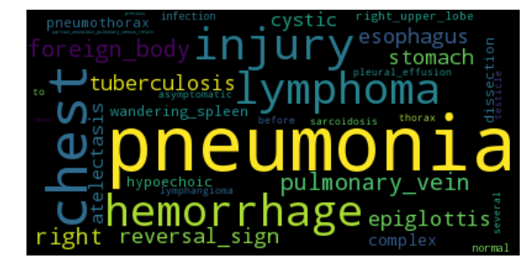
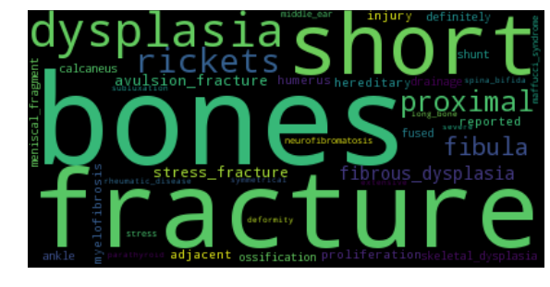
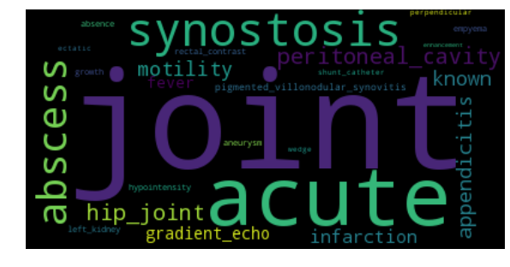
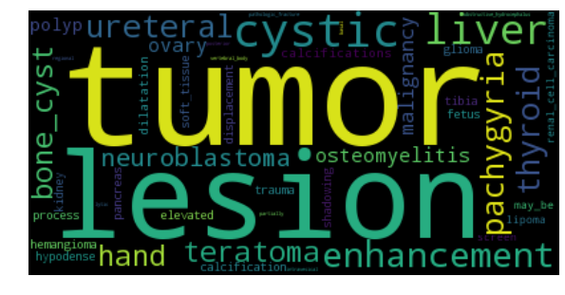
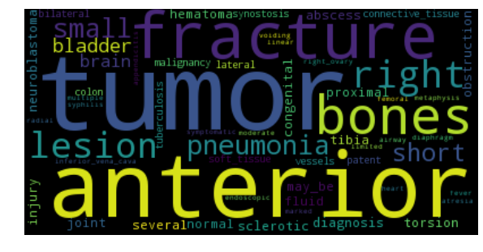
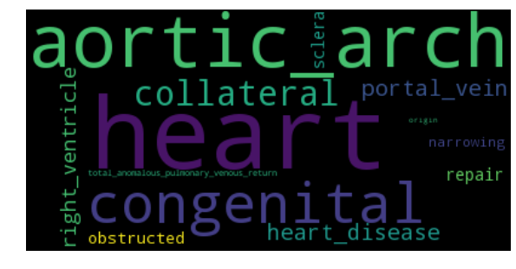
Am I able to reproduce my own results?
Yes, I am able to reproduce the result I obtained for:
Dendrogram (Clusters)
While building term frequency and Word Cloud

Slide 7
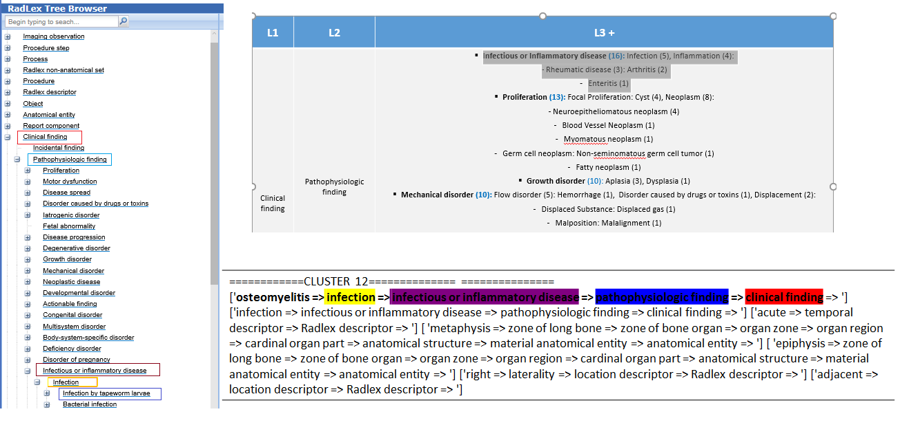
What I am working towards?

Slide 8
Work Completed: Understood the Py code and results Work in Progress: Reproducing Summery Report Work Planned for next two days: 1. Meeting Sungmin and obtaining all KT and Files 2. Work On Reports Work Planned for Next Week: 1. Work towards the comments received from meeting

Slide 9
Thank You!

