Slide 1
Reproducible Results on MIRC TFS
Date: 07 July 2017

Slide 2
Work done this week
Worked on comments provided during 30June2017 meeting by Prof. Jacob
Interpreting results
Connected with Sungmin to get required deliverables

Slide 3
Comments received from 30 June 2017 meeting
Why I am not able to reproduce the old result?
How Radlex coverage are analysed?

Slide 4
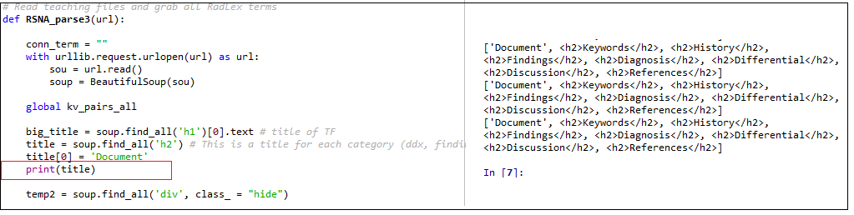
Why I am not able to reproduce the old result?
My result generate Term Frequency analysis for all categories
Document
History
Findings
Diagnosis
DDX
Discussion
Comments
References
While the previous results obtained is only for:
DDX

Slide 5
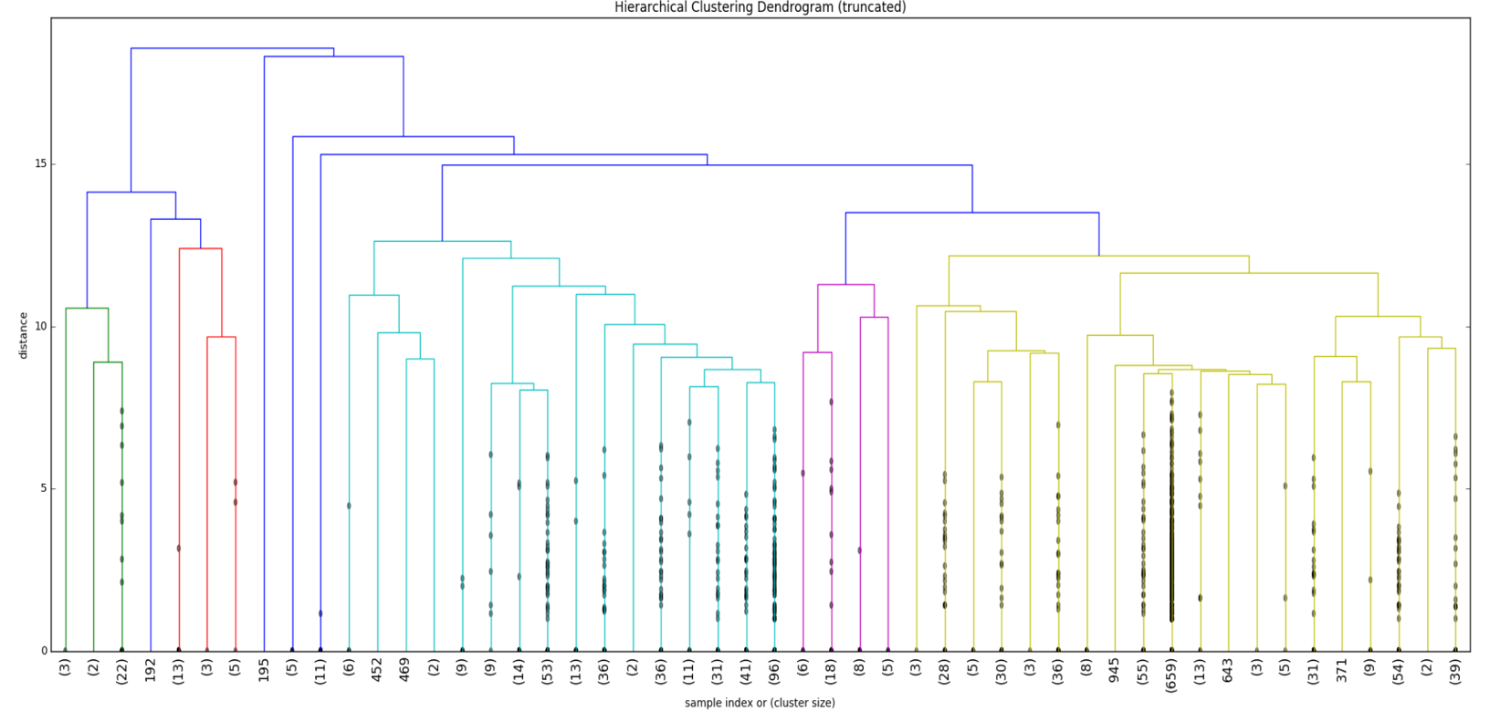
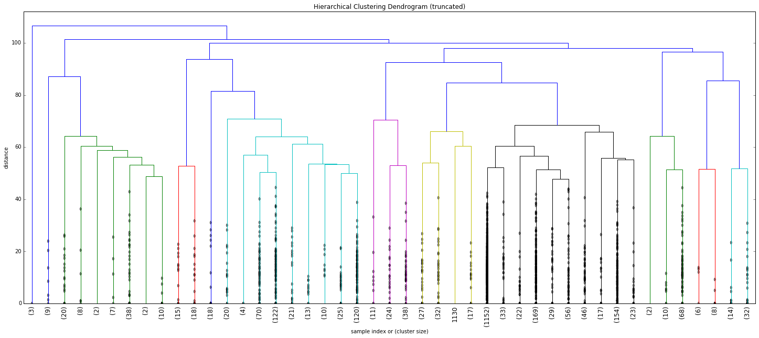
DDX vs Overall Coverage?
DDX Coverage
Over all MIRC Coverage

Slide 6
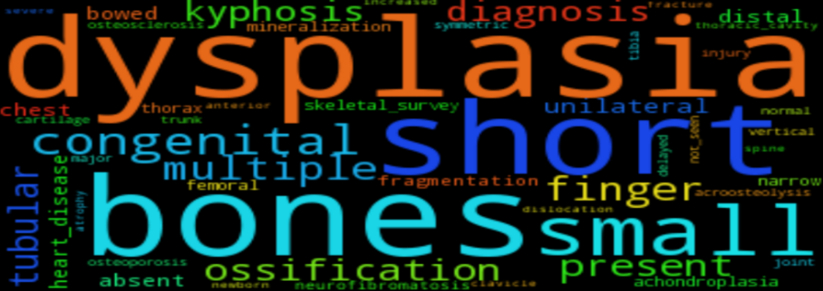
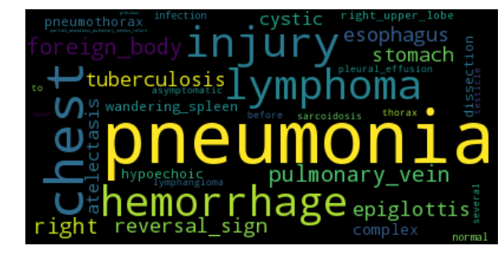
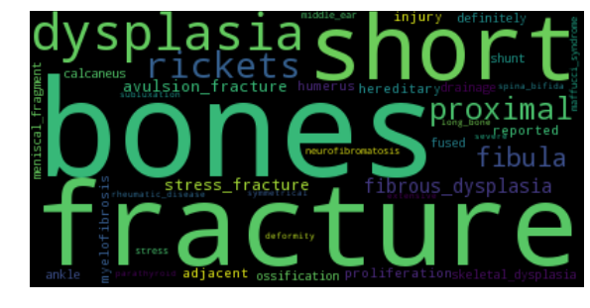
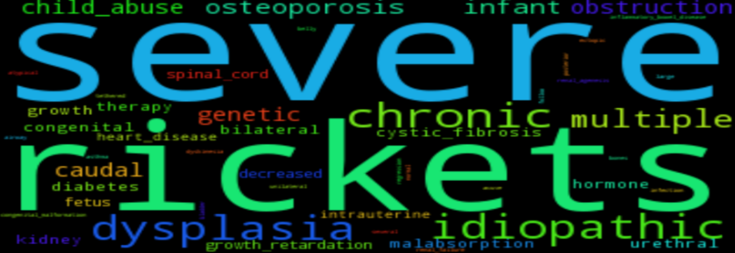
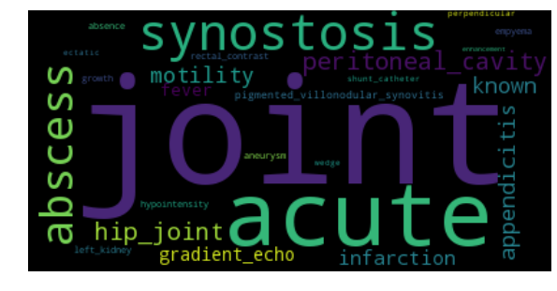
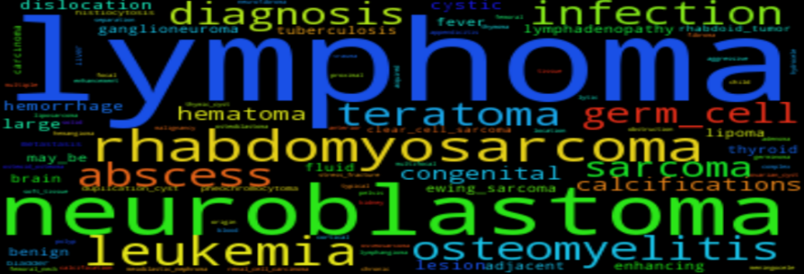
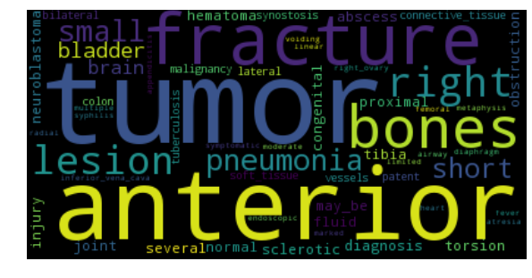
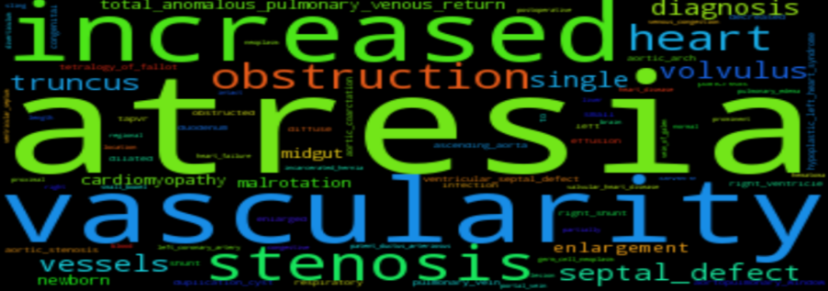
DDX vs Overall Coverage?

Slide 7
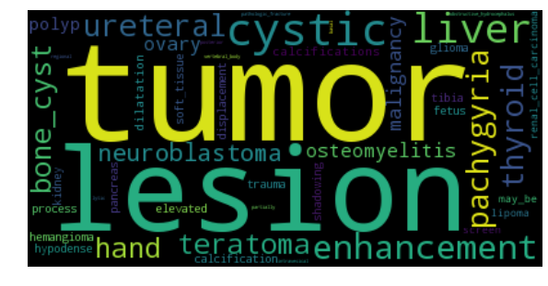
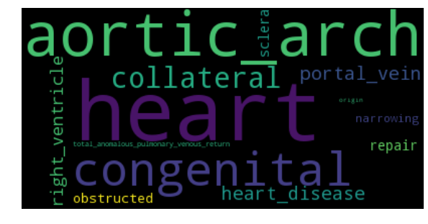
Am I able to reproduce my own results?
Yes, I am able to reproduce the result I obtained for overall and DDX Category:
Dendrogram (Clusters)
While building term frequency and Word Cloud

Slide 8
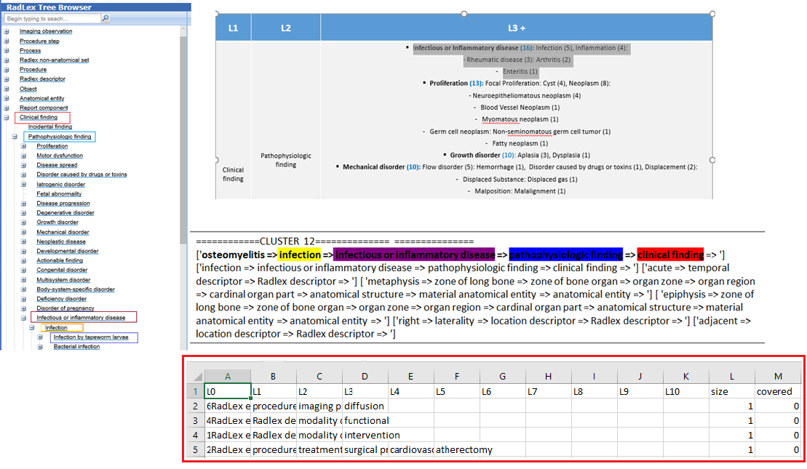
What I am working towards?

Slide 9
Work Completed: Understood the earlier results Work in Progress: Reproducing Summery Report Work Planned for next two days: 1. Obtain result for Discussion, History and Diagnosis Work Planned for Next Week: 1. Infer individual result with the over all result obtained

Slide 10
Thank You!

