Slide 1
Preliminary Results on Clustering MIRC TFS

Slide 2
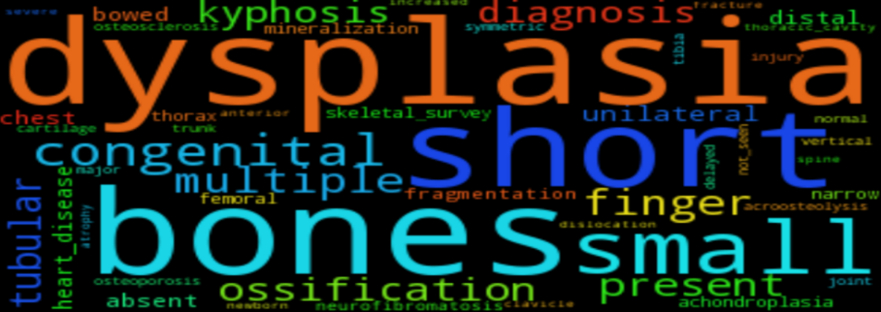
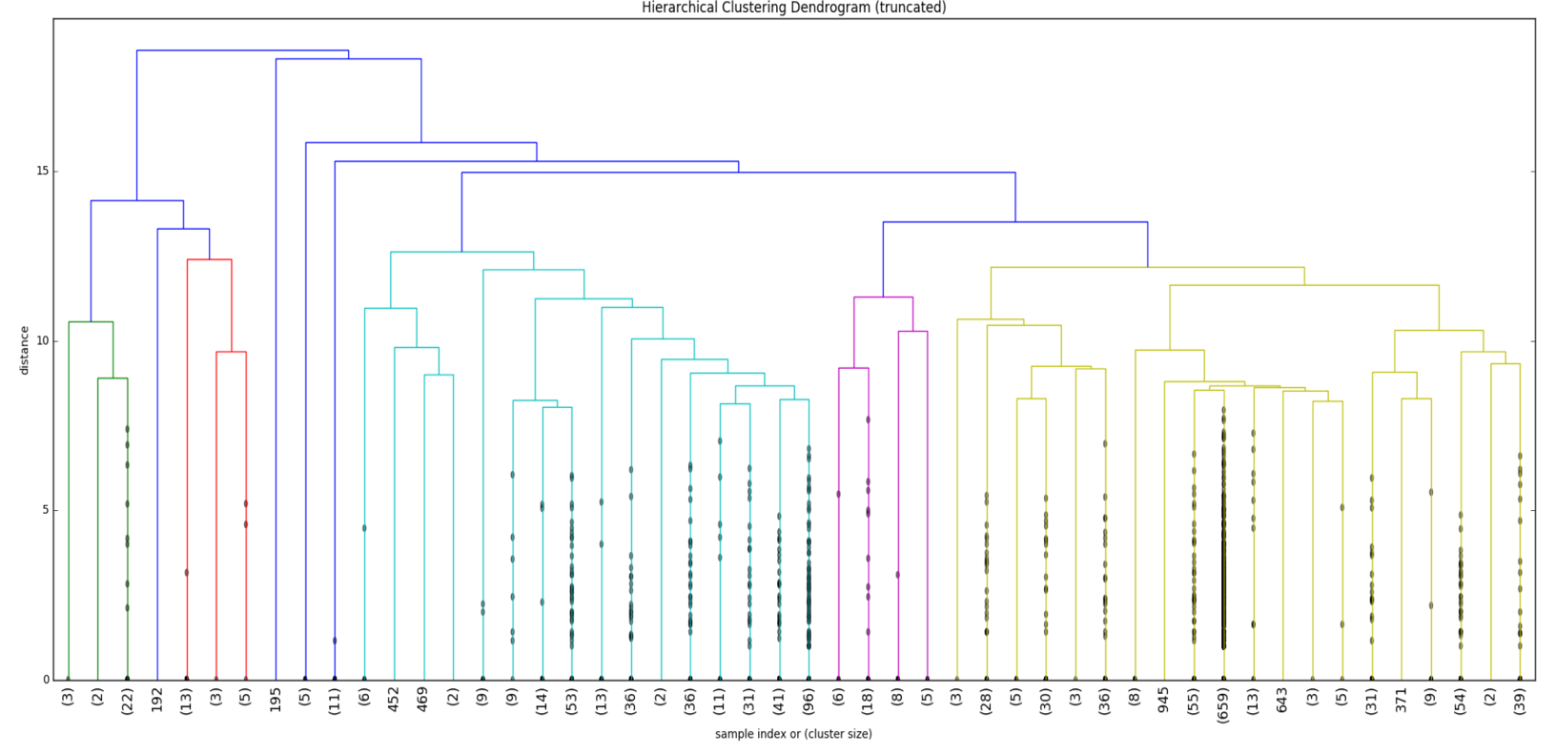
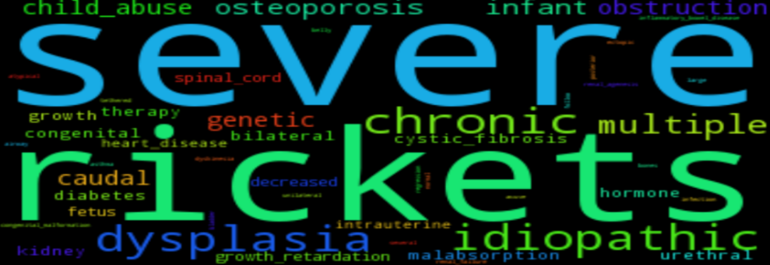
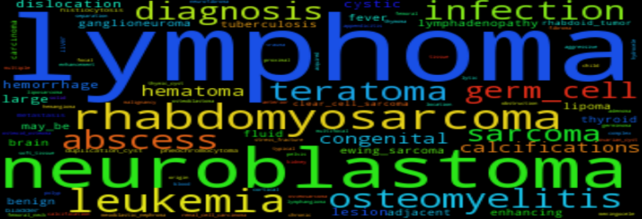
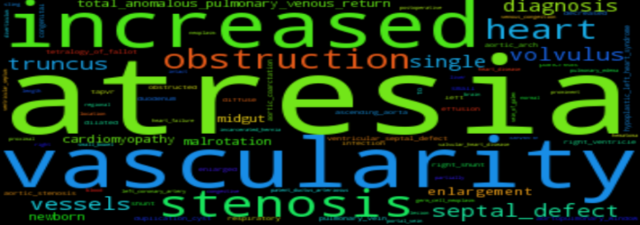
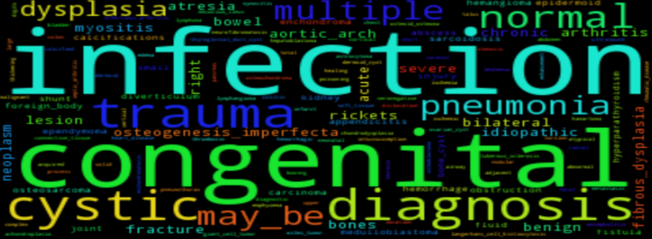
BigCluster 1 (Green) #TF =27 #Clusters=3
BigCluster 2 (Red) #TF=22 #Clusters= 4
BigCluster 3 (Steel Green) #TF=377 #Clusters= 18
BigCluster 4 (Purple) #TF=37 #Clusters= 4
BigCluster 5 (Yellow) #TF=22 #Clusters= 21

Slide 3
(Summary of top three most used RadLex terms across all 50 clusters)
L1 | L2 | L3 +
Clinical finding | Pathophysiologic finding | Infectious or Inflammatory disease (16): Infection (5), Inflammation (4): - Rheumatic disease (3): Arthritis (2) Enteritis (1) Proliferation (13): Focal Proliferation: Cyst (4), Neoplasm (8): - Neuroepitheliomatous neoplasm (4) Blood Vessel Neoplasm (1) Myomatous neoplasm (1) Germ cell neoplasm: Non-seminomatous germ cell tumor (1) Fatty neoplasm (1) Growth disorder (10): Aplasia (3), Dysplasia (1) Mechanical disorder (10): Flow disorder (5): Hemorrhage (1), Disorder caused by drugs or toxins (1), Displacement (2): Displaced Substance: Displaced gas (1) Malposition: Malalignment (1) Neoplastic disease: malignant (8) Degenerative Disorder (6): Deposition: Mineral deposition disorder: Calcification disorder (3) Body-system-specific disorder (5): Bone disorder: Bone mineralization disorder: Demineralization (2), Cardiovascular disorder (3): Heart disease (2): Septal defect (1) Deficiency disorder (2) Metabolic Disease: Metabolic bone disease (2)
 | Symptom (1)

Slide 4
L1 | L2 +
RadLex descriptor | Disease Origin (6) Anatomically-related (6) Composition (5) Morphologic (4) Status (4) Quantity (4) Location (4) Aggressiveness (4) Orientation (3) Size (3) Temporal (3) Pathophysiologic process descriptor: head (1) Composition: Solidness (1) Certainty (1) Imaging Observation: Modality-related Characteristic: Signal (1) Normality Descriptor (1)

Slide 5
L1 | L2 | L3 | L4 +
Anatomical Entity | Material anatomical entity | Anatomical structure | Organ (5): Cavitated organ (3): Organ with organ cavity (1), Organ with cavitated organ parts (2): Bone organ: - Short bone: Tarsal bone (1) - Long bone (1) Solid organ: Parenchymatous organ (2): Lobular organ (1) Cell (1) Anatomic sub-part (1) Anatomical cluster (2): Cell part cluster: Segment of neural tree organ (1), Heterogeneous anatomical cluster: Subdivision of pharynx (1)
 |  | Portion of body substance | Portion of body fluid (1)

Slide 6
L1 +
Property (6): Interventional outcome: Therapeutic response (1)
Imaging observation (4): Enhancement pattern (3), Enhancement (1)
Imaging Modality (1)
Procedure: Imaging Procedure (1)

