Slide 1
Analysis on MIRC TFS
Date: 14 July 2017

Slide 2
Work done this week
Steps used to reproduce result for DDX:
Data Scrapping
Radlex Term Frequency for DDX Category
DDX term frequency matrix for each teaching file
Decision Tree to predict proper cluster size
Dendrogram to observe the clusters
Analysing the cluster to find the most used term

Slide 3
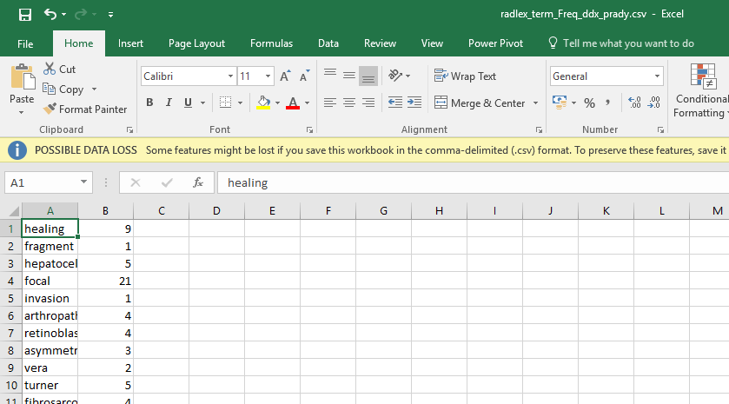
RadLex Term Frequency for DDX

Slide 4
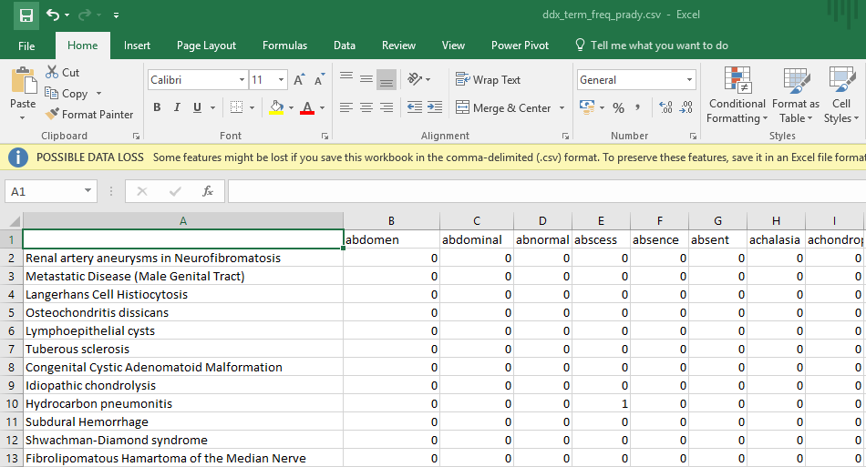
DDX Term Frequency For Each Teaching File

Slide 5
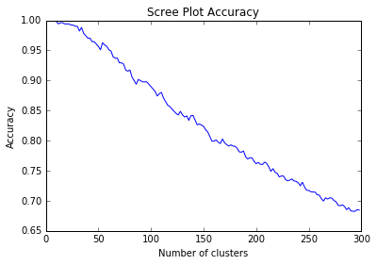
Decision Tree from DDX Term Frequency Matrix

Slide 6
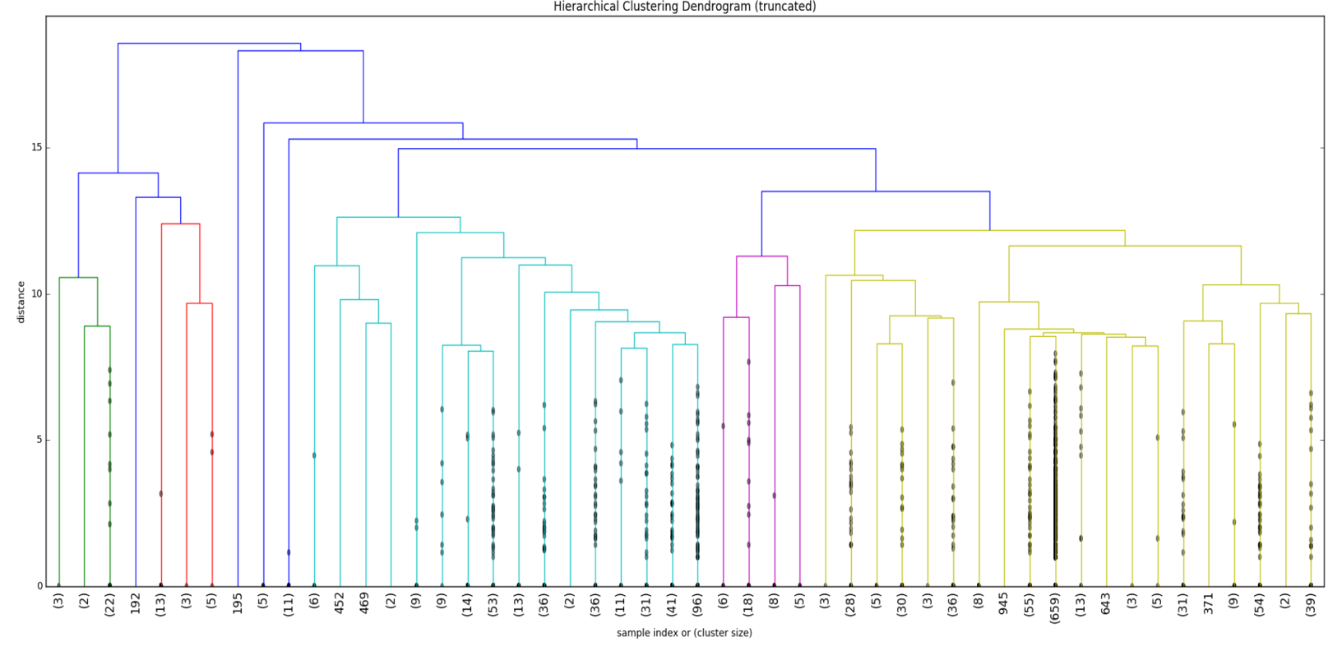
Result to be reproduce for DDX

Slide 7
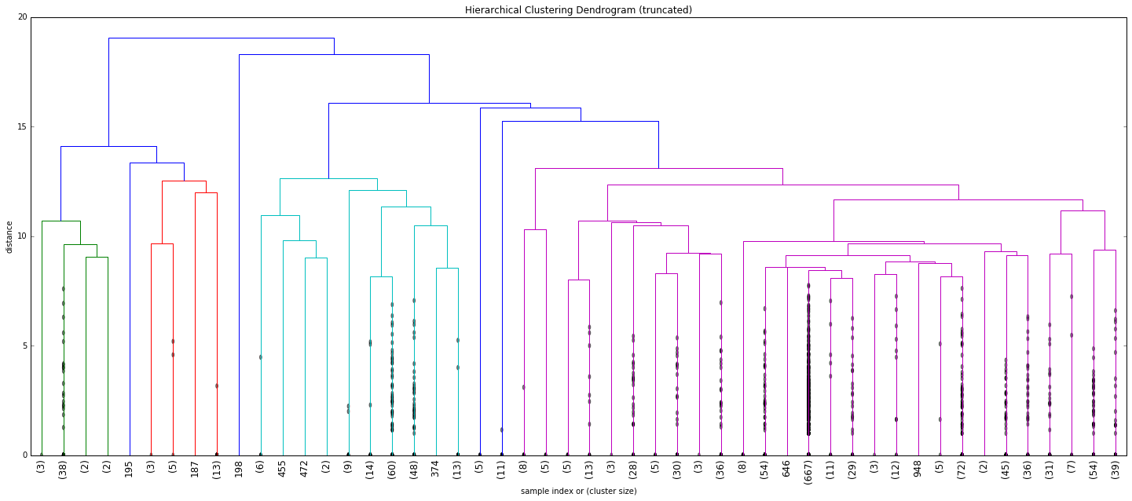
Result reproduced for DDX

Slide 8
Old DDX vs New DDX?
Old DDX Dendogram
Reproduced

Slide 9
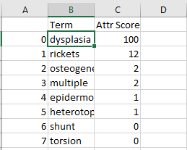
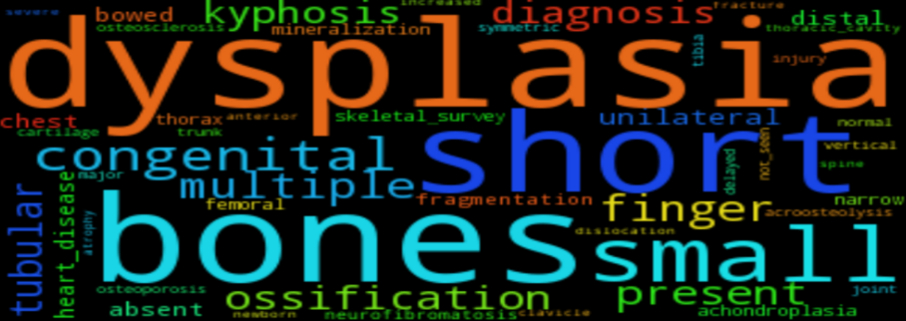
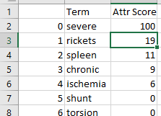
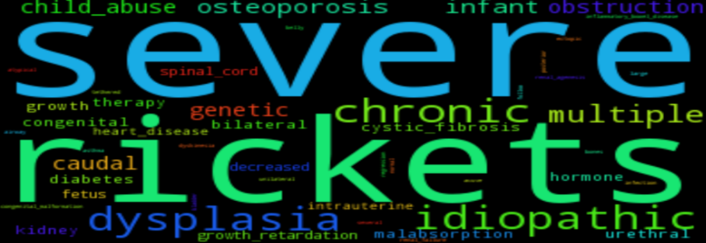
Cluster Coverage:

Slide 10
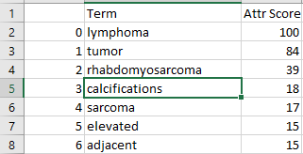
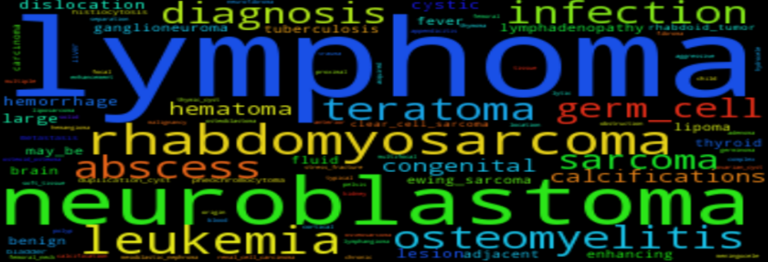
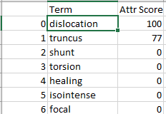
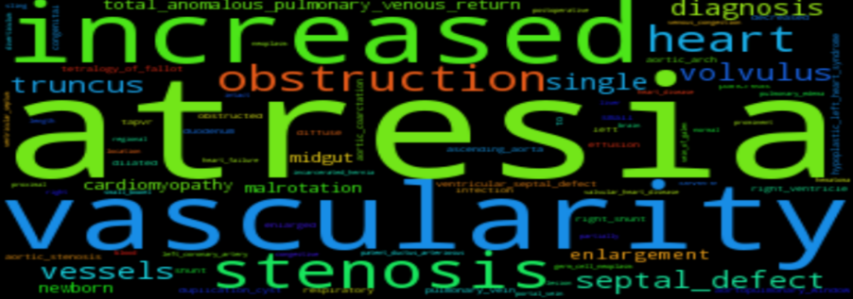
Cluster Coverage:

Slide 11
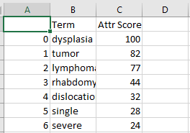
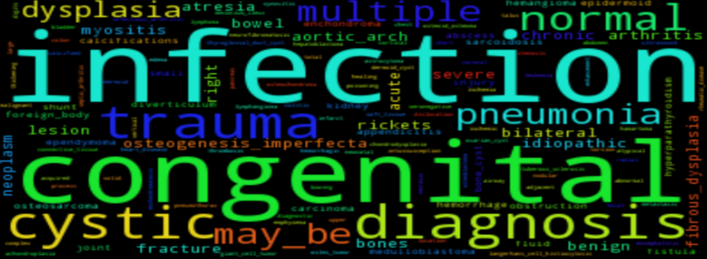
Cluster Coverage:

Slide 12
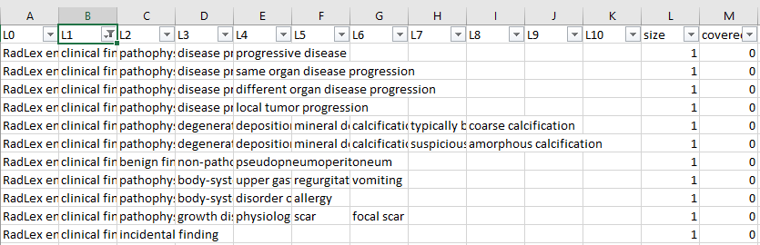
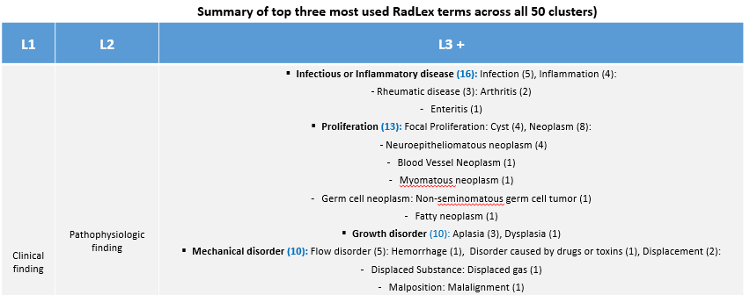
What I am working towards?

Slide 13
TO DO: Analyzing each cluster produced from DDX Reproduce similar result for History and Discussion

Slide 14
Thank You!

