Slide 1
Analysis on MIRC TFS
Date: 14 July 2017

Slide 2
Work done this week
Obtained Radlex Term Frequency and
Radlex Term Frequency wrt to each teaching file for below category:
DDX
Discussion
Diagnosis
Findings
History

Slide 3
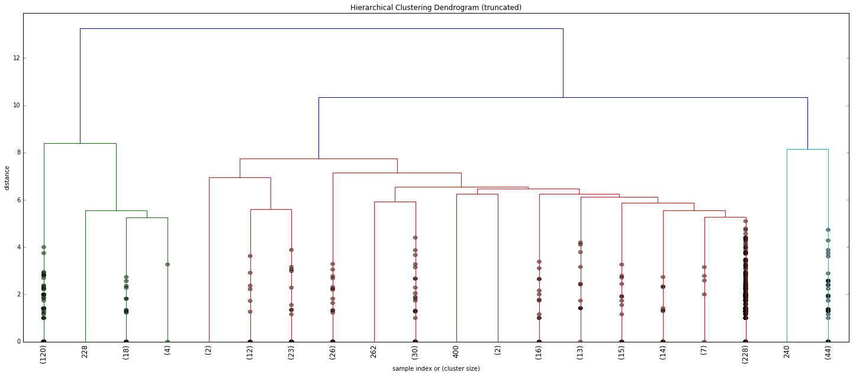
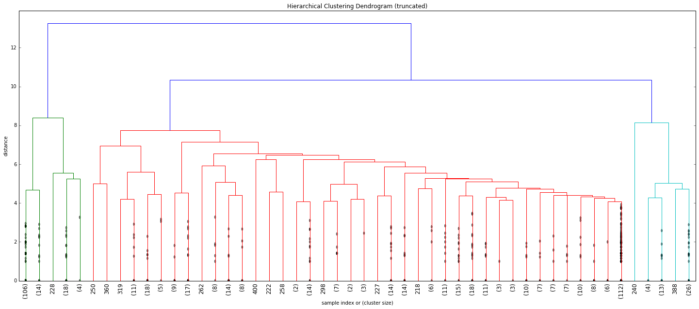
Result for History
20 Cluster:
50 Cluster:

Slide 4
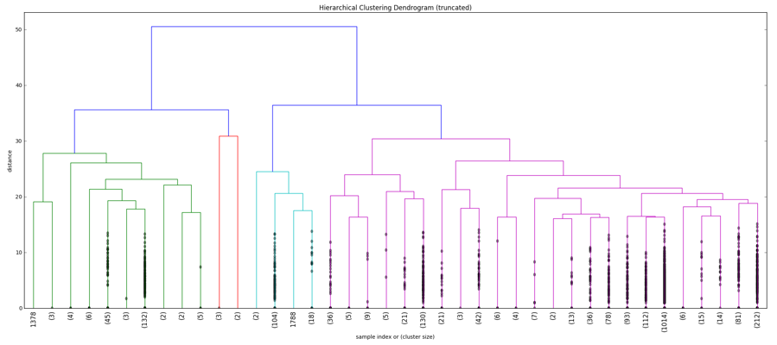
Result for Finding

Slide 5
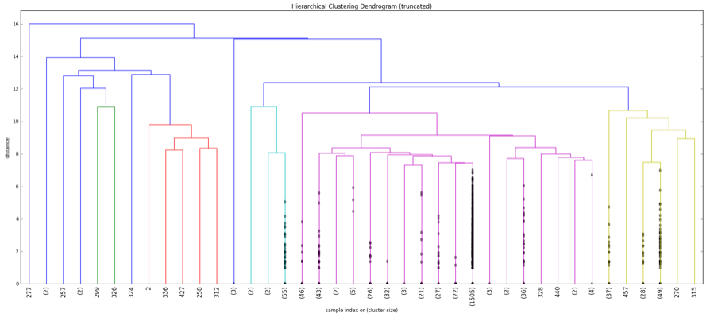
Result for Diagnosis

Slide 6
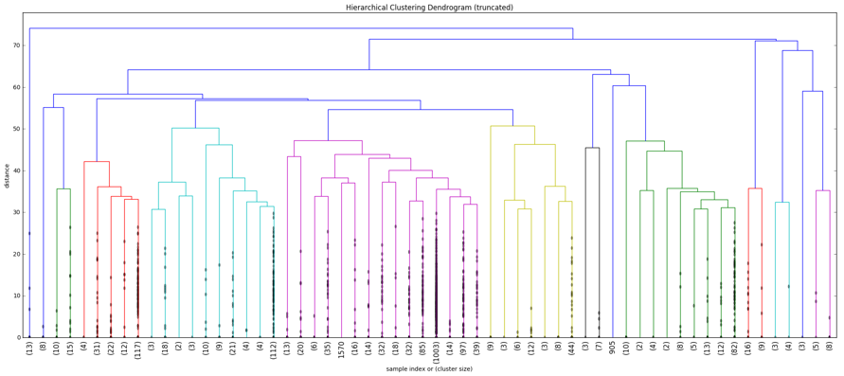
Result for Discussion

Slide 7
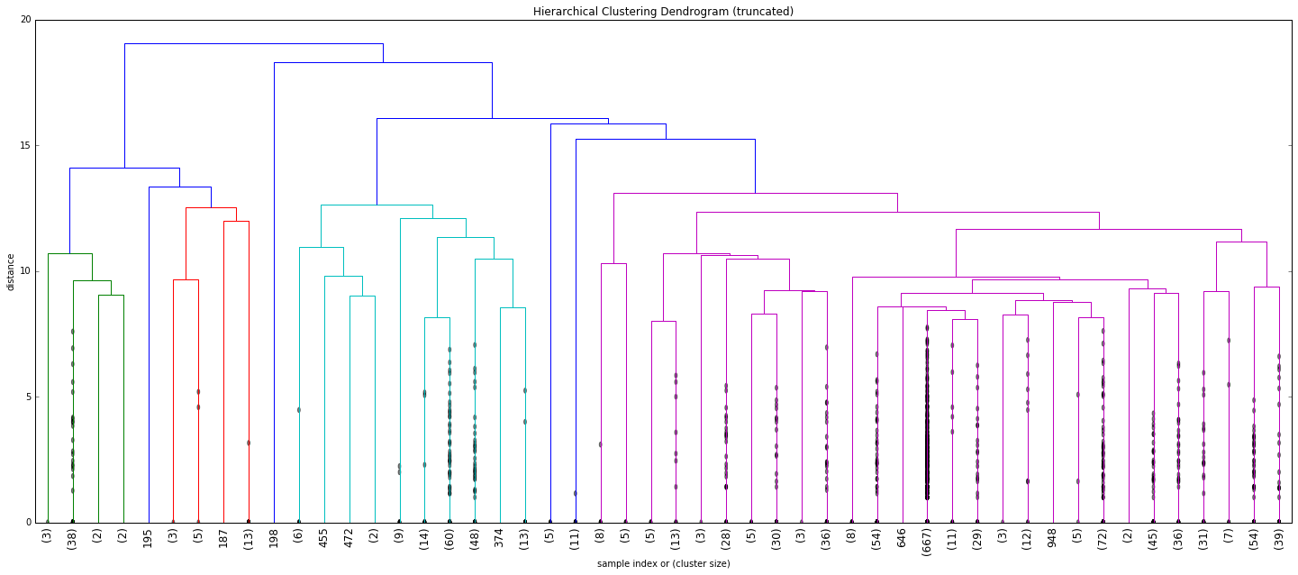
Result for DDX

Slide 8
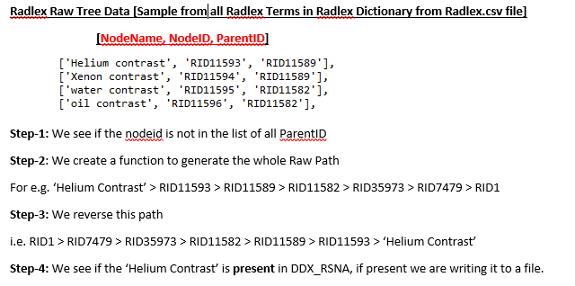
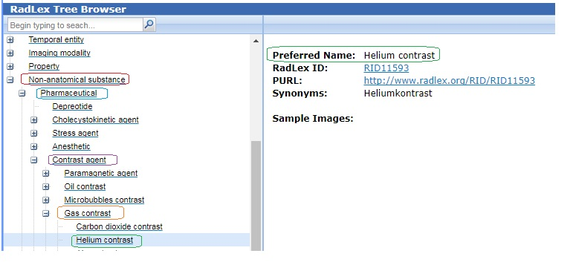
Coverage Tree for DDX Terms Without involving the Frequency Measure
For e.g. lets take a Radlex Term ‘Helium Contrast’ occurred in DDX category for a teaching file
For this we are navigating the tree path:

Slide 9
TO DO: Analyzing each cluster produced for each category

Slide 10
Thank You!

