Slide 1




















Slide 2


Freight Company does the shipping
Customer books a freight
Bad customer interaction with Freight Company executive and lack of proper information
Wrong shipping of Package results in delay
Customer receives the package
Classification of materials
Cost effective shipping and transit time option
Assistive Packing options
Assistance in customs clearance for international shipping
Service support after shipping
Insurance coverage for fragile materials
Scheduled/Rescheduled delivery
Tracking information
Prior notification before delivery
Delivery executive contact details
Assistance in customs clearance
Service support
Insurance Claim
Customs Clearance
Customs Clearance plays a major delay in shipping for international freights
To know the status of a shipment, customer has to visit the website or call customer support of the freight Service Provider and enter/say a specific code made up of alphabets and numbers.

Slide 3

@DHLBot
@DHLBot
Freight Company does the shipping
Customer books a freight
@DHLBot responds quickly, provides more personalized care and ease of contact
@DHLBot provides and confirms details of package booked through notification before shipping, to avoid wrong shipping
Customer receives the package
Classification of materials
Cost effective shipping and transit time option
Assistive Packing options
Assistance in customs clearance for international shipping
Service support after shipping
Insurance coverage for fragile materials
Scheduled/Rescheduled delivery
Tracking information
Prior notification before delivery
Delivery executive contact details
Assistance in customs clearance
Service support
Insurance Claim
Customs Clearance
@DHLBot helps customers in clearing customs related issue by allowing live uploading of Proofs, invoice etc.
To know the status of a shipment or reschedule shipment or do insurance claims or deal with customs related issue, customer has to simply ask the @DHLBot. Only on escalation, human based service support is provided.

Slide 4




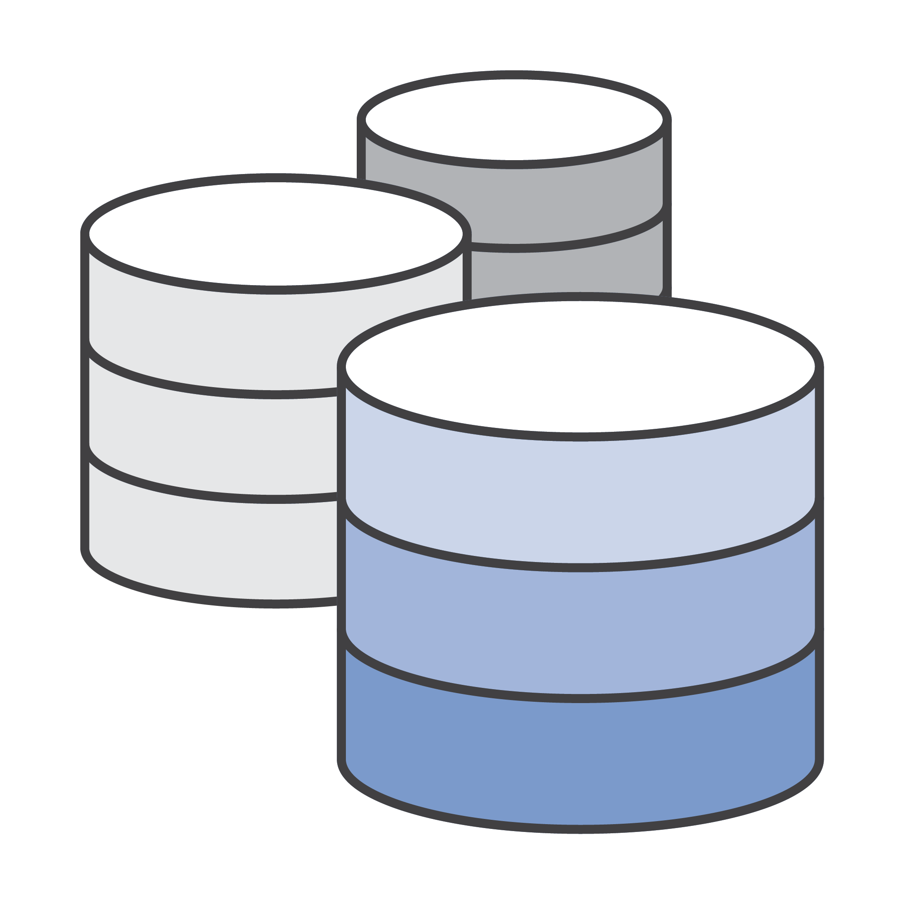




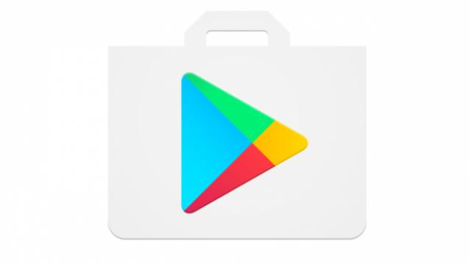
User gets Realtime quote, live transit details, Delivery time/details in calendar and gets address/order details to confirm booking. Remote user gets notified about the package so that they can confirm the address and details prior to shipping is done. This avoid wrong shipping address and unwanted wrong shipping's
Business Logic, AI, ML and Bot Infra using Google Cloud and Google APIs. It is connected with Freight IT Infrastructure to get details in Realtime
@DHLBot takes Voice and Text as input. Allows image upload too
Freight Company and Service support to get data in Realtime. And for any Human interactions
BOT connected to Global Exchange Data and DHL IT Systems to Place/Cancel/Modify Orders and even get quotes
IOT Functions
Freight Company does the shipping
Interface can be in a Mobile or a dedicated hardware like Raspberry Pi which uses Google Personal Assistant
IOTs attached to shipping vehicle provides real time transit details to Customer in Google Map
All payments/Refunds are done using Google Play Store
Conversation is the new UI! Improves customer experience and ramp up loyalty

Slide 5
User gets Realtime quote, live transit details, Delivery time/details in calendar and gets address/order details to confirm booking. Remote user gets notified about the package so that they can confirm the address and details prior to shipping is done. This avoid wrong shipping address and unwanted wrong shipping's
Business Logic, AI, ML and Bot Infra using Google Cloud and Google APIs. It is connected with Freight IT Infrastructure to get details in Realtime
@DHLBot takes Voice and Text as input. Allows image upload too
Freight Company and Service support to get data in Realtime. And for any Human interactions
BOT connected to Global Exchange Data and DHL IT Systems to Place/Cancel/Modify Orders and even get quotes
IOT Functions
Freight Company does the shipping
Interface can be in a Mobile or a dedicated hardware like Raspberry Pi which uses Google Personal Assistant
IOTs attached to shipping vehicle provides real time transit details to Customer in Google Map
All payments/Refunds are done using Google Play Store
Conversation is the new UI! Improves customer experience and ramp up loyalty

Slide 6
