Slide 1



CampusPulse: Smart Classroom Monitoring and Energy Management
Mini Project Proposal
Submitted By
IoT Connectivity
Soya Pradeep
MAC25MCA-2052
Sensor nodes communicate over Wi-Fi using HTTP REST protocol
Smart Sensing
Project Guide
Nisha Markose
PIR, DHT22, and BH1750 sensors for occupancy and environment
Cloud Dashboard
Django web application with real-time analytics and control

Slide 2
Literature Survey
A review of recent IoT-based smart classroom and energy management research establishes the academic foundation and identifies the gaps addressed by
CampusPulse. All three papers directly inform core design decisions.
Paper
Objective
Methodology
Key Findings
Relevance to CampusPulse
T. H. Noor et al. (2023)
IoT-Based Energy Conservation Smart Classroom, Intelligent Automation & Soft Computing
Automate energy conservation in smart classrooms using IoT sensors
PIR and environmental sensors with automated relay control; cloud-connected monitoring
Achieved significant reduction in energy wastage; demonstrated feasibility of sensor-driven automation
Validates PIR + relay approach; confirms cloud connectivity for classroom energy management
S. Y. Park et al. (2022)
IoT-Based Smart Classroom Incubator, Applied Sciences
Design and implement an IoT-based smart classroom environment monitoring system
ESP-based microcontroller with DHT and light sensors; web-based dashboard for real-time data
Real-time environmental data improved classroom comfort; low-cost hardware proved effective
Supports use of DHT22 and BH1750; confirms Django-style web dashboard for sensor visualization
L. Monti et al. (2022)
Edge-Based Transfer Learning for Classroom Occupancy Detection in a Smart Campus Context
Develop an edge-based system for accurate classroom occupancy detection in a smart campus.
Used Intel RealSense depth cameras with an edge-computing architecture and a transfer learning approach based on YOLOv3 for occupancy detection.
Achieved high occupancy detection accuracy while maintaining privacy, scalability, and low-cost deployment for smart campus environments.
Supports the importance of occupancy detection in smart classrooms. Although the paper uses cameras and AI, our project adopts a simpler and lower-cost PIR sensor approach suitable for a student prototype.

Slide 3


Problem Statement
Educational institutions are gradually adopting smart technologies, yet many classrooms continue to waste electricity because lights and fans remain ON even when classrooms are unoccupied. The absence of automated monitoring creates significant operational inefficiencies and avoidable costs.
No automated system exists to track classroom occupancy in real time, relying entirely on human intervention.
No unified platform exists to monitor the status of multiple classrooms simultaneously across a campus.
Inefficient Manual Monitoring
Lack of Centralized Visibility
Lights and fans remain ON in empty classrooms for extended periods, leading to wholly avoidable electricity wastage.
The complete absence of a smart energy management solution means no system can respond to occupancy changes automatically.
Unnecessary Energy Consumption
No Automated Control
Unmanaged energy use directly and measurably increases institutional operational expenses semester after semester.
These five compounding challenges establish a clear and urgent need for an integrated IoT-based solution.

Slide 4

Proposed Solution: CampusPulse
CampusPulse is an IoT-based smart classroom monitoring and energy management system designed to automate occupancy detection, environmental sensing, and appliance control through a centralized web dashboard.
Occupancy Detection
Environmental Monitoring
System Workflow
PIR sensor continuously monitors classroom presence and triggers automated appliance responses.
DHT22 sensor measures real-time temperature and humidity; BH1750 measures illumination in lux.
Sensors Collect
ESP32 Process
Automated Appliance Control
Cloud-Connected Dashboard
Wi‑Fi HTTP
Relay module switches lights and fans ON/OFF based on live occupancy data from the ESP32.
Sensor data transmitted to a Django web application for real-time visualization and remote management.
Django Dashboard
ESP32 (dual-core 240 MHz) acts as the central edge processor, supporting cloud hosting via Render or AWS for multi-campus scalability.

Slide 5

About the Project
CampusPulse integrates low-cost IoT hardware with a cloud-connected Django web application to deliver automated, real-time classroom energy management for educational institutions.
Project Objectives
Overall Data Flow
Reduce Electricity Wastage
01
Automatically switch off appliances in unoccupied classrooms to eliminate idle consumption.
Sensing Layer
Automate Classroom Monitoring
Sensors collect occupancy, temperature, humidity, and light intensity data continuously.
Eliminate manual checks through continuous, sensor-based surveillance of all classrooms.
02
Improve Energy Efficiency
Edge Processing
Optimize appliance usage based on real-time occupancy and environmental sensor data.
ESP32 processes all sensor inputs and transmits data to the backend via HTTP POST requests.
Enable Real-Time Monitoring
03
Provide live sensor readings and appliance status via an accessible web dashboard.
Backend Storage
Scalable Smart Campus Solution
Django backend receives data and stores readings in a MySQL relational database.
Design an extensible architecture covering multiple classrooms and entire buildings.
04
Visualization & Control
Dashboard renders live analytics; relay module executes automated appliance control commands.

Slide 6
Sensors and Hardware Components
The system uses a carefully selected set of low-cost, high-reliability IoT components to ensure accurate sensing, efficient edge processing, and dependable appliance control across all classroom deployments.
Component
Purpose
Key Specification
ESP32
Central microcontroller — processes sensor data and manages Wi-Fi communication
Dual-core 240 MHz, built-in Wi-Fi & Bluetooth
PIR Sensor
Detect classroom occupancy by sensing infrared motion from persons in the room
Detection range: up to 7 m, adjustable sensitivity
DHT22
Measure ambient temperature and relative humidity for environmental comfort monitoring
Temp: −40°C to 80°C, Humidity: 0–100% RH
BH1750
Measure classroom illumination in lux via I²C interface for smart lighting decisions
Range: 1–65535 lux, high accuracy
Relay Module
Switch lights and fans ON/OFF based on occupancy signals received from ESP32
5 V control signal, supports AC/DC load switching
All components are commercially available, low-cost, and field-proven in IoT deployments, making the system highly replicable across campuses.

Slide 7



Technology Stack: Database and Cloud
CampusPulse employs a full-stack web architecture combining embedded firmware, a Python/Django backend, a relational database, and cloud deployment to deliver a reliable, remotely accessible monitoring platform.
Frontend
Cloud Deployment
HTML5 & CSS3: Responsive dashboard layout and styling for cross-device compatibility.
JavaScript: Dynamic real-time data rendering and live chart updates without page refresh.
Render / AWS: Cloud hosting for the Django application, ensuring remote accessibility, uptime, and horizontal scalability for multi-campus use.
Backend
Communication Protocol
Python: Core programming language for all server-side logic and data processing.
Django: High-level web framework handling REST API endpoints, ORM queries, and the admin interface.
HTTP REST: ESP32 sends POST requests to Django API endpoints at defined polling intervals, transmitting all sensor payloads as JSON.
Data Pipeline
Database
MySQL: Relational database storing all sensor readings, appliance states, and full historical logs for analytics.
ESP32 POST
Django API
MySQL Store
Live Dashboard

Slide 8
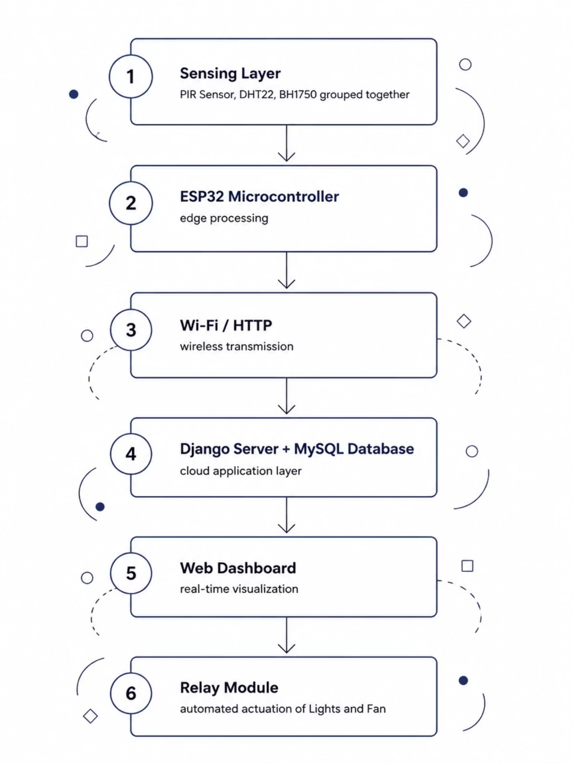
System Architecture
The CampusPulse architecture follows a layered IoT pipeline — from physical sensing through edge processing, wireless transmission,
cloud-based backend, and real-time dashboard visualization to automated appliance control.
Sensing Layer
PIR Sensor · DHT22 · BH1750
Edge Processing
ESP32 Microcontroller
Transmission Layer
Wi-Fi / HTTP REST
Application Layer
Django Server · MySQL Database
Presentation Layer
Web Dashboard (Real-Time Analytics)
Actuation Layer
Relay Module → Lights & Fan

Slide 9

Expected Outcomes and Future Scope
Expected Outcomes
Future Scope
Automated Classroom Monitoring
Reduced Electricity Wastage
Mobile Application
Continuous, sensor-driven occupancy and environment tracking without any manual intervention.
Appliances automatically switched OFF in unoccupied classrooms, directly lowering energy consumption.
Android/iOS app for on-the-go classroom monitoring and direct appliance control.
MQTT Protocol
Replace HTTP with MQTT for lower latency and a lightweight IoT communication standard.
Real-Time Environmental Monitoring
Improved Energy Efficiency
Energy Usage Analytics
Live temperature, humidity, and illumination data accessible to all administrators via web dashboard.
Data-driven appliance control optimizes usage patterns across the entire institution.
Historical consumption reports and trend analysis supporting institutional energy audits.
Smart Campus Integration
Connect with existing ERP, timetable, and access control systems for unified campus management.
Cloud-Based Monitoring Dashboard
AI-Based Occupancy Prediction
Centralized, remotely accessible interface for viewing real-time classroom status from anywhere.
Machine learning models to predict classroom usage and pre-schedule appliance states proactively.
Multi-Classroom Deployment
Scale architecture to monitor entire buildings or full campuses from a single unified dashboard.

Slide 10
References
.
1
T. H. Noor, S. Zeadally, A. Alfazi, and Q. Z. Sheng, "An IoT-Based Energy Conservation Smart Classroom System," Intelligent Automation & Soft Computing, vol. 36, no. 2, pp. 1–15, 2023. doi: 10.32604/iasc.2023.XXXXX
2
S. Y. Park, J. H. Kim, and D. H. Lee, "Design and Implementation of an IoT-Based Smart Classroom Incubator," Applied Sciences, vol. 12, no. 4, p. 2023, 2022. doi: 10.3390/app12042023
3
Y. Zhang, "College Smart Classroom Attendance Management System Based on Internet of Things," Computational Intelligence and Neuroscience, vol. 2022, Article ID 4369535, pp. 1–10, 2022. doi: 10.1155/2022/4369535
Soya Pradeep · MAC25MCA-2052 · CampusPulse: Smart Classroom Monitoring and Energy Management · Mini Project Proposal

