Slide 1
Netflix Content Data Analysis
Subtitle: Exploratory Data Analysis and Business Insights
Presented by: Pradeep Tudu

Slide 2
Objective
Understand content distribution
Identify dominant genres and content patterns
Study country-wise contribution
Explore release trends
Analyze audience targeting through content ratings

Slide 3
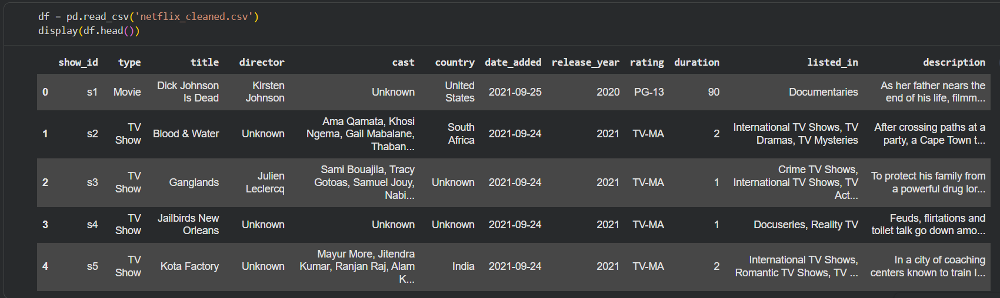
Dataset Information
Total Records: 8804 titles
Total Features (Variables): 12 columns

Slide 4
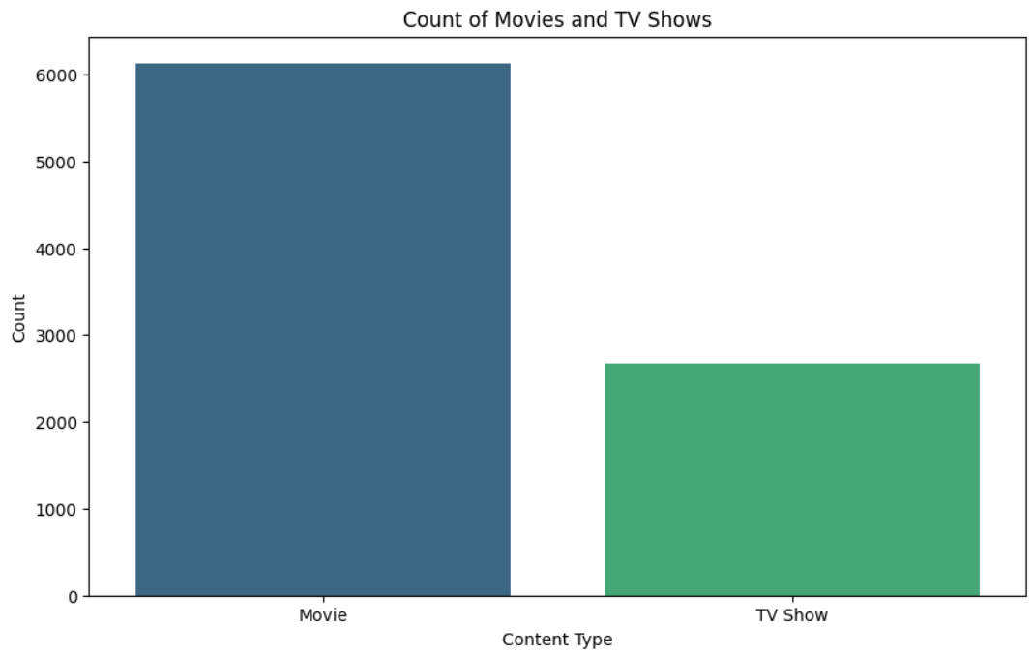
Movies vs TV Shows
Movies = 69.6%
TV Shows = 30.4%

Slide 5
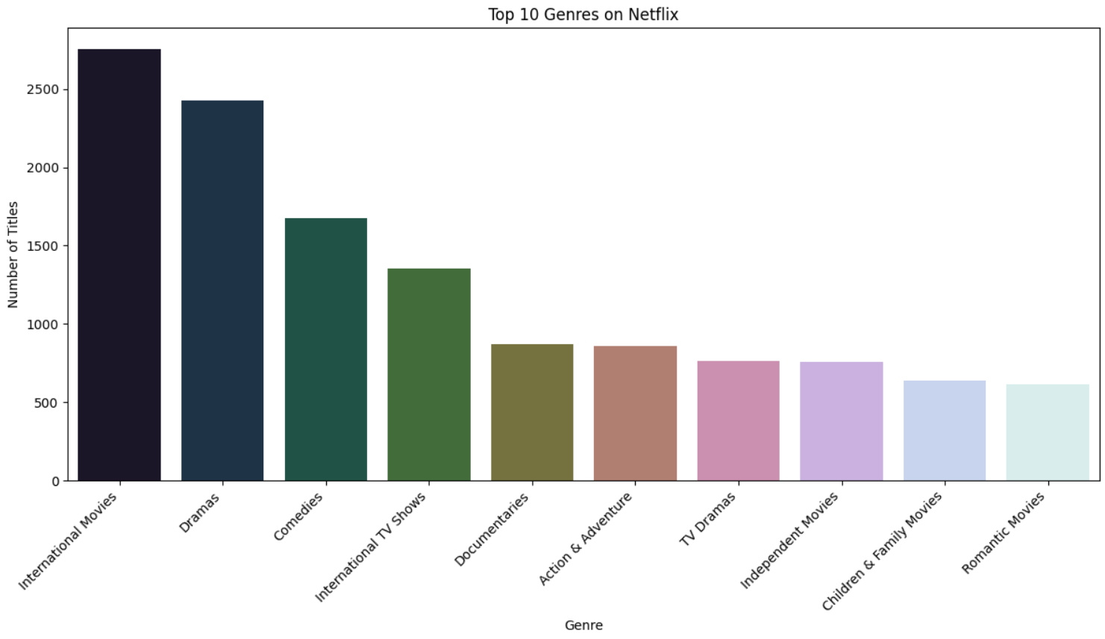
Top Genres Distribution on Netflix
International Movies
Dramas
Comedies
International TV Shows
Documentaries

Slide 6
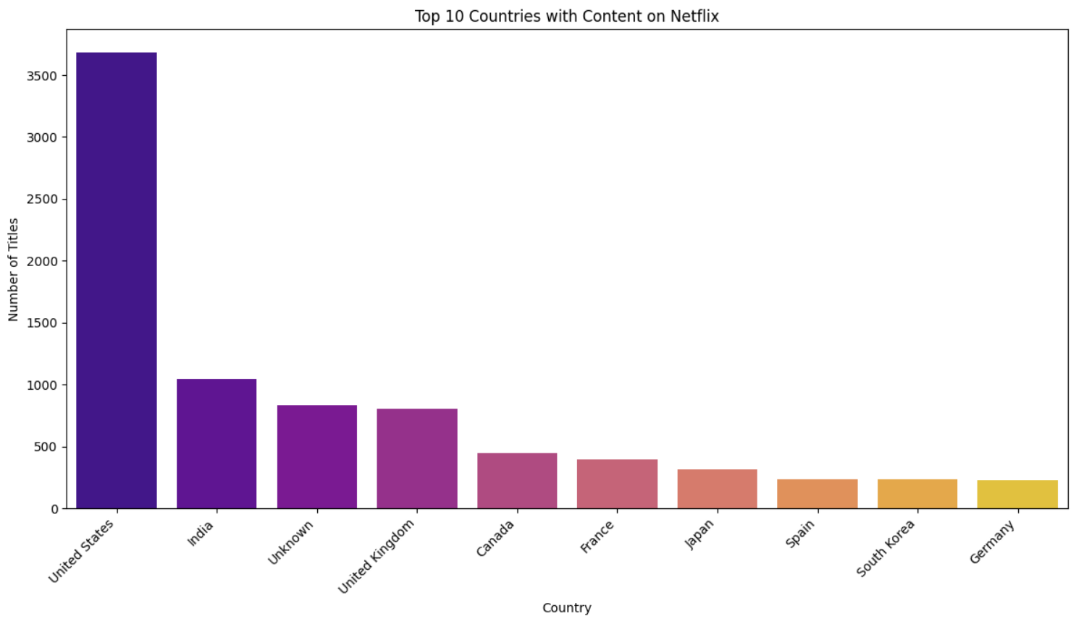
Top Countries
Key Findings:
US highest contributor
India among top producers

Slide 7
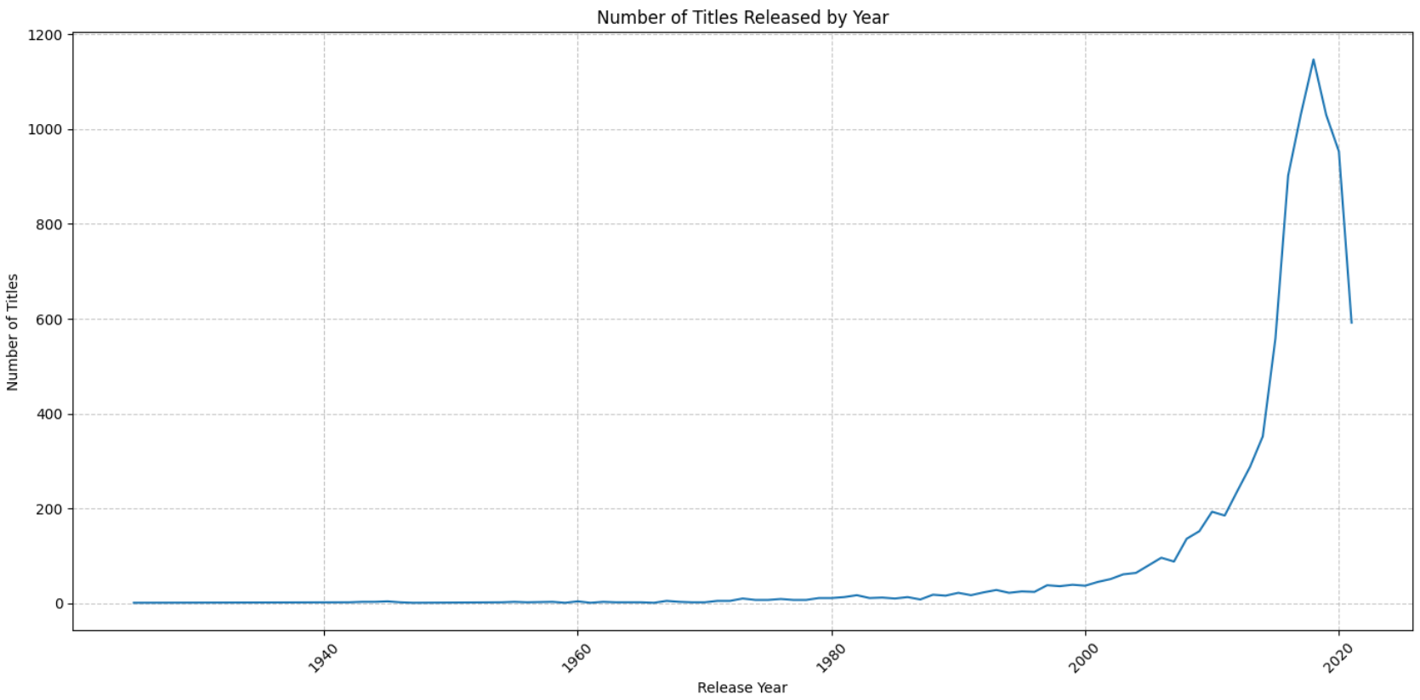
Content Growth Over Time
Key Finding:
Strong growth in recent years

Slide 8
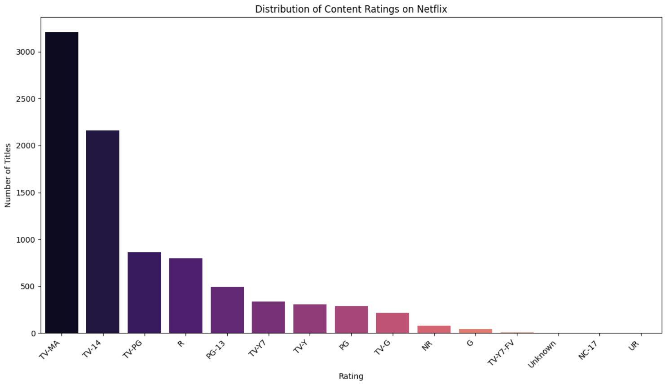
Audience Category Distribution
Key Findings:
Most titles fall under major audience groups

Slide 9
Key Insights
Movies dominate platform
Drama/Comedy lead
Few countries produce most content
Rapid content growth observed

Slide 10
Recommendations
Invest in trending genres
Expand in high-demand regions
Improve diversity

Slide 11
Conclusion
Summary of findings and impact.

Slide 12
Thank You

