Slide 1
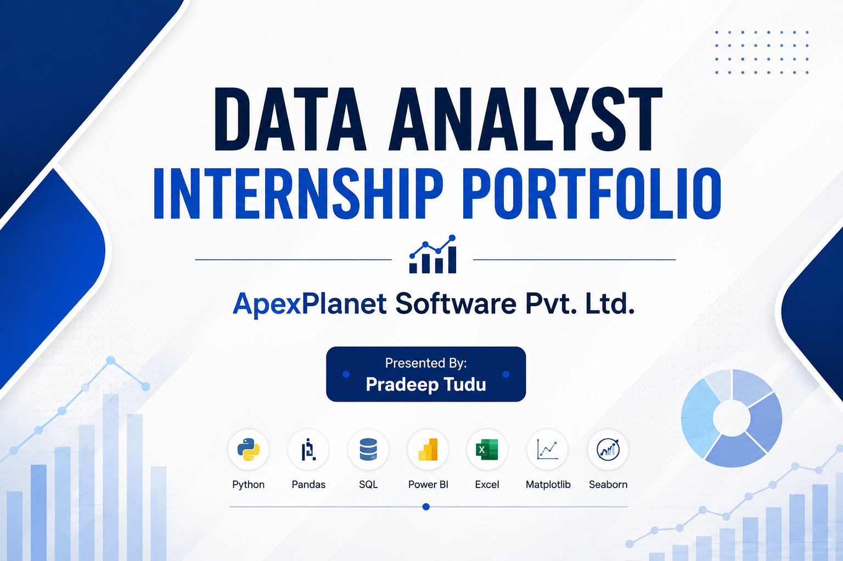

Slide 2
Tools Used
Python
Pandas
NumPy
SQL
Power BI
Excel
Matplotlib
Seaborn

Slide 3
Objectives
Data cleaning
EDA (Exploratory Data Analysis)
Dashboarding
Statistical analysis
Business intelligence

Slide 4
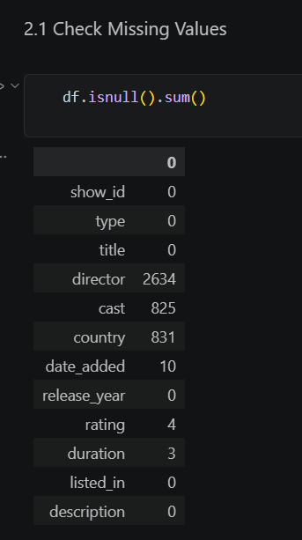
Task 1:Data Immersion & Wrangling
Missing value handling
Duplicate removal
Date formatting
Feature engineering

Slide 5
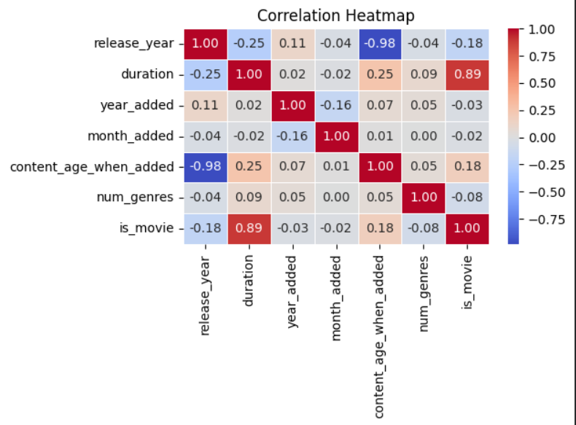
Task 2: EDA & Business Intelligence
EDA & correlation analysis
SQL business queries
Trend analysis
Key business insights

Slide 6
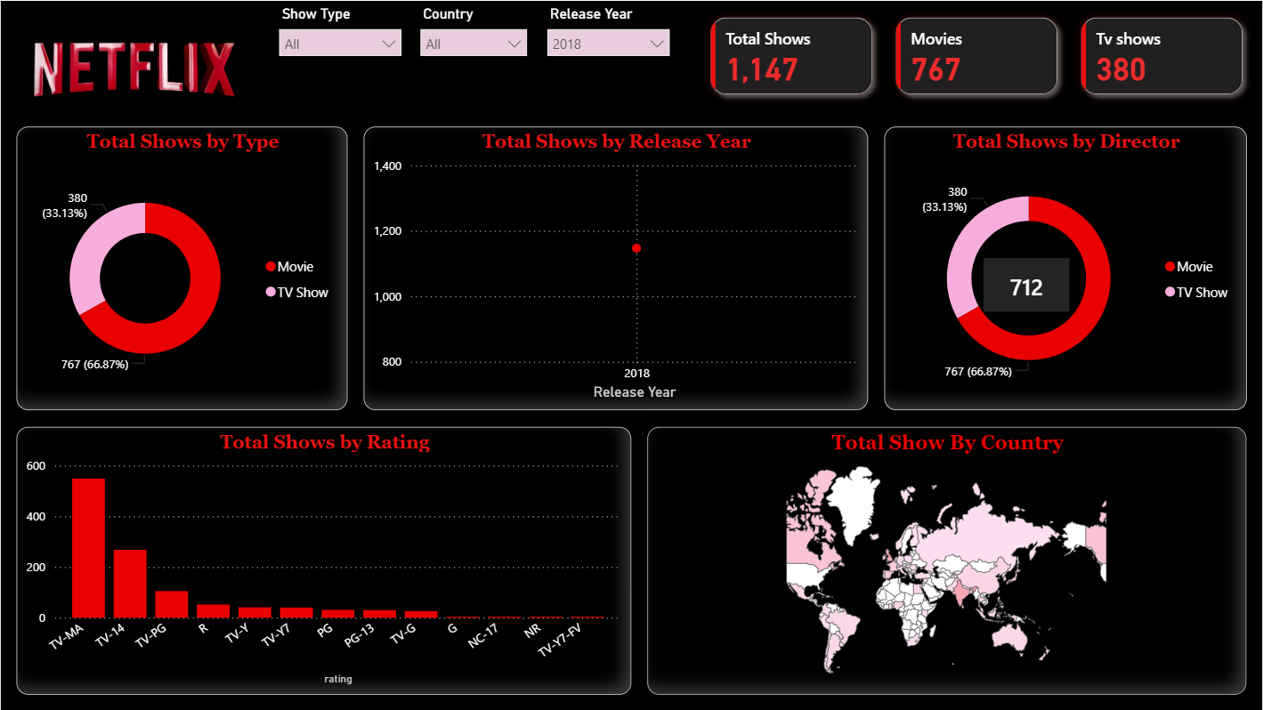
Task 3:Deep-Dive Analysis & Interactive Dashboarding
Interactive dashboard
KPI monitoring
Content trend analysis
Genre distribution

Slide 7
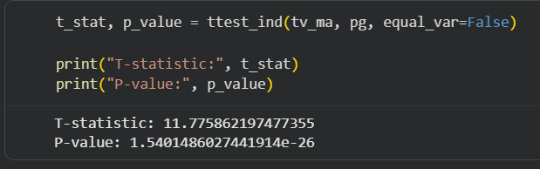
Task 4: Data Storytelling & Hypothesis Testing
Data storytelling
Business recommendations
Hypothesis testing
Statistical validation

Slide 8
Conclusion
This internship enhanced my practical knowledge in
data cleaning, exploratory data analysis, SQL, dashboard
development, statistical analysis, and data storytelling.
Through this project, I gained hands-on experience
in transforming raw data into meaningful business insights
using Python, Power BI, and visualization techniques.
The internship also strengthened my analytical thinking,
problem-solving abilities, and business intelligence skills.
Thank You

