Slide 1
MORTALITY PREDICTION IN ICU PATIENTS
PRADEEP VAIRAMANI

Slide 2
Structured Features
Extract the following baseline features:
Age
Gender
Simplified Acute Physiology Score (SAPS II)
Oxford Acute Severity of Illness Score (OASIS)
Acute Physiology Score (APS III)
Total patient count : 46,520
Filtering criterion:
Patients with age < 15
Patients without chartevents
Final patient count : 38,557
DATABASE

Slide 3
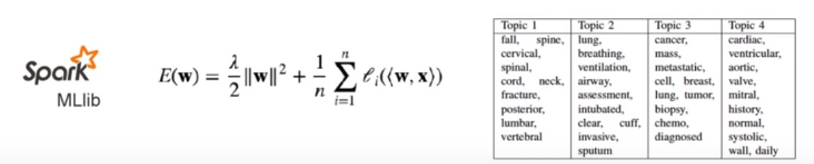
Free text note count : 2,078,705
Data cleaning :
Change gender from "M" and "F" to 0 and 1
Remove newline/space/non-alphanumeric characters
Remove the stop words in the onix database
Tokenizing of notes
50 TOPICS ARE GENERATED BASED ON LATENT DIRICHLET ALLOCATION

Slide 4
LOGISTIC REGRESSION
FEATURE VECTORS
SUPPORT VECTOR MACHINE
DECISION TREES

Slide 5
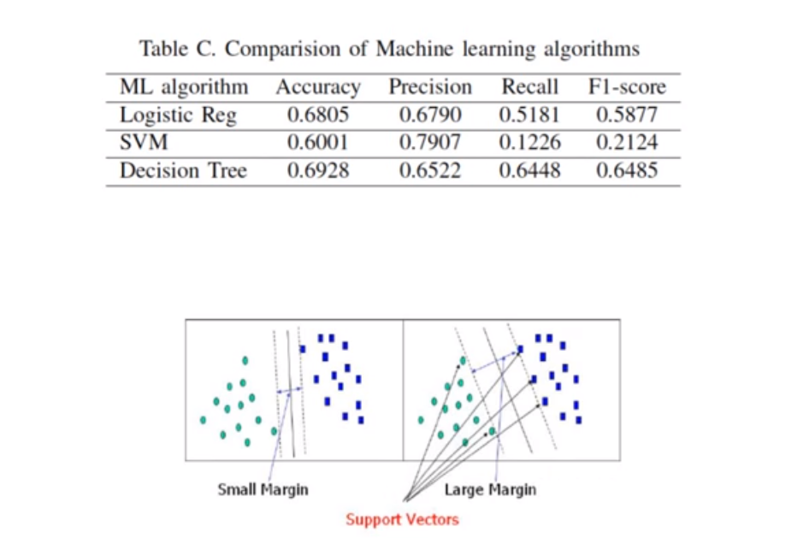

Slide 6
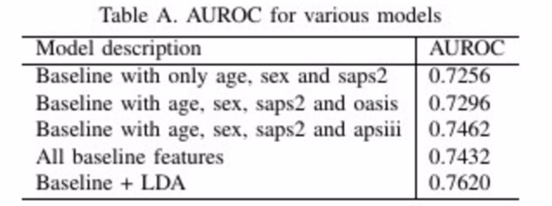
RESULTS

