Slide 1

Rider Get Rider - Insights
Pradeep Varanasi
"First we eat, then we do everything else." - M.F.K. Fisher

Slide 2
Agenda
Business objective
Unveiling the story behind the numbers
Examining data's suitability for analysis
Deriving insights from feature exploration
Key Takeaways
Next steps
Questions & Discussion

Slide 3
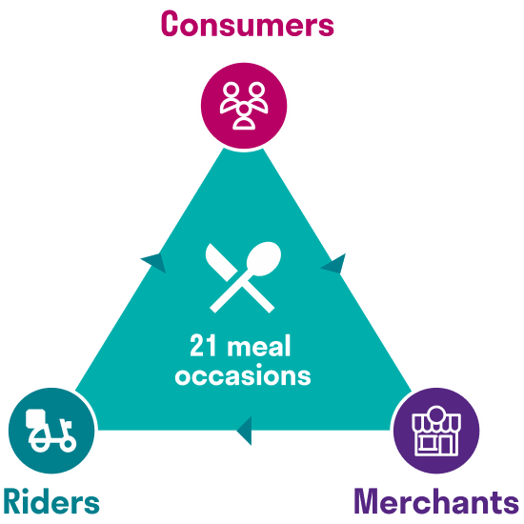
Business objective
Broader Mission: “Our mission is to build the definitive online food company. We want to be the platform that people turn to whenever they think about food.”
Objective:
What: The primary objective is to assess the performance of the 'Rider Get Rider' (RGR) channel. Compare RGR's performance with other marketing channels.
North Star Metric: Successful Referrals per Rider
Primary Metric: Average Throughput
Why: Tracking the performance is essential to study the parameters such as, but not limited to
Cost Efficiency of Program
Rider Retention
Customer Experience
Who: If the RGR is performing well,
Riders benefit directly from the incentives.
Leadership, Marketing and Operations and other stakeholders can improve the profitability.
Ultimately, customers would be happy for better service quality.

Slide 4
Unveiling the story behind the numbers

Slide 5
Examining data's suitability for analysis
Challenges:
Data Capture: Granular data about the Riders, comprising approximately 30,000 rows, organized by pre-defined weeks.
Transformed the data into unique Rider-level data to facilitate aggregated analysis. (5173 unique riders)
Managed to optimize memory resources and achieved an 83% reduction.
Missing Value Imputation: The presence of missing values within the data has the potential to impede the overall effectiveness of any analysis.
APPLICATION_DATE - replaced it with default date of ‘1900-01-01’
APPLICATION_APPROVED_DATE – replaced it with default date of ‘1900-01-01’
REFERRALS_CUMULATIVE – replaced it with 0
SUCCESSFUL_REFERRALS_CUMULATIVE – replaced it with 0
Outlier Analysis: Validated if the features and data points that significantly deviate from the mean, which can greatly impact the reliability of the results.
Box plots were utilized to identify potential outliers at the 1% and 99% percentiles, but it was determined that they do not have a detrimental impact on the final results.

Slide 6
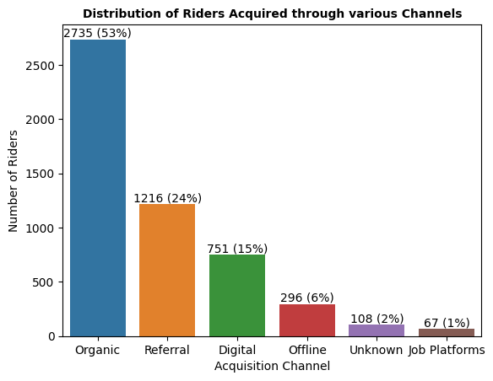
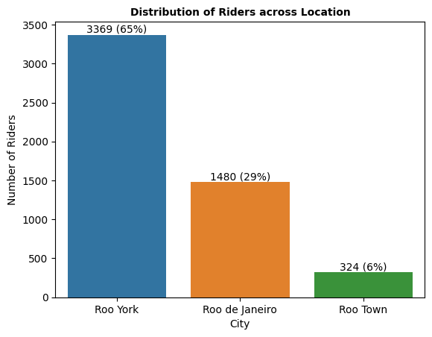
Preliminary Insights (1/2)
What is the distribution of riders across the acquisition channel and location?
More than half of the riders are on-boarded through natural or unpaid channel. 24% of the riders are acquired through Referral channel.
Based on the data, 2/3rd of the total riders are serving customers in Roo York city.

Slide 7
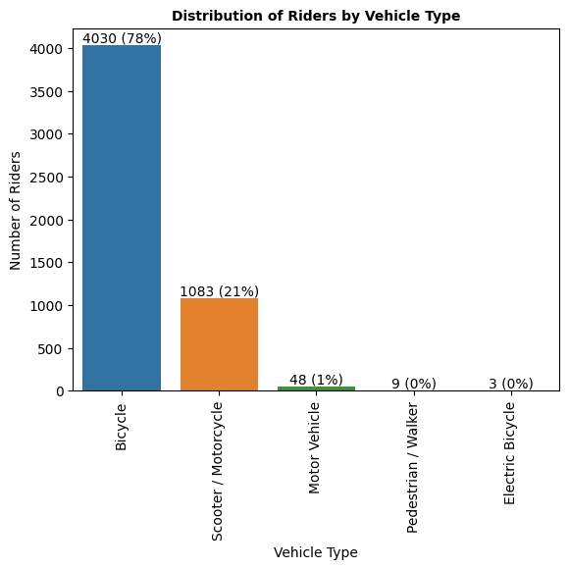
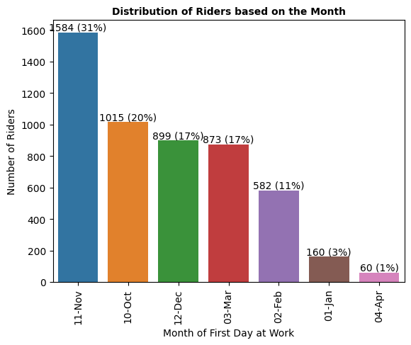
Preliminary Insights (2/2)
What is the distribution of riders by Vehicle type and Month of first day at work?
Every 4 out of 5 Deliveroo riders use bicycles to serve customers.
Over the years, ~67% of the total riders were acquired during the holiday season of Oct, Nov, Dec months.

Slide 8
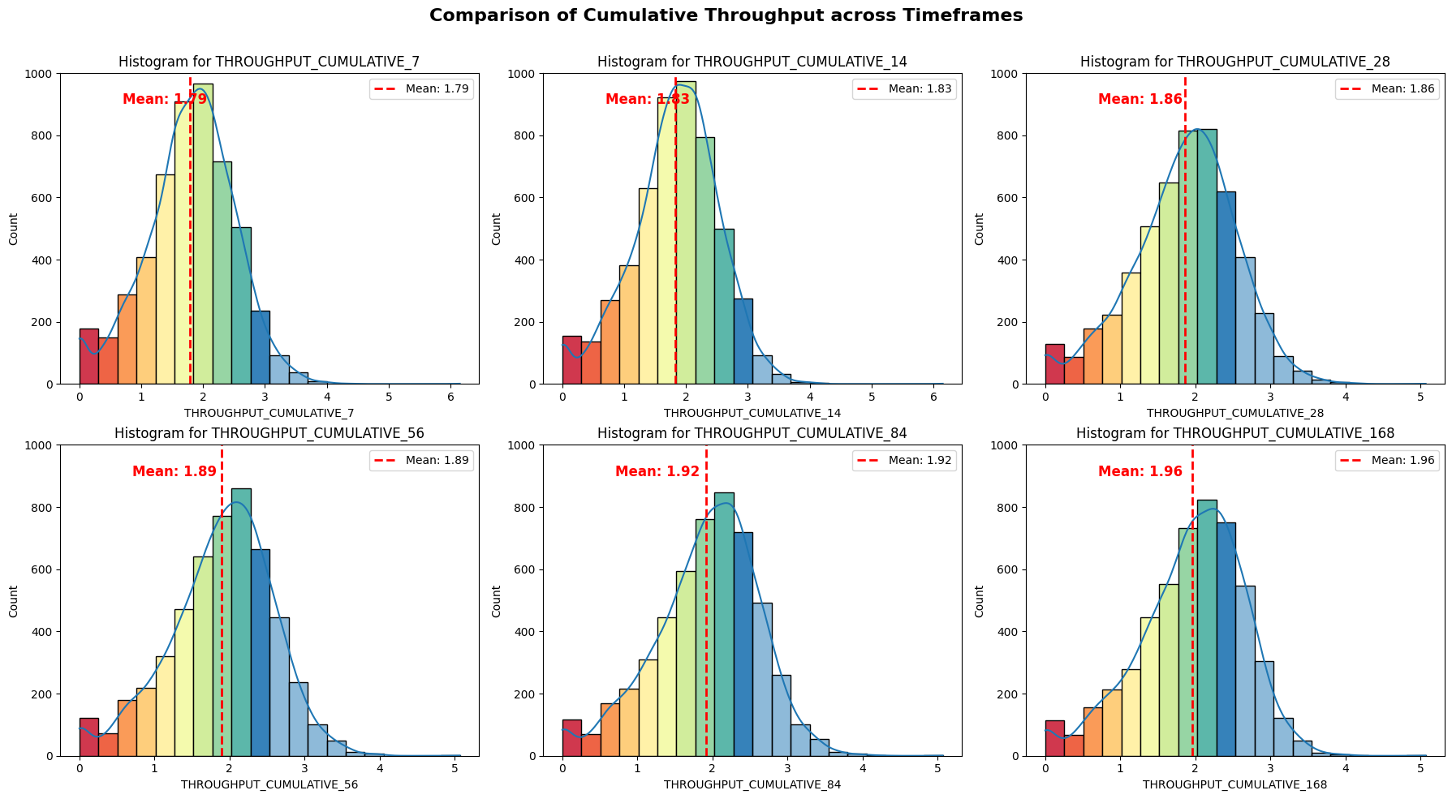
Intermediate Insights (1/4)
Does Throughput have an impact across the timeframes?
Increasing Efficiency: The data shows a consistent increase in cumulative throughput as the time period extends. This indicates that, on average, riders are becoming more efficient in handling orders over time.
Learning Curve: The upward trend in cumulative throughput is consistent with a typical learning curve phenomenon. New riders may often take some time to become familiar with the platform, routes, and customer preferences
*Throughput = (orders/hour) of the rider to date

Slide 9
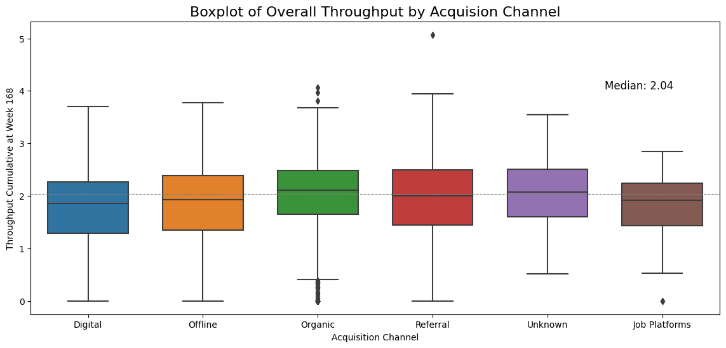
Intermediate Insights (2/4)
Is the Throughput effected by the type of Acquisition Channel?
The median throughput of 2.04 orders per hour represents the middle value of the data, suggesting approximately half of the data points fall below this value, while the other half falls above it.
Based on the data, Organic channel throughput is slightly higher than the median suggests that, on average, riders acquired through organic methods tend to have a relatively higher throughput.
Referral channel’s throughput is close to the median. (The effectiveness of the Referral’s throughput in comparison with other channels can be verified in the advanced exploration.)
Digital channel has the lowest throughput rate.
*Throughput = (orders/hour) of the rider to date

Slide 10
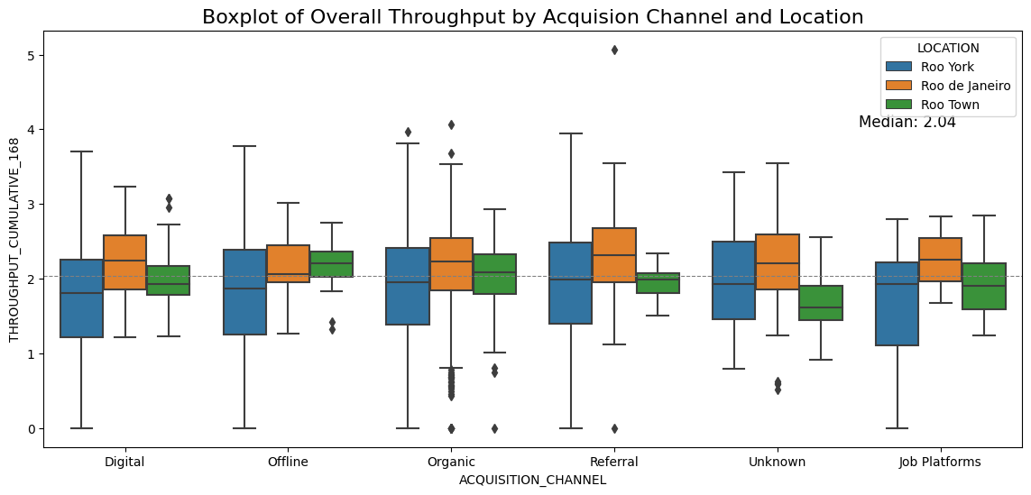
Intermediate Insights (3/4)
Does the Acquisition Channel and Location impact the Throughput?
Roo York: Referral (RGR) riders in Roo York outperform other channels, indicating the effectiveness of the Referral program in this area.
Roo de Janeiro: Roo de Janeiro riders consistently exhibit high throughput across acquisition channels, possibly due to strong customer demand or experienced riders.
Roo Town: Organic and Offline channels yield slightly higher throughput in Roo Town, highlighting the performance of organically acquired and locally recruited riders.

Slide 11
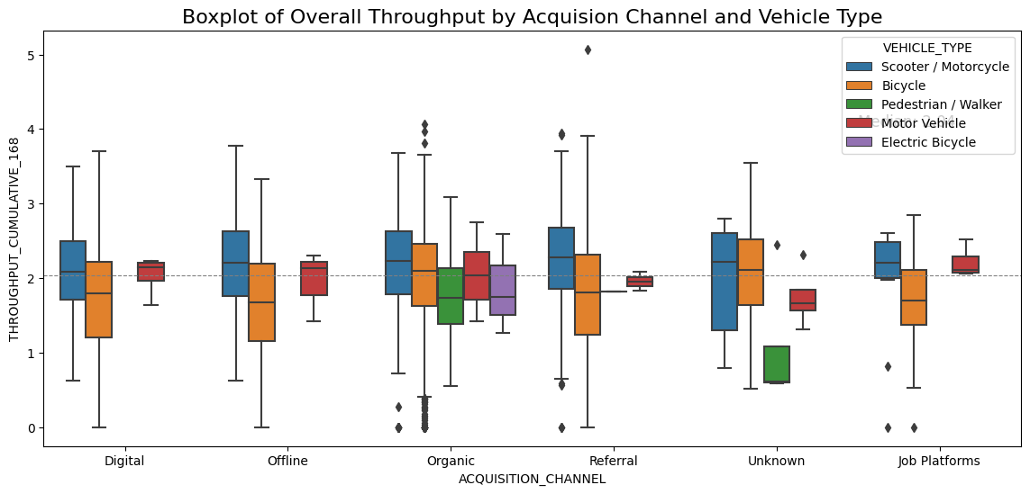
Intermediate Insights (4/4)
Does the Acquisition Channel and Vehicle Type impact the Throughput?
Scooters: Riders using scooters exhibited high throughput consistently across channels.
Bicycles: Naturally, riders using bicycles have lower throughputs across channels with Organic channel as an exception. This could indicate that organically acquired bicycle riders are more efficient.
Other Vehicle Types: The throughput data for other vehicle types does not show a consistent trend
It would be interesting to capture the throughput vs. environmental impact metrics. (emissions, noise etc.)
*Throughput = (orders/hour) of the rider to date

Slide 12
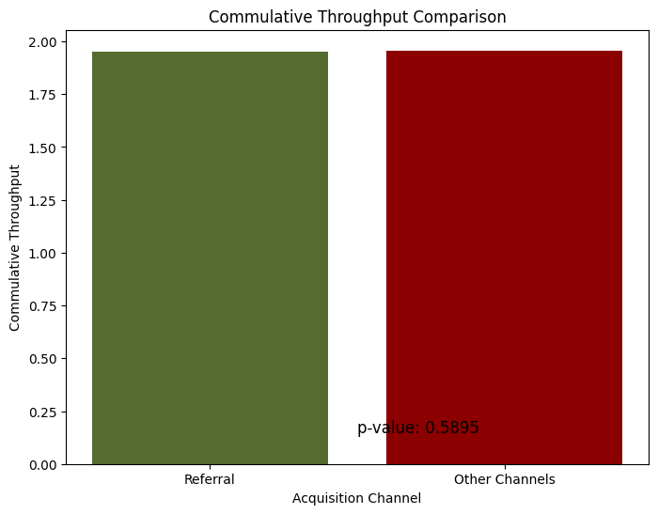
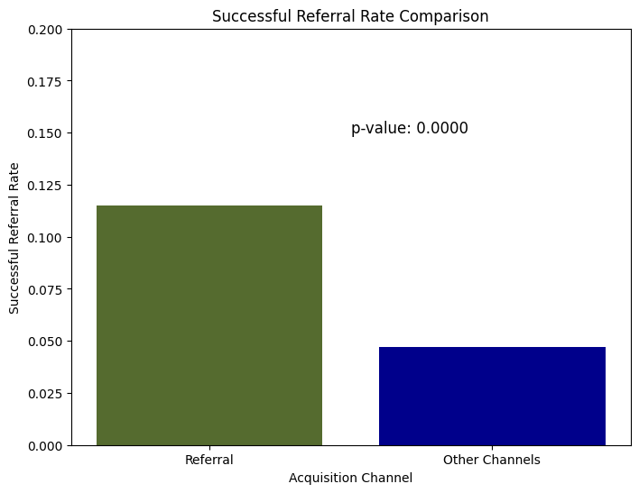
Advanced Insights (1/2)
Effectiveness of Deliveroo's Rider Get Rider (RGR) Program by Throughput and Successful Referral Rate
The t-test with a p-value of ~0.59 indicates that there is no significant difference in throughput between the RGR (Referral) channel and other channels with 95% confidence.
The t-test with a p-value of ~0.00 reveals with 95% confidence the exceptional effectiveness of the RGR (Referral) channel in successful rider referrals compared to other channels.

Slide 13
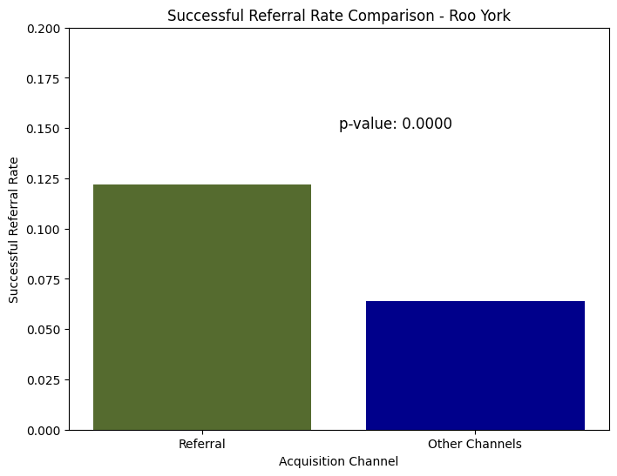
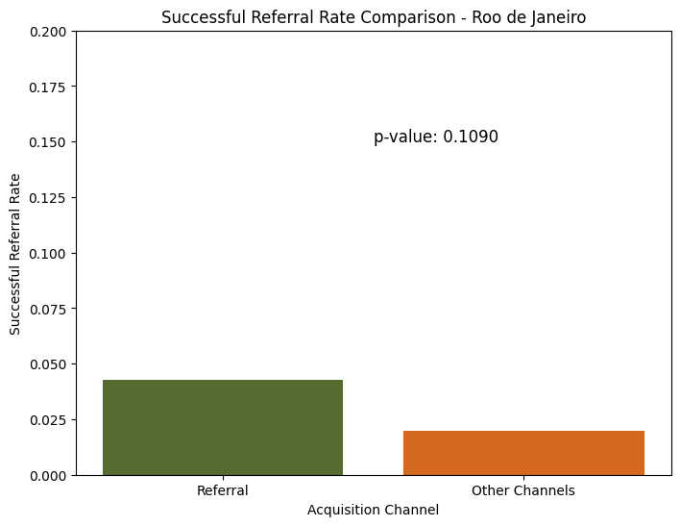
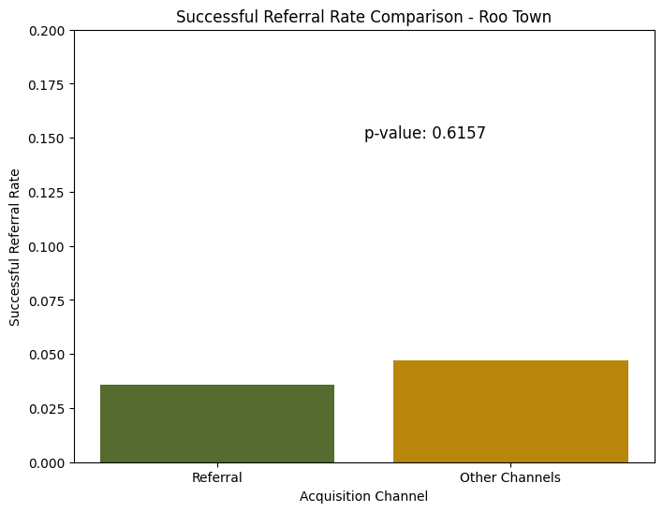
Advanced Insights (2/2)
Effectiveness of Deliveroo's Rider Get Rider (RGR) Program by various Locations – Roo York, Roo de Janeiro, Roo Town
Extremely low p-value of, provide strong evidence that in Roo York, Deliveroo's Rider Get Rider (RGR) program performs significantly better than other acquisition channels
p-value of 0.1, indicate that in Roo de Janeiro, there is no significant difference in the performance of Deliveroo's Rider Get Rider (RGR). This suggests that the RGR program is on par with other channels in this market
A high p-value of 0.6 in Roo Town suggests that there is no significant difference in Rider Get Rider (RGR) program and other acquisition channels. RGR and other channels are performing similarly in Roo Town.

Slide 14
Key Takeaways

Slide 15
Key Takeaways
Q1. How has RGR performed? How does that compare with other channels?
Successful Referral Rate: RGR (Referral) stands out as a significantly effective channel, with a notably higher rate of successful rider referrals compared to other acquisition channels. (North Star Metric)
Throughput Comparison: However, when assessing average throughput, RGR performs similarly to other channels. This suggests that while RGR excels in attracting new riders, it aligns with the overall rider fleet in terms of order processing efficiency. (Primary Metric)
Market-Specific Differences: Notably, RGR's performance varies by location. In Roo York, RGR outshines other channels, emphasizing its regional effectiveness. Conversely, in Roo de Janeiro and Roo Town, it performs at par with other channels, indicating the need for localized strategies.
Q2. Is RGR a successful scheme? Should it be changed?
Overall Success: RGR is successful, driven by exceptional performance in specific markets like Roo York, where it effectively attracts and retains new riders, contributing to rider fleet growth.
Regional Focus: In high-performing markets like Roo York, the investment and promotion must be continued. In areas where it aligns with other channels, localized optimizations would be necessary.

Slide 16
Next Steps

Slide 17
Next Steps
Q3. Next steps and what are some important factors which should be considered?
Additional Data/Metrics:
Customer Feedback: Collect feedback from customers who have interacted with RGR-referred riders to gauge the quality of service and rider professionalism.
Transaction Data: Capturing details of each delivery such as order value, delivery time, and customer ratings, to assess the impact of rider acquisition channels on the overall customer experience and business revenue.
Market Demand Analysis: Explore factors such as customer demand, delivery frequency, and peak hours to optimize rider allocation.
Cost Data: Capture detailed cost data associated with rider acquisition, referral incentives, and operational expenses to calculate the true ROI of the RGR program.
Machine Learning Algorithms for Scaling:
Churn Model: Develop a Churn Prediction Model to Identify and Target Riders at Risk of Churning, with the primary objective of enhancing Rider Satisfaction.
A/B Testing: Conduct A/B tests to experiment with variations of the RGR program, such as different referral incentives, to optimize its performance.
Fraud Detection: Utilize machine learning algorithms to detect fraudulent referrals.

Slide 18
Questions?

