Slide 1

RESEARCH PROTOTYPE · GLUCOTWIN
GlucoTwin:
A CGM-Based Digital Twin Research Prototype
Retrospective glucose forecasting with uncertainty estimation and synthetic EHR demonstration
INTERACTIVE HISTORICAL REPLAY · MULTI-HORIZON FORECASTS · RESEARCH USE ONLY
Notes:
1

Slide 2
01 / MOTIVATION
WHY THIS PROTOTYPE EXISTS
Glucose forecasting needs a view beyond the current reading
THE LIMIT
THE INTERPRETATION PROBLEM
OBJECTIVE
One measurement is not a trajectory.
Longer horizons need uncertainty.
Make the forecast inspectable.
CGM values change dynamically, so one measurement does not reveal the future trajectory.
Longer horizons increase forecasting difficulty and make uncertainty essential to interpretation.
GlucoTwin replays historical CGM observations, forecasts four horizons, shows prediction intervals, evaluates held-out data, and demonstrates a separate synthetic EHR interface.
AN INTERACTIVE AND TRANSPARENT RESEARCH PROTOTYPE FOR RETROSPECTIVE GLUCOSE FORECASTING AND UNCERTAINTY ANALYSIS.
Notes:
2

Slide 3
02 / SYSTEM OVERVIEW
The prototype turns historical CGM data into an interactive workflow
From prepared records to forecast interpretation, with a separate synthetic EHR demonstration surface.
01
02
03
Historical CGM dataset
Forecast inference
Synthetic EHR workflow
Model-ready features and saved models.
Uncertainty estimation feeds an interactive Streamlit dashboard.
Synthea synthetic records become EHR summaries and a virtual-patient demonstration panel.
95,619
80
33
CGM RECORDS
UNIQUE PATIENT IDENTITIES
PREPARED FEATURE COLUMNS
TRAIN 67,532 · VALIDATION 10,713 · TEST 17,374 RECORDS
Notes:
3

Slide 4
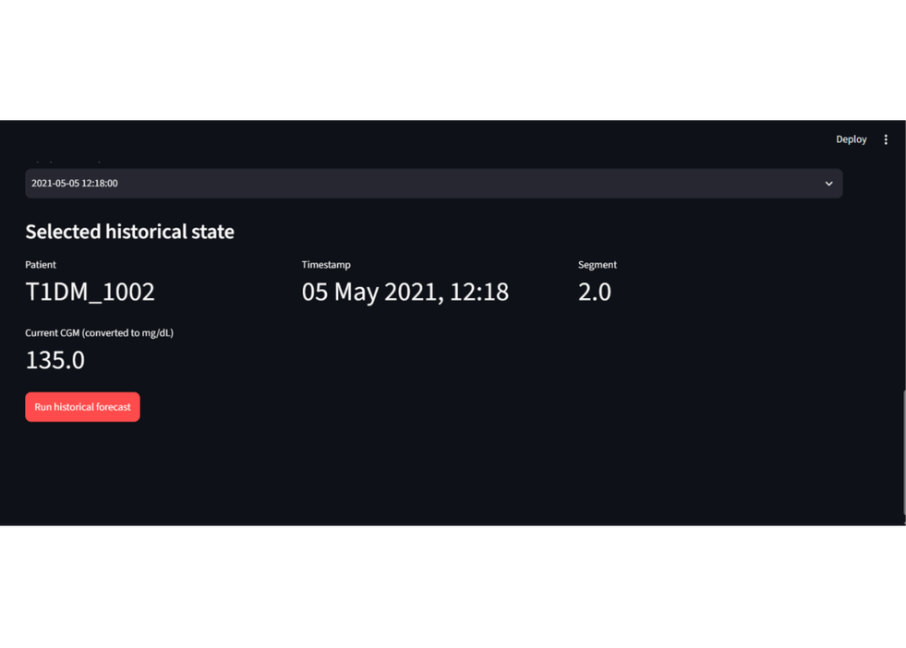
03 / HISTORICAL REPLAY
HELD-OUT PATIENT WORKFLOW
Forecasting starts from a selected historical state
Select a held-out patient, segment, and timestamp; retrieve the historical state; then run the saved forecasting inference engine.
HORIZONS
+30
+60
+90
+120
MINUTES
MINUTES
MINUTES
MINUTES
MODELS EXPLORED DURING DEVELOPMENT: LINEAR REGRESSION, RANDOM FOREST, EXTRA TREES, LIGHTGBM, XGBOOST, AND GRU.
SELECTED PATIENT · SEGMENT · TIMESTAMP · HISTORICAL STATE
Notes:
4

Slide 5
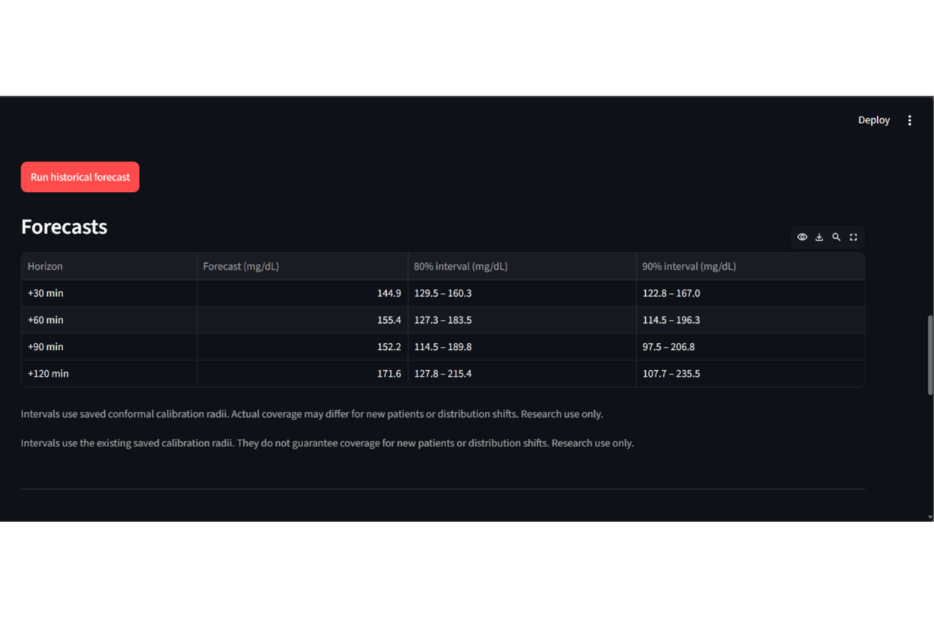
04 / UNCERTAINTY
INTERPRETATION BEFORE CONFIDENCE
The dashboard makes uncertainty visible beside each forecast
80% · 90%
PREDICTION INTERVALS
Point forecasts are shown with 80% and 90% prediction intervals, so users can see both the expected value and the range around it.
The interface presents forecast values and interval bounds for all four horizons.
INTERVALS USE SAVED CONFORMAL CALIBRATION RADII AND ARE INTENDED FOR RESEARCH USE ONLY.
EXPECTED VALUE AND INTERVAL BOUNDS REMAIN ADJACENT IN THE WORKFLOW.
Notes:
5

Slide 6
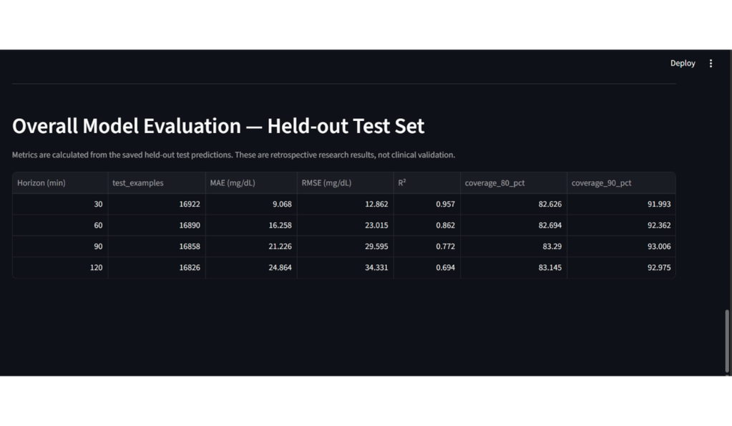
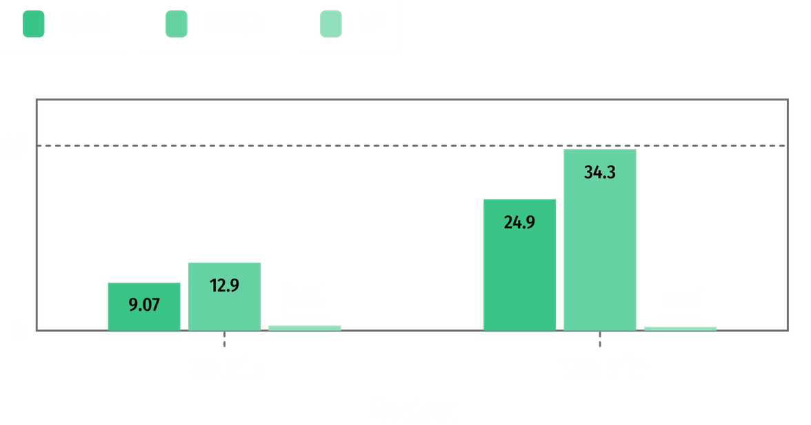
05 / EVALUATION
Performance is strongest at 30 minutes and degrades with horizon
HELD-OUT TEST RESULTS
EMPIRICAL COVERAGE EXCEEDED NOMINAL LEVELS AT EVERY HORIZON.
30 MIN: MAE 9.068, RMSE 12.862, R² 0.957 · 120 MIN: MAE 24.864, RMSE 34.331, R² 0.694
80% intervals: 82.626%–83.290%
90% intervals: 91.993%–93.006%
RETROSPECTIVE HELD-OUT TEST RESULTS, NOT CLINICAL VALIDATION.
Notes:
6

Slide 7
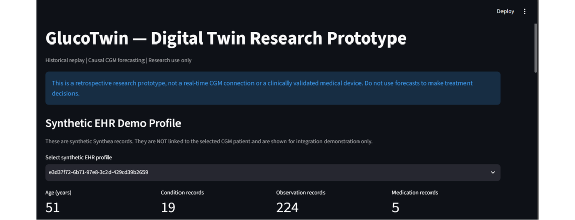
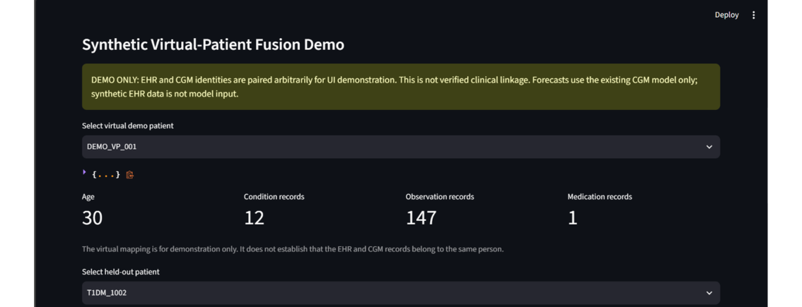
06 / INTEGRATION SURFACE
Synthetic EHR shows the integration surface without claiming clinical linkage
SYNTHETIC PROFILE
DEMONSTRATION PANEL
Synthetic profiles expose demographics, condition counts, observation counts, medication counts, and virtual-patient mapping.
EHR and CGM identities are paired arbitrarily for UI demonstration; the linkage is not clinically verified, and synthetic EHR data is not model input.
THE EHR SURFACE DEMONSTRATES A FUTURE INTEGRATION BOUNDARY, NOT A CLINICAL DATA RELATIONSHIP.
Notes:
7

Slide 8
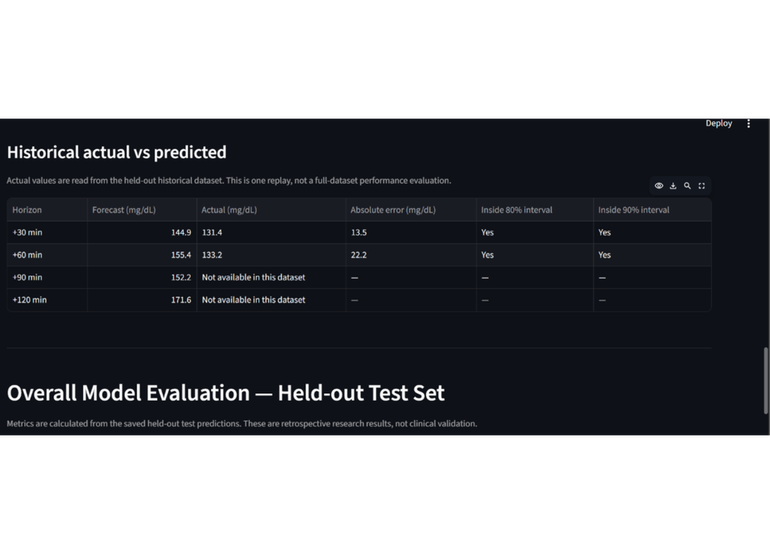
07 / RESEARCH PATH
PROTOTYPE → VALIDATION
Implemented today, with a clear path to validated research
IMPLEMENTED
CURRENT LIMITS
NEXT
Held-out patient selection, historical segment and timestamp selection, CGM state display, multi-horizon forecasts, prediction intervals, evaluation table, and synthetic EHR demonstration.
Retrospective evaluation only, no real-time CGM connection, no clinical validation, no verified EHR–CGM linkage, and no EHR input to the current model.
Independent cohorts, verified and consented linkage, uncertainty calibration, subgroup analysis, EHR-aware modeling, and validated real-time integration.
HISTORICAL-VERSUS-PREDICTED EVALUATION CONTEXT.
Notes:
8

Slide 9
08 / CLOSE
RESEARCH PROTOTYPE
GlucoTwin is a foundation for transparent digital-twin research
Replay the state.
Show the range.
Expose the limits.
GLUCOTWIN
Thank you
Questions & discussion
Interactive CGM historical replay dashboard.
Multi-horizon forecasting for 30, 60, 90, and 120 minutes with prediction intervals.
Held-out evaluation plus a separate synthetic EHR demonstration interface.
Notes:
9

